Slide 1






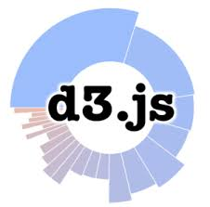













FooStack Architecture
Charts
Altair-Viz

Slide 2


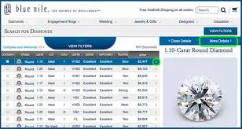
Diamond Analytics Stack
Charts
CI / CD

Slide 3



Homicide Stack
Altair-Viz
CI / CD

Slide 4

Snow Stack
CI / CD

