Slide 1

Integration Testing Infrastructure

Slide 2
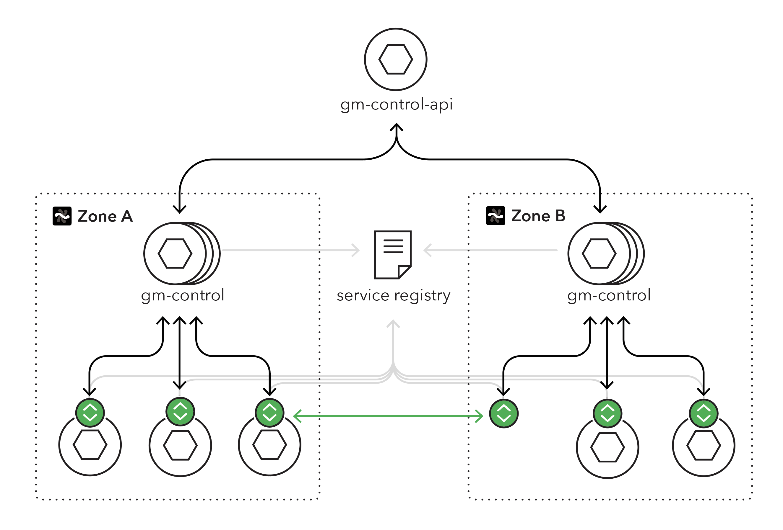
Grey Matter Dynamic Configuration

Slide 3
The Three Body Problem
control
control API
proxy

Slide 4
Configuration change: add a metrics filter
"gm_metrics": {
"metricsPort": 8081,
"metricsHost": "0.0.0.0",
"metricsDashboardUriPath": "/metrics",
"metricsPrometheusUriPath": "/prometheus",
"prometheusSystemMetricsIntervalSeconds": 15,
"metricsRingBufferSize": 4096,
"metricsKeyFunction": "none"
}

Slide 5
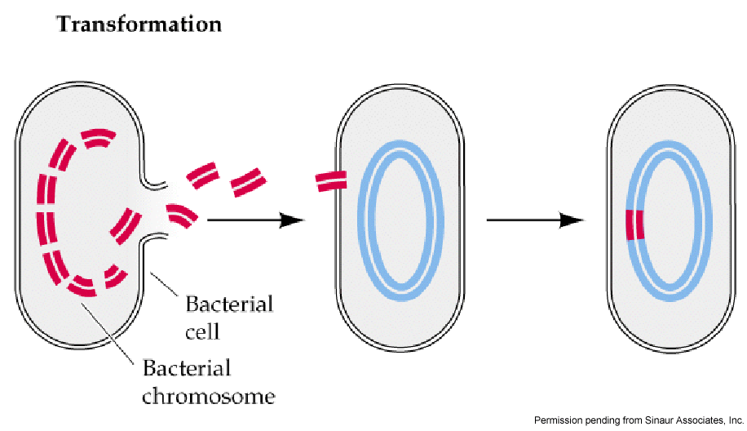
Horizontal gene transfer

Slide 6
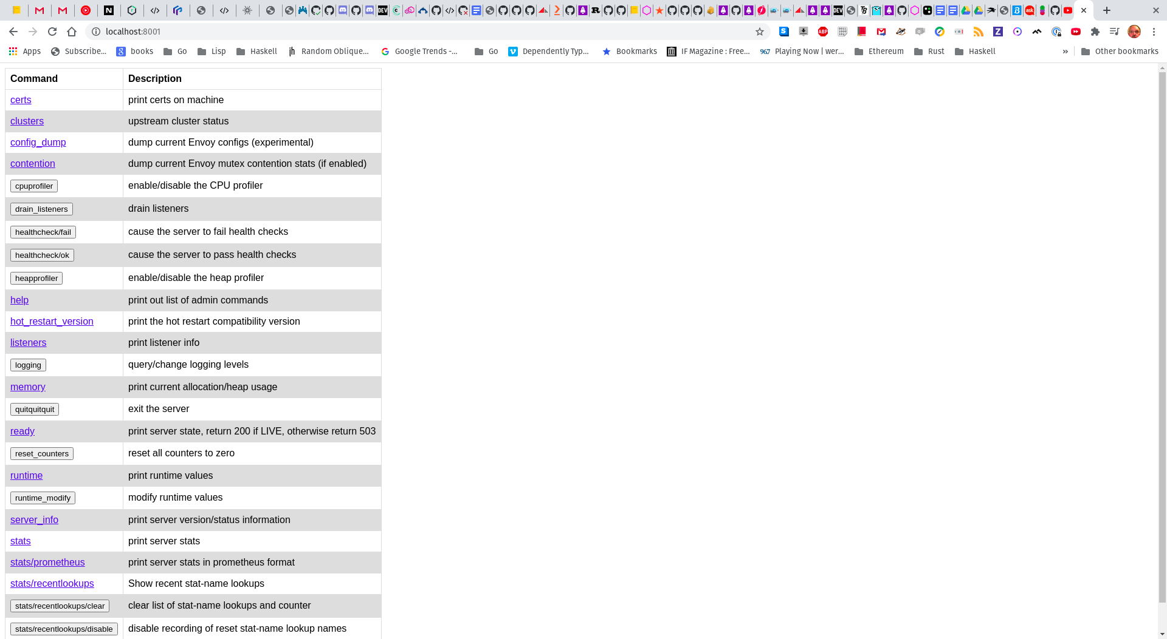
Envoy Admin

Slide 7
/config_dump (before)
{
"@type": "type.googleapis.com/envoy.admin.v3.ListenersConfigDump",
"version_info": "4f+IQmOPXhZ/f4e26tAi4Q==",
"dynamic_listeners": [
{
"http_filters": [
{
"name": "envoy.cors",
"typed_config": {
"@type":"type.googleapis.com/...filter.http.cors.v2.Cors"
}
},
{
"name": "envoy.router",
"typed_config": {
"@type":"type.googleapis.com/en..filter.http.router.v2.Router",
"upstream_log": [

Slide 8
Config dump after
"http_filters": [
{
"name": "envoy.cors",
"typed_config": {
"@type":"type.googleapis.com/...filter.http.cors.v2.Cors"
}
},
{
"name": "gm.metrics",
"typed_config": {
"@type":"type.googleapis.com/...gm_proxy.filters.MetricsConfig",
"metrics_port": 8081,
"metrics_host": "0.0.0.0",
"metrics_dashboard_uri_path": "/metrics",
"metrics_prometheus_uri_path": "/prometheus",
"prometheus_system_metrics_interval_seconds": 15,
"metrics_ring_buffer_size": 4096,
"metrics_key_function": "none"
}
},
{
"name": "envoy.router",

