Slide 1
Design a Computer from Scratch
Part 4 – Register File Design

Slide 2
Register File Design
Refresher - Requirements (from Part 2)
  Simplifying assumptions
    No register to register transfers
    Same register that was the source of data for ALU operations is also the destination
      To do otherwise would have required multiple register fields in the instruction
    Opcode bits D11..D8 select the register to be read or written
    Multiple clock cycles to read and write ALU result back
      Implications for control block
    Instructions that affect the register file – IOR, IOW, ALU operations

Slide 3
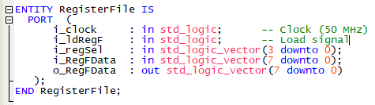
Create Register File Entity
Entity looks like

Slide 4
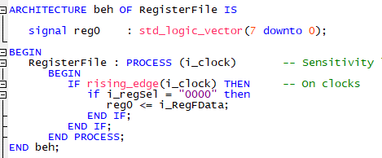
Create single register
Looks like
Compiles

Slide 5

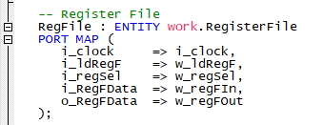
Add register file to top
Signals
Instance in top
Compiles

Slide 6
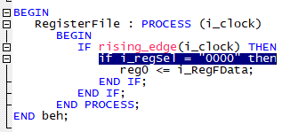
Input Demultiplexer
The input has an implicit demultiplexer
Only the right register is loaded
Easy to expand

Slide 7

Output Multiplexer
Need an output selector to pick the register
Easy to expand to more registers

Slide 8

Add 3 More Registers to Register File
Signals

Slide 9
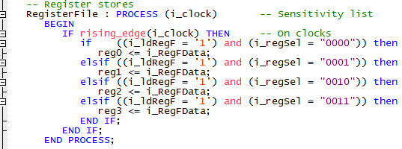
Add 3 More Registers – Register Loads
Add these into the RegisterFile process

Slide 10

Expand Output Multiplexer
Add these lines

Slide 11
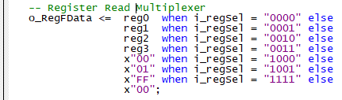
Add Constants to Register File
Frequently used values can be stored in the register file
Used by the IOW or ALU instructions
Values
Reg8 = 0x00
Reg9 = 0x01
RegF = 0xFF

Slide 12
Test Register File
It would take some serious work to fully test the register file
  Signal Tap?
Could test 1 bit of the first register by passing KEY0 through reg0 bit D0 and putting it to LED0

Slide 13

Register File Test Code
In top
Works – press KEY0, lights LED0
Routed through the register file

Slide 14

Test Read Register Select
Change w_regSel to select between the reg8 (0x00) and reg9 (0x01)
View register file D0 on LED0
Works!
  Press KEY0, lights LED0

Slide 15
Register File - Summary
Created a register file
  4 of 8-bit write/read registers - reg0-reg3
  Three constants reg8=0x00, reg9=0x01, regF=0xFF
  Room for 9 more registers or constants
Minimal Testing
  Register Select – 3 different registers
  Load reg0
  Will test more at a higher level

Slide 16
GitHub
Created a Git Hub Repository
  https://github.com/douggilliland/Design_A_CPU/tree/main
Created a branch with progress so far
  https://github.com/douggilliland/Design_A_CPU/tree/cpu_001_Part5_RegFile
Top Level entity
  https://github.com/douggilliland/Design_A_CPU/blob/main/cpu_001.vhd

