Slide 1
Design a Computer from Scratch
Appendix A2 – Subroutine Support

Slide 2
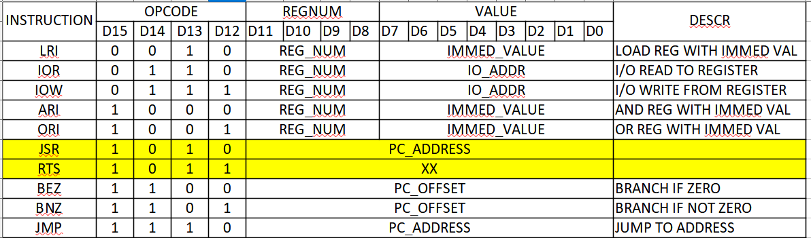
ALU / Branch Control
Add Jump to Subroutine (JSR) and Return from Subroutine (RTS) instructions

Slide 3
Implementation
Currently no subroutine support
Large examples can leverage subroutines
Store next address + 1 when JSR in w_rtnAddr
Pull from w_rtnAddr when RTS

Slide 4


In cpu_001.vhd – Add signals

Slide 5

In cpu_001.vhd – Add Opcode Decodes

Slide 6
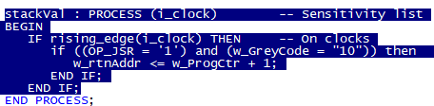
In cpu_001.vhd – Add process
Store PC+1 when JSR instruction and state = 10

Slide 7


Need to add mux to PC Load value
Add signal
Add mux to select load PC value (normally w_romData(11..0)

Slide 8
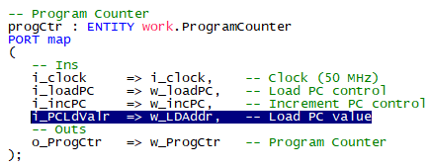
Change Program Counter Port
Change progCtr

Slide 9

Update w_loadPC for JSR and RTS

Slide 10
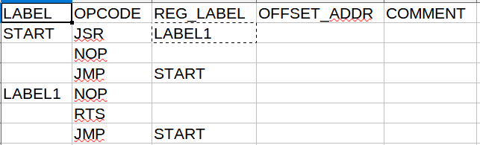
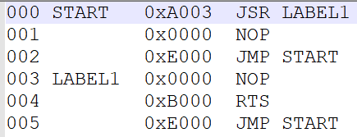
Test Code (Part_A2_Test1.csv)
Source
List File

Slide 11
Expect PC to go
0x000 > 0x003 > 0x004 > 0x001 > 0x002 > 0x000
If PC goes 0x00 > 0x001 directly then JSR failed
If PC goes 0x004 > 0x005 directly then RTS failed
Run...

Slide 12
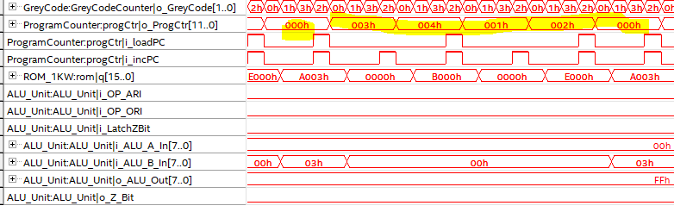
Result
It worked!

Slide 13
Summary
Added single level subroutine facillity
  JSR - Jumps to Subroutine
  RTS – Returns from Subroutine
Tested and works
Does not support nested subroutine calls
For larger code expect ~75% reduction in code size
Penalty is slower execution times
  JSR/RTS instructions take time

Slide 14
GitHub
Git Hub Repository
  https://github.com/douggilliland/Design_A_CPU
Created a branch with progress so far
  https://github.com/douggilliland/Design_A_CPU/tree/cpu_001_App1
Top Level entity
  https://github.com/douggilliland/Design_A_CPU/blob/main/cpu_001.vhd

