Slide 1
Design a Computer from Scratch
Appendix A1 – New Opcodes

Slide 2
ALU / Branch Control
Refresher - (from Parts 1-8)
  Designed a CPU in an FPGA
  16 bit instructions
    4-bit opcodes (used 7 / 16)
    4-bit register select (coded 7 / 16)
  12.5 MIPS (4 of 50 MHz clocks per instruction) performance
  12-bit address code space
  Peripheral support
    8-bits of address, 8-bits of data in/out

Slide 3
Objectives
Add ORI (OR with Immediate value) instruction
Further test CPU and fix bugs in original design
  ARI was not writing back after AND (was setting Z-bit)
Add 4 more registers to Register File (8 R/W registers)

Slide 4
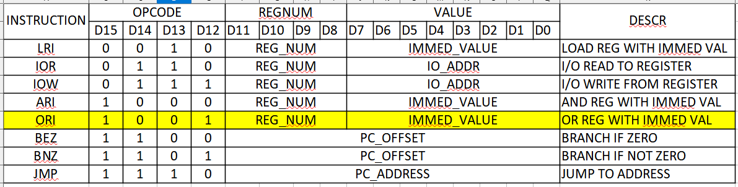
Add ORI opcode
Add ORI (OR with immediate value) instruction
  Bit-wise OR of selected register and D7..D0 of instruction

Slide 5
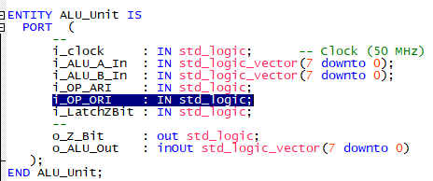
Add to ALU.vhd
Add entity
Add to o_ALU_Out

Slide 6
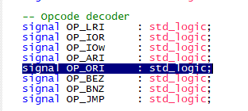
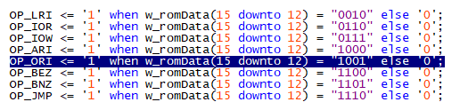

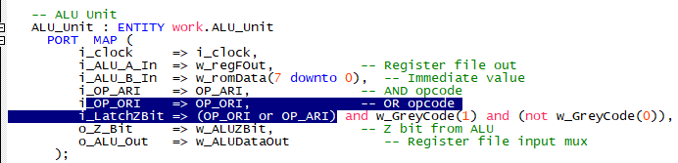
Changes in cpu_001.vhd
Add to signals
Add
Add
Add

Slide 7
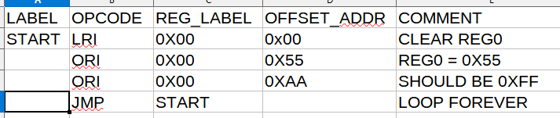
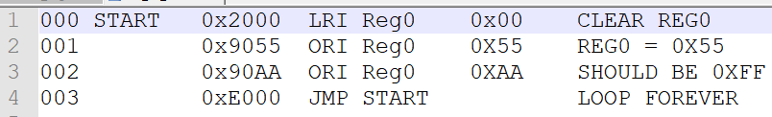
Test ORI code
Code – Part_A1_Test1.csv
List file shows assembler coding (opcode = 0x9)

Slide 8
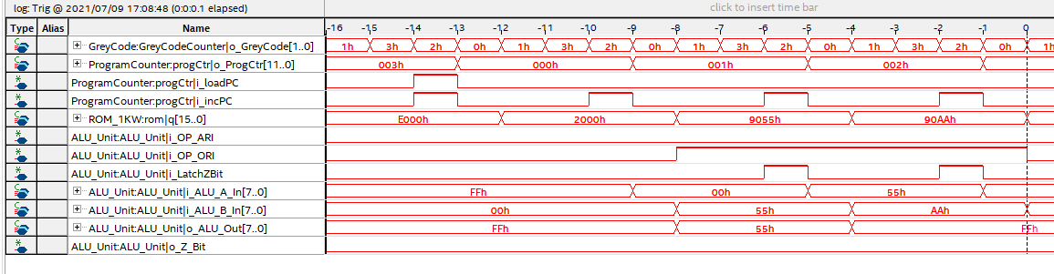
Missing Write to Register File for ARI/ORI
Found out that the write back to the register file after ARI (and new ORI) instructions wasn’t happening
Fixed and now working

Slide 9

VHDL code change to fix register file write
Added code to cpu_001.vhd that fixed register file writes after ARI (and new ORI) opcodes
  Without these lines, ARI, ORI function like Bit Test instructions
Really need a good instruction test program!!!

Slide 10
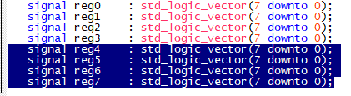
Expand Register File to 8 R/W Registers (1/3)
In: RegisterFile.vhd
  Expand signals list

Slide 11
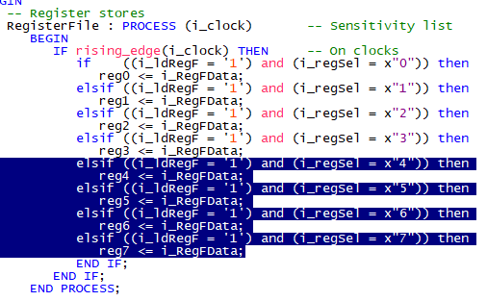
Expand Register File to 8 R/W Registers (2/3)
In: RegisterFile.vhd
  Add registers (recoded to hex values)

Slide 12
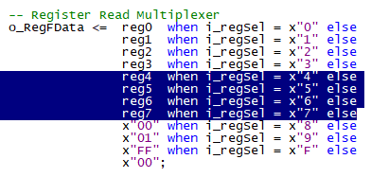
Expand Register File to 8 R/W Registers (3/3)
In: RegisterFile.vhd
  Add to register output mux (recoded to hex values)

Slide 13
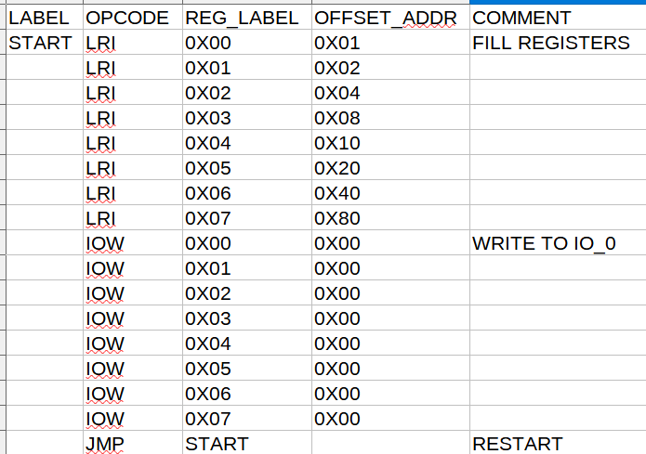
Code to Test Register File
LRI each register with a unique value, write to output port

Slide 14
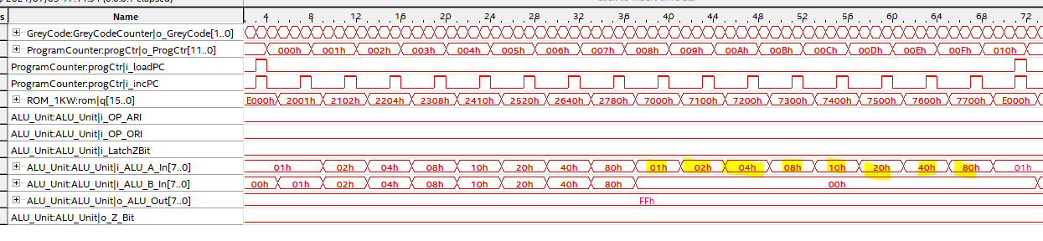
Register File Test Result
Works, 8 writes with bouncing bits

Slide 15
GitHub
Git Hub Repository
  https://github.com/douggilliland/Design_A_CPU
Created a branch with progress so far
  https://github.com/douggilliland/Design_A_CPU/tree/cpu_001_App1
Top Level entity
  https://github.com/douggilliland/Design_A_CPU/blob/main/cpu_001.vhd

