Slide 1
Design a Computer from Scratch
Part 3 – Program Counter Design

Slide 2
Program Counter Design
Refresher - Requirements (from Part 2)
  12-bits Program Counter (PC)
  Loads 0x000 at reset
  PC controls
    Increment counter
    Load counter for branches or jump instruction
    Branches will use 12-bit absolute addresses
      Relative branching is not necessary

Slide 3
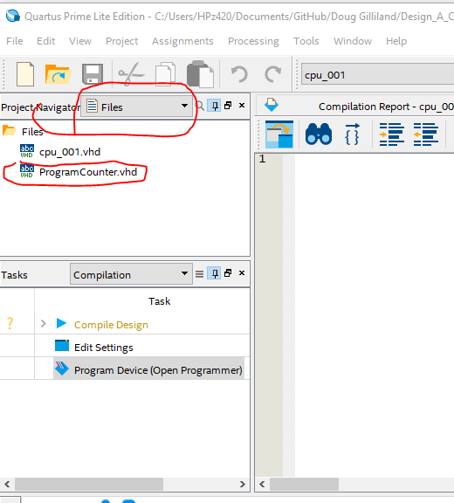
Counter Entity
File, New
VHDL File
Save-As:
ProgramCounter.vhd
Make sure folder is the same
as cpu_001.vhd location
Select Files to see

Slide 4
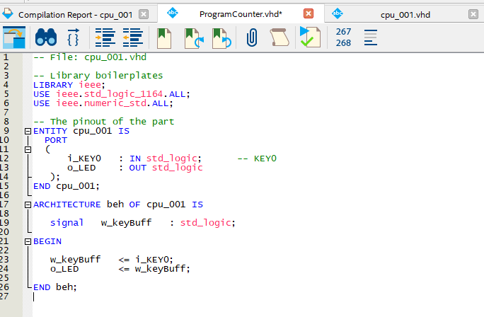
Copy/Paste to start
Copy the contents of
cpu_001 and paste into
ProgramCounter.vhd
We will change to add the ports/function we need
Start with entity pins list
We will replace the pins with new ones

Slide 5
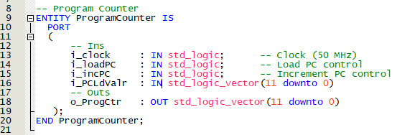
Entity Pins List
Search/replace cpu_001 to ProgramCounter
Add Clock, Load, Increment controls
Add PC Load Value
Add Output value
Do we need a reset or will FPGA reset registers automatically?

Slide 6

Signals List
We will use a signal for the PC
Placed after the ARCHITECTURE and before the BEGIN statements

Slide 7
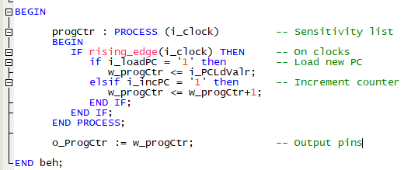
The PC Function
This needs to be clocked inside a process statement
Load takes priority over increment

Slide 8
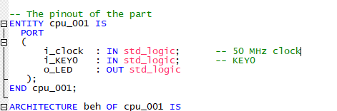
Need to add clock to top entity
Out top only had the KEY0 and LED0
Add the FPGA clock to the top entity pin list
This will get connected later to the PC

Slide 9
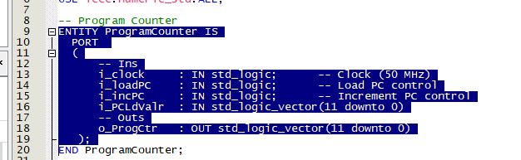
Add the Program Counter to the top
The counter needs to be instantiated in the top
Copy the highlighted portion

Slide 10
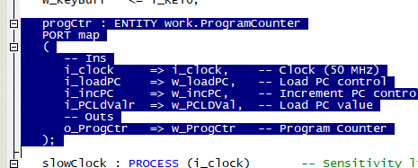
Paste into the top
Paste into the top
Goes below the BEGIN in the top
We will fix/hook it up in the next step

Slide 11
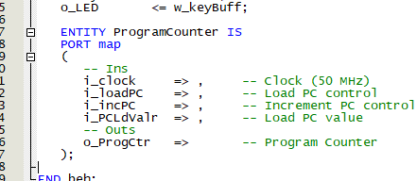
Fix Pasted PC Entity
VHDL has differences between the formatting when an entity is the pin list vs when it is used
For now change it to leave it dangling
We will fill in the values before the commas with pins or signals

Slide 12
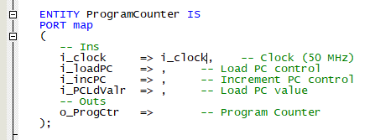
Add Pins
The only external pin we have is the clock so fill that in
The rest will be signals

Slide 13

Adding signals to top
Here’s the signals we need to add with default values added
Here’s the signals used

Slide 14
Testing the PC
There’s guaranteed to be typos and other errors in what we just did
Maybe you even spotted some of them!
How can we test this? Ben [Eater] would just insert a 555 and run it slow to look at the address lines with LEDs
We could use Signal Tap – maybe too advanced at this point?
Or maybe we could use the pushbutton and LED to do something like what Ben would do!

Slide 15
Make a Slow Clock
If we run the 50 MHz clock into the PC divided by the 2^12 address counts that’s still pretty fast. Too fast to see.
What about making our own slow clock to test the PC functions? Should be easy enough. We just made a counter after all!
Let’s put it into the top (cpu_001)
A clock which generates a single 20 nS pulse around 10 Hz would probably work nicely. 50 Mhz/10Hz is a divide by 5 Million. Let’s pick the nearest power of 2.
  2^22 = 4,194,304
  Looks like a 22 bit counter should fit the bill nicely – will be 12 Hz-ish

Slide 16
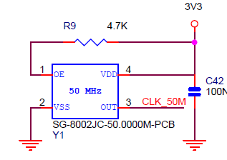
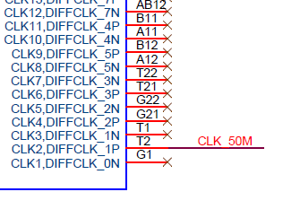
Making a Slow clock
22 bits, one pulse per
Test this counter on the LED
The most significant bit should be ~2 Hz
Need to add the clock pin in the Pin Assignment at Pin_T2

Slide 17

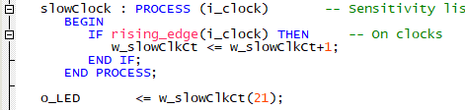
“Slow” Blinkey Clock VHDL code
Worked!
Signal was
Code is:
Sending slower clock out the LED

Slide 18

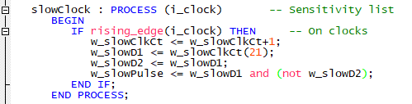
Edge Detect the Slow Clock
The slow clock needs to be turned into a single clock 20 nS wide pulse every 12 Hz

Slide 19


Test the Program Counter Increment
Clock the w_incPC with the pulse
Run a PC address bit to the LED
LED blinks slower
Pick a higher bit
LED blinks even slower
Working

Slide 20


Test the Program Counter Load
Load takes priority over increment
Set load value
Use pushbutton to load - invert pushbutton
Works
Check specific bit load

Slide 21
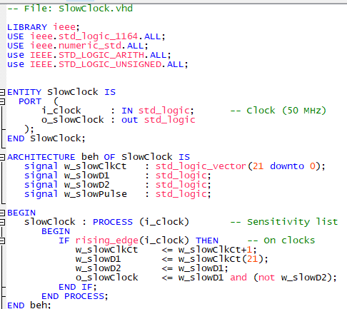
Move the slow clock to a new VHDL file
Might want this slow clock later

Slide 22
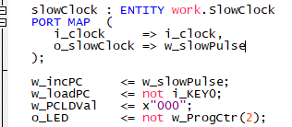
Fix top to use new Slow Clock
Instantiate the slow counter in the top
Works!

Slide 23
Program Counter - Summary
Built a Program Counter
  Counter counts
  Counter loads
Testing
  Built a slow clock for testing

