Slide 1
Design a Computer from Scratch
Appendix B3 – Board Specific Pt 3

Slide 2
So far
Last video
  Hooked up the 7 segment display
  Refactored the CPU with separate CPU and CPU_top
  Made a new Peripheral Memory Map
  Connected up UART pins
This video will continue driving the functions we will want to use with the CPU

Slide 3
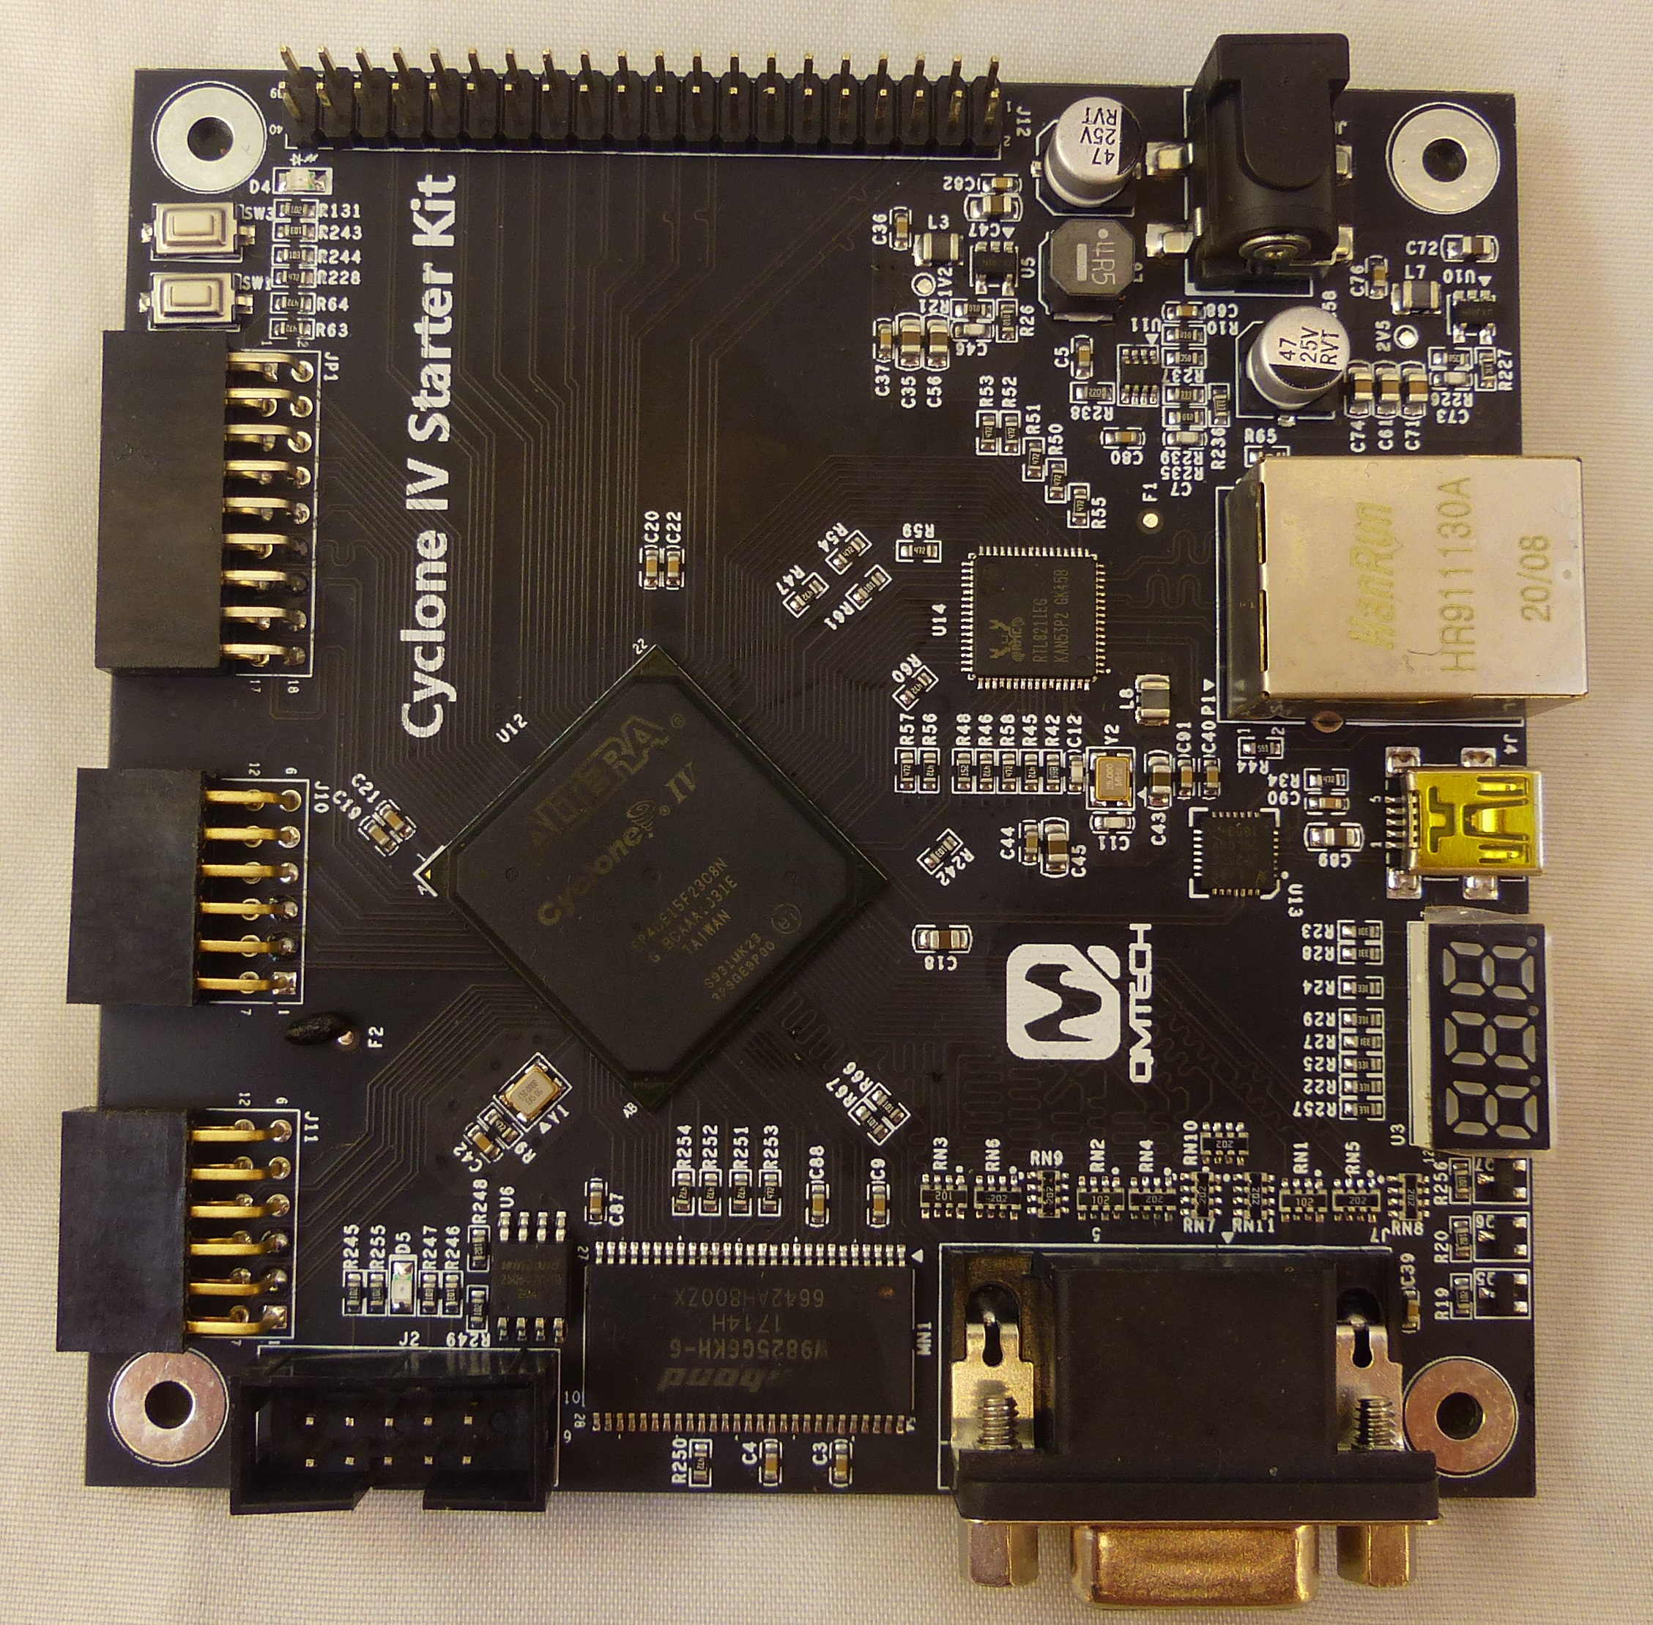
Add Board Specific functions
Make use of
  Seven Segment Display
  USB port
  VGA
  I/O Connector(s)
    Header
    PMOD connectors

Slide 4

Refer to QMTECH Documentation
Need pin numbers - refer to
  Code Examples (easiest way)
  Schematics
Code Examples
Used VGA qsf for pin numbers

Slide 5
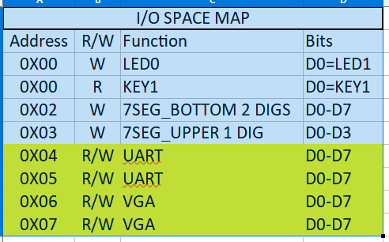
Peripheral Memory Map
New Peripherals (UART, VGA)
  Will continue to expand as peripherals get added

Slide 6
Added UART and VGA Entities
I added the UART and VGA from Grant Searles’ Multicomp to CPU_top
VGA has 5:6:5 R:G:B bits
  Mapped to the 2:2:2 bits from Grant’s VGA
  No PS/2 keyboard jack on the card – could use external adapter
  6850 style contro/status and data interface
UART has 6850 style interface

Slide 7
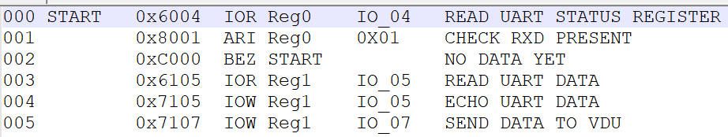
UART/VGA Test Code (Part_B3_Test1.csv)

Slide 8
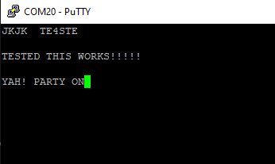
UART/VGA Running
Code run
  Type into PuTTY and characters gets echoed to the USB and VDU

Slide 9
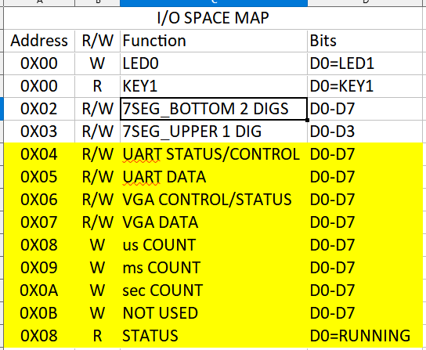
Add Timer Unit

Slide 10
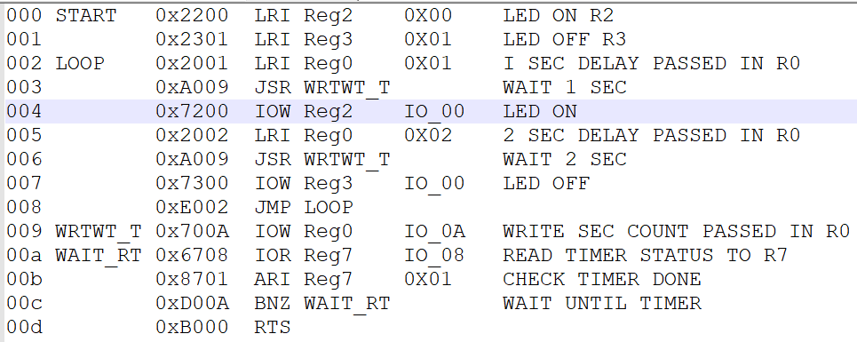
Timer Unit Test Code (Part_B3_Test2.csv)

Slide 11
Time Test Results
Timer works
LED blins on for 1 sec, off for 2 secs

Slide 12
GitHub
Git Hub Repository
  https://github.com/douggilliland/Design_A_CPU
Created a branch with progress so far
  https://github.com/douggilliland/Design_A_CPU/tree/cpu_top_PartB2
Top Level entity
  https://github.com/douggilliland/Design_A_CPU/blob/main/CPU_top.vhd

