Slide 1
Design a Computer from Scratch
Part 1 – Getting Started

Slide 2
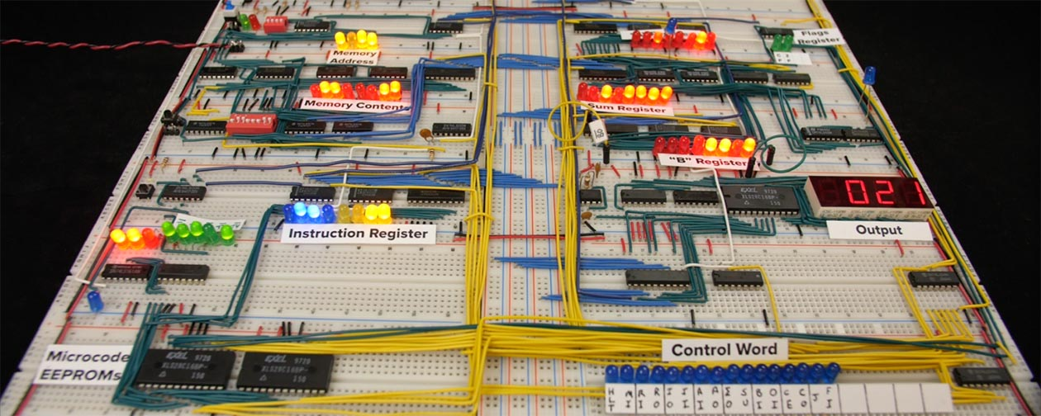
Not going to...
Build a large breadboard ala Ben Eater

Slide 3
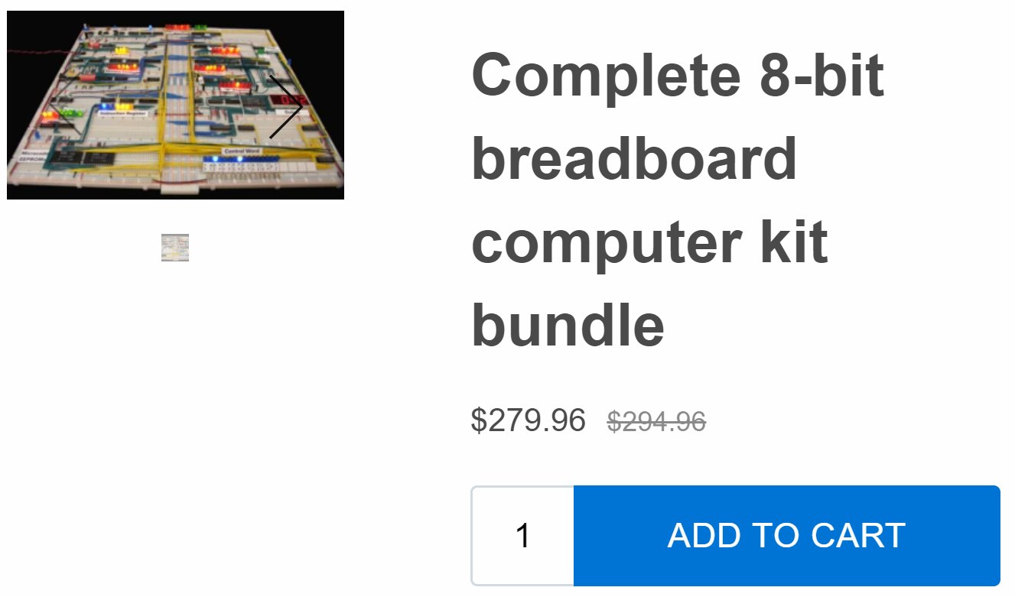
Not going to...
Spend a lot of money

Slide 4
Going to ...
Design a CPU
Be inexpensive
Learn about FPGA design using VHDL

Slide 5
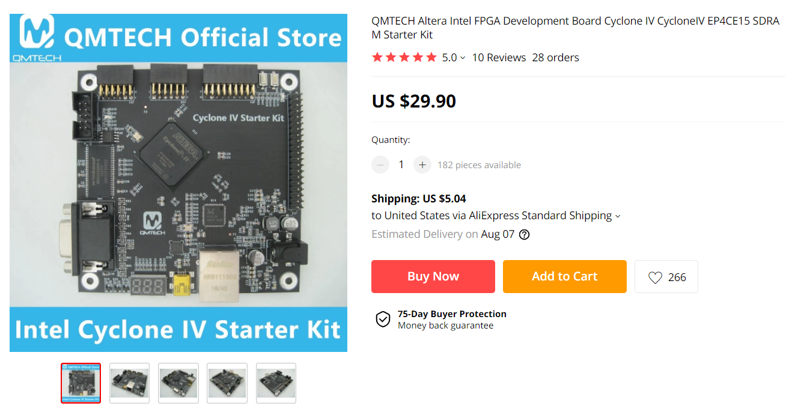
Hardware
Intel (Altera) FPGA card
  AliExpress QMTECH

Slide 6
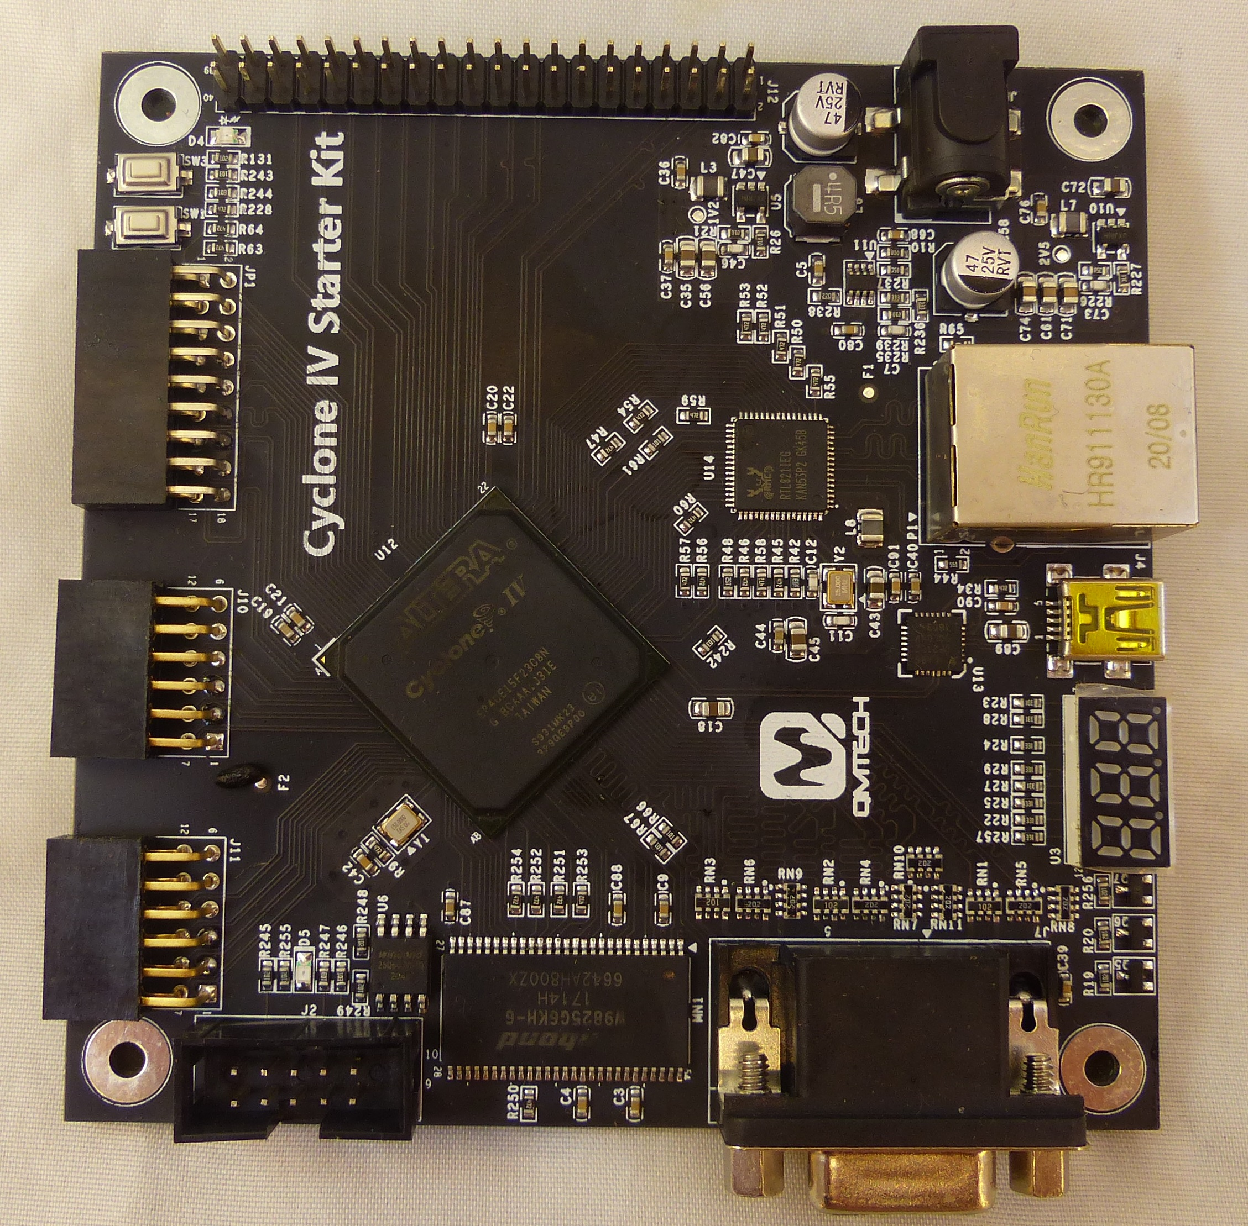
About the QMTECH card
EP4CE15F23C8N FPGA
2 user switches
2 user LEDS
USB to Serial Interface
I/O Connectors
VGA connector
3 digit 7 Segment LED

Slide 7
About the FPGA...
Cyclone IV, EP4CE15F23C8N
  56KB internal memory (SRAM, ROM)
  15K Logic Cells
    Ref: M6800 CPU has 1050 Logic cells

Slide 8
Other Features
Not using these features on the QMTECH FPGA card
  32 MB SDRAM
  Ethernet Interface

Slide 9
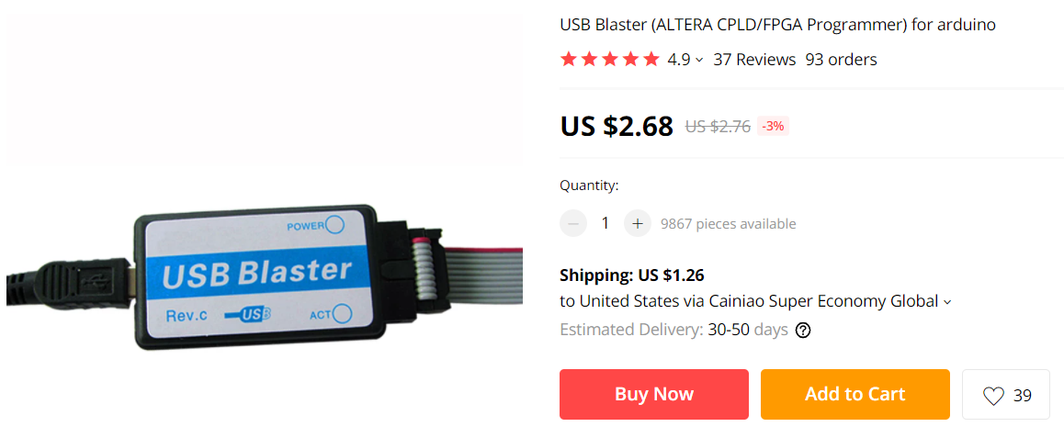
Programming the FPGA
Needs USB Blaster to program the FPGA (JTAG)

Slide 10

FPGA Development Environment
Intel/Altera Quartus II
Free Lite version
Search Intel FPGA

Slide 11
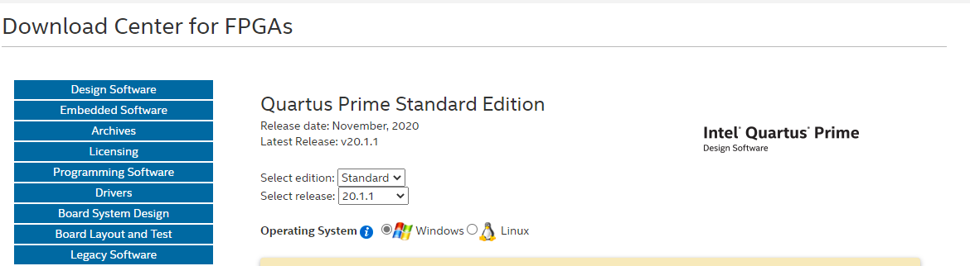
Get Started
On Intel page create an account
Go to Download Center for FPGAs
Download latest version of Quartus Prime Standard Edition

Slide 12

Download Cyclone IV Support File
Make sure to get Cyclone IV device support files
Install/Run

Slide 13
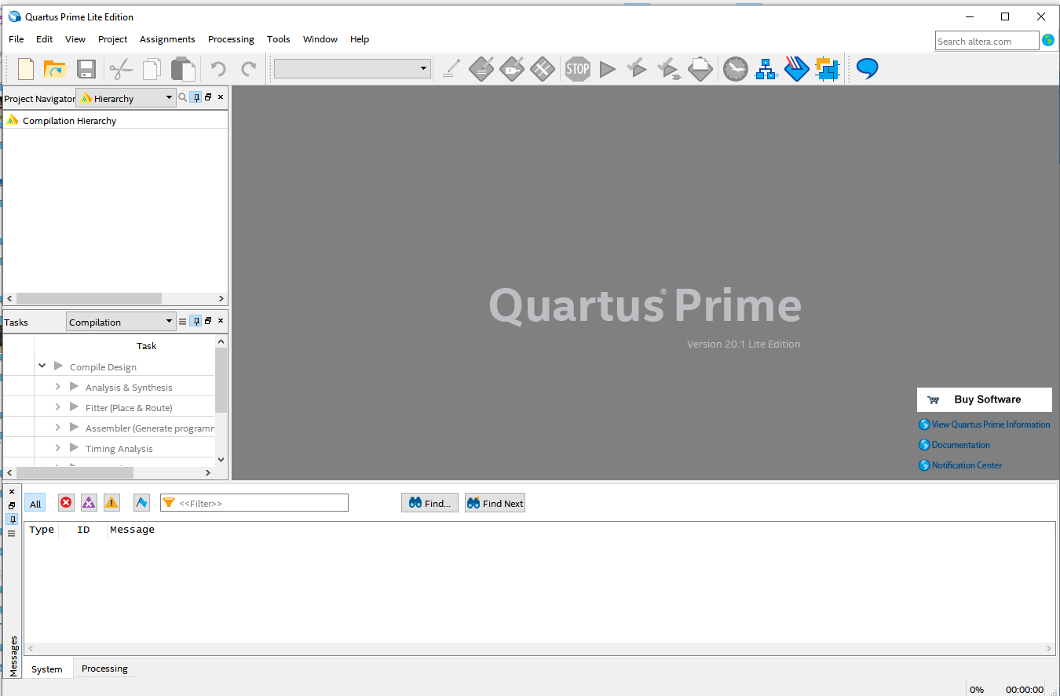
Quartus IDE

Slide 14
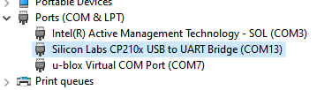
Hook up card
Connect 5V to barrel jack – power light should be on
Cable USB on FPGA card to your PC
Byte Blaster to your PC
Run Windows Device Manager to find the Serial port
Run PuTTY to connect to card
115,200 baud, 8 data bits, no parity, 1 stop bit

Slide 15
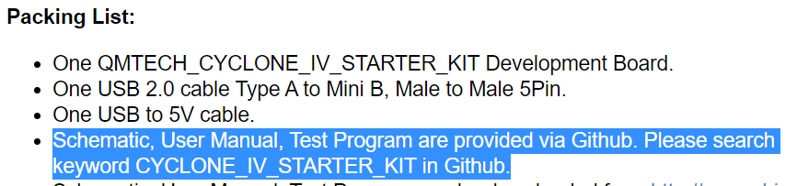
Simple VHDL Program
Write a simple VHDL “program” to verify setup
Read pushbutton in and write LED out
Will need to know the pin numbers – reference schematic

Slide 16
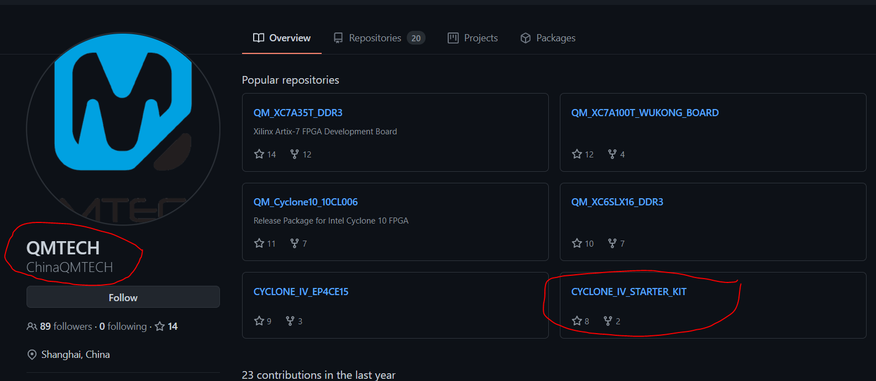
Download QMTECH schematic/files
Github

Slide 17
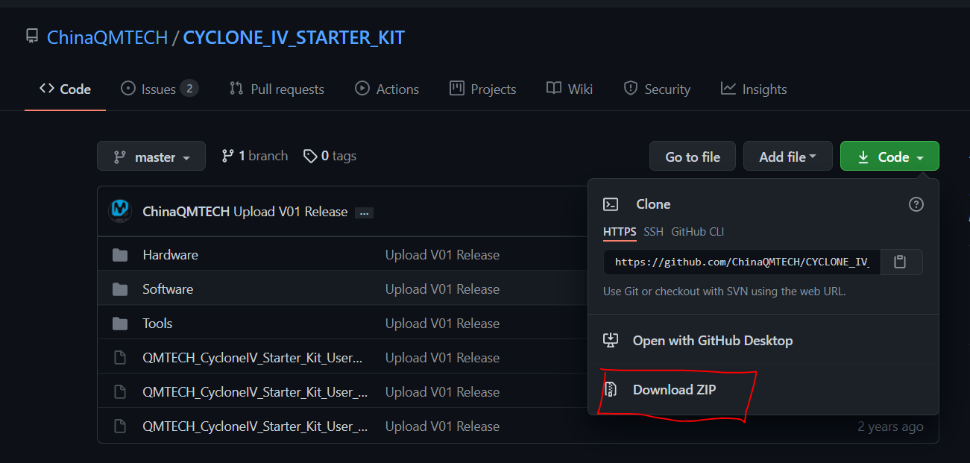
Download/Unzip QMTECH Docs/Examples

Slide 18
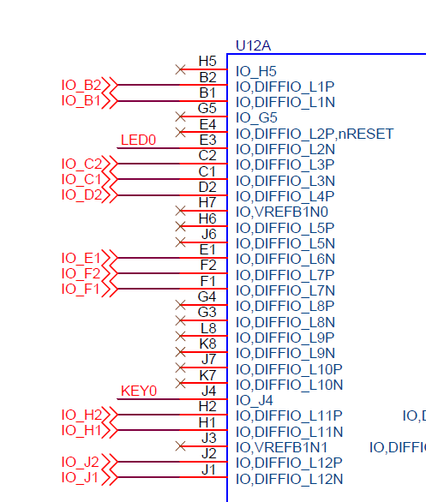
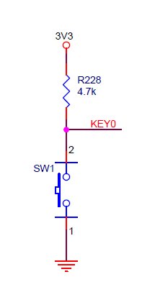
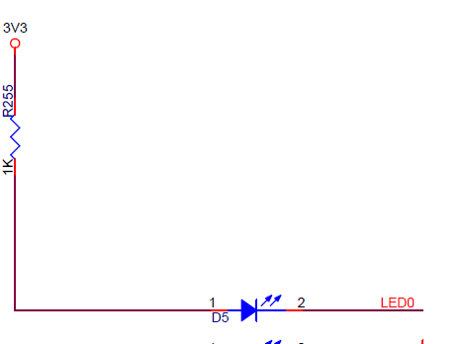
Find KEY0, LED0 and FPGA pins
KEY0 = Pin_J4
LED0 = Pin_E3

Slide 19
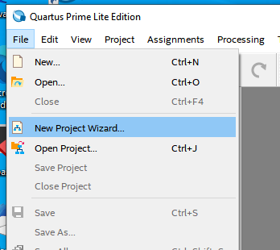
Run New Project Wizard in Quartus
File
New Project Wizard

Slide 20
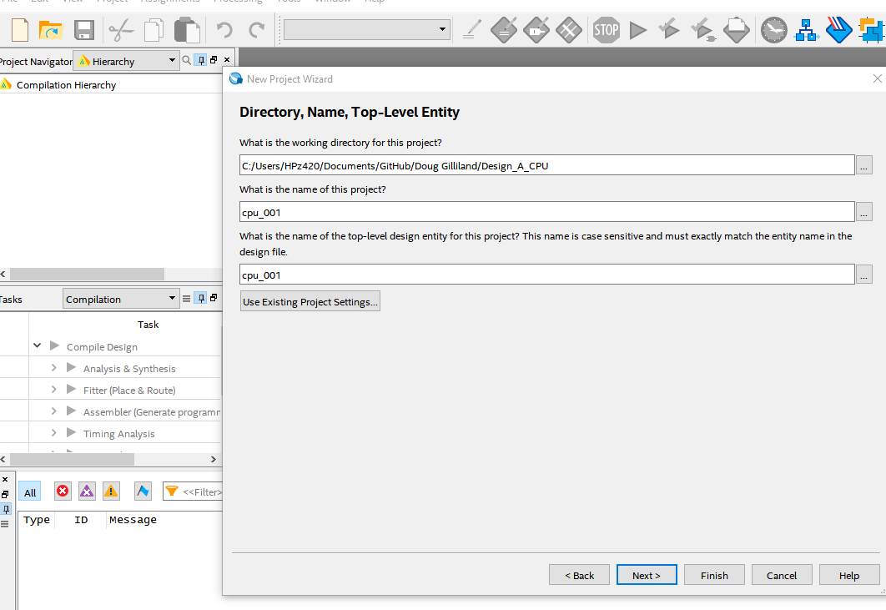
New Project Wizard
Create a folder
Call this section
  cpu_001

Slide 21
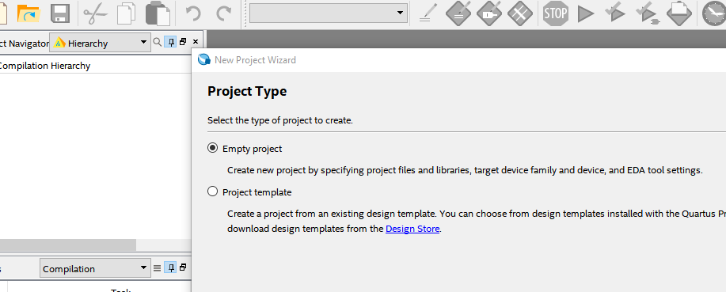
Empty Project

Slide 22
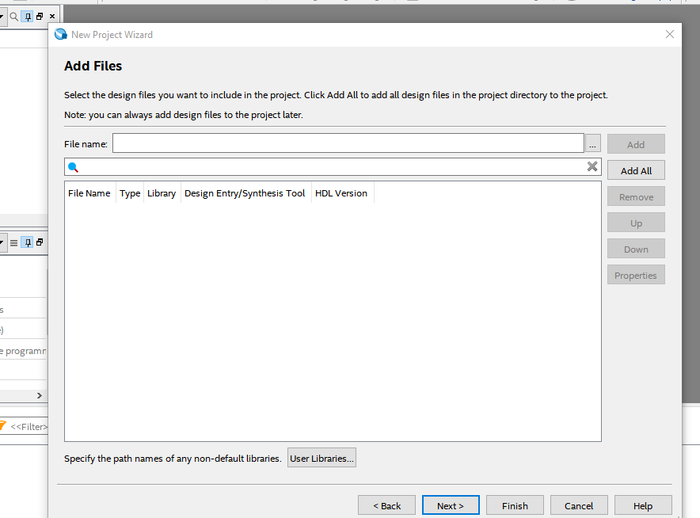
No files to add (*yet)

Slide 23
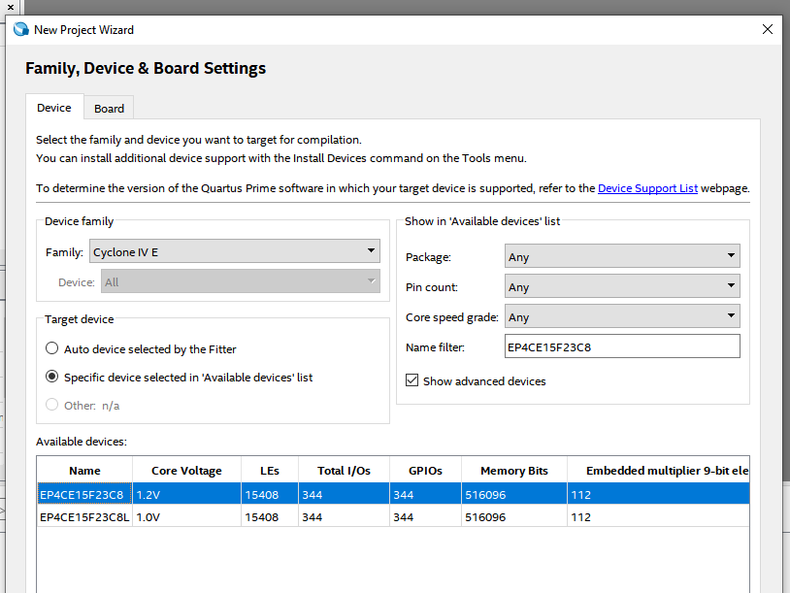
Device Settings
Name filter
  EP4CE15F23C8

Slide 24
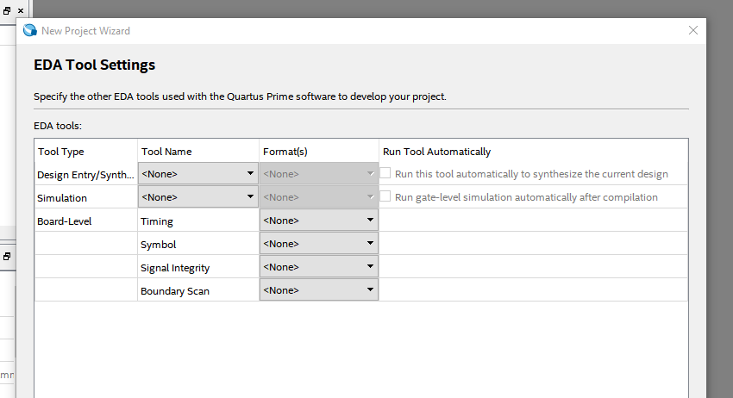
Skip EDA Test Settings

Slide 25
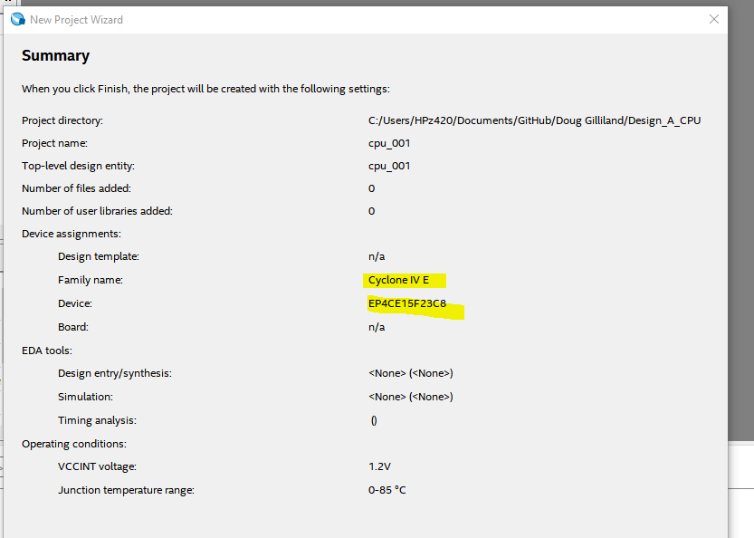
Verify Summary then Finish

Slide 26
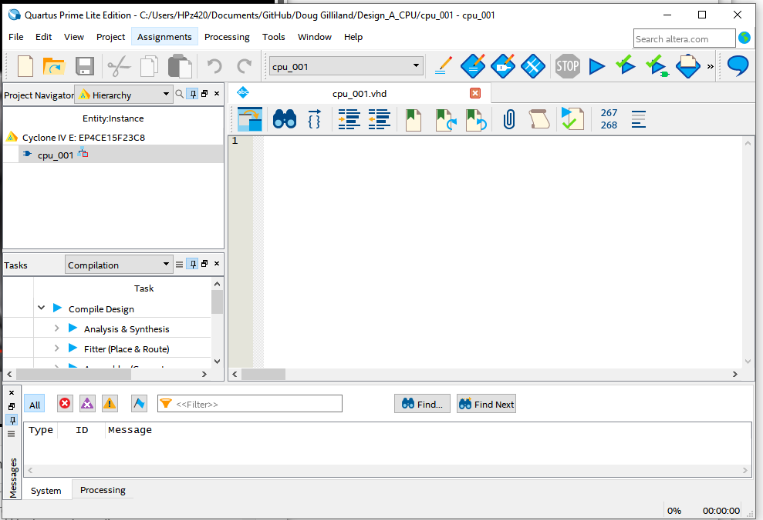
Create top level file
File, New
  VHDL File
Creates vhdl1.vhd
Save as
  cpu_001.vhd

Slide 27
Create First VHDL code (1/3)
-- File: cpu_001.vhd
-- Library boilerplates
LIBRARY ieee;
USE ieee.std_logic_1164.ALL;
USE ieee.numeric_std.ALL;

Slide 28
Create First VHDL code (2/3)
-- The pinout of the part
ENTITY cpu_001 IS
PORT
(
    i_KEY0 : IN std_logic; -- KEY0
    o_LED : OUT std_logic
  );
END cpu_001;

Slide 29
Create First VHDL code (3/3)
ARCHITECTURE beh OF cpu_001 IS
signal w_keyBuff : std_logic;
BEGIN
  w_keyBuff <= i_KEY0;
  o_LED <= w_keyBuff;
END beh;

Slide 30
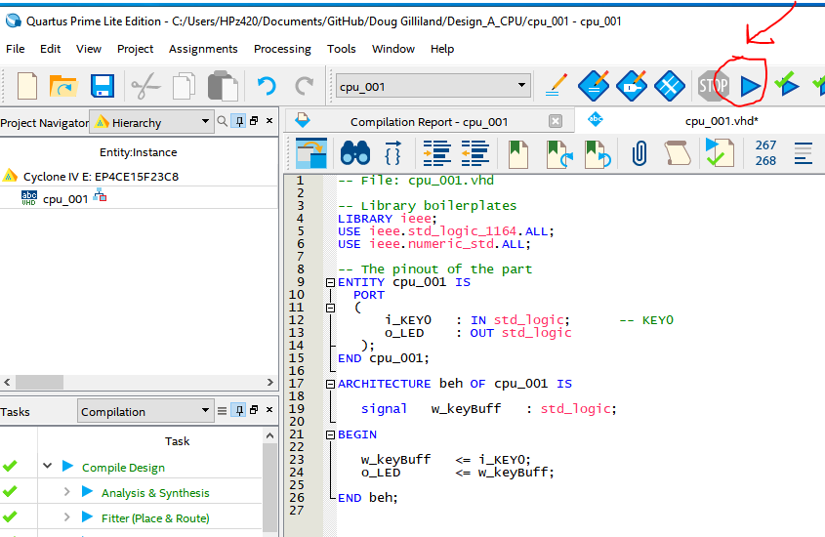
Compile
Click blue arrow
Start Compilation

Slide 31
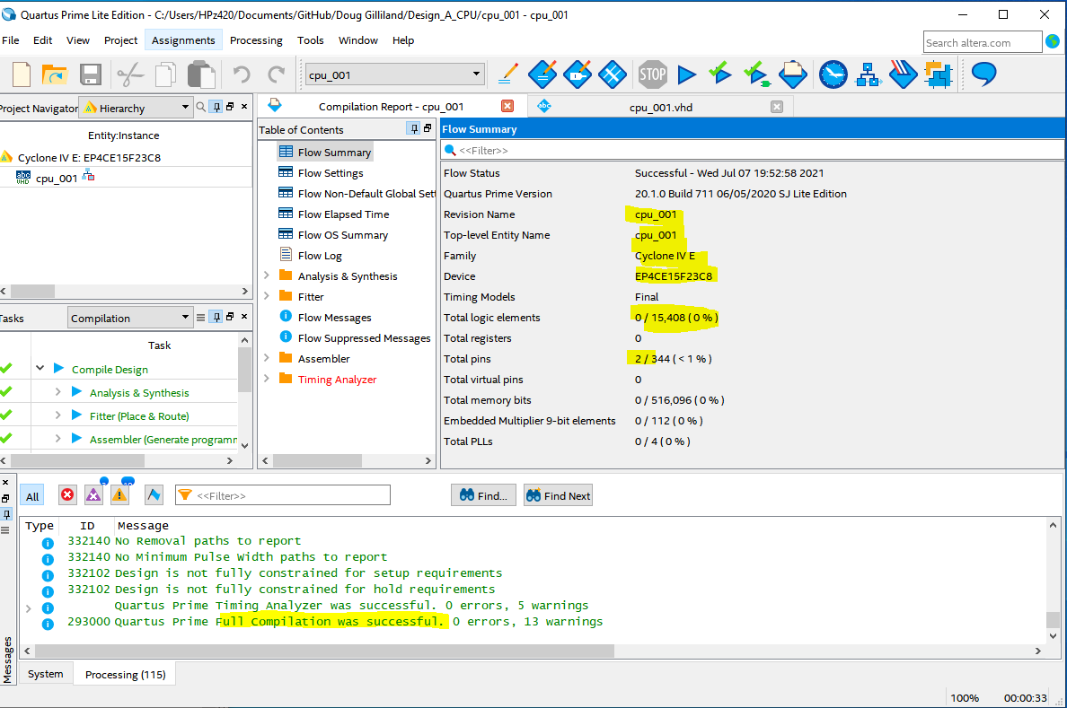
Check Result (fix any typos)

Slide 32
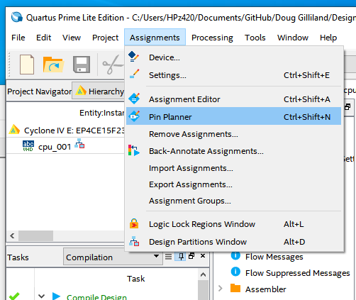
Run Pin Planner to Assign Pins
Assignments
Pin Planner

Slide 33
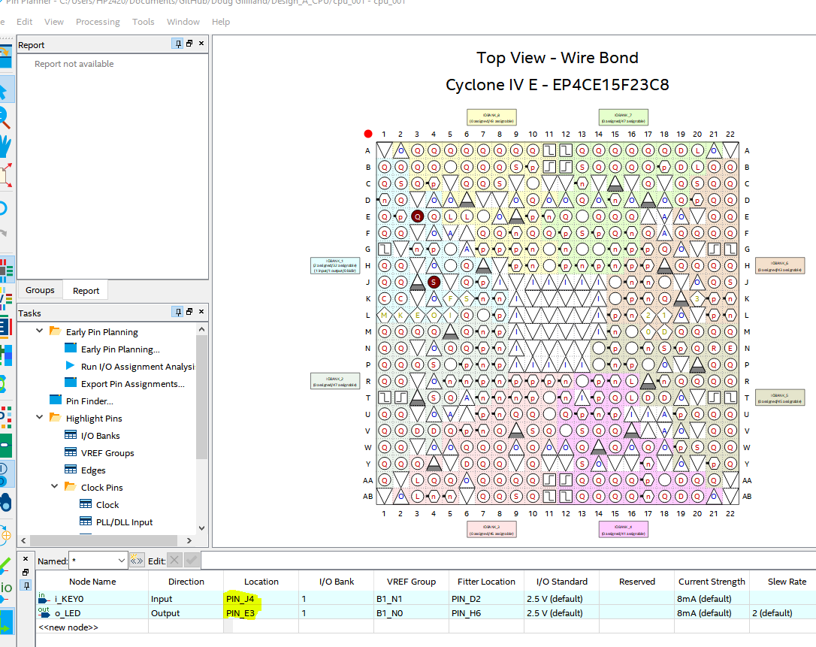
Assign Pins
Remember
  KEY0 = Pin_J4
  LED0 = Pin_E3
Double click i_KEY0 Location Pin_J4
Set LED0

Slide 34
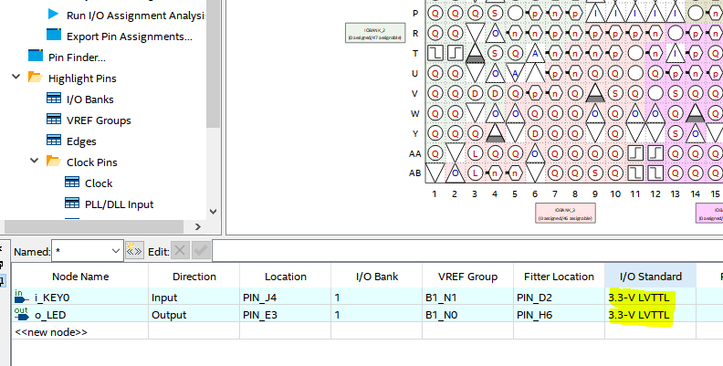
Set I/O Standard Voltages to 3.3-V LVTTL
Double click to set
in pull-down
Close when done
Compile again to use pinout

Slide 35
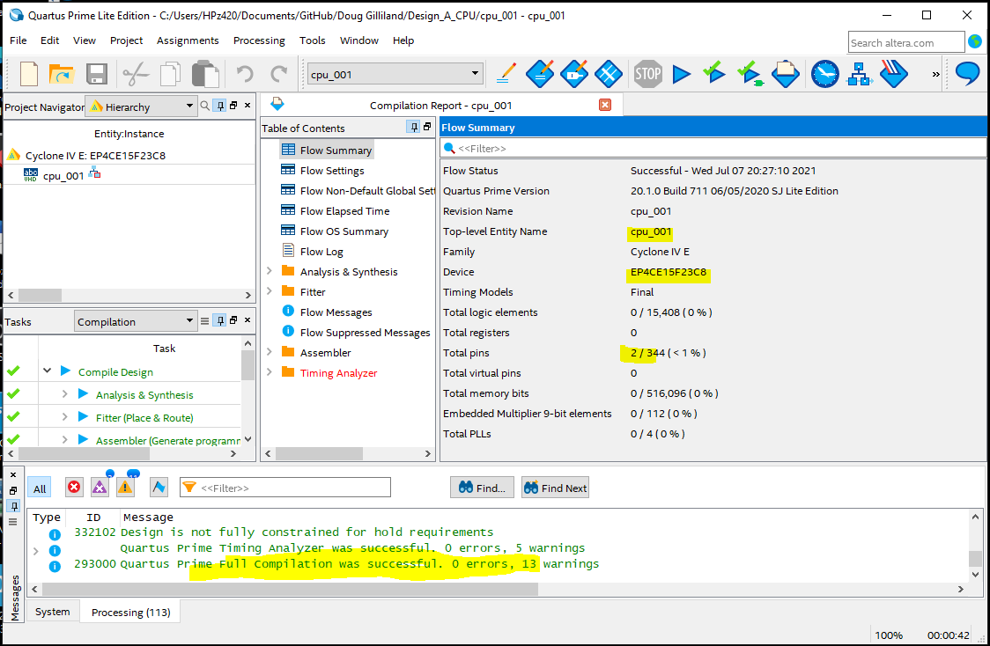
Check Results
Success!

Slide 36
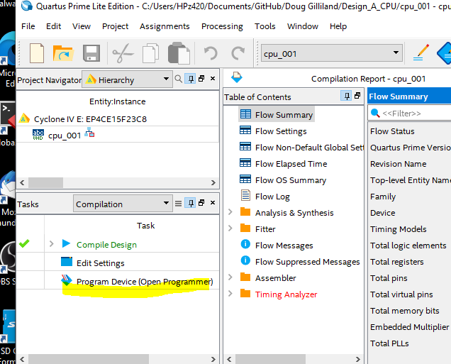
Download to FPGA
Program Device

Slide 37
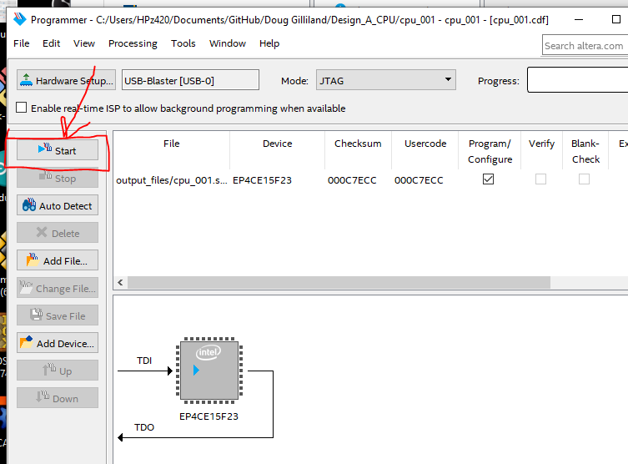
Start
May be some fiddling to get it to work (power to card?)

Slide 38

Check program works
Press KEY0
(not config key)
Observe LED)

Slide 39
Thoughts
Setup is long and a bit painful, but only gets done once
Things that we will do other times
  Add pins
  Compile
  Download

