Slide 1
Design a Computer from Scratch
Part 5 – ROM Design

Slide 2
ROM Design
Refresher - Requirements (from Part 2)
  Altera has ROM wizard
  Need to create initialization contents
  ROM has registered address inputs
    Adds a clock delay
      Control/timing needs to account for this delay
      Could load one clock before the end of the previous instruction but branches have be finished calculating

Slide 3
ROM Initialization File
Quartus needs either an Intel HEX file or MIF (Memory Initialization File) to fill ROM
HEX file is complicated (Needs checksum, etc)
MIF file is relatively simple

Slide 4
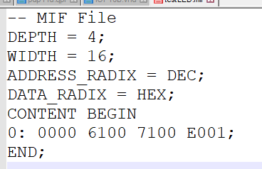
Example MIF File
Relatively simple file format
Need to convert program to data
Need an assembler

Slide 5
Assembler
Convert Source File into MIF file
Requires encoding the opcodes

Slide 6
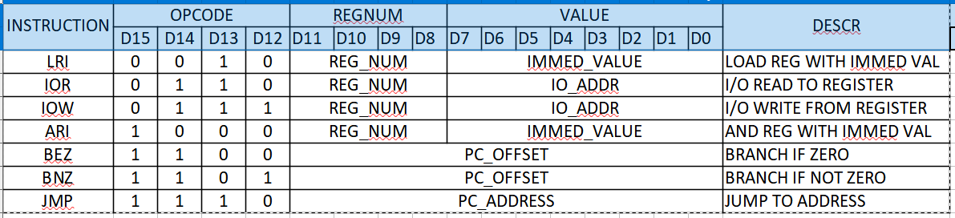
Opcodes

Slide 7
Assembler
Two-pass assembler
  First pass builds symbol table
  Second pass builds output
Takes CSV file
  Fixed format header
Written in Python 3
  Tkinter Windows application
Produces MIF File and Listing File

Slide 8

Simple Source File That Would Run
Jumps to self

Slide 9
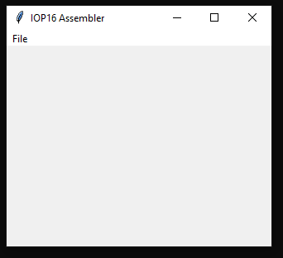
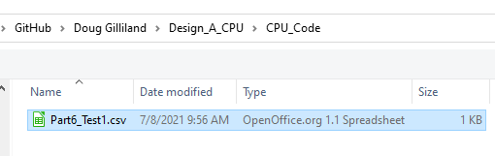
Run Assembler
Double click on pyAssemble_cpu_001.py
File, Open
Select file
Part6_Test1.csv

Slide 10
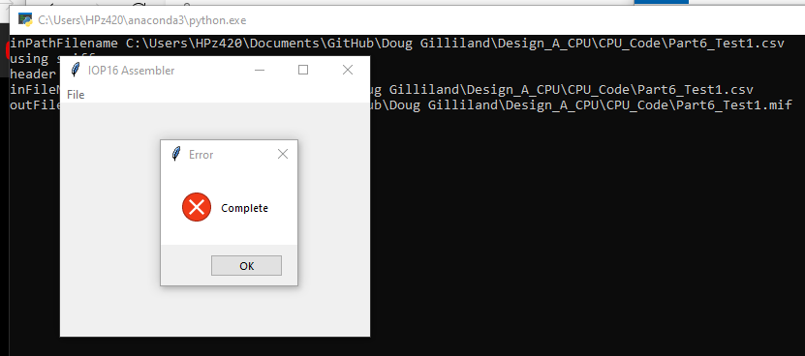
Run Assembler (Part 2)
Program will put up “Complete” dialog box
If there are errors they will be in the Command window

Slide 11

List File
The List file looks like:

Slide 12
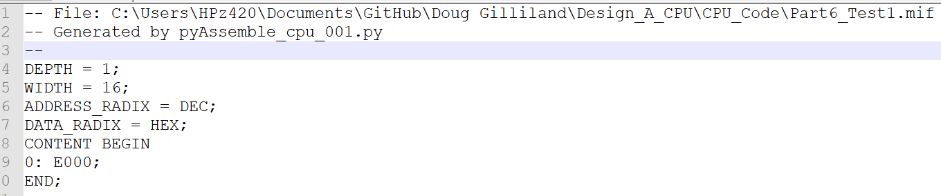
MIF File
The MIF file looks like:
Now have a ROM Initialization file

Slide 13
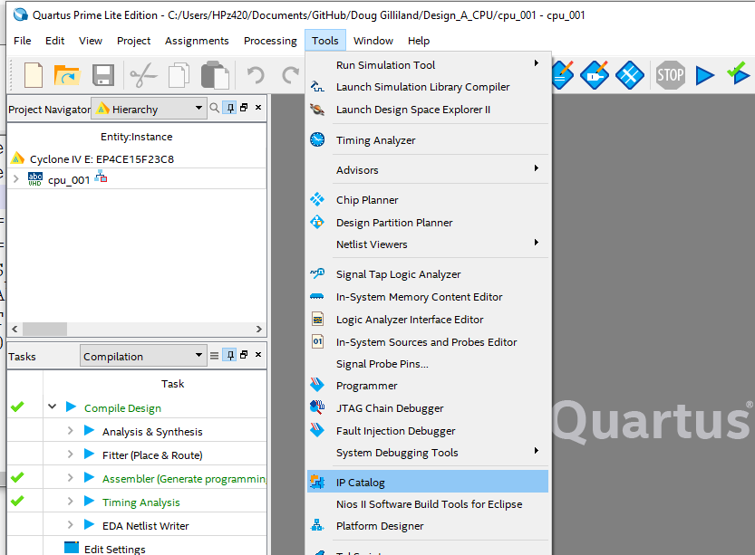
Quartus Load IP Catalog
In Quartus II 20.1
Tools, IP Catalog

Slide 14
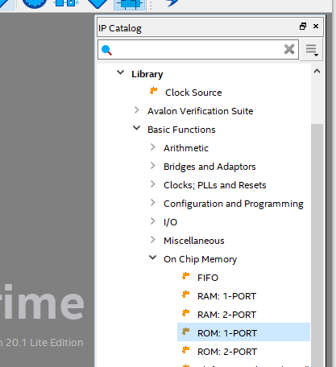
Select Basic Functions, On-Chip Memory, ROM 1-Port

Slide 15
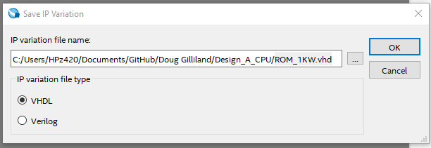
IP Catalog Wizard – Set Name
Select VHDL
File name: ROM_1KW.vhd
File will be 1KW (could be different size – up to 4KW)

Slide 16
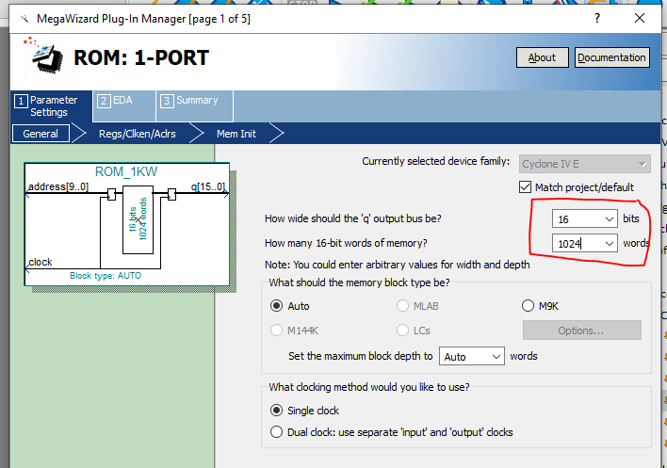
IP Catalog Wizard – Set address/data sizes
Data width
  16 bits
Memory size
  1024 words
Note input address and output data are both clocked

Slide 17
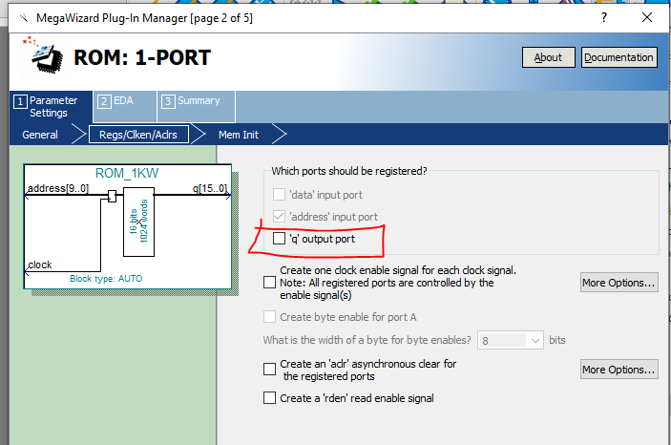
IP Catalog Wizard – Remove output register
Unclick ‘q’ output port
Note output register is no longer displayed

Slide 18
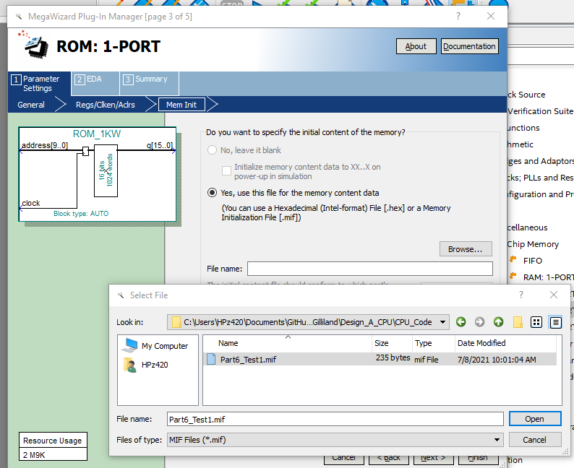
IelectP Catalog Wizard – Select MIF File
Select Files of Type: MIF
Select file that was created
  Part6_Test1.mif
Finish (2x)

Slide 19
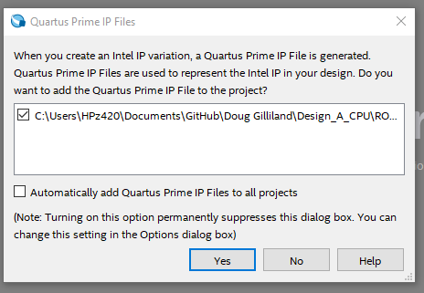
Add to Project

Slide 20
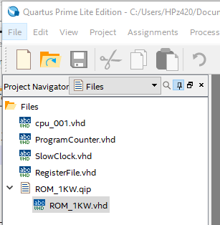
ROM VHDL now shows up
The ROM VHDL file now should show up in the Files list
Open file to see entity pins

Slide 21
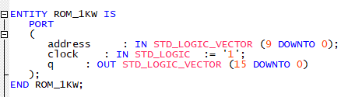
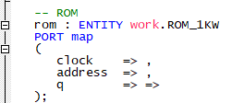
ROM pins list
The ROM pins list has
Need to add ROM to top
  Connect next

Slide 22
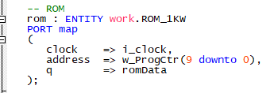
Connect ROM to top Signals
Signals
ROM entity in top
  Note address width matches ROM size

Slide 23

Testing ROM
Only one instruction
  Load 0x000 to PC
  Simulates JMP
Instruction 0xE000
  Select D15, D0 with KEY0
Works!
  Press KEY0 turns off LED0, release turns on

Slide 24
ROM - Summary
Encoded opcodes
Wrote assembler in Python 3
Wrote simple test code – Jump to self
Assembled code
Created ROM entity with assembly output as MIF file
Did minimal testing

Slide 25
GitHub
Git Hub Repository
  https://github.com/douggilliland/Design_A_CPU/tree/main
Created a branch with progress so far
  https://github.com/douggilliland/Design_A_CPU/tree/cpu_001_Part6_ROM
Top Level entity
  https://github.com/douggilliland/Design_A_CPU/blob/main/cpu_001.vhd

