Slide 1
Design a Computer from Scratch
Part 6 – Peripheral Bus Design

Slide 2
Peripheral Bus Design
Refresher - Requirements (from Part 2)
  8 address bits come from D7..D0 of the opcode
  Data only goes out from and into register file
    Register number is selected by Opcode D11..D8 (in Register File module)
  8-bits separate data in/out connections
    No need to tristate
  Need write strobe (most peripherals are designed this way)
    1 clock wide strobe
  Need read strobe
    2 clocks wide strobe

Slide 3

Peripheral Signals
8-bits address
8-bits data out
8-bits data in
Write/Read strobes

Slide 4
Data Mux to Register File to CPU
Data mux into register file
  Data from peripheral (IOR)
  Output of ALU (ARI)
  ROM (LRI immediate instructions)
Add Opcode decoder signals to select register file input

Slide 5
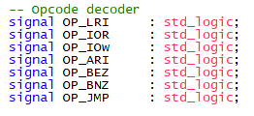
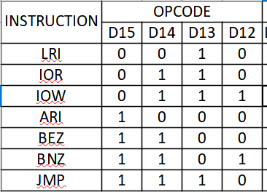
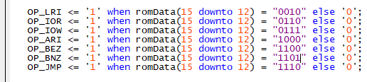
Opcode Decoder
Signals
Controls

Slide 6

Data Mux to Register File to CPU (pt 2)
Data mux into register file
  Data from memory (IOR)
  Output of ALU (ARI)
  ROM (LRI immediate instructions)
ALU faked out for now

Slide 7

Peripheral Bus
Connect up the rest of the Peripheral bus
Need timing section to generate valid strobe signals

Slide 8
Testing Peripheral Code
Tough to test without having a peripheral
Could made an I/O peripheral out of KEY0 and LED0
Strobes need a timing unit
Could create a program that loops on IOW and see the OP_IOW signal on the LED
  Would not be too meaningful – 60-50% chance of verifying it is correct
  No ALU needed for this application

Slide 9
Summary
Created Peripheral bus signals
  Address, data in/out, controls
Created Register file input data mux
  Hooked up immediate values, ALU output (not designed yet), Peripheral read data
Lack of timing block makes this hard to test
Didn’t do testing, but it compiles so syntax is likely correct

Slide 10
GitHub
Git Hub Repository
  https://github.com/douggilliland/Design_A_CPU/tree/main
Created a branch with progress so far
  https://github.com/douggilliland/Design_A_CPU/tree/cpu_001_Part7_PeripBus
Top Level entity
  https://github.com/douggilliland/Design_A_CPU/blob/main/cpu_001.vhd

