Slide 1
Design a Computer from Scratch
Part 7 – Opcode Decoder/Timing Design

Slide 2
Opcode Decode/Control Timing Design
Refresher - Requirements (from Part 2)
  Program Counter control - Inc PC, Load PC
  Register File control - Load Register File strobe
  ALU set Z-bit
Need multiple clocks for instruction
  PC increment
  ROM address input register > output prop delay
Use 4 clocks for instruction
  Code with 2-bit Grey Code for glitch free decodes
    00 > 01 > 11 > 10

Slide 3
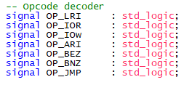
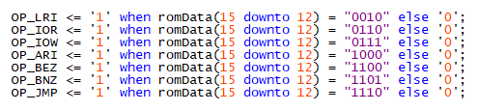
Decoder
Already did most of this in previous Part

Slide 4
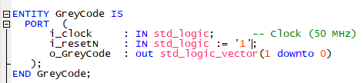
Timing
Use 4 clocks for instruction
  Code with 2-bit Grey Code for glitch free decodes
    00 > 01 > 11 > 10
  Make in Grey Code counter in VHDL module (GreyCode.vhd)
    Entity

Slide 5
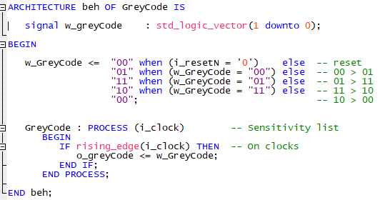
Grey Code Counter
Code
Includes i_resetN to reset counter at reset

Slide 6
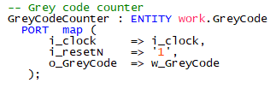
Add Grey Code entity to top
Signals
Entity in top

Slide 7

Wiring up JMP controls
Flow control
  JMP – always loadPC
  Not JMP
[Remember] Load PC has priority over increment
Increment / load at state 10 if JMP otherwise just increment at state 10
Remove default values

Slide 8


Wiring up Register File Controls
w_ldRegF loads at state 10 when doing LRI or IOR instruction
Remove default value on signal now that we are driving it
Result

Slide 9
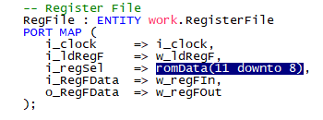
Select Register in Register File
Selected register to read/write is the D11..D8 of the instruction

Slide 10
Fake out ALU
No ALU yet
Fake out ALU
Change to
Wrap back ALU output from Register File
Will create ALU in next part

Slide 11
Peripheral Strobes
1 clock write at state 11 for IOW
2 clocks read at states 11, 10 for IOR
Usefulness of Grey Code can be seen in the Rd strobe
  Glitch free

Slide 12
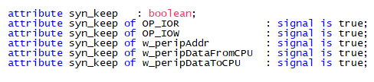
Add Peripheral bus to Signal Tap
Need to first tell Quartus to preserve Peripheral Bus signals
Use -
Need to compiler then add in Signal Tap then re-compile

Slide 13
Check / Debug Peripheral

Slide 14
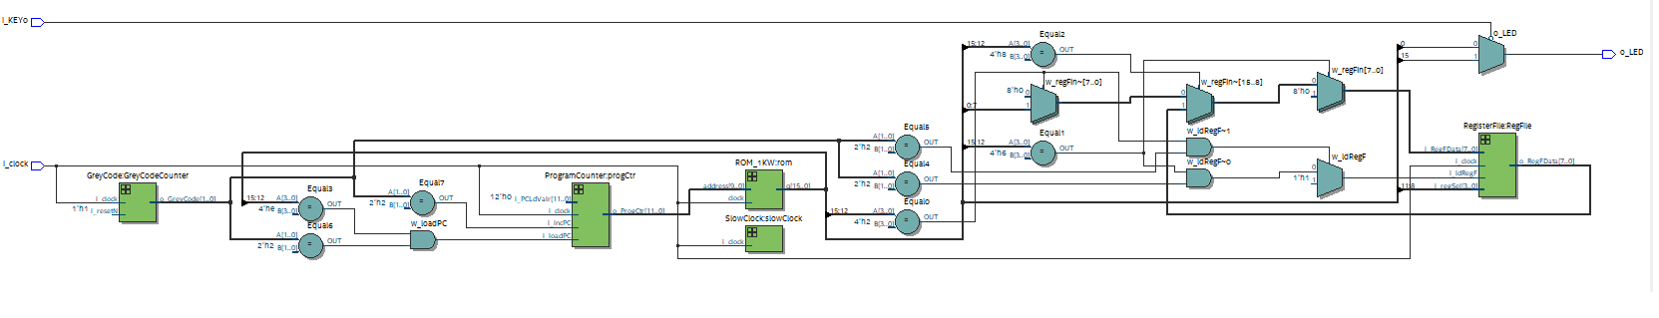
Block Diagram _ RTL Netlist

Slide 15
CPU Performance
Can now calculate CPU performance
50 MHz FPGA clock speed
4 clocks per instruction
12.5 Million Instructions per Sec (MIPS)
Good performance for small CPU
Much faster than TTL computer
  ROM runs at 50 MHz clk > q

Slide 16
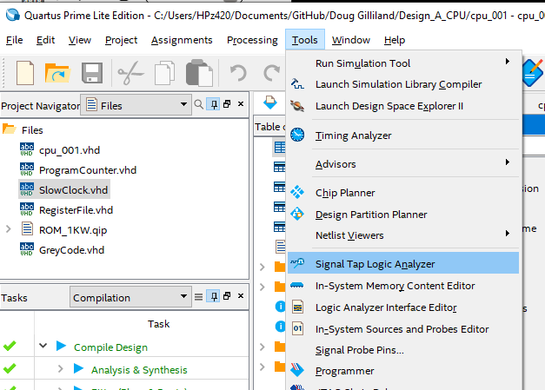
Testing
Lot of untested and under-tested elements
Use Signal Tap Logic Analyzer tool

Slide 17
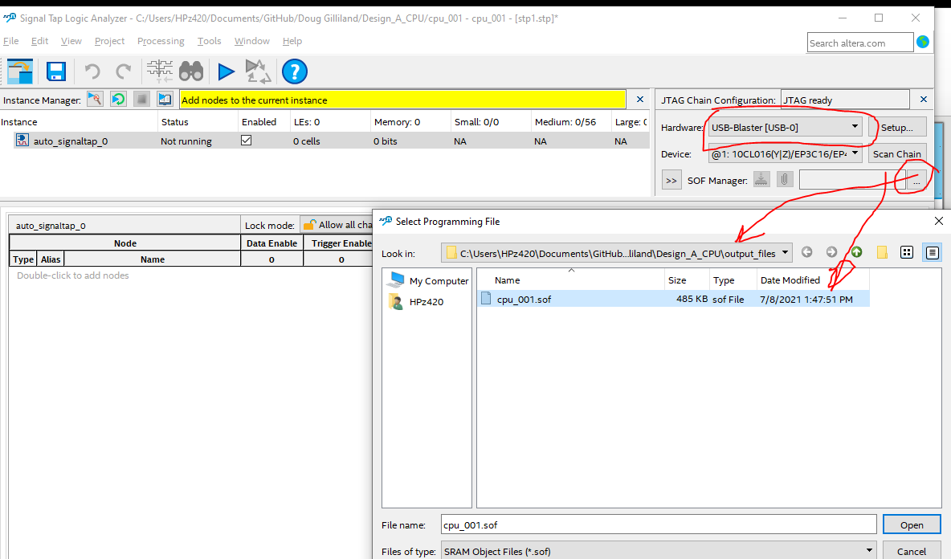
Configure Signal Tap
Hardware: USB Blaster
Select SOF file
(may be in output folder)

Slide 18
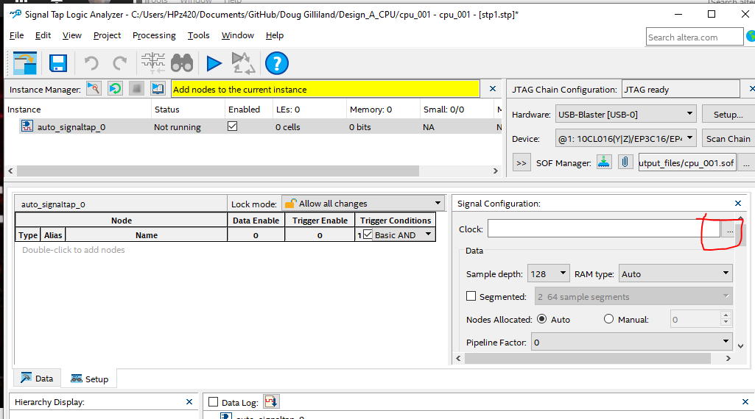
Add Signal Tap Clock
Select … in Signal Configuration
Node Finder will appear

Slide 19
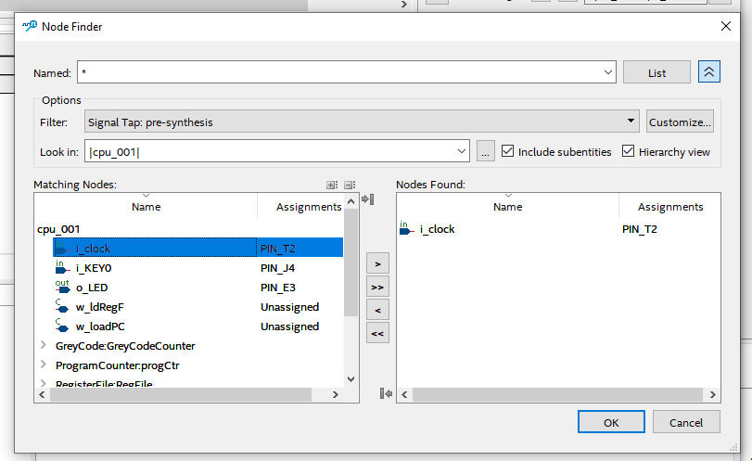
Search for Clock
Filter: Signal Tap: pre-synthesis
Click List
Double Click on i_clock to insert
Copies to right window
OK

Slide 20
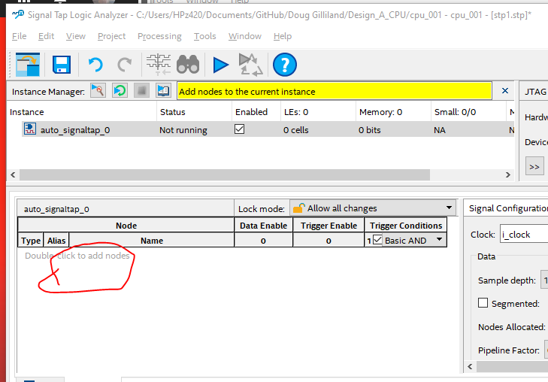
Add Nodes
Double-click to add nodes
List to see nodes

Slide 21
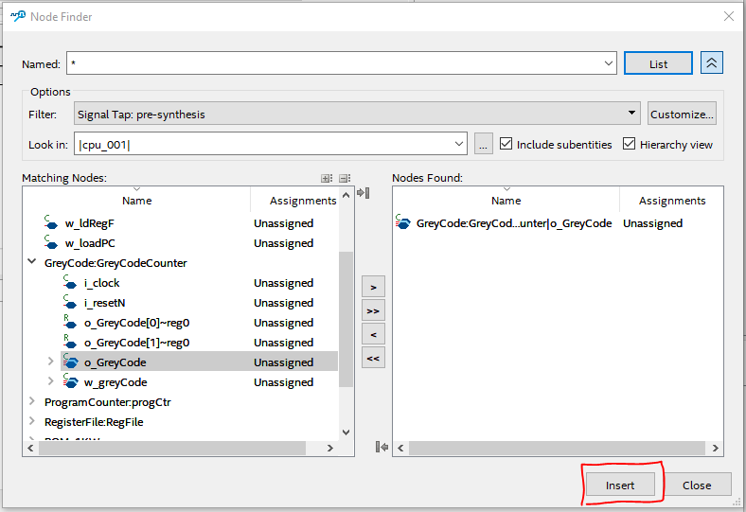
Add nodes to monitor
Double click on nodes to add to list
Click Insert when done then close

Slide 22
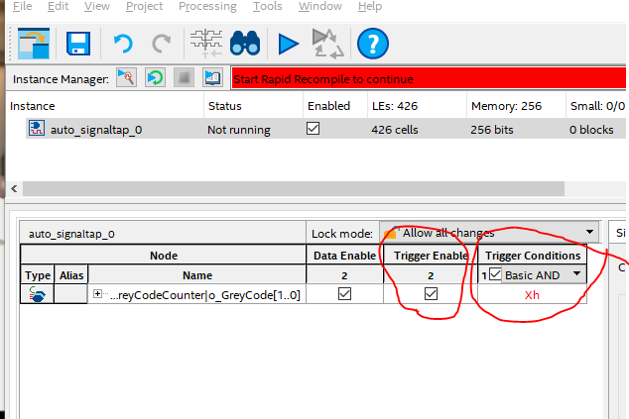
Set trigger Enable / Conditions
Click or unclick Trigger Enable
Set condition (value, edge, level)

Slide 23
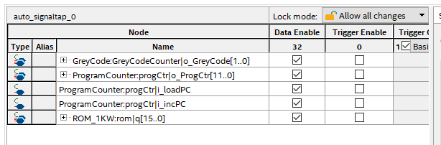
Monitoring Nodes
Nodes being monitored

Slide 24
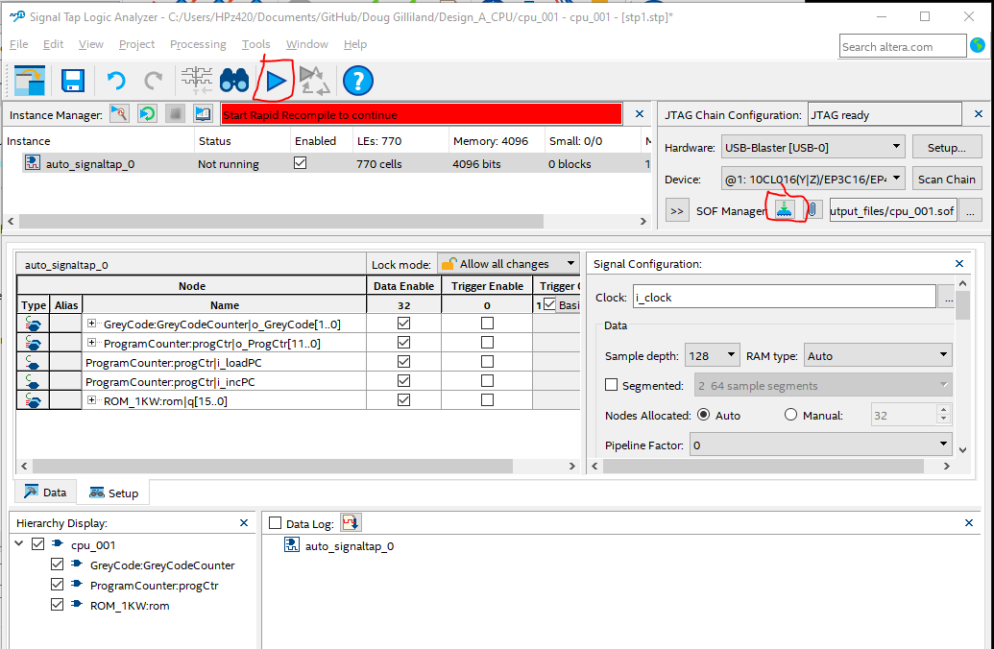
Compile / Download
Compile by clicking right arrow
Download by clicking download button
Save STP file cpu_002_Part8.stp
Yes to enable for project

Slide 25
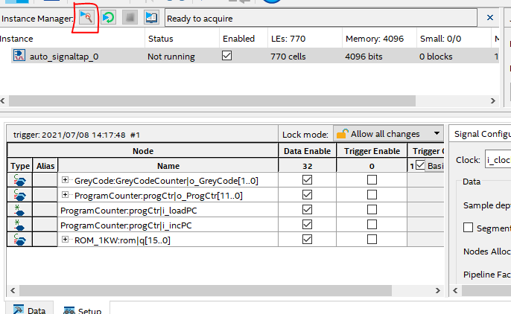
Run and capture
Click little blue arrow

Slide 26
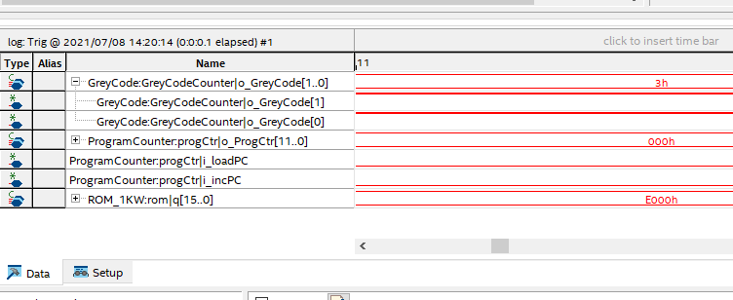
Debugging
PC = 0x000, ROM data = 0xE000 (correct)
Grey code is stuck 0x3

Slide 27
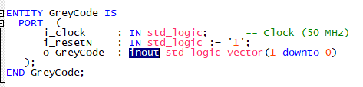

Debug / Fix Grey Code Counter
Fix entity
Fix load values

Slide 28
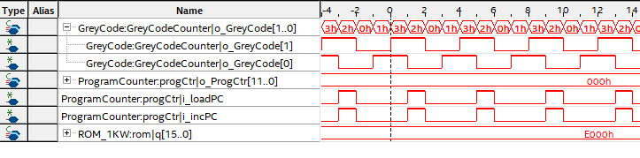
Re-compile / Run Results
Grey code now works
PC works (stays at 0x00)
Load PC working
ROM data 0xE000 correct

Slide 29

New Test Program
Unimplemented Opcode (0x0) has no action on registers, I/O or ALU – coded as NOP in Assembler (Part8_Test1.csv)
Listing file (Part8_Test1.lst)
Load ROM file (Part8_Test1.MIF)

Slide 30
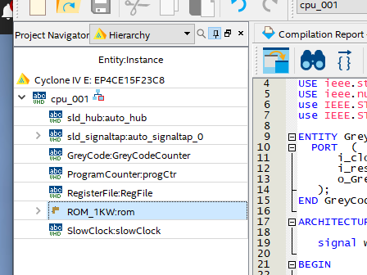
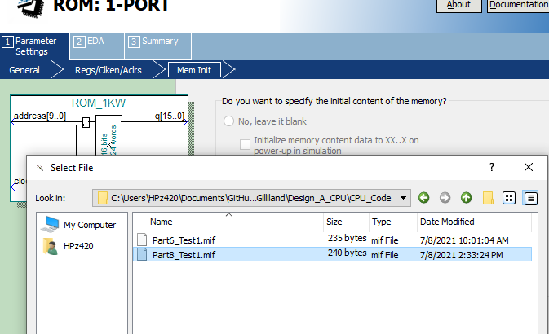
Load New ROM file
In Heirarchy double click on ROM file
Select new MIF file
Compile, download and run

Slide 31
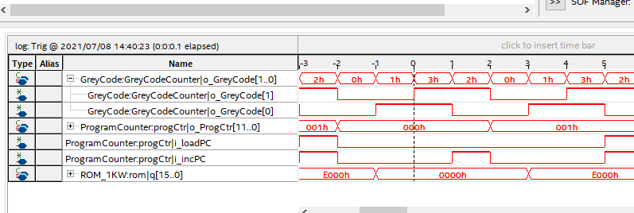
Check Output In SignalTap
Address does count and alternate between 0x000 and 0x001
ROM data alternates between 0x0000 (NOP) and JMP (0xE000)
Load PC when address = 0x001 performs JMP to 0x000
ROM data is one clock after address

Slide 32
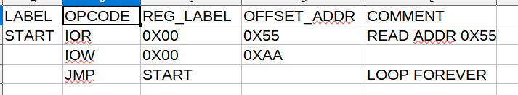
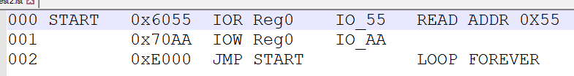
Check Peripheral Unit
IOW, IOR strobes, address, data in/out
New program (Part8_Test2.csv)
List file

Slide 33
Add Peripheral Interface
There are no Peripherals so Quartus optimizes away the bus
Create a simple I/O register for test (PeriphTestReg.vhd)
Write register when address = 0xAA
Read address when address = 0x55
Register return compliment of data that was writte

Slide 34
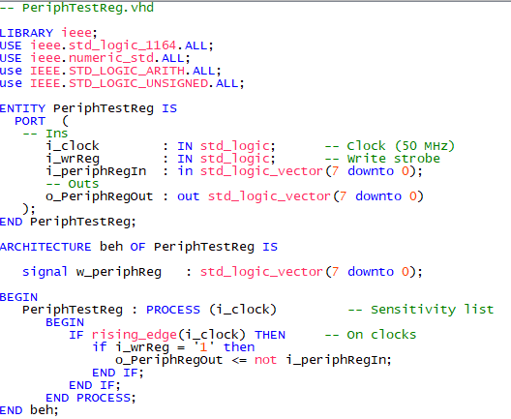
Peripheral Test Code
Code

Slide 35

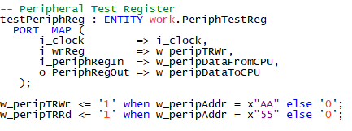

Add Peripheral Test Register to top
Signals
Code

Slide 36
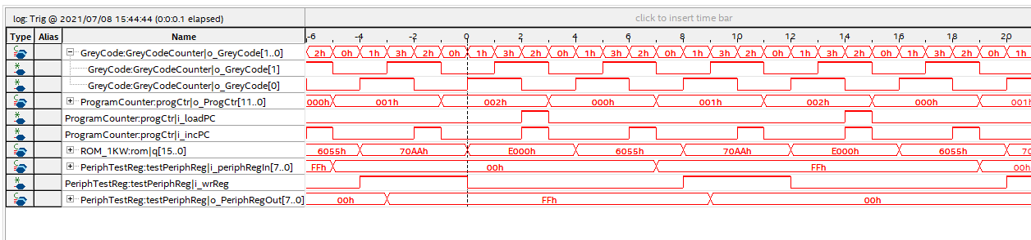
Data Capture IOR, IOW test
Reads 0x00, writes 0xFF
Reads 0xFF, writes 0x00
Peripheral Interface is working

Slide 37
Summary – Opcode / Control / Timing
Tested/working
  Grey code counter tested
  PC counter working
  IOR, IOW with simple peripheral tested
  LRI Register File Read/Write working
Still to do
  No ALU yet
  No Conditional Branching Flow Control

Slide 38
GitHub
Git Hub Repository
  https://github.com/douggilliland/Design_A_CPU/tree/main
Created a branch with progress so far
  https://github.com/douggilliland/Design_A_CPU/tree/cpu_001_Part8_ControlUnit
Top Level entity
  https://github.com/douggilliland/Design_A_CPU/blob/main/cpu_001.vhd

