Slide 1
Design a Computer from Scratch
Part 8 – ALU and Conditional Branch Design

Slide 2
ALU / Branch Control
Refresher - Requirements (from Part 2)
  Used for ARI – AND register immediate
  Two 8-bits in
    One input is immediate value on D7..D0
    Other input is register selected by D11..D8 from Register file
  One 8-bits out plus Z-bit
  Opcode determines the ALU operation
    ARI only instruction so far
    ORI (OR register immediate) could be added easily
    ADI (ADD register plus immediate) could be added easily

Slide 3
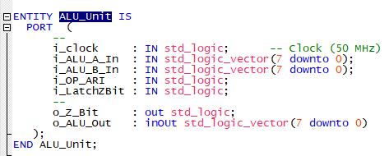
Create VHDL ALU Module
New File: ALU.vhd
Entity Name: ALU_Unit

Slide 4
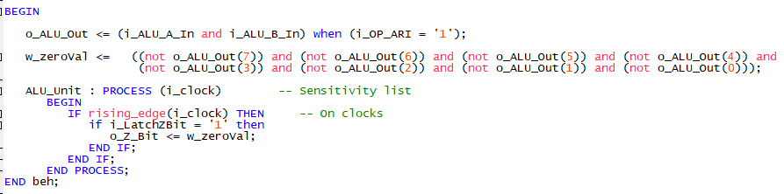
ALU Code
Code

Slide 5
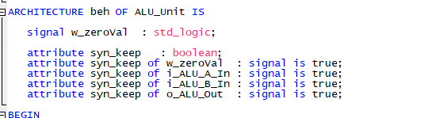
Signals and Test Pins
Signals / Test pins

Slide 6
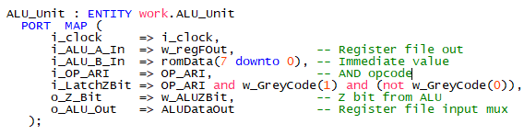

Add entity to top
Entity in top
Comment out

Slide 7
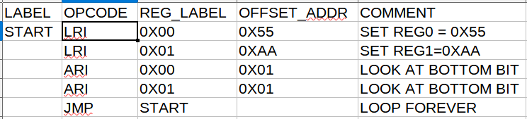
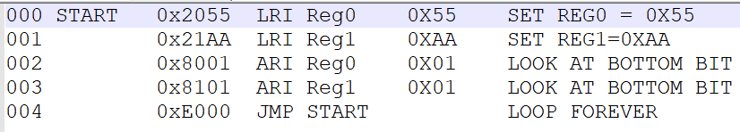
ALU Test Code
File: Part9_Test1.csv
List file:

Slide 8
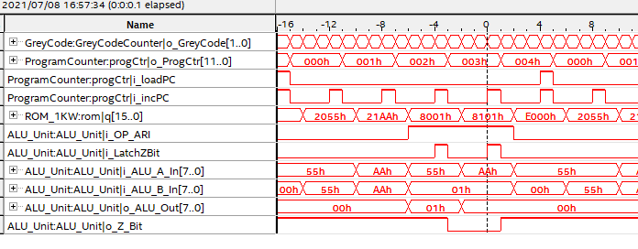
Test Z-Bit Results
Z bit being set properly

Slide 9
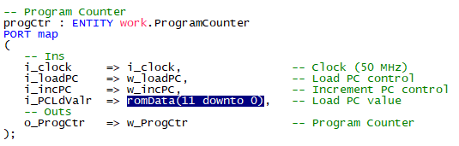
Add branch control and test
Add load PC control for BEZ and BNZ
Set branch address (absolute)

Slide 10
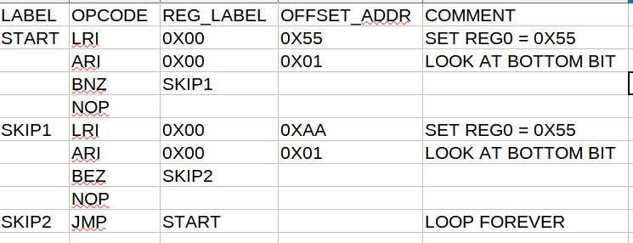
Test Code
Code:
(Part9_Test2.csv)

Slide 11
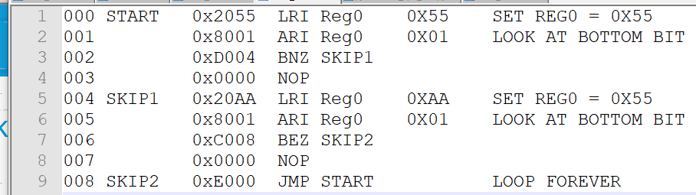
Test Code (lst file)
Should skip 0x003, 0x007 – Takes both branches
Tests BNZ, BEZ

Slide 12
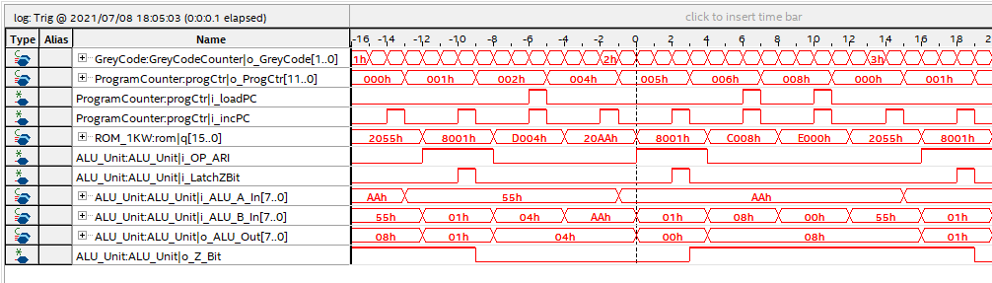
Results
Skips 0x003, 0x007 (like it should

Slide 13
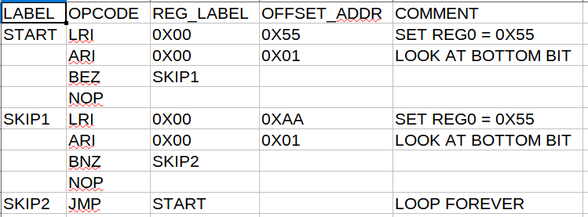
Test Not Taking Branches
Reverse code
(Part9_Test3.csv)

Slide 14
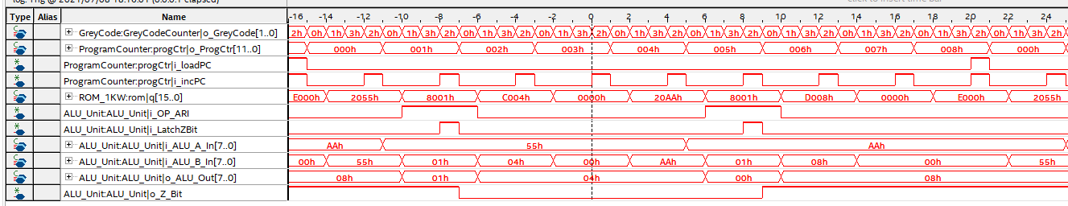
Test Not Taking Branches
Branches not taken - Working

Slide 15
Summary – ALU / Branch Control
Tested/working
  Zero Flag working
  ARI – Working
  BNZ – Working
  BEZ – Working
  Some registers tested, only 4 implemented
This is all of the design objectives accomplished

Slide 16
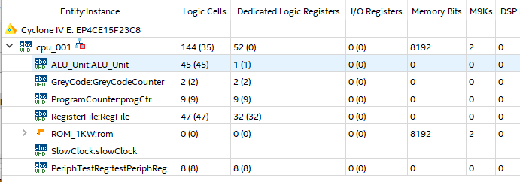
Resources
Reduced the ROM size to 512 Words
CPU only uses 144 logic cells and 2 Memory Blocks

Slide 17
Additional Features
Add subroutine support instructions
  Branch To Subroutine (BSR) and Return from Subroutine (RTS)
  Allow code re-use and saves code space
  Will require a stack to store addresses
Add ORI instruction
  Some applications could use it
Implement all of first 8 registers in register file

Slide 18
GitHub
Git Hub Repository
  https://github.com/douggilliland/Design_A_CPU
Created a branch with progress so far
  https://github.com/douggilliland/Design_A_CPU/tree/cpu_001_Part9_Condit_Branches
Top Level entity
  https://github.com/douggilliland/Design_A_CPU/blob/main/cpu_001.vhd

