Slide 1
Design a Computer from Scratch
Part 9 – Shifting (Logical and Arithmetic)

Slide 2
So far...
B3 video
  Created a shift / rotate instruction
    Had some documentation errors
  Only did logical shifts
This video will
  Add Arithmetic Shifts
  Rename the mnemonics for consistency
  Add two new Instructions – ADI (Add Immediate to register) and CMP (compare register to immediate value)

Slide 3
Add New Instructions
Add Arithmetic Shifts
  Rename the mnemonics for consistency
ADI - Add Immediate to register
CMP - Compare register to immediate value
  Add psuedo-mnemonics
    BEQ Branch if EQual (same opcode bits as BEZ)
    BNE Branch if Not Equal (same opcode bits as BNX)

Slide 4
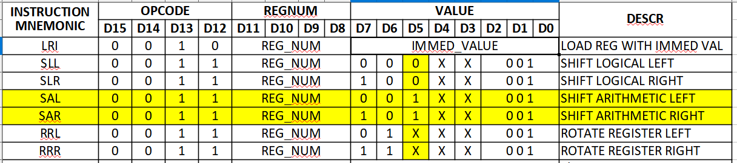
Shift/Rotate Instruction Changes
D7 - 0=Left, 1=Right
D6 – 0=Shift, 1=Rotate
D5 – 0=Logical, 1=Arithmetic (Shifts only)
D2-D0 = Shift Count (Only 0x01 currently)

Slide 5
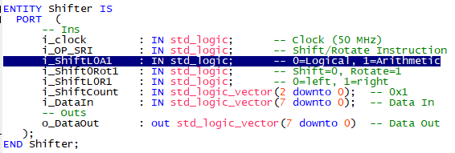
Updated Shifter.vhdl Entity
Added Logical/Arithmetic flag

Slide 6
Shifter Code

Slide 7
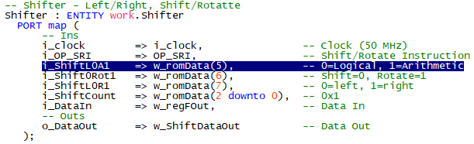
Add Logical/Arith Flag to cpu_001.vhd

Slide 8
Test Code (Part_9_Test1.csv)
Uses the Land Boards LEDS-SWITCHES Card
Reads switches to determine which of the Shift/Rotate instructions to run
Shifts/Rotates a single bit through a register and sends it out to LEDs
Also tests new ADI (Add instruction)

Slide 9
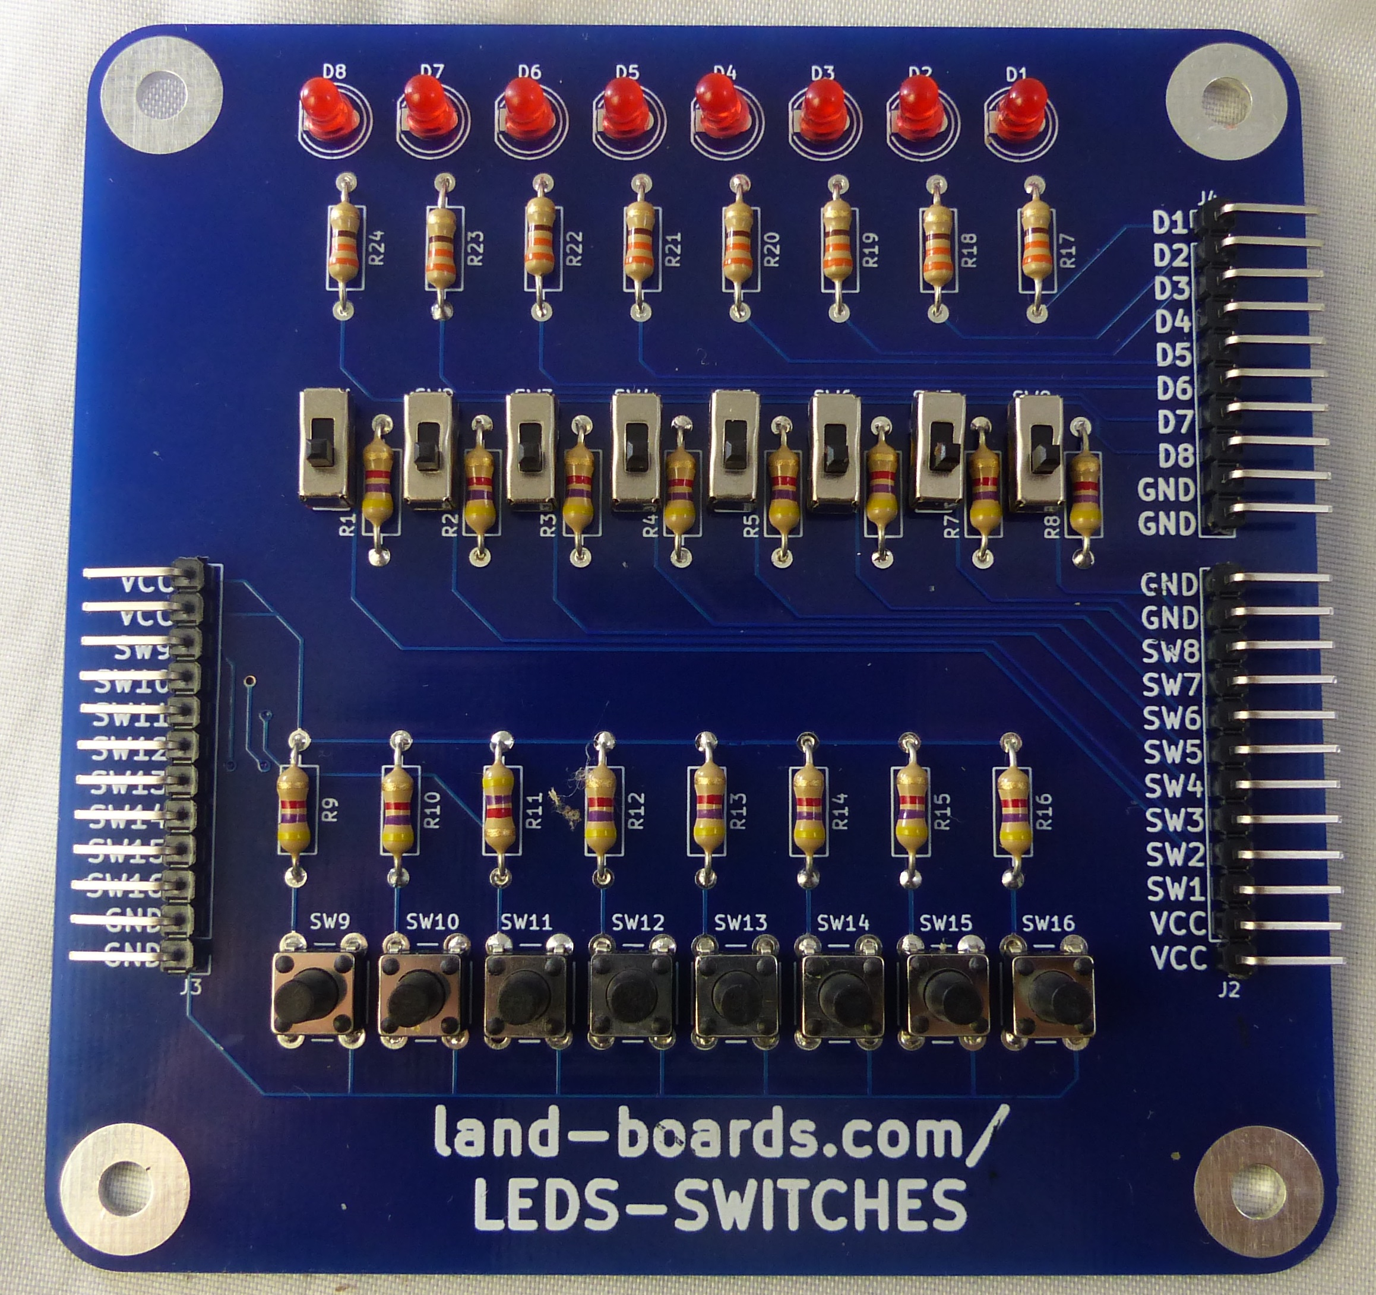
Use Switches to Control Operation
Use slide switches on LEDS-SWITCHES card to set the Operation
  SW1 = Test SLL
  SW2 = Test SLR
  SW3 = Test SAL
  SW4 = Test SAR
  SW5 = Test RRL
  SW6 = Test RRR
  SW7 = Test ADI
  SW8 = Test XRI/CMP

Slide 10
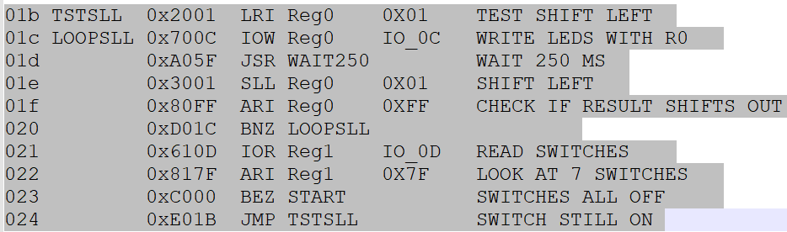
SLL Test Code

Slide 11
SLL Test Video
Insert video

Slide 12
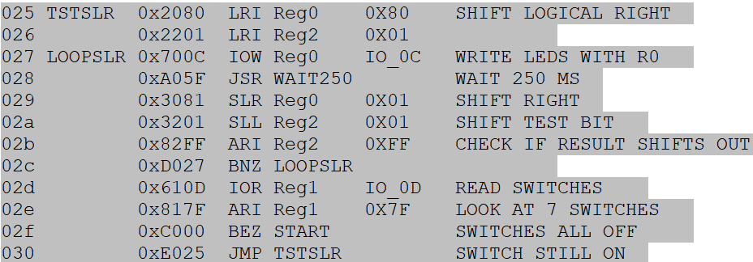
SLR Test Code

Slide 13
SLR Test Video
Insert video

Slide 14
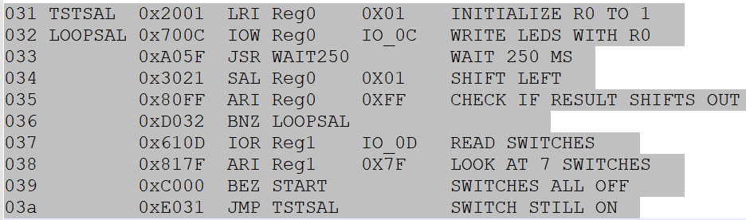
Test SAL Code

Slide 15
Test SAL Video
Insert video

Slide 16
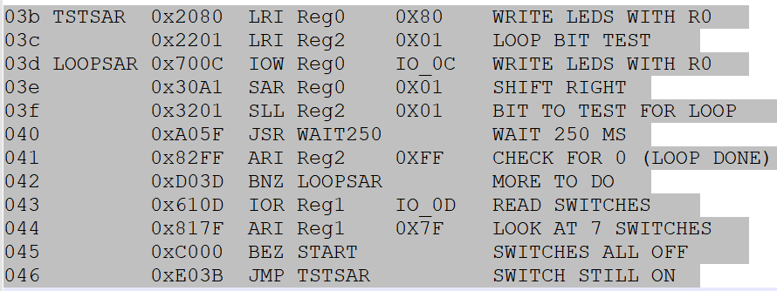
Test SAR Code

Slide 17
Test SAR Video
Insert video

Slide 18
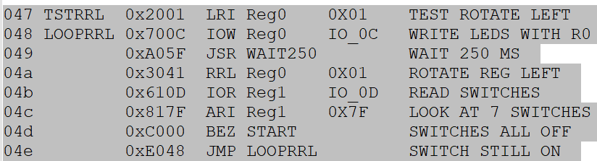
Test RRL Code

Slide 19
Test RRL Video

Slide 20
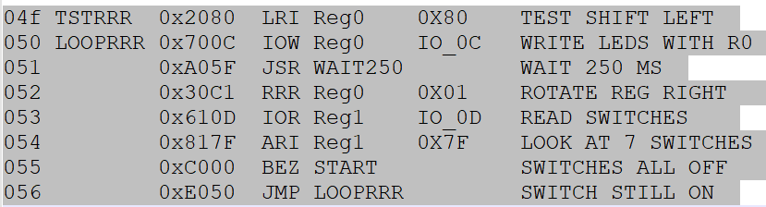
Test RRR Code

Slide 21
Test RRR Video
Insert video

Slide 22
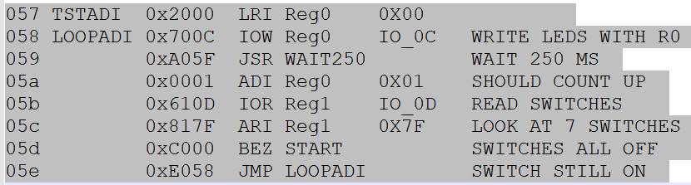
Test ADI (ADD) Code

Slide 23
Test ADI (ADD) Video
Insert video

Slide 24
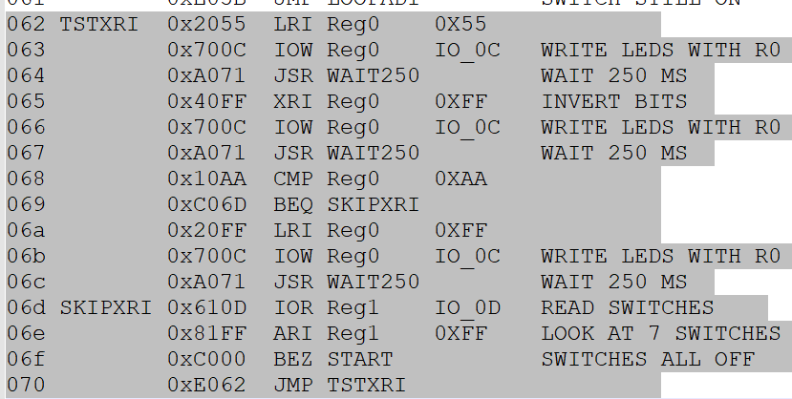
Test XRI and CMP Code

Slide 25
Test XRI and CMP Video
Insert Video

Slide 26
Summary
Added/tested Arithmetic Shift Instructions
Added XRI Instruction
Added CMP instruction

Slide 27
GitHub
Git Hub Repository
  https://github.com/douggilliland/Design_A_CPU
Created a branch with progress so far
  https://github.com/douggilliland/Design_A_CPU/tree/cpu_001_Part9_1_Sh/Rot/EOR/CMP
Top Level entity
  https://github.com/douggilliland/Design_A_CPU/blob/main/CPU_top.vhd

