Slide 1
Design a Computer from Scratch
Appendix A3 – Assembler Improvements

Slide 2
Goals
Make Assembler independent of external dependencies
  Currently requires some common Python code from another GitHub
  Need to fix this so others can run it
Add some psuedo Instruction
  Allows expansion of the Instruction set without adding new opcodes

Slide 3
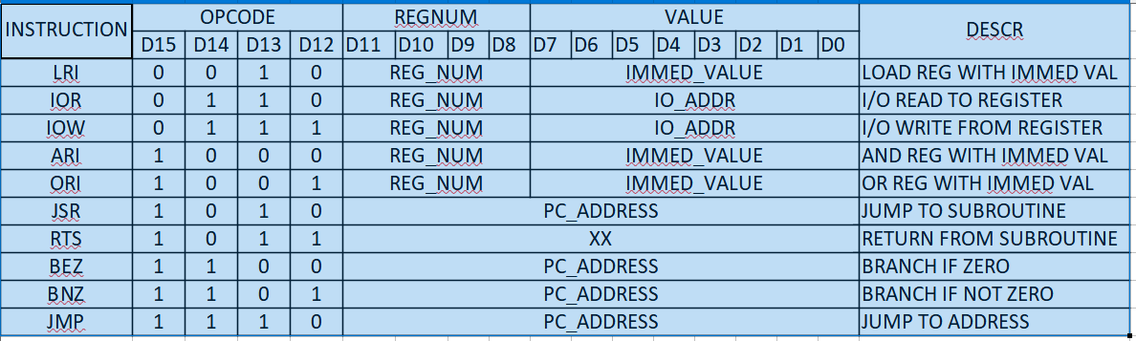
Instruction Set
Currently using 10 opcodes
  Leaving 6 free opcode values for future expansion of the instructions

Slide 4
Add Psuedo NOP
NOP currently works by using an unimplemented instruction
  Currently done by the assembler which codes NOP as 0x0
  This essentially ties up one of the Opcodes leaving only 5 free opcodes
It would be nice to free the NOP opcode

Slide 5
Free the Opcode - Add Psuedo NOP
Code NOP as an instruction which has no effect, ie, “safe”
  Example: ORI Reg8, 0x00
  “Doubly safe” since Reg8 is constant = 0x00 and OR of 0x00 would not change the register even if it could
Do this in the Assembler
  Allow source to have NOP
  Code as: ORI Reg8, 0x00
  Still show NOP in the listing file

Slide 6
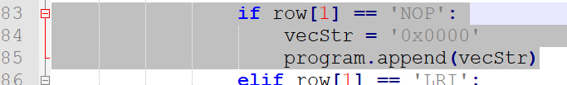
Encoding in the assembler
Current encoding code (Python)
Replace with

Slide 7
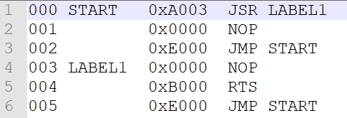
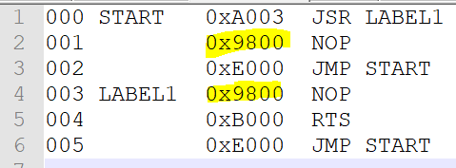
List file effects
List file (before Assembler change)
List file (after Assembler change)

Slide 8
Doing More in the Assembler...
Created a Psuedo-NOP instruction
  Interpreted by the Assembler as a “safe” (no effect) instruction
Some other things can be done by the Assembler
  Could code other frequently done instructions in the Assembler
Add “Halt” instruction
  Allow for multiple HLT instructions so need unique Labels
    Use address as part of the label

Slide 9
Implementing HLT
HaLT is a jump to self
Implemented as
  HALT JMP HALT
Internally reserve the label H_x
  X is the address
Use Psuedo Opcode HLT
Done in the Assembler

Slide 10


Halt as Implemented
Assembly code
List file
Implemented as JMP to self

Slide 11
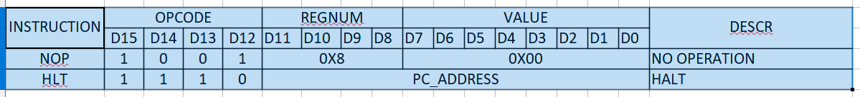
Psuedo Operations
List of Psuedo Opcodes

Slide 12


Fix Assembler External Dependencies
The Assembler has external dependencies
Resolve external dependencies by adding the imported files into the folder
Remove sys.path.append(…) from the Assembler

Slide 13
Summary
Resolved external dependencies
  Now Assembler can be run without hunting down the externals in GitHub
  Independent code so others can run it
Added two Psuedo-Ops
  NOP
  HLT
  Set pattern for implementing other Psuedo-Ops in the assembler
None of these affected the cpu_001 VHDL code

Slide 14
GitHub
Git Hub Repository
  https://github.com/douggilliland/Design_A_CPU
Created a branch with progress so far
  https://github.com/douggilliland/Design_A_CPU/tree/cpu_001_App3
Top Level entity
  https://github.com/douggilliland/Design_A_CPU/blob/main/cpu_001.vhd

