Slide 1
Design a Computer from Scratch
Appendix B1 – Board Specific Pt 1

Slide 2
So far...
Created a CPU
Could be used on any Altera/Intel FPGA card
  Only uses LED, pushbutton which is on pretty much any FPGA card

Slide 3
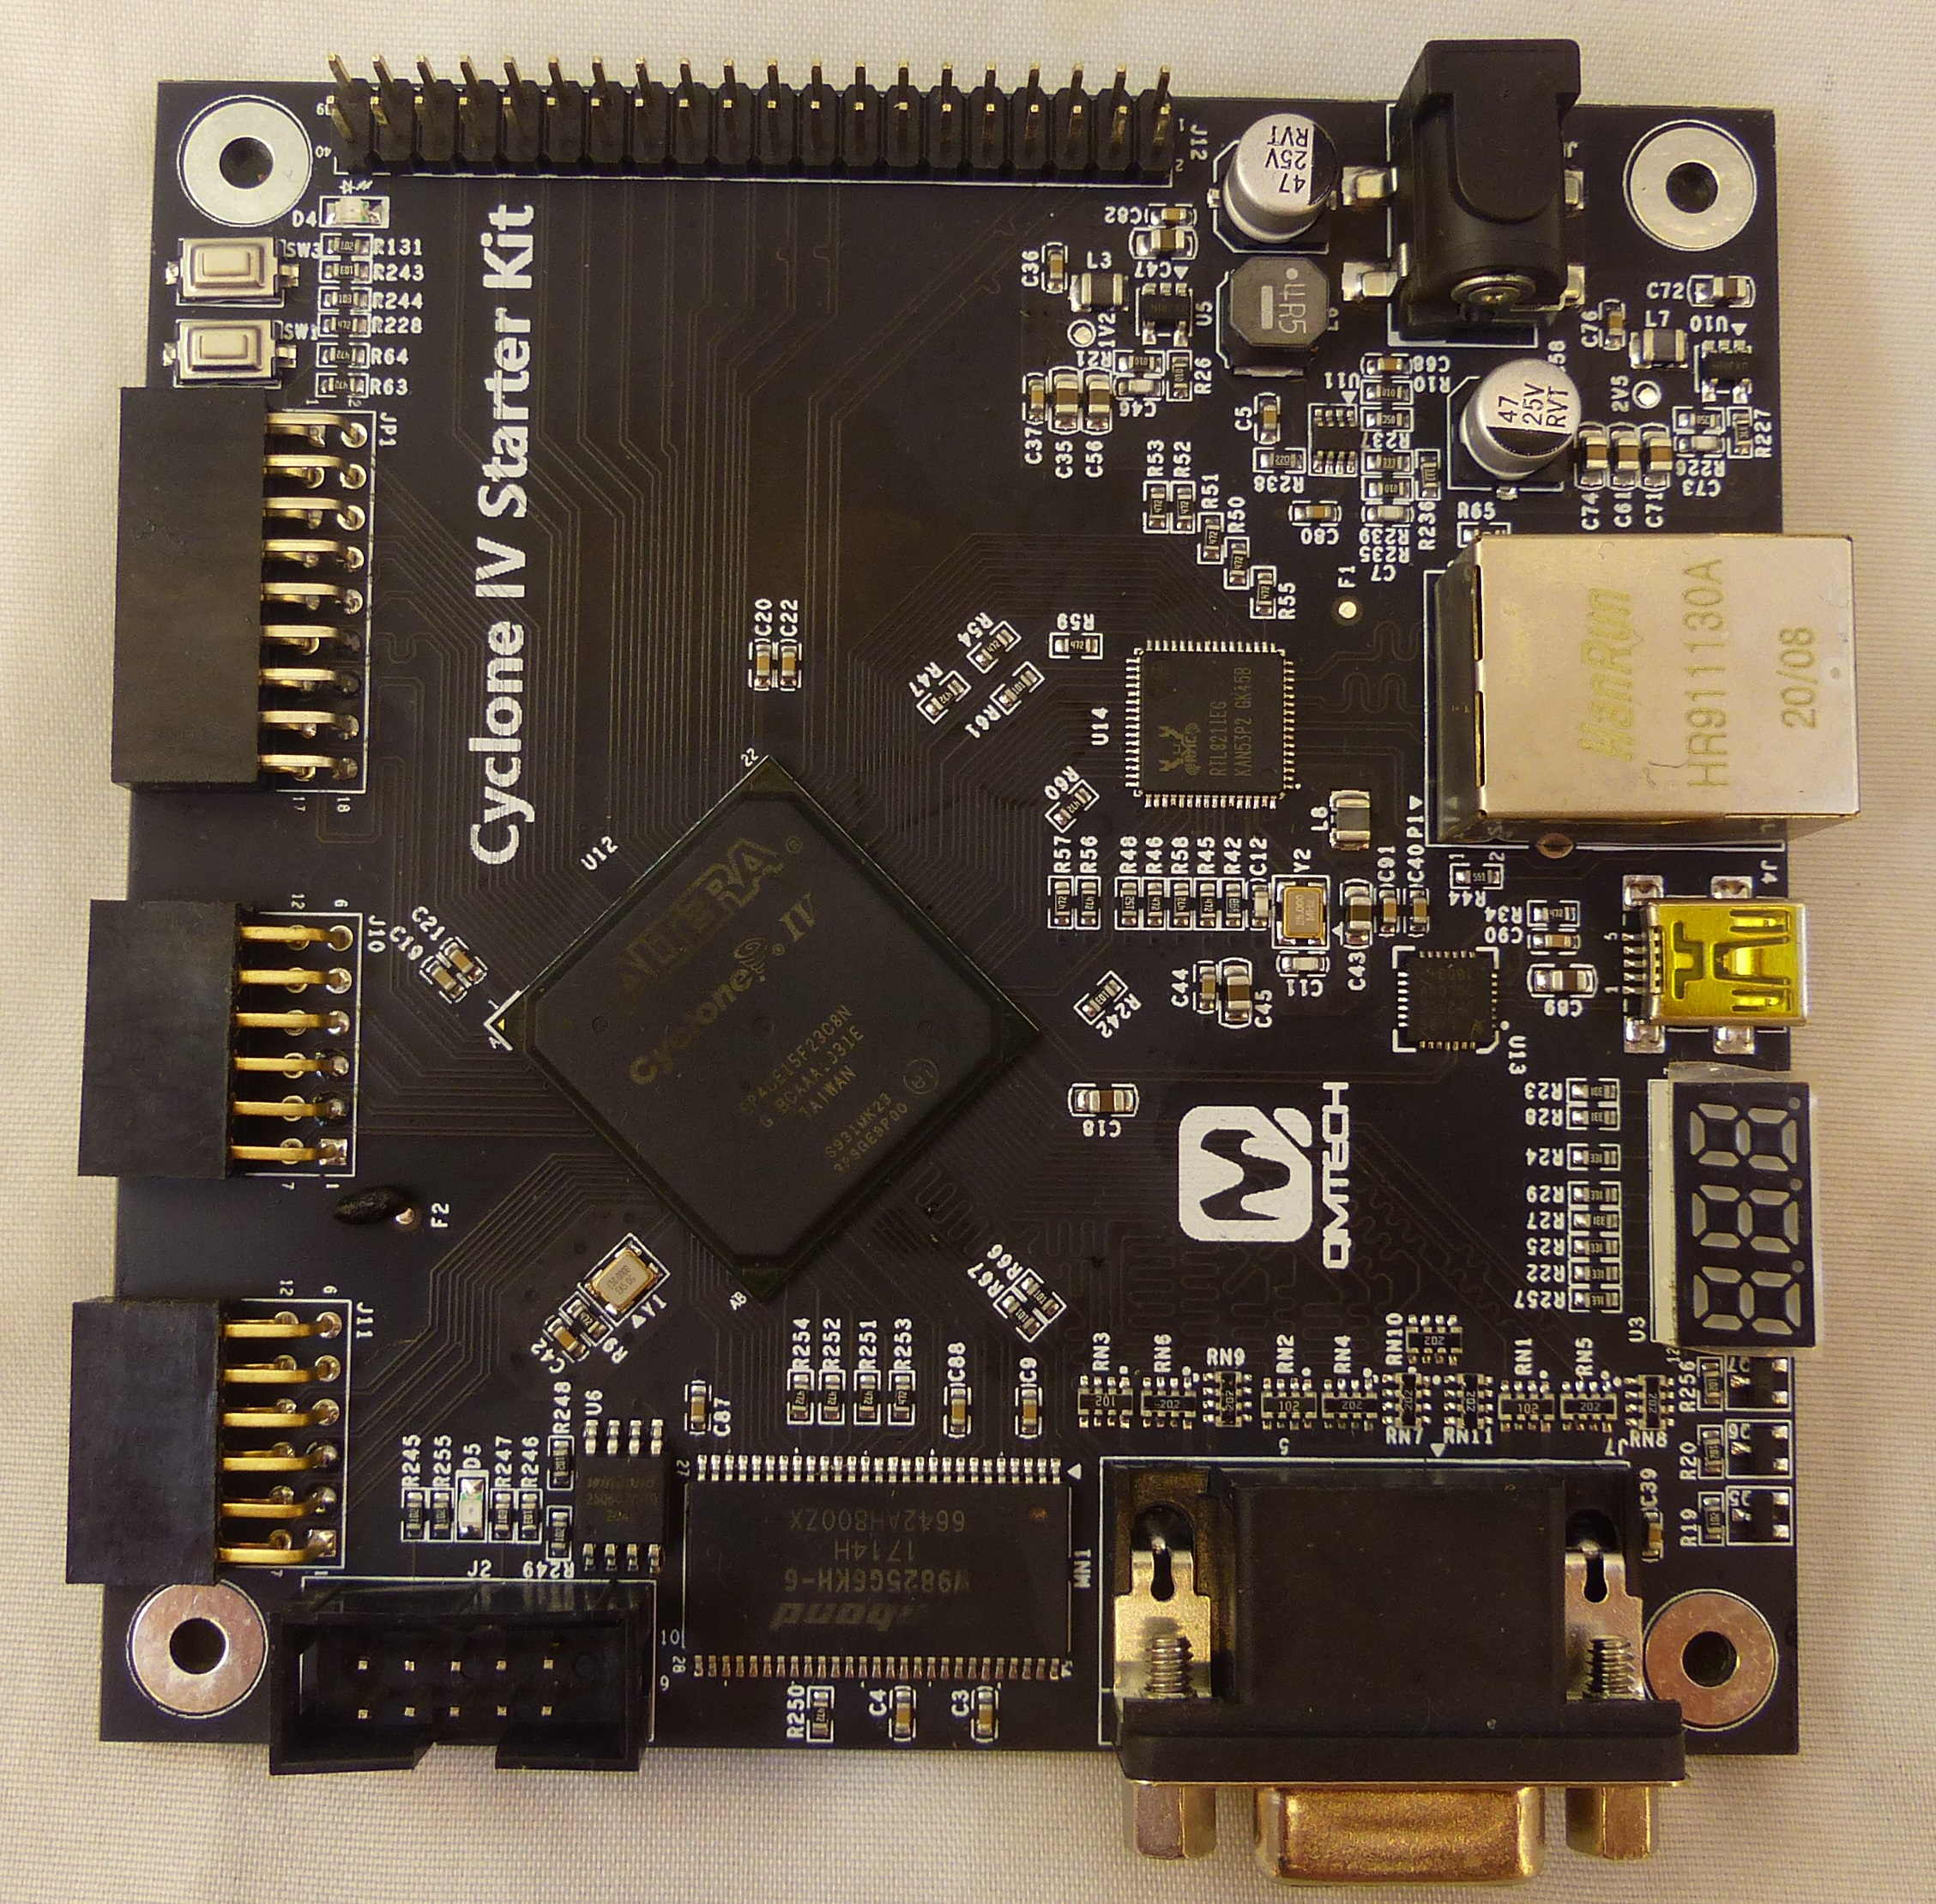
QMTECH Card Specific Functions
Lot of functions on the card
Not using some of them
Might use some of them

Slide 4
Taking Care of Unused Function Pins
Tie off unused functions to known voltages
  Probably OK as-is
    So far no puddles of solder
  Better to deliberately make the devices/ports inactive
    SDRAM
    Ethernet
  Locks down pins

Slide 5
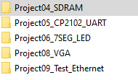
Refer to QMTECH Documentation
Need pin numbers - refer to
  Code Examples (easiest way)
  Schematics (more work but doable)
  Resort to datasheets
Code Examples

Slide 6
First set IO Voltage to 3.3-V LVTTL
If you don’t do this, Quartus will set the voltage to 2.5V
  And you will have to fix this in the Pin planner – a lot of clicking….
Close project (maybe important)
In cpu_001.qsf, paste (near other similar statements):
I/O voltages will now default to 3.3V

Slide 7
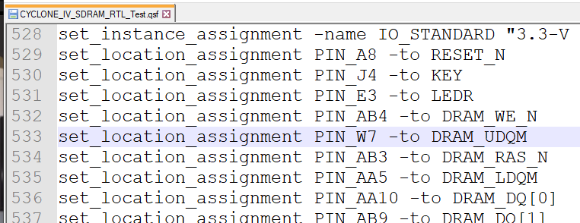
SDRAM
Pin lists can be found in the .qsf file – save a lot of typing/errors
Ex: SDRAM example qsf file has:

Slide 8
Add to cpu_001 entity
Pattern – Quartus says “Don’t do this” – but I do it
  Add the signals to the CPU entity with default values
  Close Project
  Add pins to cpu_001.qsf file
  Compile
Can we create a Board Support package?
  Could use with all designs using this card

Slide 9
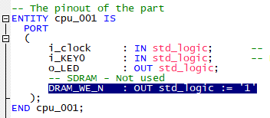
Example: SDRAM Pin DRAM_WE_N
Add pin to cpu_001.vhd
Close Project (important?)
Edit cpu_001.qsf to add
Save cpu_001.qsf

Slide 10

Add DRAM_WE_N
Open cpu_001 project
Compile
View Pin Planner – see that pin was added as assigned
Make sure to close project when adding pin(s) (follow this sequence otherwise it may not work)

Slide 11
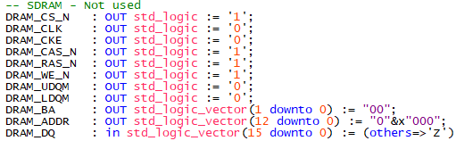
Rinse and Repeat
Can do all SDRAM pins this way – the defaults I used
Might seem painful but much easier than clicking each pin in Pin Planner and scrolling through list to select the pin

Slide 12
Tie Off Ethernet Pins
Not using the Ethernet Interface, so tie off pins
Ethernet example in QMTECH files
Look at ethernet.v to tell directions of pins
Could also pull up datasheet for the Ethernet controller

Slide 13
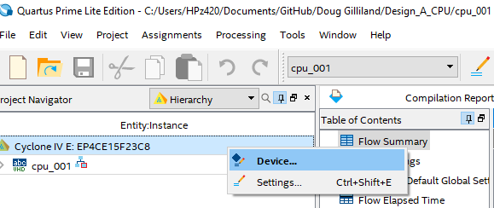
Fixing a common Quartus Problem (1/4)
When I tried to assign the Ethernet pins I got an error message
  Common error
Solution : Right click and select Device

Slide 14
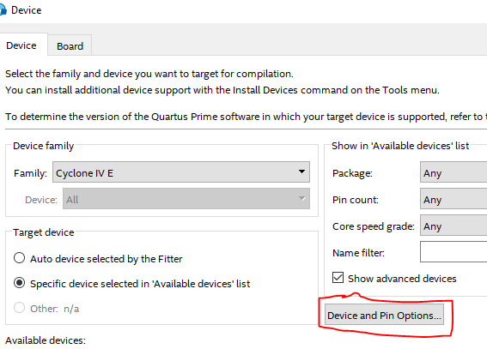
Fixing multiple pin assignments (2/4)
Select Device and Pin Options

Slide 15
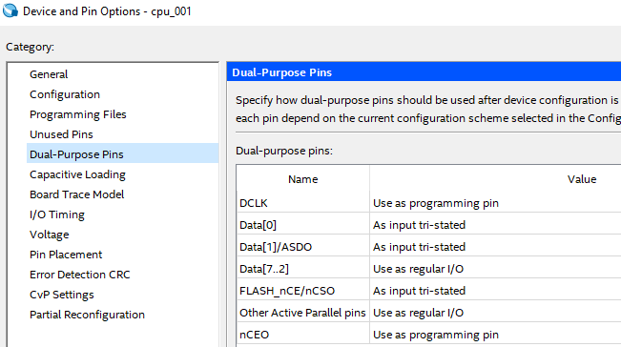
Fixing multiple pin assignments (3/4)
Select Dual-Purpose Pins

Slide 16
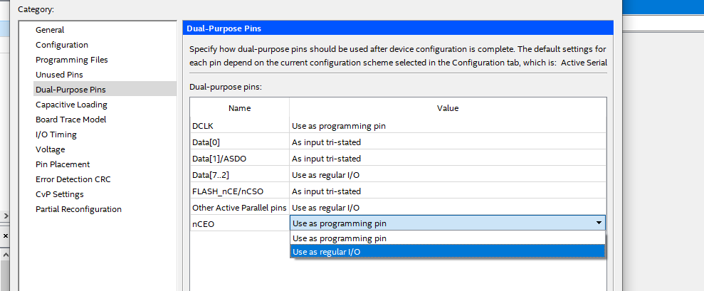
Fixing multiple pin assignments (4/4)
Change to Use as regular I/O

Slide 17
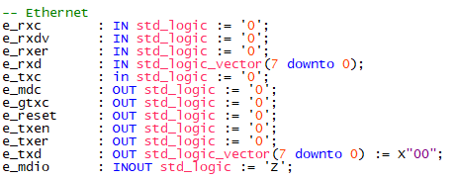
Ethernet Defaults
I set these defaults
Some defaults are probably wrong
Need to look at Datasheet

Slide 18
Ethernet Chip RTL8211EG Datasheet
http://files.pine64.org/doc/datasheet/pine64/rtl8211e(g)-vb(vl)-cg_datasheet_1.6.pdf
Reset (e_reset) is active low – set to low

Slide 19
Summary
Tied off unused function pins on the card to known values
Next up: Add pins for functions we want to use

Slide 20
GitHub
Git Hub Repository
  https://github.com/douggilliland/Design_A_CPU
Created a branch with progress so far
  https://github.com/douggilliland/Design_A_CPU/tree/cpu_001_App3
Top Level entity
  https://github.com/douggilliland/Design_A_CPU/blob/main/cpu_001.vhd

