Slide 1
Design a Computer from Scratch
Part 11 – Instruction Set Changes

Slide 2
So far...
Part 10 video ...
  Added register-to-register transfer function to peripherals
  Added reset key
  Added optional nested subroutine LIFO
  Added Memory Size options

Slide 3
In This Video...
Take a look at the Instruction set
  Can we free up any Opcode encodes
    Only have 2 free opcodes
  Reorder instructions?
Warning
  Any code will need to be recompiled if we do any changes and the changes won’t be backwards compatible with previous VHDL code

Slide 4
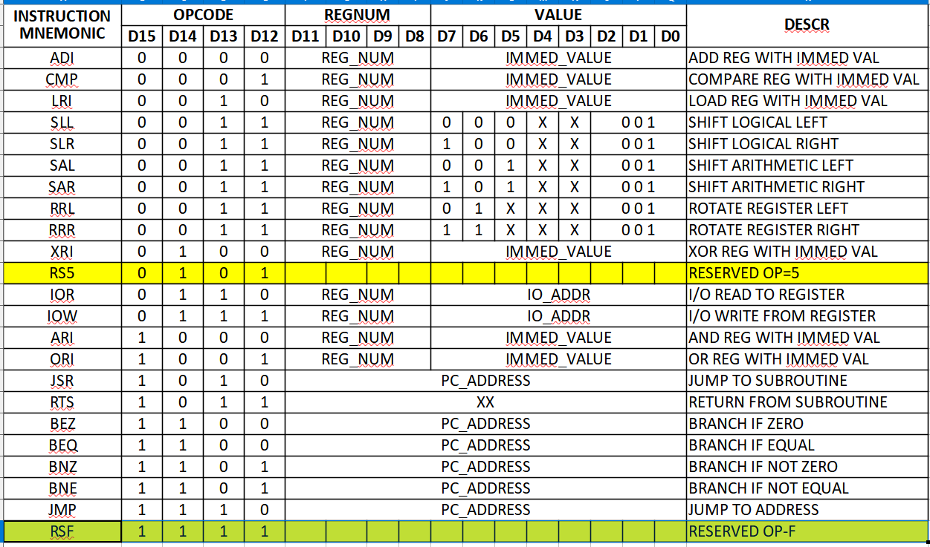
Two unused Opcode Values

Slide 5
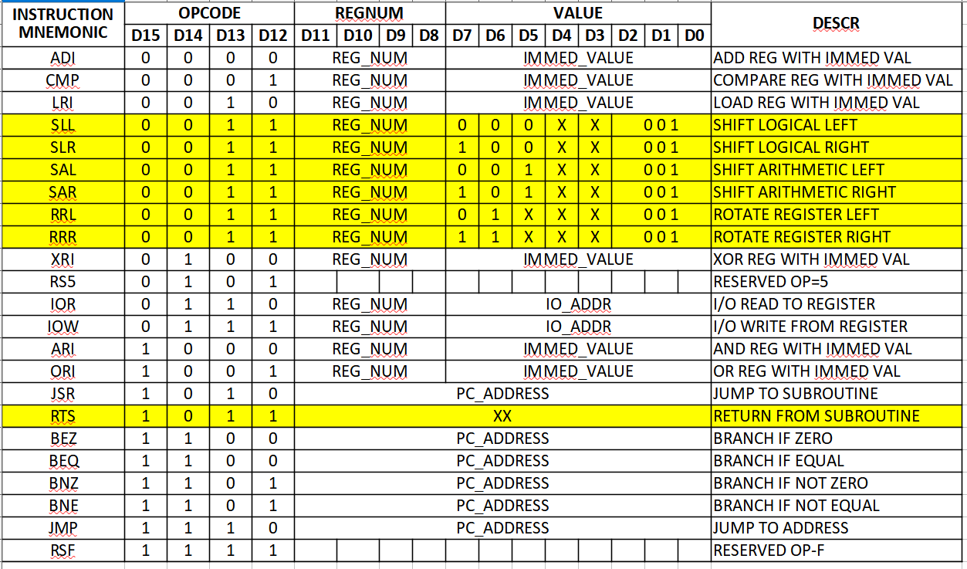
Free Up an Opcode
How?
RTS only uses the 4 opcode bits
S/Rxx has undefined (X) bits
Constrain S/Rxx

Slide 6
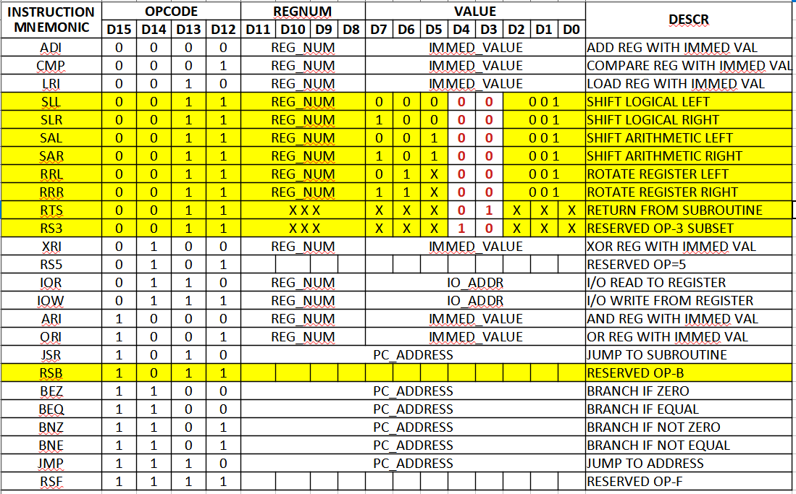
Changes to Free One Opcode
OP B = Reserved
RTS, OP 3,
d3 = 1
S/Rxx OP 3,
d3 = 0
Reserve more d4=1 for new opcodes

Slide 7
Re-Order Instruction
Since we’ve already broken the opcode encoding, what else can we break?
  Hoping to make things better in the end
ALU operations are scattered all over the place
  Move them to be adjacent in encoding

Slide 8
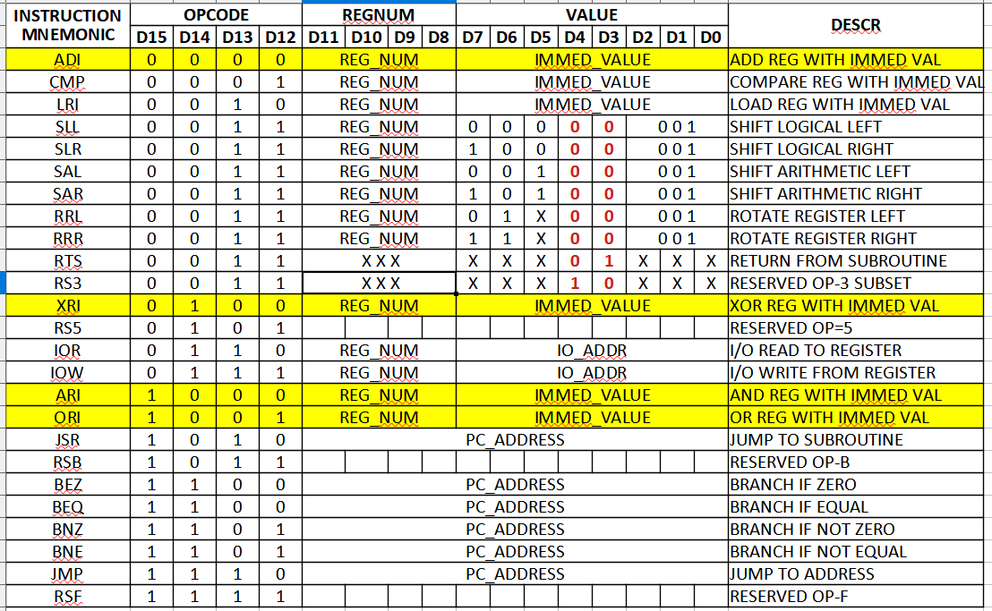
Before ALU encoding re-ordering
ALU operations are in three different places
Move to be adjacent + power of 2 block
Will reduce decoding logic

Slide 9
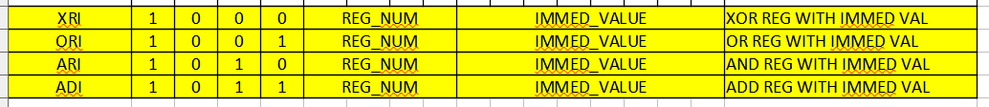
Put ALU next to each other 0x8-0xb
New encoding will be

Slide 10
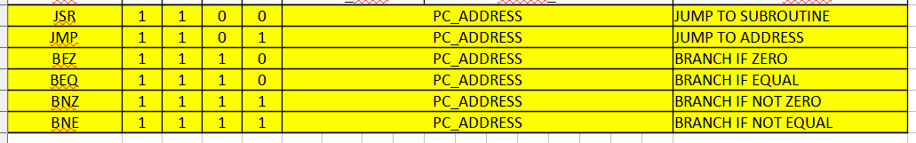
Put branch/jumps next to each other 0xc-0xf
JSR, JMP. Bxx encoding will be
Leave IOR/IOW opcodes at 0x6, 0x7

Slide 11
Move LRI/CMP to 0x4, 0x5
Put LRI/CMP at
Very similar fields
Will also reduce decoding

Slide 12
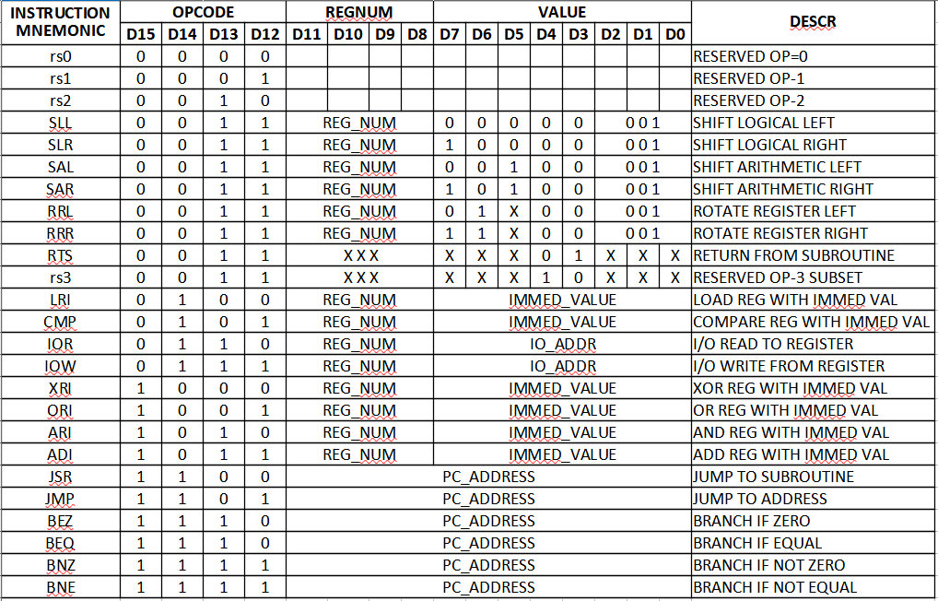
Opcodes after Shuffling
Much cleaner
Similar things are grouped next to each other

Slide 13
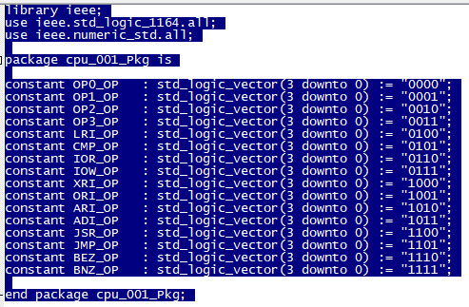
Made Opcode Package File
Single place with [most of the] opcode fields
File: cpu_001_Pkg.vhd

Slide 14
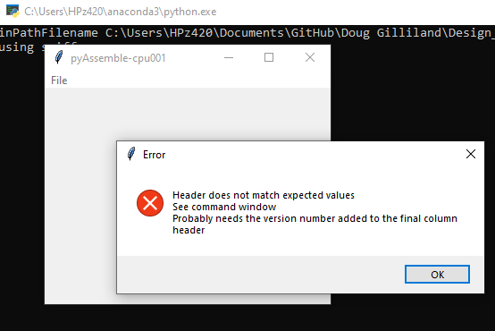
Update Assembler
Detect in the Assembler if the code is for the old Assembler version
  Add version number column to header
  Assembler can see the change and toss up an info box with warning

Slide 15
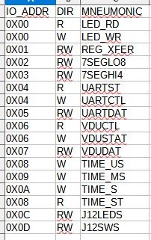
Add I/O Memory Map
If there’s a file with sourceName_MMAP.csv, then read the file and use as an I/O Memory Map for .lst file
  Use is optional
  Tightly constrained header name
If there is no MMAP.csv file the Assembler
will still print IO_XX as the address
See Part9-1_Test1_MMAP.csv for example
Easier to read code in .lst file

Slide 16
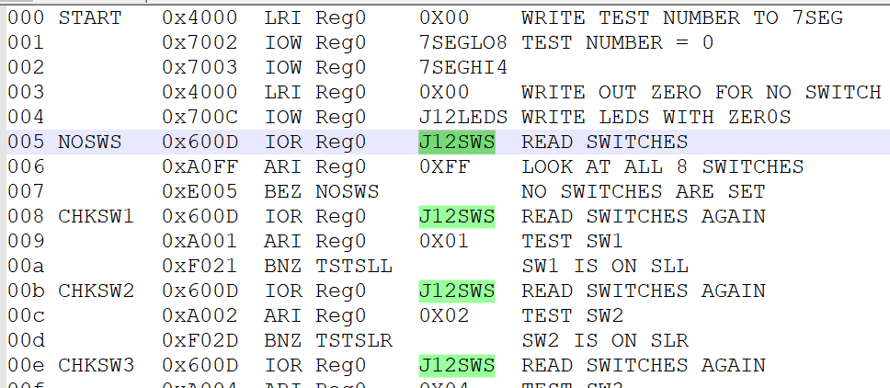
Example I/O Memory Map in .lst File

Slide 17
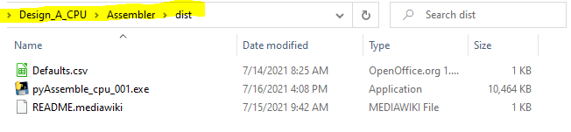
Made Assembler .exe file
Large .exe, but does not require Python 3
Located in Design_A_CPU\Assembler\dist

Slide 18
Summary
Refactored the Instruction Set
  Broke previous code
    GitHub branches will still do what they did
    Assembler will match the VHDL if they are both from the same GitHub release or branch
    Mixing the new Assembler with old VHDL code will not work
    Running previously compiled code won’t run on the new VHDL
  Much more “regular” instruction set
  Created new reserved (for future expansion) instructions
Added I/O Memory Map capability
Made exe Assembler

Slide 19
GitHub
Git Hub Repository
  https://github.com/douggilliland/Design_A_CPU
Created a branch with progress so far
  https://github.com/douggilliland/Design_A_CPU/tree/CPU_top_Part11
  Also made a v3.0 release
Top Level entity
  https://github.com/douggilliland/Design_A_CPU/blob/main/CPU_top.vhd

