Slide 1
Design a Computer from Scratch
Appendix B1 – Board Specific Pt 1

Slide 2
So far
Created a CPU
Could be used on any Altera/Intel FPGA card
  Only uses LED, pushbutton which is on pretty much any FPGA card

Slide 3
Taking Care of other Parts
Tie off unused functions to known voltages
  Probably OK as-is
  Better to deliberately make the devices/ports inactive
    SDRAM
    VGA
    Ethernet

Slide 4
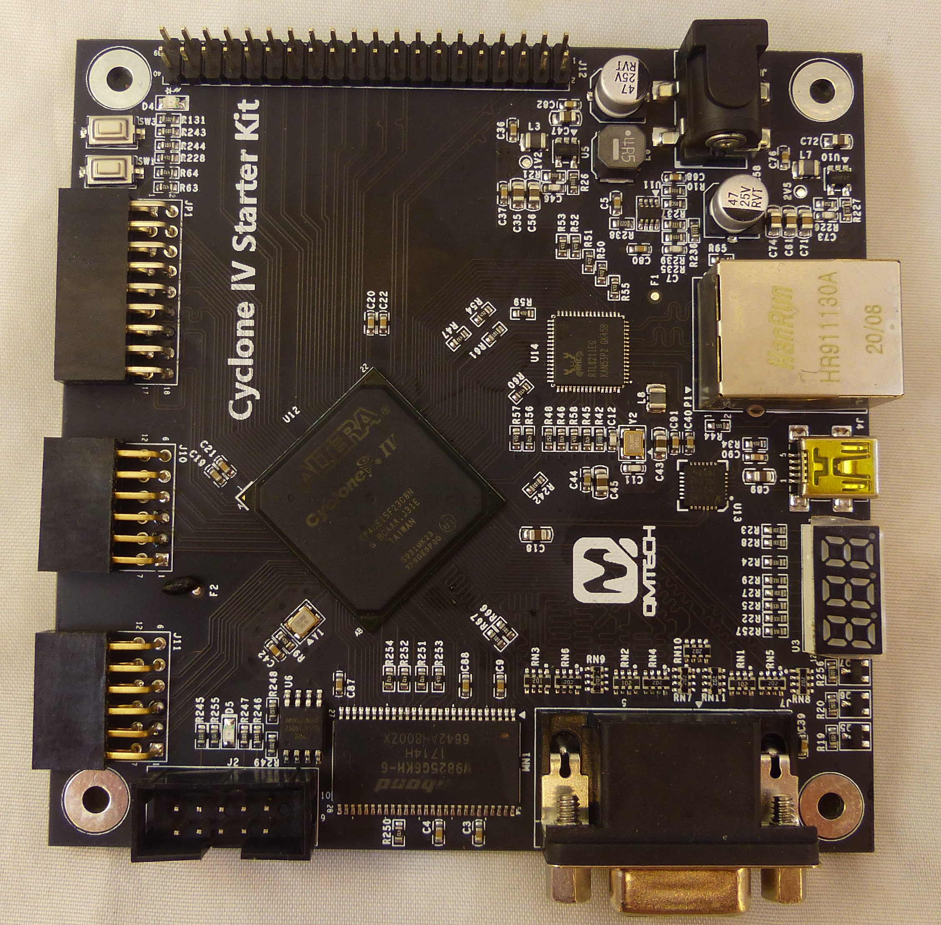
Add Board Specific functions
Make use of
  I/O Connector(s)
    Header
    PMOD connectors
  Seven Segment Display
  USB port

Slide 5
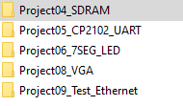
Refer to QMTECH Documentation
Need pin numbers - refer to
  Code Examples (easiest way)
  Schematics
Code Examples

Slide 6
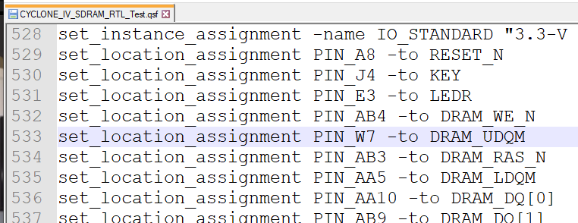
SDRAM
Pin lists can be found in the .qsf file – save a lot of typing/errors
Ex: SDRAM qsf file has:

Slide 7
Add to cpu_001 entity
Pattern – Quartus says “Don’t do this” – but I do it
  Add the signals to the CPU entity with default values
  Close Project
  Add pins to cpu_001.qsf file
  Compile
Can we create a Board Support package?
  Could use with all designs using this card

Slide 8
First set IO Voltage to 3.3-V LVTTL
If you don’t do this, Quartus will set the voltage to 2.5V
  And you will have to fix this in the Pin planner – a lot of clicking….
Close project (maybe important)
In cpu_001.qsf, paste (near other similar statements):
I/O voltages will now default to 3.3V

Slide 9
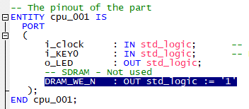
Example: SDRAM Pin DRAM_WE_N
Add pin to cpu_001.vhd
Close Project (important?)
Edit cpu_001.qsf to add
Save cpu_001.qsf

Slide 10

Add DRAM_WE_N
Open cpu_001 project
Compile
View Pin Planner – see that pin was added as assigned
Make sure to close project when adding pin(s) (follow this sequence otherwise it may not work)

Slide 11
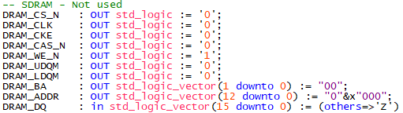
Rinse and Repeat
Can do all SDRAM pins this way – the defaults I used
Might seem painful but much easier than clicking each pin in Pin Planner and scrolling through list to select the pin

Slide 12
Summary
Tied off unused items on the card to known values
Added peripheral support

Slide 13
GitHub
Git Hub Repository
  https://github.com/douggilliland/Design_A_CPU
Created a branch with progress so far
  https://github.com/douggilliland/Design_A_CPU/tree/cpu_001_App3
Top Level entity
  https://github.com/douggilliland/Design_A_CPU/blob/main/cpu_001.vhd

