Slide 1
Design a Computer from Scratch
Part 10 – Misc Improvements

Slide 2
So far...
Part 9 video added new instructions
  SAR/SAL - Arithmetic Shifts
  XRI – Exclusive OR Immediate to register
  ADI - Add Immediate to register
  CMP - Compare Register to Immediate value
  Psuedo-Opcodes BEQ, BNE
  All required changes to CPU instruction set

Slide 3
In This Video...
Add register-to-register transfer function
Add reset button
Add optional nested subroutine LIFO
Add Memory Size options

Slide 4
Add Register-to-Register Transfers
Want to be able to do register-to-register transfer
Don’t want to add a new instruction
Add a Transfer Register (XFER_REG) in I/O space
Write to XFER_REG from one register, read back into another register

Slide 5
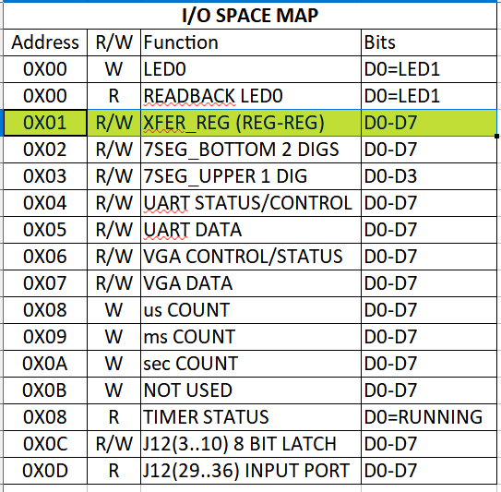
I/O Space Register Transfer

Slide 6
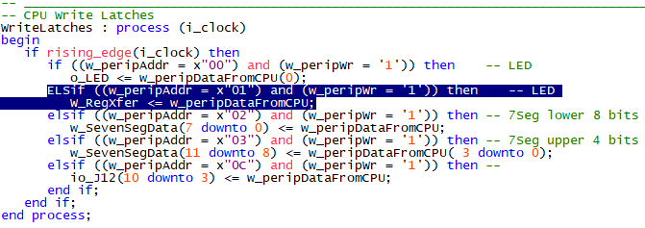
Implementation
All changes are in CPU_top
  Add to writes latch

Slide 7
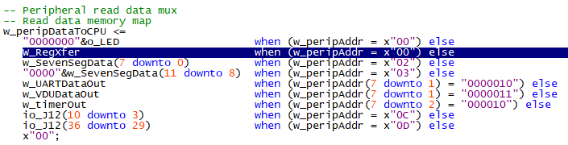
Implementation (Part 2)
All done in CPU_top
  Add to read data multiplexer

Slide 8
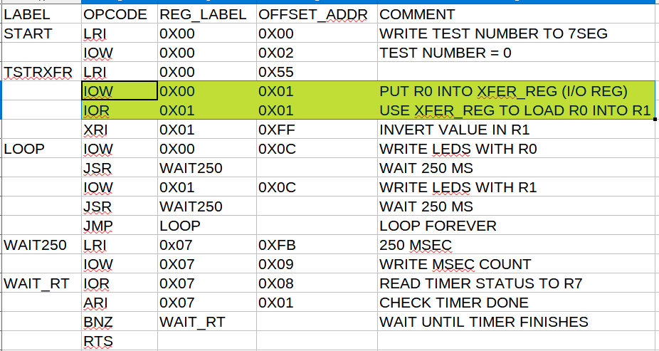
XFER_REG Test Code

Slide 9
Fairly Trivial Example
Could have just loaded both registers with a constant
Would be useful for saving “destructive” values like ARI
Ex:
  Read a status register from a UART – multiple status bits
    Transfer Error bit, Receive Data Present flags
  Can mask off the bits we don’t care about, save status into XFER_REG, then look at one status bit at a time

Slide 10
Advantages/Disadvantages
Benefits of this approach
  No change to Instruction set
    No CPU changes
  Can implement other functions by adding function to I/O space
  Can do expansion as “macro” instruction in the Assembler
Disadvantages
  Cost is extra instructions/cycles
    Takes 2 or more instruction cycles
  Not “standard”

Slide 12
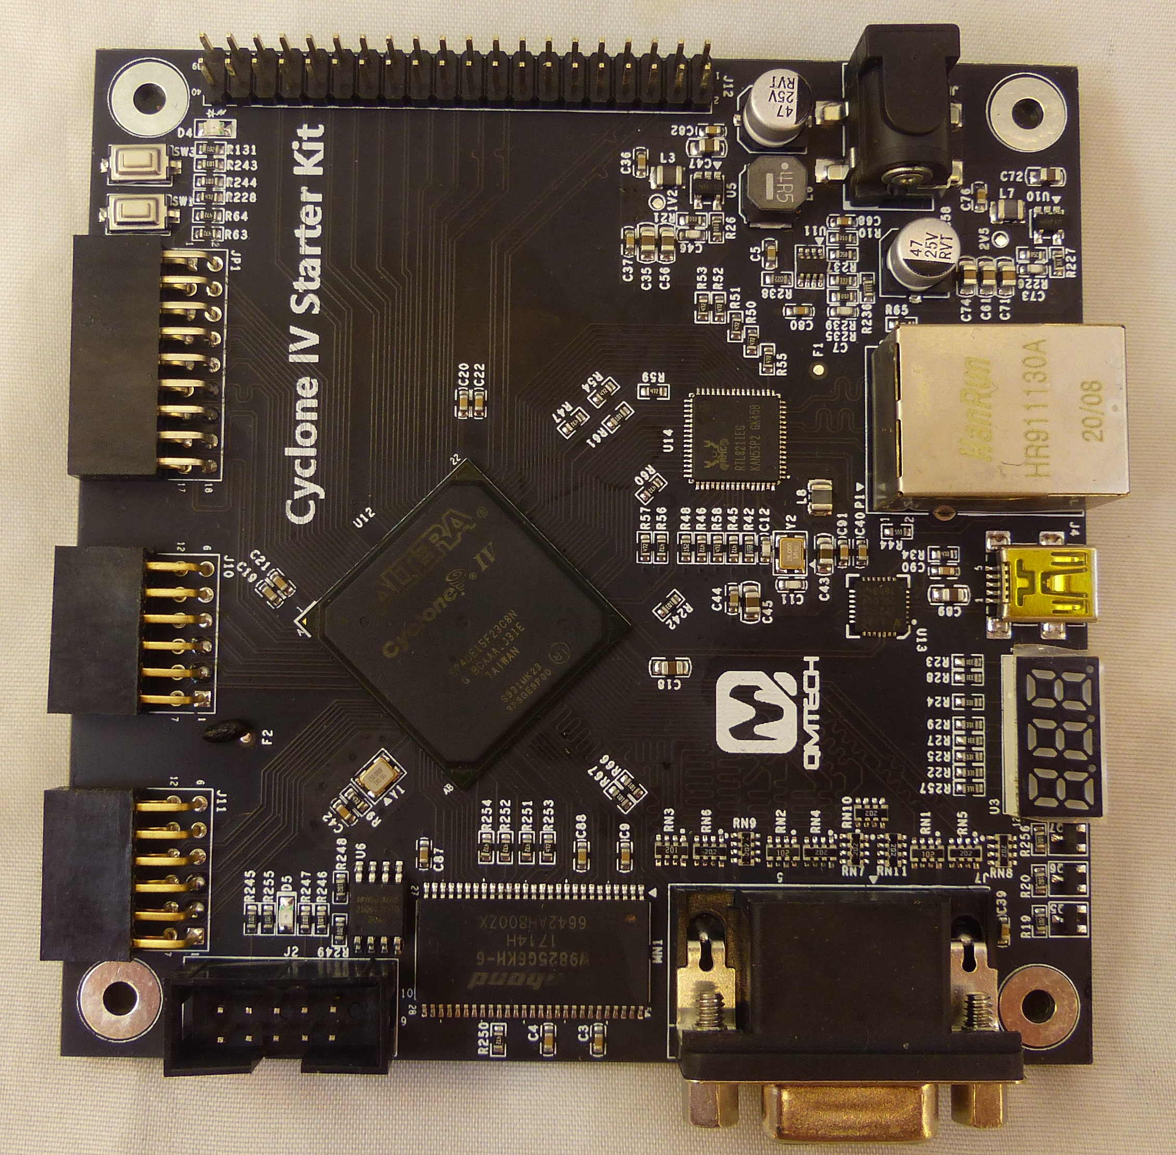
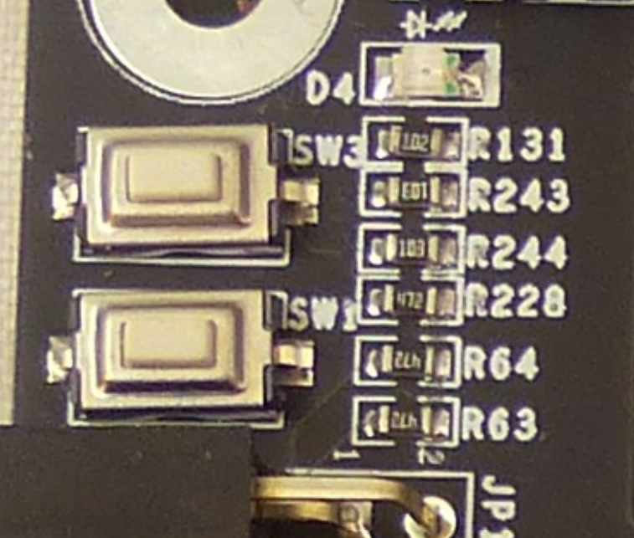
Add Reset Switch
So far there is no reset capability
Can hit SW3 KEY to reload CPU
Use KEY0 (SW1)as reset
  Loses KEY0 as input
  Good trade-off

Slide 13
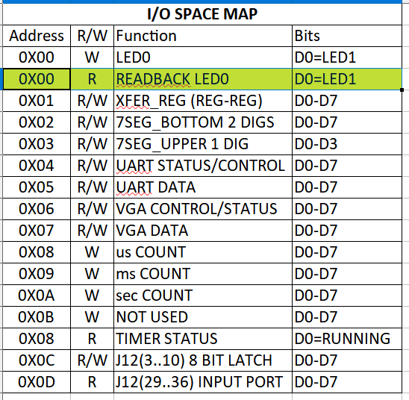
Change to I/O Memory Map
Warning: This breaks all previous Test applications which use KEY0
  Can still pull previous branches
  GitHub “tip” always moves forward
Plenty of pushbuttons on
LEDS-SWITCHES cards to play with

Slide 14
VHDL Code Changes
All of the changes are in CPU_top.vhd file
Leave top entity pin name as KEY0
Add Debouncer for clean reset as pulse
Reset happens on KEY0 release
resetN was set to ‘0’ in a lot of places
  Need to fix the places where the entities are called from CPU_top
  Some are active high

Slide 15
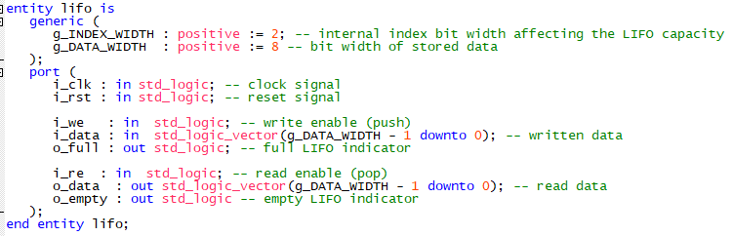
Add Nested Subroutine Option
Need LIFO = Last-In-First-Out
Could write one, but found one on GitHub
  https://github.com/dominiksalvet/vhdl-collection/blob/master/rtl/lifo.vhdl
  Has depth/width optionally passed in generic

Slide 16
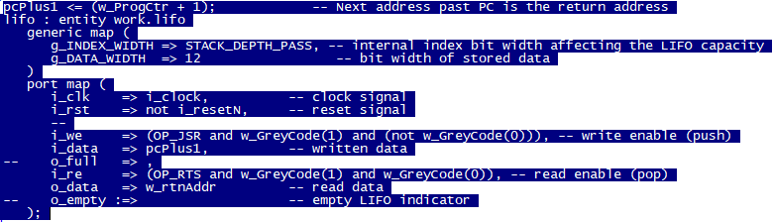
Add LIFO to cpu_001
Ignore full, empty

Slide 17
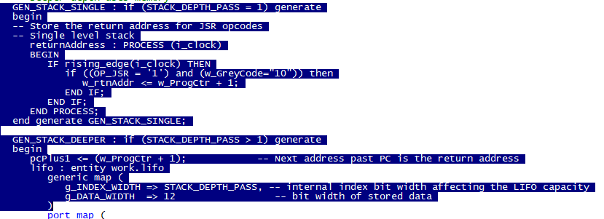
Make size an option with generic
Can select the existing single stack or deeper with a generic/generate

Slide 18
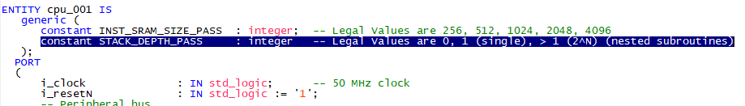
Add generics to cpu_001 entity
Adding to generic the cpu_001 entity allows passing the stack depth from CPU_top
At the entity level:
Note syntax differences is generic uses

Slide 19
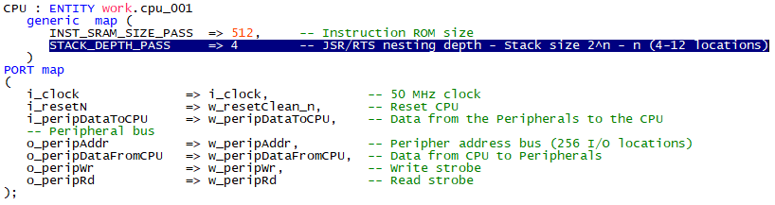
Update CPU instance in CPU_top
Pass the values from CPU_top into the cpu_001 instance
Allows the value to be changed depending on the application
  Passing 1 uses the “old” single 12-bit register
  Passing > 1 uses the new LIFO

Slide 20
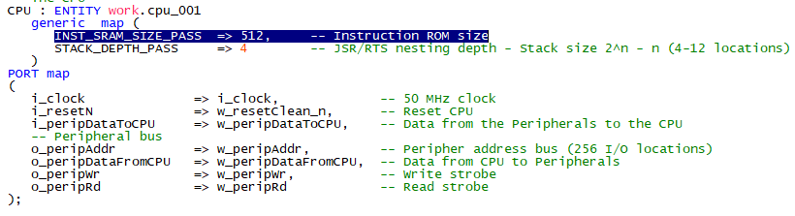
Support Different Memory Sizes
Use the concept of generic/generate from the stack to add configurable memory sizes
Pass INST_SRAM_SIZE_PASS from CPU_top to cpu_001 using generic

Slide 21
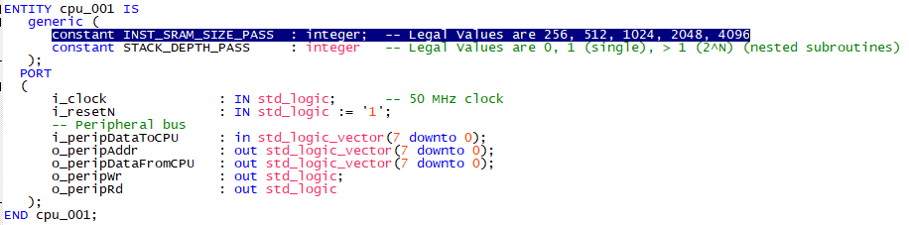
In cpu_001
Use generic/generates in cpu_001 to pick different memory sizes
Passed to cpu_001 entity

Slide 22
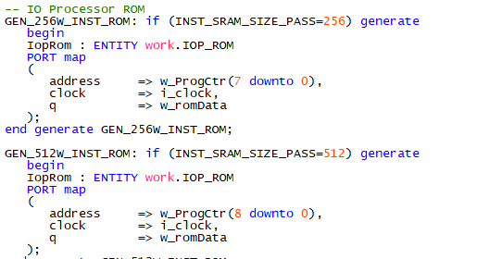
Add generates for Memory Sizes
Needed new IOP_ROM definition (IP Catalog) see Part 5 video
First two sizes are… Note address bits change
Need to recompile FPGA and re-select ROM MIF file

Slide 23
Summary
Added register-to-register transfer function
Added reset key
Added optional nested subroutine LIFO
Added Memory Size options

Slide 24
GitHub
Git Hub Repository
  https://github.com/douggilliland/Design_A_CPU
Created a branch with progress so far
  https://github.com/douggilliland/Design_A_CPU/tree/cpu_001_Part9_1_Sh/Rot/EOR/CMP
Top Level entity
  https://github.com/douggilliland/Design_A_CPU/blob/main/CPU_top.vhd

