Slide 1
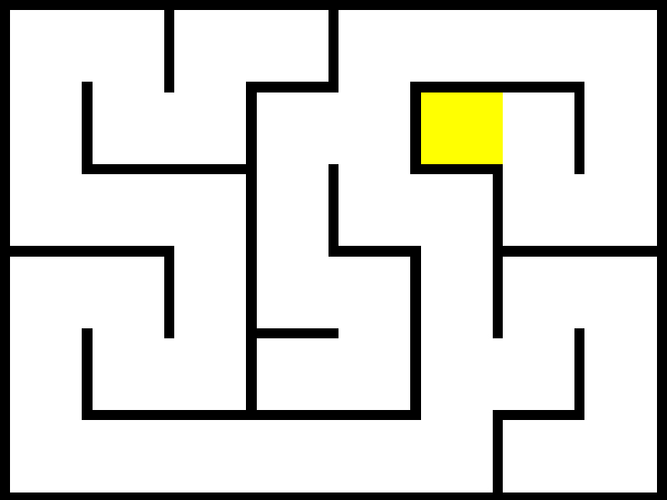
Simple Maze Game
Uffaz Nathaniel

Slide 2
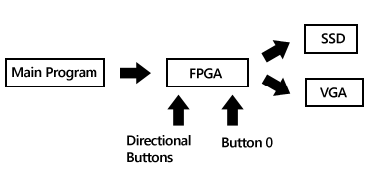
Project Overview
Build and deploy a simple maze game
Interface with VGA for graphics output
Provide directional movement via the buttons on the Nexys3
Time players takes to solve a maze (in seconds) displayed on SSD

Slide 3

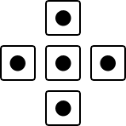
Design Implementation
VGA Controller
VGA
Logical Layer
SSD
f(x,y)
[R, G, B]
Graphics ROM

Slide 4
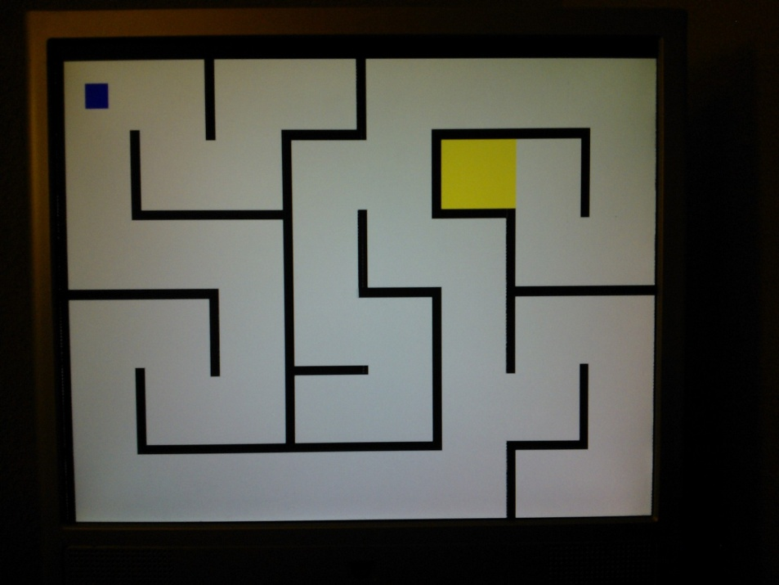
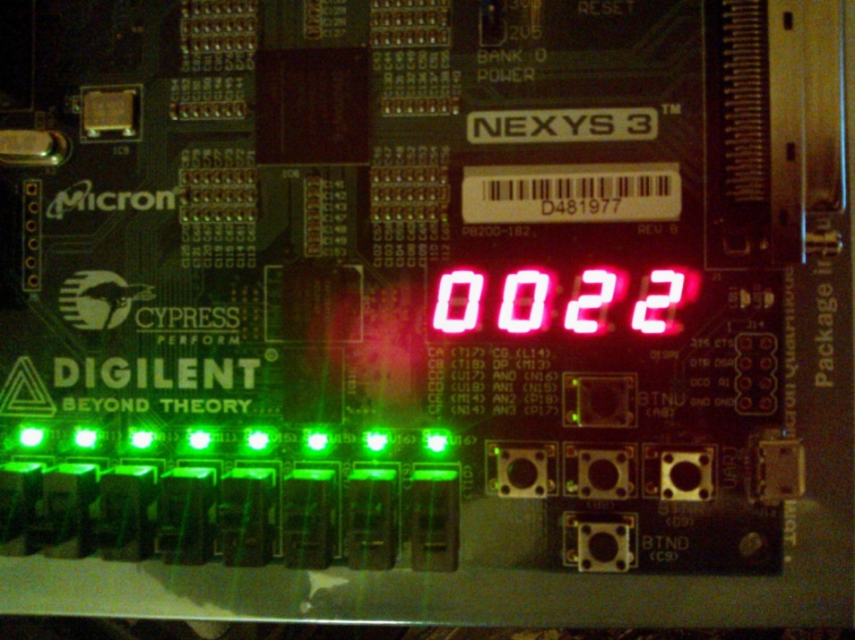
Results/Conclusion
Full functional maze game with collision detection
Easy extensibility to multiple levels (not implemented due to long synthesize times)
An easy way to paint graphics

