Slide 1



Supercover Insurance
2016

Slide 2


Insurance
Phones
Tablets
Cameras
Wearables
Fully Comprehensive
Theft & Loss
Accidental & Malicious Damage
Extended Warranty
International Cover
1 Million Bit Encryption
25%
Ongoing Commission
Volume discounts
The average person will carry £851 worth of handheld gadgets with them every day, rising to £1,034 for Londoners
Source: Zurich Insurance
A mobile phone is stolen in around 52% of robberies
Source: Government News Network
Over 6.2 million Brits lose at least one tech gadget each year
Source: O₂
12 months for
price of 10
24 months for
price of 18
Make claims on behalf of customers
Simple set up
Sign terms Receive login
Add policies
CUBEITZ
LOGO
*Next day domestic replacement

Slide 3
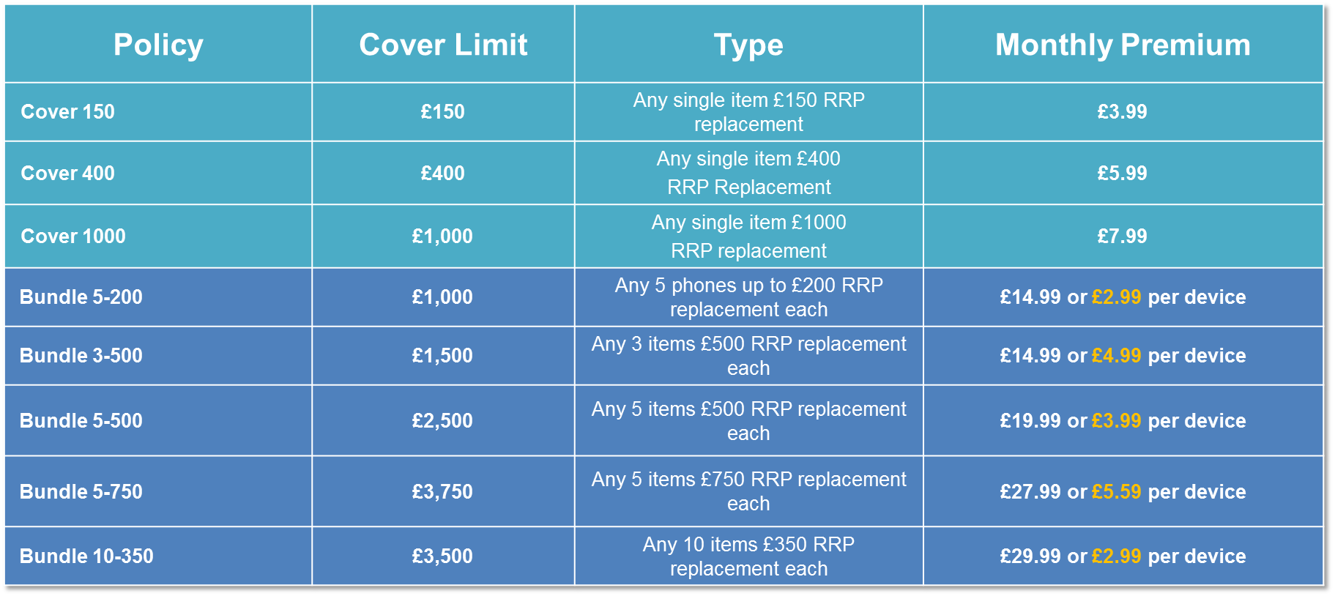
Insurance Tariffs
1 Million Bit Encryption
CUBEITZ
LOGO
A mobile phone is stolen in around 52% of robberies
Source: Government News Network
*Next day domestic replacement

Slide 4
Insurance – Bundle Examples
Customer has
9 x iPhone 6s
Wants to pay monthly
Within “cover option” add “Bundle 5-750 x 9”
This is because:
RRP is under £750
Volume of 9 - qualifies under MOQ of 5 devices
Customer will pay 9 x £5.59pm
Total - £50.31pm
1 Million Bit Encryption
5 x iPhone 6s,
9 x Samsung S7,
3 x Samsung J3’s
Wants to pay monthly
Within “cover option” add “Bundle 5-750 x 14” and “Cover 150 x 3”
This is because:
RRP on S7’s and iPhones are under £750 but over £500 and volume meets MOQ for Bundle 5-750. The J3’s have an RRP under £150 but there is no volume discount
Customer will pay
14 x £5.59pm
3 x £3.99pm
Total - £90.23pm
5 x iPhone 6s
9 x Samsung S7
3 x Samsung J3’s
Buy 2 years’ upfront
Within “cover option” add “Bundle 5-750 x 14” and “Cover 150 x 3 – 2 years UPFRONT
This is because:
RRP on S7’s and iPhones are under £750 but over £500 and meets MOQ for Bundle 5-750. J3’s have RRP under £150 but there is no volume discount. The customer is also paying upfront and can take the 24 months for the price of 18
Customer will pay upfront
Total -18 x £90.23 £1624.14
Saving of £541.38
CUBEITZ
LOGO
*Next day domestic replacement

Slide 5
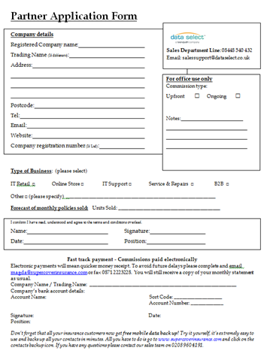

Insurance – Setting up a reseller & Commission payments
Reseller signs Supercover terms
Details sent to Data Select
Data Select confirm details with Supercover
Supercover sends login details to reseller
Reseller then free to register customer policies
1 Million Bit Encryption
Reseller access to ongoing spend and live reports
Partner Support – 0208 960 4191
Website – www.supercoverinsurance.com
Email – partnersupport@supercoverinsurance.com
Reseller receives monthly commissions direct from Supercover
CUBEITZ
LOGO
*Next day domestic replacement

