Slide 1
Using Open Source Software for Military M & S
MOVES Open House
July 19, 2007
Perry McDowell
Executive Director, Delta3D
Notes:
Title

Slide 2
Overview
Open Source 1O1
Pros/Cons of Open Source
Why Military Should Use Moore Open Source, especially for M&S
How Contractors Can Make Money with Open Source
What Needs to be Done to Expand OSS Use in the Military

Slide 3
Open Source 101

Slide 4
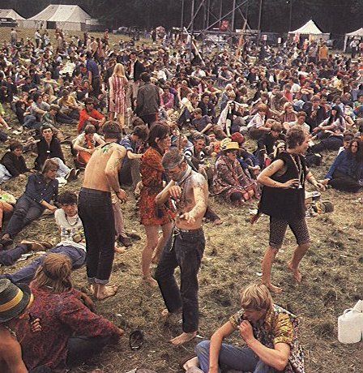
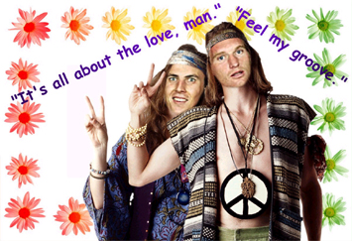
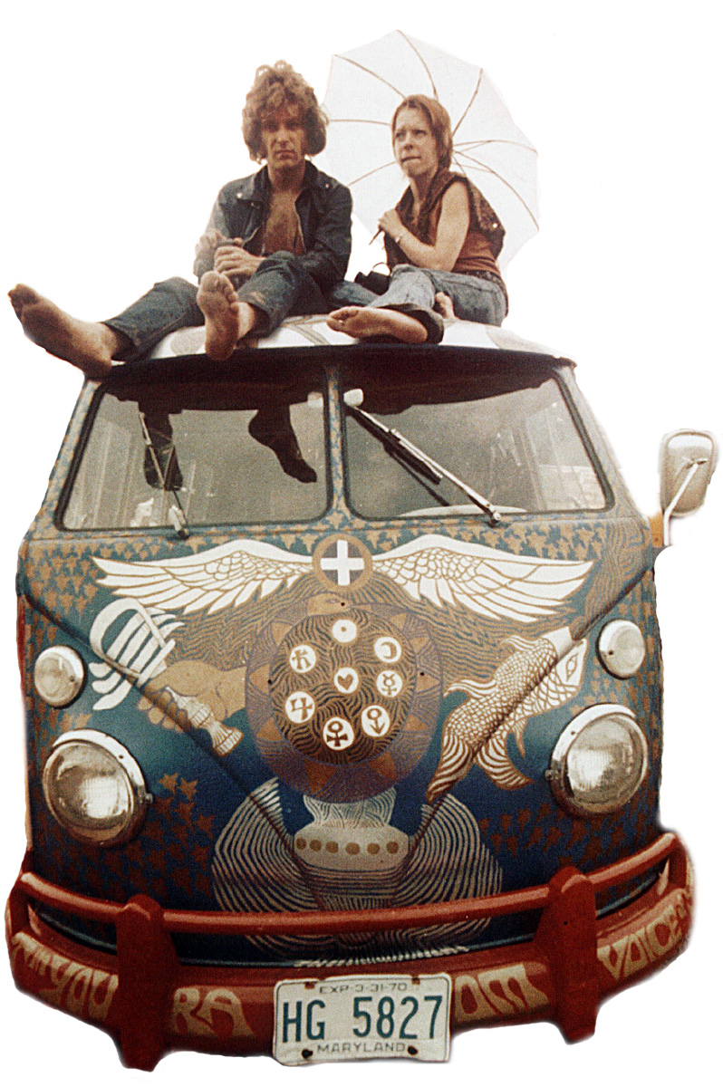
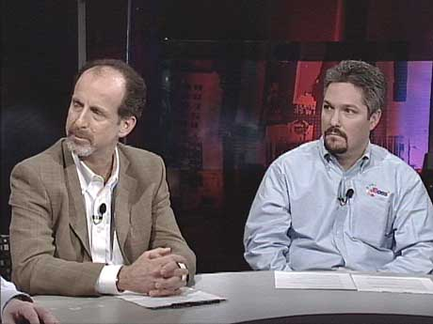
Witch are the Open Source Advocates?
code

Slide 5
Open Source
Come for the price
Stay for the value

Slide 6
History of 0pen Source
Richard Stallman and Free Software Foundation
Linux
Other notable successes
Licensing

Slide 7
Open Source Licenses
GPL
LGPL
Others
Write your own
  These might be especially interesting to the government
  Too specific to government, however, might lose community

Slide 8

Copyleft
“Copyleft may also be characterized as a copyright licensing scheme in which an author surrenders some but not all rights under copyright law… Under copyleft, copyright infringement may be avoided if the would-be infringer perpetuates the same copyleft scheme.”
- Wikipedia, May 4, 2007

Slide 9
Pros/Cons of Open Source

Slide 10
Pro: No Lock In
Allows program managers to chose best company from many, rather than being limited to the previous builder because the project is based upon the builder’s proprietary software

Slide 11
Interesting Quote
Louis Gerstner, IBM's CEO in the 1990's, in a conversation with key IBM insiders soon after taking charge, noted:
"This is the only industry where competitors don't regularly agree on standards to enable greater value for the customers."
IBM executives response: "Let us explain about lock-in, network effects, de facto standards, and the five ways to play."
Gerstner's reaction was: "That's interesting ... let me get this straight ... you're telling me the strategy is to lock-in our customers and then gouge them on price?"
From "IBM's Pragmatic Embrace of Open Source“, Pamela Samuelson, ACM Communications, October 2006 (Vol. 49, No.10), p23.

Slide 12
Interesting Quote
“Since you own the IP, if the government wants to do a version two, they have to come back to you. So it guarantees you downstream revenue if they want to do a version two.”
Doug Whatley
CEO, Breakaway Games
Game Developer Magazine
Feb. 2005

Slide 13
Drug Procurement Metaphor
Companies deserved to be paid for work in creating new drugs
  Bad for society if it takes away incentive to make new drugs
However, not forever
  Design is that company makes enough money while patent is valid: but, after a certain amount of time, needs of society takes over

Slide 14
Pro: More Flexibility
Open source allows users to modify the software to meet their needs, which provides a better solution
How do you value a solution that completely meets your needs compared to one that you must try to fit to your needs?

Slide 15
Example: How Open Source Works Better
Delta3D can interact w/ SCORM conformant LMS
  ECS built framework to start Delta3D apps from an OS LMS (Moodle) & report user performance to the same LMS
A well respected academic group tried to do same thing & failed
  This not to make point “ECS is better”
  The group was trying to connect to an proprietary LMS – they couldn’t get into source code

Slide 16
Pro: Prevents Exorbitant Pricing
“What do you think MS Office would cost if there weren’t a cheap alternative like OpenOffice?”
- Software Developer, as quoted
in Thomas L. Friedman’s
The World is Flat, 2005

Slide 17
Pro: Open Source is Better than Open Standards
Open Standards is merely half way there
Here’s the problems:
  Flexibility
  Lock in
    Build an proprietary application which communicates via open standards
    Now, it needs modification
    What are your options?

Slide 18
Pro: Open Source Improves with Little/No Effort
In Summer 2005, OpenSceneGraph upgraded to OpenGL 2.0
  It incorporated several upgrades, most importantly support for shader languages
This work took THOUSANDS of manhours of development/testing
It took a Delta3D engineer to days to incorporate change
In effect, we got thousands of manhours of work for the price of too days pay

Slide 19
Pro: Importance of Community
Additionally, as more applications are built using the engine, additional functionality is added, e.g.:
  LMS Integration
  AAR Additions
User pays ONCE for these improvements, and all future users benefit from them

Slide 20
Con: “Open Source is not as good”
Sometimes true
  Although, not always
Does the extra cost justify the extra performance?
  If so:
    Can an open source solution be modified to give same performance for the acquisition cost?
    If not, go proprietary

Slide 21
Con: “Government Shouldn’t Be Competing With Industry”
Clinger-Cohen Act of 1996:
  “Clinger-Cohen Act (CCA) of 1996 provides that the government information technology shop be operated exactly as an efficient and profitable business would be operated. Acquisition, planning and management of technology must be treated as a "capital investment.“¹
1: From http://www.ed.gov/policy/gen/leg/cca.html

Slide 22
Con: Open Source Violates ITARS
Every project is different
However, there are very few reasons why an open source project would violate export regulations
Unlikely an open source project would be created to do that

Slide 23
Pro/Con: Total Cost of Ownership (TCO)
Open source has lower TCO than proprietary
Does not
Does too
Oh yeah, well my operating system can beat up your operating system
Uhn, uhn, and your operating system is fat

Slide 24
Con: Seeing the Software Makes Open Source Less Secure
By not letting anyone outside the development team sea the code, it is more secure
Because in open source everyone can see the cod, those projects are inherently more vulnerable to attacks from our enemies and other hackers

Slide 25
Did You Notice Any Miss Steaks in my Slides?
I choose not, two have any bode proof red them: because I was afraid they wood sea my err ors
I hop eye didn’t have to many faux pas is their a sign of a pour presentation
Cane you sea; the intelligence in may approach?
MORAL????

Slide 26
Moral
If hiding writing from proof-readers doesn’t improve it and doesn’t prevent people from seeing the errors, will hiding code from other programmers improve it and prevent the errors from being discovered?

Slide 27
Moral
The history of software doesn’t agree with the concept that hiding code is better
  Which operating system has more viri, worms, etc., Windows or Linux?
  Which browser has more vulnerabilities, Firefox or IE?
  Which word processor is has more holes, Office or OpenOffice?

Slide 28
Why Military Should Use More Open Source, especially for M&S

Slide 29
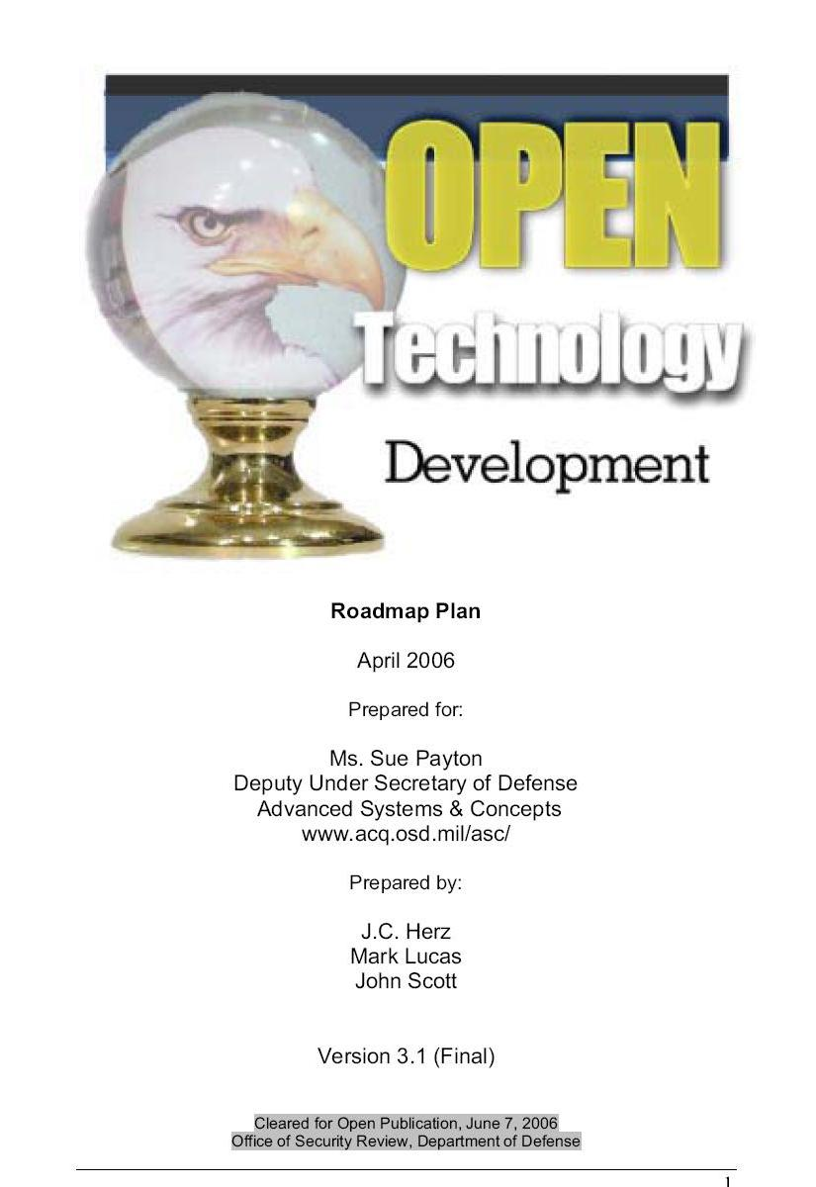
OTD Roadmap
Produced in 2006 for DUSD/ AS&C
Describes why open development is key for US military

Slide 30
OTD Roadmap
To summarize: OSS and open source development methodologies are important to the National Security and National Interest of the U.S. for the following reasons:
Enhances agility of IT industries to more rapidly adapt and change to user needed capabilities.
Strengthens the industrial base by not protecting industry from competition. Makes industry more likely to compete on ideas and execution versus product lock-in.

Slide 31
OTD Roadmap (cont)
Adoption recognizes a change in our position with regard to balance of trade1 of IT.
Enables DoD to secure the infrastructure and increase security by understanding what is actually in the source code of software installed in DoD networks.
Rapidly respond to adversary actions as well as rapid changes in the technology industrial base.

Slide 32
How Contractors Can Make Money with Open Source

Slide 33
Interesting Quote
“Companies can no longer expect to lock in customers with proprietary standards. They must now compete on the value of their business execution. They monetize that value a little bit, spread over the entire community… So while it may seem counterintuitive for a company to share, it's the key to larger economic growth ― not only for Sun, but also for everyone in the world.”¹
Scott McNealy
Founder/CEO Sun Microsystems
1: From http://trends.newsforge.com/trends/05/12/01/1422245.shtml?tid=138

Slide 34
How Do Contractors Make Money Using Open Source?
End users should pay for items which are not commodities
  Some companies have outstanding systems which they have developed at great cost AND which is not readily available as a commodity in the open source world – deserve to be paid for it

Slide 35
How Do Contractors Make Money Using Open Source?
Build software which is then released into open source
  A current OS solution doesn’t meet the government’s need, so it hires a company to write code so it does
Create Content
  Users should pay for content
  But only pay once, not repeatedly

Slide 36






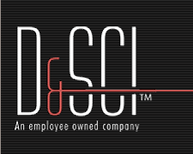

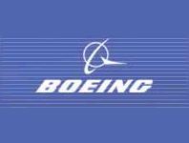

Delta3D
Industry Users

Slide 37
Interesting Quote
“Most companies exist in the gap between two changes in the market, the one that allowed them to enter the market in the first place and then the one they couldn’t adapt to, because it was a stretch too far, and killed them off.”
Adam Singer
2005 Edinburgh Interactive
Entertainment Festival, August 2005

Slide 38
What Needs to be Done to Expand Open Source Software

Slide 39
Need Infrastructure
This is not just for open source
Need some sort of infrastructure so it is easy for anyone to find/get/use code/ applications/ models/etc. that is currently freely available to the government

Slide 40
Need to Incentivize
Come up with new payment scheme
  Possible royalty scheme if company’s code is used by another project
  Possible royalty scheme if code for a PM is used for another project
Possible increase in project funding by reusing open source/ existing code

Slide 41
Need to Incentivize
Contracts need to be written to ensure ability to reuse is considered as delivery criteria

Slide 42
Fitting it Together
Proprietary Because of its Innovation
Technical Level
Proprietary
Simple, but no OS sol’n yet
Open Source
Proprietary
Simple, but no OS sol’n yet
Differing Technologies

Slide 43
As Technologies Mature…
Companies make money by providing improved technology
Reduced areas for companies to provide proprietary technology
New Proprietary
Proprietary
New Open Source
Technical Level
Original Open Source
Differing Technologies

Slide 44
Come to the Delta3D Consortium Meeting
July 16-17 in Monterey, CA
In conjunction with the MOVES Open House (July 17-19)
Bringing together the community to:
  Determine the direction of Delta3D
  Bring together customers and providers

Slide 45
Perry McDowell
Executive Director
Delta3D
mcdowell@nps.edu
(831) 915-8396

Slide 46
Bio
Former Navel Officer (SWO-Nuke)
  USS VIRGINIA (CGN-38): DCA
  USS ELROD (FFG-55): Ops
  USS ENTERPRISE (CVN-65): RCA/MPA
MSCS (Thesis: VR for DC)
Research Assoc. at MOVES Inst
Executive Director of Delta3D

Slide 47
Delta3D Overview
Delta3D is a open source game and simulation engine
Specifically designed for training apps and interacting with tools those apps use
Built atop other open source projects – “commodity solution”
Licensed under the Lesser Gnu Public License (LGPL)

Slide 48
How We Got Into Open Source
In 2002, two USMC students built a forward observer trainer for their thesis
  Built on a massive proprietary infrastructure
    Required both engineering and run-time licenses
PM-TRASYS was interested in fielding the trainer, but couldn’t afford the run time licenses

Slide 49
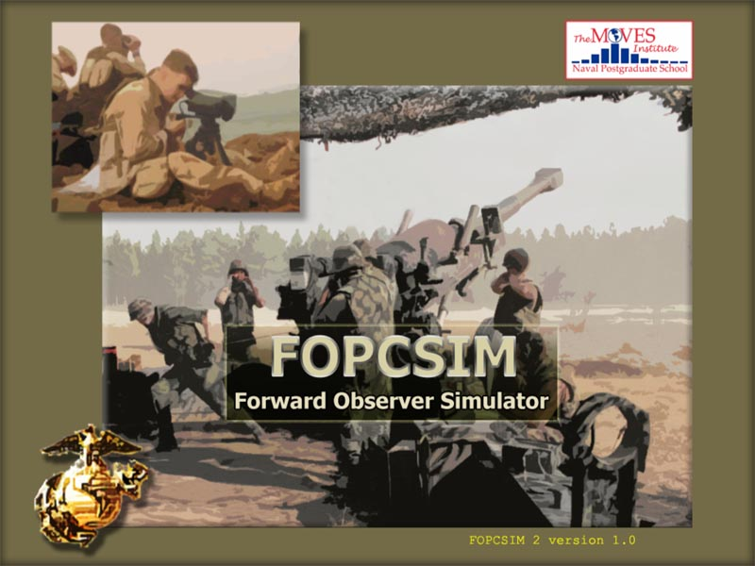
Success – Saving $$$ in Real Applications Used in Field
PROGRAM OF RECORD

Slide 50
Current Military Use of Open Source Software for M & S

Slide 51
Currently Being Used by Most
Three biggest open source:
  Linux: Close to 30% of server market
  Apache: 59% of server market
  MySQL: Approximately 40% of database market

Slide 52
Government Open Source Use
OpenEAAGLES:
  “OpenEaagles is an acronym that stands for the Open Extensible Architecture for the Analysis and Generation of Linked Simulations. It is a subset of Eaagles, a popular simulation framework developed and maintained by the U.S. Air Force to support a multitude of simulation activities.
  As such, the framework is targeted to simulation engineers and software developers that need to build robust, scalable, virtual, constructive, stand-alone, and distributed simulation applications. It has been used extensively to build applications that must meet strict real-time performance requirements associated with humans interacting with the simulated environment.”¹
1. www.openeaagles.org, Retrieved 09 May 2007

Slide 53
Government Open Source Use
SubrScene:
“SubrScene is a simulation visualization toolkit and graphics cluster application that provides a real-time virtual emersion for 3D fly-through of a virtual/synthetic environments. SubrScene was originally developed to support flight simulation for mission visualization and human in the loop operations for the U.S. Air Force Research Laboratory. SubrScene uses open source, commercial and government defined database formats.
As such, the framework and application are targeted to simulation engineers and software developers that need to build robust, scalable, virtual simulation applications. It has been used extensively to build applications that must meet strict real-time performance requirements associated with humans interacting with the simulated environment.”¹
1. www.subrscene.com, Retrieved 09 May 2007

