Slide 1

Spatial Reference Model
(SRM)
An Overview
http://www.sedris.org/srm.htm
6 January 2004
Lake Buena Vista, Florida
Dr. Paul Berner
SEDRIS Core Team
ISO/IEC 18026 Editor
Berner@Consultant.com
Dr. Ralph M. Toms
SRI International
ISO/IEC 18026 Editor
ralph_toms@sri.com
Copyright © 2004 SEDRIS™

Slide 2
SRM tutorial
DESCRIPTION:
The SRM is a unified approach for the representation and use of spatial location information. Designed as a standalone technology, the SRM is a unified approach for the representation and use of spatial location information. Designed as a standalone technology, the SRM provides a complete and concise treatment of the different descriptions of spatial location, and precisely defines the relationship between various spatial reference frames. This tutorial provides a detailed review of the SRM framework and concepts with an emphasis on the modeling implications of different ways of representing spatial location. Challenges and issues in implementing precise and efficient coordinate operations are also discussed.
WHO SHOULD ATTEND:
Those interested in gaining a more complete understanding of the SRM and the theory of accurately representing spatial locations in modeling.
PREREQUISITE:
Prior knowledge of other SEDRIS technologies is not required, however prior attendance at either the "Introduction to SEDRIS for Managers" or "SEDRIS - The Technology Components" tutorial is recommended.
WHAT TO EXPECT:
At completion, the attendee has an appreciation for the complexities involved in accurately representing spatial location. Topics such as object reference models, spatial reference frames, ellipsoids and geoids are covered, among others.

Slide 3
Prerequisite
To get the most from this tutorial, we assume you know the following, as a prerequisite to this session:
  An understanding of basic mathematical concepts
  An interest in coordinate representation, conversion, and transformation techniques
  Familiarity with the SEDRIS technology components and how they fit together. We assume you have attended:
    “Introduction to SEDRIS for Managers” or
    “SEDRIS - The Technology Components”

Slide 4
Outline
Introduction
  scope
  goals
SRM Concepts
  key concept preview
  object-space and position-space
  reference datums and object reference models
  coordinate systems
  spatial reference frames
  vertical offset surfaces
  spatial operations and the API
Computational considerations
Spatial operation validity, conformance, accuracy
Structure of the SRM ISO standard

Slide 5
The Spatial Reference Model (SRM)
is a general concept
There are two aspects of the SRM discussed in this tutorial
• One aspect is the SRM as an International Standard.
- ISO/IEC 18026 Spatial Reference Model.
- Under development, the final committee draft is to be released summer ‘04.
- This tutorial uses the nomenclature, definitions and
concepts of ISO/IEC 18026.
- Consistency with other International Standards is promoted.
- Efficiency of algorithms or their implementation is not part of the
ISO/IEC 18026 specification.
• Another aspect is the implementation of the SRM in SEDRIS
- The SEDRIS implementation is designed to be compliant with the
emerging 18026 International Standard.
- The SEDRIS implementation is an application driven development.
- A software architecture and spatial operations API is required.
- Algorithms for spatial operations in spatial frames are designed to be
accurate robust and efficient.
- The SEDRIS software has been subject to extensive testing.

Slide 6


In the beginning ...
Systems
Systems, where?
Systems, and what else?
The void ...
The environment starts with locating your systems; sometimes that’s about all you could afford in legacy simulations.
The environment continues with defining the context within which systems interact; and that context
can advantage, or disadvantage,
them ...
Defining and using a consistent spatial reference framework is critical for simulation interoperability
  System models (men, equipment, material, …)
  Environmental: data, models, phenomena
At all levels of simulation detail/resolution
  Aggregated / Entity; Constructive / Virtual / Live
Notes:
2
8

Slide 7
Why is a Spatial Reference Model
(SRM) needed?
The Modeling & Simulation (M&S) community has not been consistent in the treatment of models of the Earth and related coordinate systems.
Consistency is required for joint distributed simulation in order to:
  Achieve a reasonably level playing field,
  To support meaningful VV&A.
A number of different Earth reference models (ERMs) are currently employed and this affects:
  Representation of the environment in M&S and authoritative data bases.
  Dynamics formulations, both kinematics and kinetics (movement).
  Acquisition modeling and processing (inter-visibility).
Loss-less and accurate spatial operations are critical to representation and interchange of location data.
A nomenclature inconsistency exists.
  For example, how do these variables relate?
  Altitude, elevation, height, geodetic height, ellipsoidal height, orthometric height, height above sea level, height above mean sea level, terrain height, pressure altitude, temperature altitude, nap of the Earth, ...

Slide 8
Other interoperability examples
It isn’t just simulations that have potential interface problems due to spatial referencing.
Real (embedded) systems also need to communicate spatially referenced data.
Test range operation is another application domain where consistent spatial referencing is important, particularly if multiple ranges share real-time information.
The federation of live, virtual and constructive
systems requires a standardized SRM.

Slide 9
Why is accuracy needed for coordinate transformations?
In the past, it has been difficult to measure positions on the surface of the Earth to better than 1 metre.
  This situation is changing due to new technology developments.
  GPS now can achieve absolute accuracy of about 21 cm (SEP 90%) over large regions.
Real-world applications mostly use relative coordinate systems
  Dynamically correct location errors by using on-board sensors.
In the simulation environment, both absolute and relative spatial referencing must be accurately portrayed.
Mixing of live & synthetic environments has special accuracy requirements*.
Mission planning, rehearsal, & conduct of real operations have situation-dependent accuracy requirements.
* Lucha, G. V., On the Consequences of Neglecting Measurement
Accuracy Issues in Live and Virtual interactions”, SIW Spring 1997

Slide 10
Target shooting at a visible target in the real world
(Relative coordinate system)
Set up paper target with aim-point approximately 1000 metres away.
Shoot N rounds.
Measure miss distances using bullet holes on paper target, and compute CEP or some other measure of accuracy.
Never used any precise location or environmental data.

Slide 11
Simulation of target shooting at a visible target
(Simulation of a relative coordinate system)
Select lococentric Euclidean 3D CS, origin at the shooter.
Define coordinates of the target & shooter.
  Both with target plane oriented perpendicular to line of sight.
Develop an aiming model with random inputs.
Define shoot time, T.
Integrate bullet trajectory in time, from T until it pierces the plane of the target (need air temperature, density, speed of sound, wind, etc.)
  May have to access geodetic system for each of the environmental parameters.
  Will need an iterative scheme to get the impact point.
Compute radial miss at target plane impact.
Any errors made in any of the position-location computations,
including those needed to compute the correct environmental
parameters, can and will dilute the accuracy of the result.

Slide 12
Servicing a non-visible target in the real world
The problem: An artillery piece shoots at a target coordinates provided from an external source.
The shooter has its location in some coordinate system, e. g. Augmented TM.
The target coordinates may be known to some accuracy in geodetic latitude, longitude & geodetic height.
The fire control system may or may not require conversions to another coordinate system, for example a lococentric Euclidean 3D coordinate system.
The fire control system computes firing angles based on its internal mechanization and may model wind, air density and other environmental parameters.
The round impact and miss distances are observed by a forward observer who feeds information back to the firing site.
The process is completed when the impact error is small enough.
Use location data but no precisely measured environmental data.
Simulation of this scenario requires detailed dynamics
and environmental models

Slide 13
Augmented Transverse Mercator(ATM) example
Several distortions are introduced, especially at the higher latitudes.
plane of the projection
90º East
•
•
•
TM plane inset to
reduce average distortion
(scale factor 0,9996 at the
central meridian)
•
Central Meridian
The results of such elevation angle and range distortions may not be so apparent when all simulations involved use ATM. However, in a federation involving real world coordinate systems the distortions may become evident. Use of ATM increases visibility, causes interactions to prosecute too fast, leads to an uneven playing field and is not recommended for use in joint simulations.

Slide 14
SRM requirements
Completeness, must:
  include coordinate systems in wide usage.
  tie those systems together into a commonly used framework.
  educate the system developer.
    E.g., What’s a horizontal datum, a vertical datum, a geoid?
Accuracy
  Generally higher than required for C4ISR systems.
  E.g., Typically better than 1 cm. up past geosynchronous orbit (nominally 1 mm near the ERM surface).
  Computation of operations in spatial frames must not impact
  application validity.
Performance
  Never fast enough!
  Many environmental data sets dominated by location data.
    Therefore efficient inter-conversion is key to meeting 72 hour “ready-to-run” mandate.
  Federate costs for distributed simulation using heterogeneous coordinate systems can be substantial (e.g., 20% or more).
SEDRIS algorithms and implementations are very accurate and 2-5x faster than algorithms/implementations reported in the literature.
Notes:
3
9

Slide 15
Location is not enough
The key in Modeling and Simulation is not so much where things are, but what they can interact with …
  Remembering that “what” includes both systems and components of the environment itself
A complete SRM must address:
  Location
  Distance (range, line of sight, geodesics…)
  Vector quantities, such as direction
  (azimuth and elevation angle)
Location interconversions between
common spatial reference frames
do not necessarily preserve these.
Systems, and what else?
The environment continues with defining the context within which systems interact; and that context can advantage, or disadvantage, them ...

Slide 16
The scope of the SRM
The SRM is developed to include spatial referencing for any real or conceptual object in the solar system, or any abstract or virtual universe.

Slide 17
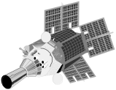
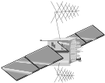





It’s a Loooong way up
MAGNETOSPHERE
30+ Satellites
S
E
A
M
L
E
S
S
E
N
V
I
R
O
N
M
E
N
T
DSP
MILSTAR
DSCS
RADIATION BELTS
25+ Satellites
GPS
IONOSPHERE
25+ Satellites
DMSP
MESOSPHERE
SHUTTLE
STRATOSPHERE
Space Weather
U-2
Terrestrial Weather
TROPOSPHERE

Slide 18
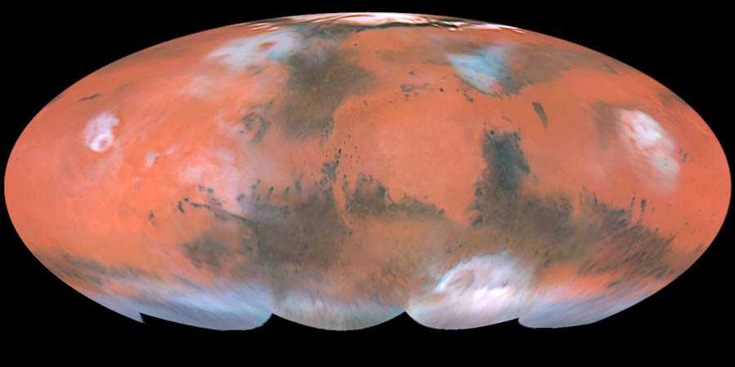
The SRM encompasses more than the Earth

Slide 19
The SRM requires a shared solution
If you have spatially located data,
  Who doesn’t?
Then you need to understand spatial referencing,
  A very complex topic (as we’ll demonstrate)
Especially if you intend to interchange data.
This situation/problem is not unique to M&S.
  E.g., precise positioning for navigation, range tracking,…
A “worldwide problem”
  Being tackled by ISO/IEC JTC 1/SC 24/WG 8.
  ISO/IEC 18026: Spatial Reference Model (SRM)
  See the following URLs for more information:
  http://www.iso.ch
  http://www.jtc1.org
  http://isotc.iso.ch/livelink/livelink.exe?func=ll&objId=327973& objAction=browse&sort=name
  http://www.sedris.org/wg8home

Slide 20
SRM goals
Unambiguous Spatial Referencing
  locations and directions
  well defined terminology
A single framework for diverse communities of users
  CAD/CAM
  modeling and simulation
  geodesy
  space science
Extensibility
  including an extensible API
  a standardized registration process

Slide 21
SRM concepts

Slide 22
Key concepts
(Preview)
Abstract
Coordinate
System
Spatial
Coordinate
System
position-space
object-space
spatial
object
Embedding

Slide 23
Key concepts
(Preview)
position-space
object-space
spatial
object
Embedding
object reference model
reference datum
reference datum
reference datum

Slide 24
Key concepts
(Preview)
Spatial Reference Frame
object-space
spatial
object
Coordinate
System
object reference model
reference datum
reference datum
reference datum

Slide 25
SRM concepts
Spatial objects and object-space
Position-space and normal embeddings
Reference datums
Object reference models
Coordinate systems
  Abstract coordinate systems
    localization
    Induced surface coordinate systems
    map projections
  Temporal coordinate systems
  Spatial coordinate systems
Spatial reference frames
Vertical offset surfaces
Spatial operations
Spatial objects and object-space

Slide 26
Spatial objects and object-space
spatial object
Object-space:
The real or abstract universe that contains a spatial object.
(A spatial object is assumed to be fixed in its object-space.)

Slide 27
Spatial objects and object-space
spatial object
engineering models,
virtual world,
CAD,...
“real world”
physical object
abstract object
The length of a metre has
intrinsic meaning.
The length of a metre length
does not have intrinsic meaning.
Length scale shall
be defined.

Slide 28
SRM concepts
Spatial objects and object-space
Position-space and normal embeddings
Reference datums
Object reference models
Coordinate systems
  Abstract coordinate systems
    localization
    Induced surface coordinate systems
    map projections
  Temporal coordinate systems
  Spatial coordinate systems
Spatial reference frames
Vertical offset surfaces
Spatial operations

Slide 29
Position-space and embeddings
y-axis
z-axis
p
x-axis
object-space
position-space
Position-space:
An n-dimensional Euclidean space abstraction of object-space.
y-axis
z-axis
p
x-axis
embedding:
A particular position-space model of object space.
embedding

Slide 30
Position-space and embeddings
An embedding is a function from position-space to object-space.
y-axis
z-axis
(x, y, z)
p
x-axis
object-space
position-space
An embedding is normal if distance is preserved assuming
1 Euclidean unit = 1 metre in object-space.
In the 3D case, an embedding is either right-handed or left-handed.
An embedding allows position-space operations and methods of
algebraic geometry to be applied to object-space.

Slide 31
Position-space and embeddings
p
object-space
y-axis
z-axis
y-axis
z-axis
p
p
x-axis
x-axis
normal embedding 1
normal embedding 2
There are infinitely many normal embeddings of a given object-space.
In general, no one normal embedding is intrinsic or canonical.

Slide 32
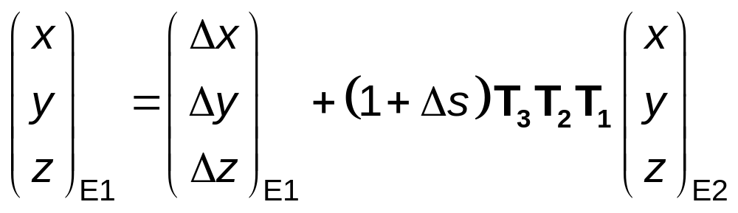
Position-space and embeddings
Given two normal embeddings, E₁ and E₂
how are are they related to each other?
7-parameter transformation:
Each T_{k} is a rotation matrix ...

Slide 33
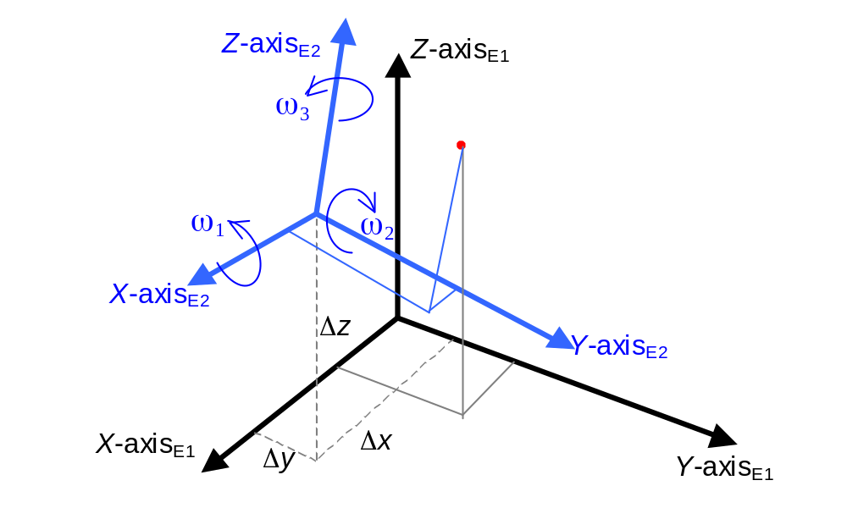
7 parameter transformation
Relates embedding E2
to embedding E1

Slide 34
SRM concepts
Spatial objects and object-space
Position-space and normal embeddings
Reference datums
Object reference models
Coordinate systems
  Abstract coordinate systems
    localization
    Induced surface coordinate systems
    map projections
  Temporal coordinate systems
  Spatial coordinate systems
Spatial reference frames
Vertical offset surfaces
Spatial operations

Slide 35
How are embeddings specified?
The specification pieces
  Reference Datum (RD)
  Spatial binding
RD and normal embedding compatibility
“Assembly instructions”:
  Object Reference Model Template (ORMT)
Object Reference Model (ORM)
  ORMT Realization
  Embedding specification

Slide 36
Reference datums
Reference datum (RD):
A geometric construct in position-space
that is used to specify an aspect of an embedding
of position-space into object-space.

Slide 37
Reference datum (RD)
Concept
  A construct with position-space analytic representation
  and object-space geometric representation
  Category:
    Point
    Directed curve
    Oriented surface
  Expressed as implicit or explicit function of position-space
  Method of orientation (except point)
  Method of binding to object is application domain specific and is outside of SRM scope
Standardized set
  Label, code, definition
  set of Ellipsoid RD associated to celestial objects

Slide 38
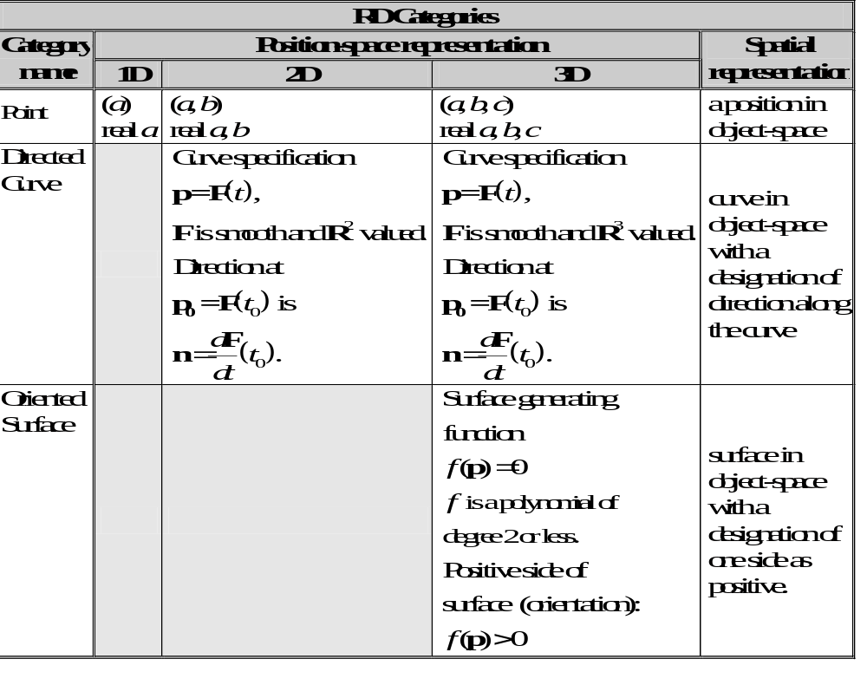
Reference datum (RD)

Slide 39
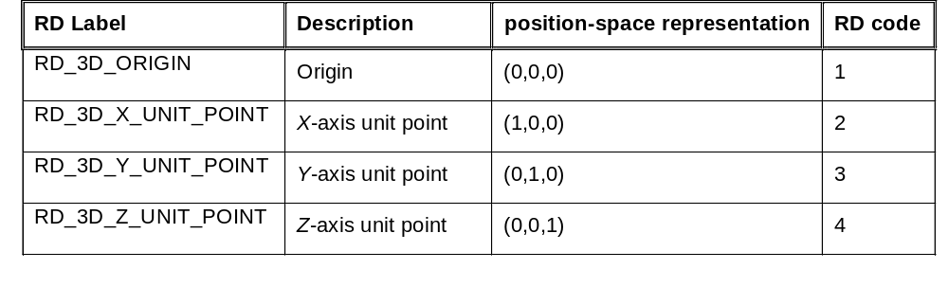
3D point RDs

Slide 40
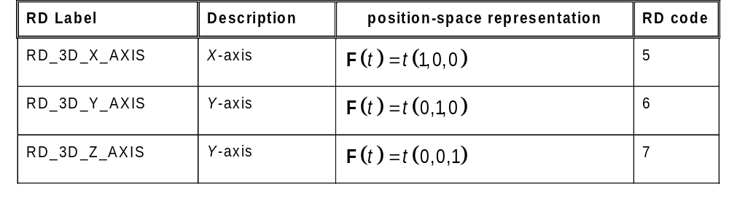
3D directed curve RDs

Slide 41
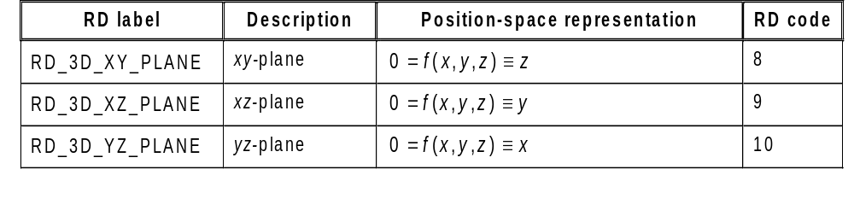
Oriented surface RD (planes)

Slide 42
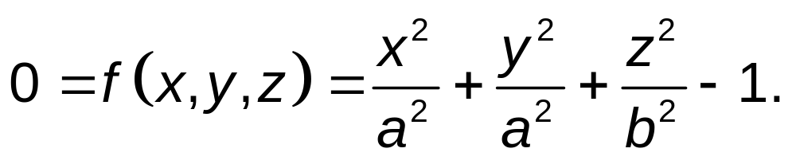
Oriented surface RD (ellipsoids)
Oblate: a > b
Sphere: a = b
Prolate: a < b
Example:
RD_AIRY Airy 1830
a = 6 377 563,396 flattening = 1/299,324 964 6
flattening = (a-b)/a
b = a·(1-flattening)

Slide 43
Standard reference datums
RD
Reference Datum:
a simple geometric construct in position-space that can be bound to
object-space.
Oriented surface
Point
Directed Line
Ellipsoid RD
Plane
Origin
Oblate
Ellipsoid type:
semi-major axis,
flattening, date
Sphere
type:
radius,
date
Prolate
Ellipsoid
type
X-axis
OBE
Sphere
PRS
(0, 0, 0)
F(t)=(t, 0, 0)
Etc.
Y-axis
XZ-plane
F(t)=(0, t, 0)
Airy 1830
NOGAPS
MM5
Z-axis
Clark 1880
MODTRAN Mid Latitude
F(t)=(0, 0, t)
International 1924
North American 1983
Etc.
WGS84 Ellipsoid
Reference Spheres
and Ellipsoids
Etc.

Slide 44
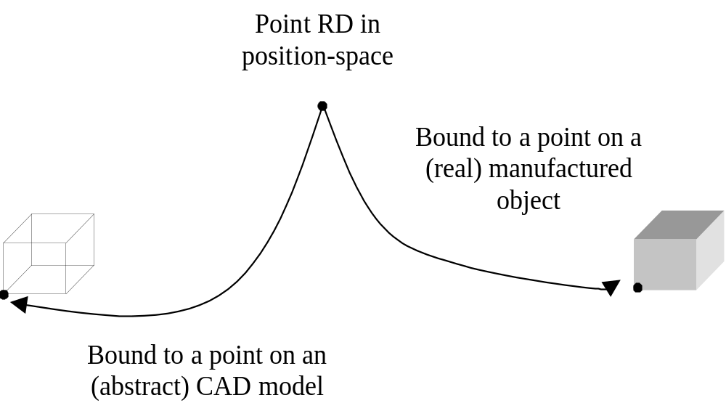
RD bindings
An RD is bound when the RD is identified with a
corresponding constructed entity in object-space.
Points are bound to identified points, directed curves to constructed curves, and oriented surfaces to constructed surfaces.

Slide 45
RD bindings and embedding compatibility
An RD is compatible with a normal embedding if
the locus of the RD in position-space is coincident with
the points (and direction or orientation, as applicable)
of the geometric construction of the binding.
y-axis
binding
z-axis
y-axis
z-axis
p
x-axis
x-axis
RD_3D_XY_PLANE
embedding is not compatible

Slide 46
RD bindings and embedding compatibility
An RD is compatible with a normal embedding if
the locus of the RD in position-space is coincident with
the points (and direction or orientation, as applicable)
of the geometric construction of the binding.
y-axis
y-axis
binding
z-axis
z-axis
p
x-axis
x-axis
RD_3D_XY_PLANE
embedding is compatible

Slide 47
Object reference models
The set of normal embeddings compatible with a
single RD binding has many members.
The set of normal embeddings compatible with
a set of 2 or more RD bindings may be empty.
A careful selection of RDs and bindings may result
in a compatible set of normal embeddings
consisting of a single member.
I.e.: There is a unique compatible embedding for the bound RD set.
This is the concept for an object reference model.

Slide 48
Object reference models
Object reference model (ORM) for a spatial object:
A set of RDs bound by identification with geometric constructions
in object-space for which there exists exactly one normal embedding
of position-space into object-space which is compatible with each RD
binding in the set.
In the 3D case, this unique embedding shall also be right-handed.

Slide 49
Object reference model template
An object reference model template (ORMT), is a set of RD components, together with binding constraints which will determine a unique normal embedding of position-space into object-space when an instance of each the RD components is bound to corresponding geometric constructs in object-space that conform to the binding constraints.
  If the position-space is 3D, the unique normal embedding shall be right-handed.
A binding constraint is a specification of relationships in object-space between geometric constructs corresponding to RD instances.
  The binding constraint specification may include containment of a point in a curve, or a surface, or a curve in a surface, coincidence of a line with the axis of symmetry of a surface, the right-handedness of sets of directed lines or oriented planes, or the distance in object-space between points.

Slide 50
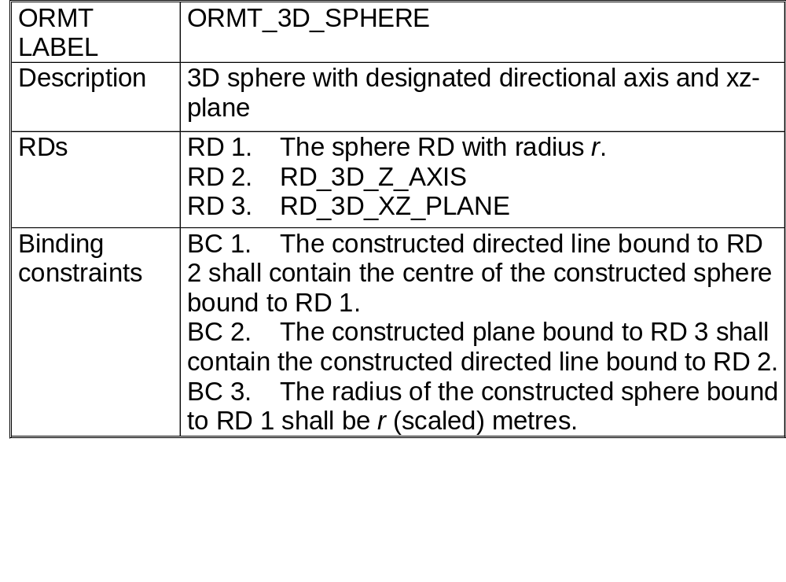
ORMT example

Slide 51
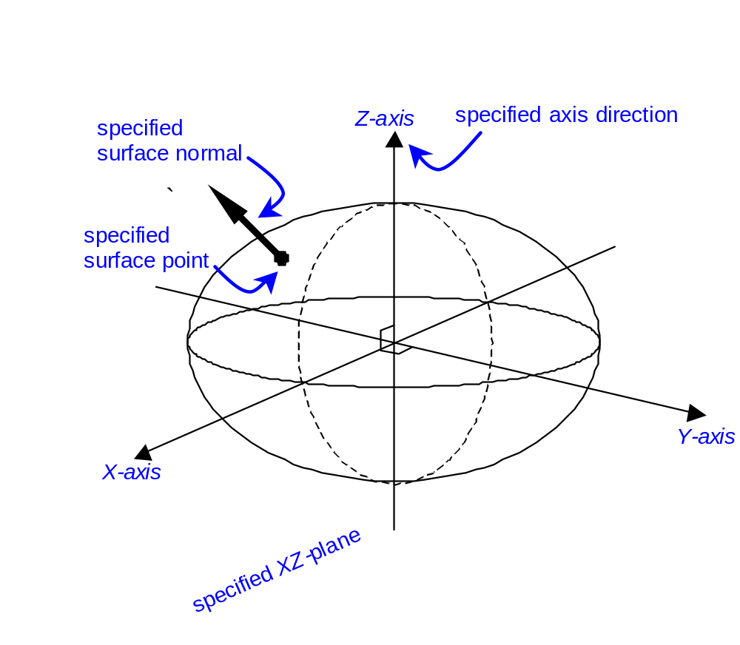
Realization of an ORMT
The binding creates an
indirect normal embedding
of 3D position-space
RDS
  RDS
    Oblate ellipsoid instance
    XZ-plane
  Binding Rule
    the ellipsoid minor axis must be contained in the plane.
Binding
  There is only one place in Earth’s space for the RDS with:
    ellipsoid minor axis points parallel to Earth’s rotational axis
    The point is on the ellipsoid surface with given long/lat
    The surface normal at the point points in the given direction.
The actual binding
methodology
is not part of the SRM

Slide 52
3D ORMTs
ORMT_3D_SPHERE
  3D sphere with designated directional axis and xz-plane
ORMT_3D_OBLATE_ELLIPSOID
  3D oblate ellipsoid with designated minor axis direction and xz-plane
ORMT_3D_PROLATE_ELLIPSOID
  3D prolate ellipsoid with designated major axis direction and xz-plane
ORMT_3D_BI_AXIS_ORIGIN
  x- and y-axes determined by directed perpendicular lines passing through the origin
ORMT_3D_TRI_PLANE
  Origin determined by the intersection of three planes

Slide 53
standard ORMs
Each standardized ORM is a realization of a standard ORMT
Concept
  ORMT realization bound to a specific object at a specific time
    Intrinsically determines a unique (right-handed) normal embedding
  Name of object, definition, RD components
  Object binding
Standard/registered ORMs
    Label, code, definition, region, epoch, etc.
    Standard ellipsoid RD (if so based)
    Reference transformation(s) specified with respect to the
    object reference ORM by 7 parameter values:
        origin offset (Δx, Δy, Δz)
        axis rotations (ω₁, ω ₂, ω ₃)
        scale adjustment Δs
Every spatial object has one reference ORM
    The WGS 84 ORM is the Earth reference ORM

Slide 54
ORMT realization example
North American 1927 (NAD 27)
  ORMT_3D_OBLATE_ELLIPSOID
    Oblate ellipsoid RD instance: Clark 1866 ellipsoid
      semi-major axis 6378206.4 m
      inverse flattening 294.9786982
  Binding (not part of the SRM specification)
    Meades Ranch, Kansas on the oblate ellipsoid surface with long=98°32’30.506” W, lat=39°13’26.686” N and surface normal χ= -1.32 ξ=1.93.
  ORM reference transformation:
    specification of the binding by 7 parameters w.r.t WGS 84 ORM
      origin offset: Δx = -8, Δy = 160, Δz = 176
      axis rotations ω₁= 0, ω ₂ = 0, ω ₃ = 0
      scale adjustment Δs = 0

Slide 55
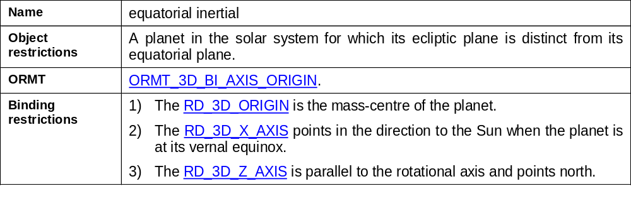
Binding categories
A binding restriction for an ORMT is an
object specific restriction for the binding of
a single RD in the RD set of the ORMT.
A binding category is an ORMT with:
- a binding category name,
- a set of binding restrictions for the ORMT, and
- object restrictions which delineate the
objects for which the binding restrictions apply.
Example: The equatorial inertial dynamic binding category

Slide 56
ORMs vs. object models
Reference Surface:
An ORM is often selected to contain one or more RDs of category
oriented surface to correspond to (physical or conceptual) surface(s)
which is significant to the modelled spatial object.
Example: an oblate ellipsoid as a model of the shape of the Earth.
An RD is chosen and its position with respect to the object is bound so that
the RD instance is a “best fit” to the object in some application-specific sense.
In particular, if the RD surface is “fitted” to a specific part of the object surface,
the ORM is a local model.
If the RD is selected to best fit the entire surface, the ORM is a global model.
Other Surface models:
  geoid: gravity equipotential surface that approximates the mean sea level of the Earth.
  pressure equipotential surface: equipotential surface of a pressure field.
  topographic surface: interface between the solid and liquid/gas portions of a celestial object.
Some of these surfaces are treated in the SRM as vertical offset surfaces (a later topic), while others are outside of the scope of the SRM.

Slide 57
SRM concepts
Spatial objects and object-space
Position-space and normal embeddings
Reference datums
Object reference models
Coordinate systems
  Abstract coordinate systems
    localization
    Induced surface coordinate systems
    map projections
  Temporal coordinate systems
  Spatial coordinate systems
Spatial reference frames
Vertical offset surfaces
Spatial operations

Slide 58
Coordinate Systems (CS)
An abstract CS is a means of identifying a set positions in
m-dimensional position-space (1 ≤ m ≤ 3) that is comprised of:
  a. a CS domain,
  b. a generating function, and
  c. a CS range,
where:
  d. the CS domain is a connected domain in the Euclidean space
  of n-tuples (1 ≤ n ≤ m), called the coordinate-space,
  e. the generating function shall be a one-to-one, smooth, orientation
  preserving function from the CS domain onto the CS range, and
  f. the CS range is a sub-set of position-space.

Slide 59
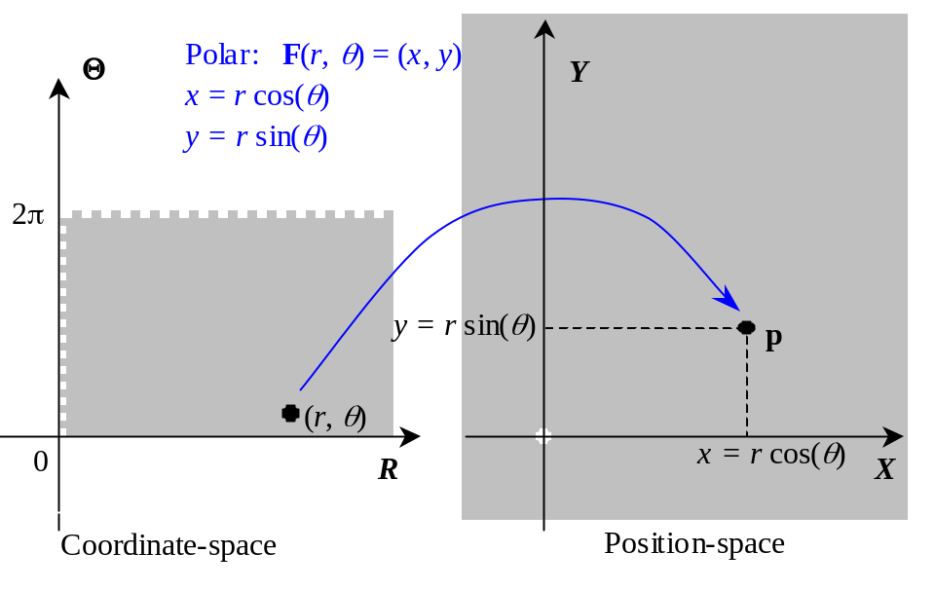
Coordinates for position-space
Y
Geometric/Trigonometric
derivation
r cos θ
r
r sin θ
θ
X
Generating function
realization
Not all CSs have Geometric/Trigonometric derivations

Slide 60
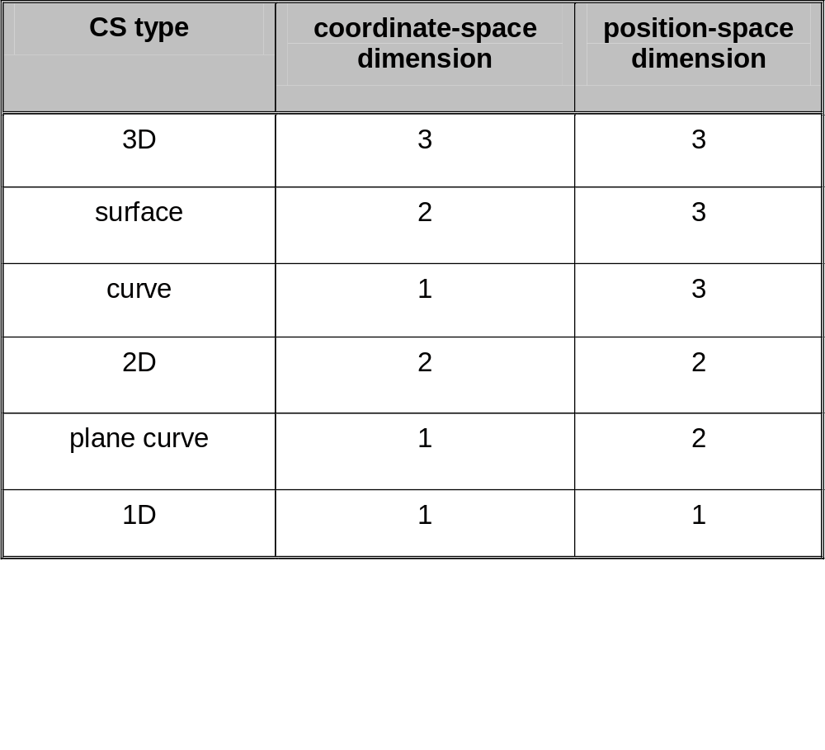
Coordinate system type

Slide 61
Coordinate system characteristics
A CS is linear if it has an affine generating function
(a function is affine if it is a translation operator plus a linear operator)
A non-linear CS is curvilinear.
A linear CS is orthonormal if
3D CS case: the coordinates (1,0,0), (0,1,0),
and (0,0,1) are length one and mutually
perpendicular in position-space.
Surface and 2D CS case: the coordinates (1,0),and (0,0,1)
are length one and mutually perpendicular
in position-space.

Slide 62
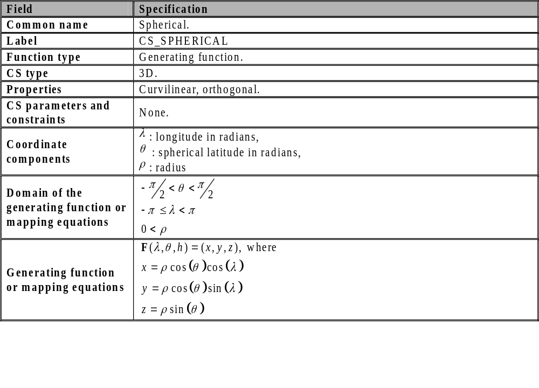
Spherical CS specification
Part 1

Slide 63
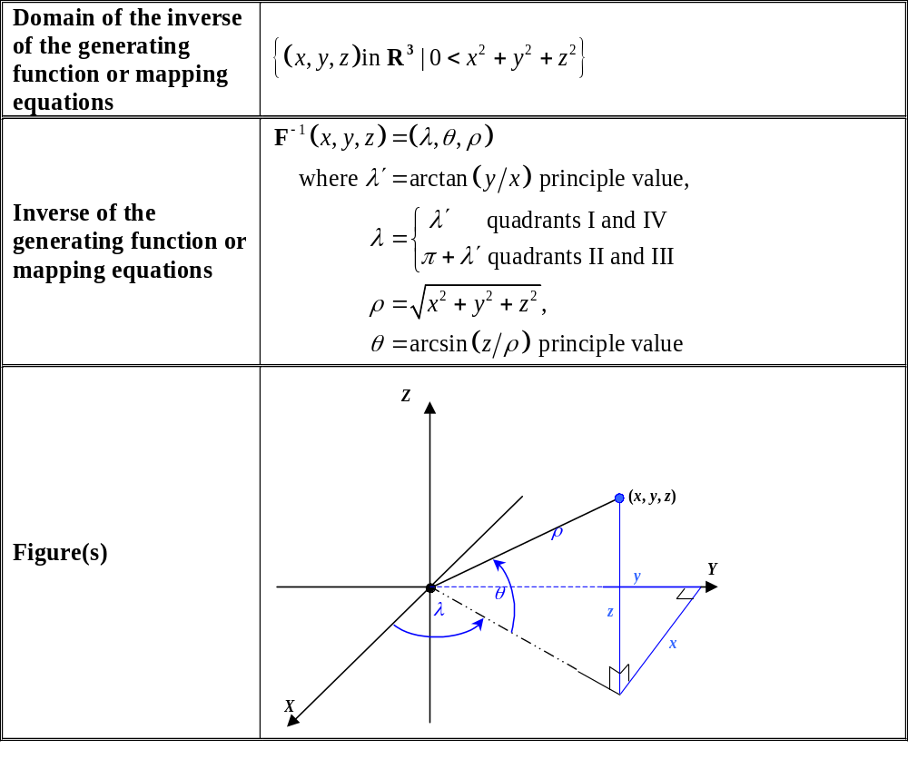
Spherical CS specification
Part 2

Slide 64
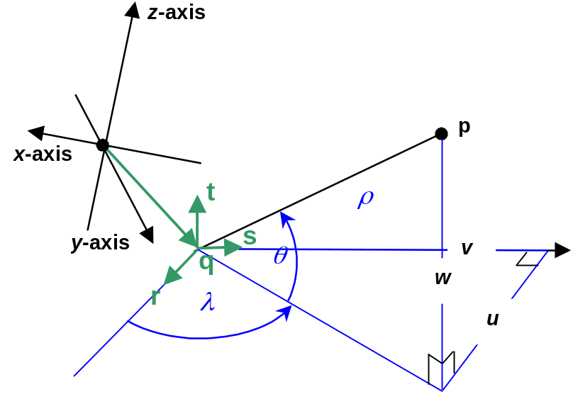
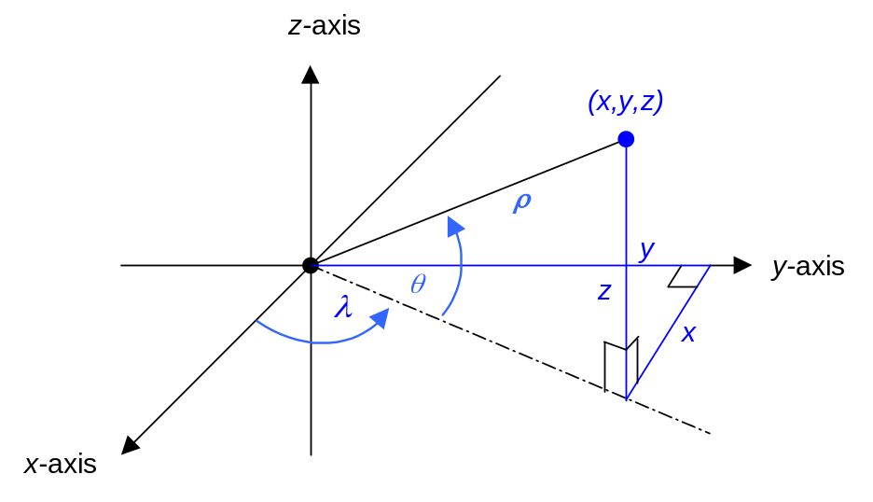
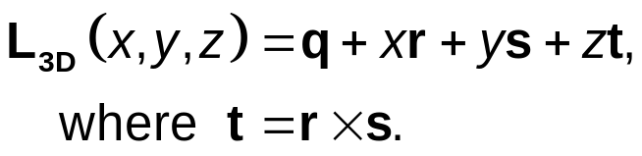
Lococentric spherical CS
Position-space
origin
Lococentric
origin
Spherical CS
Lococentric Spherical CS
F_{s}(λ, θ, ρ)
F_{LS}(λ, θ, ρ)=L_{3D}(F_{s}(λ, θ, ρ))
Localization operator:

Slide 65
Coordinate surfaces and curves
3D CS generating function: G(u, v, w).
Surface 1: G_{S1}(u, v) = G(u, v, w₀).
Surface 2: G_{S2}(u, v) = G(u, v₀, w).
Surface 3: G_{S3}(u, v) = G(u₀, v, w).
Each G_{Sk} is the generating function for a surface CS.
Curve: G_{C1}(u) = G(u, v₀, w₀).
Curve: G_{C2}(v) = G(u₀, v, w₀).
Curve: G_{C3}(w) = G(u₀, v₀, w).
Each G_{Ck} is the generating function for a curve CS.
A CS is orthogonal if its coordinate curves intersect at right angles.

Slide 66
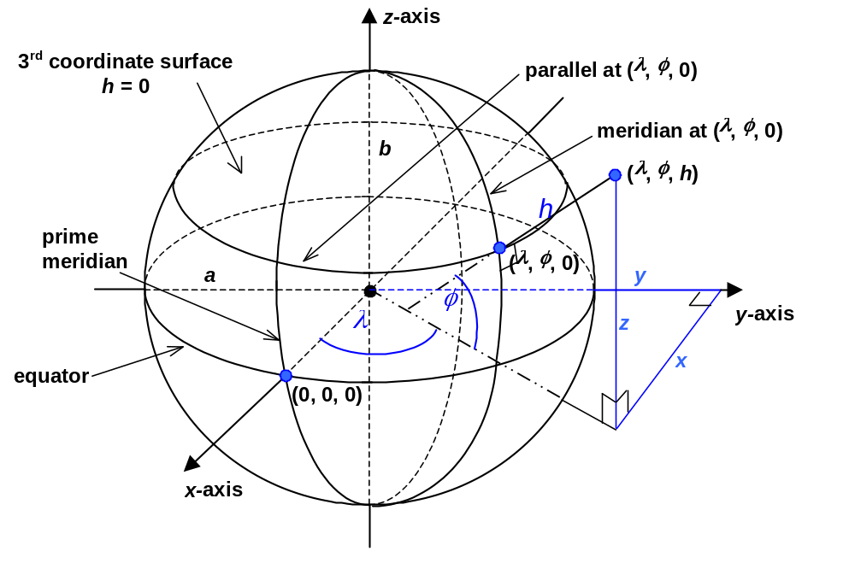
Coordinate surfaces and curves
3D geodetic
Example: Geodetic G(λ, φ, h)
Ellipsoid: G_{S}(λ, φ) = G(λ, φ, 0).
parallel: G_{C1}(λ) = G(λ, φ₀, 0).
meridian: G_{C2}(φ) = G(λ₀, φ, 0).
(induced)
Surface geodetic

Slide 67
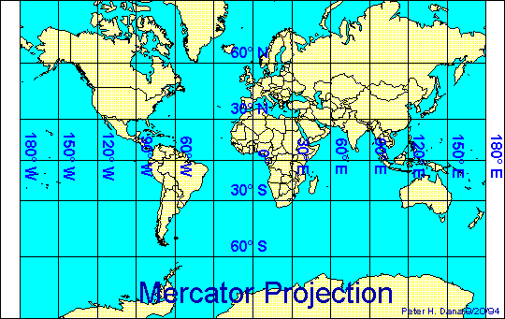
Map projections
Map projections are 2D models of a 3D curved surface.

Slide 68
Map projections
Map projections are 2D models of a 3D curved surface.
A map projection (MP) is comprised of
    a. a connected region of the surface of an oblate ellipsoid,
    b. a generating projection, and
    c. an MP range in 2D coordinate-space,
where:
    d. the MP range is connected, and
    e. the generating projection is one-to-one from the region
    of the oblate ellipsoid onto its MP range and its
    inverse function is smooth and orientation preserving.
The generating projection is formulated in terms of
surface geodetic coordinates called mapping equations.

Slide 69
Map projections
Map projections are 2D models of a 3D curved surface.
Map projection coordinate-space geometry
models/approximates oblate ellipsoid
surface geometry.
But the model geometry is distorted.

Slide 70
Map projection distortion
Length distortion
  The ratio of map distance to geodesic distance is not constant.
  “Equidistant” map projections have a constant distance ratio in one direction (E.g.: North/South distances)
Angular distortion
  A map projection may or may not preserve angles.
  A map projection is conformal if it preserves angles.
Area distortion
  The ratio of map area to ellipsoid area may not be constant.
  “Equi-area” map projections have a constant area ratio.

Slide 71
Map projections
Quantifying distortion:
Map distance vs geodesic distance
  point scale
    ratio at a point for “infinitesimal” distances
    varies at different points
    varies by direction in non-conformal map projections
  map scale
    Nominal ratio for the map area
map azimuth vs. geodetic azimuth
Convergence of the Meridian (COM)

Slide 72
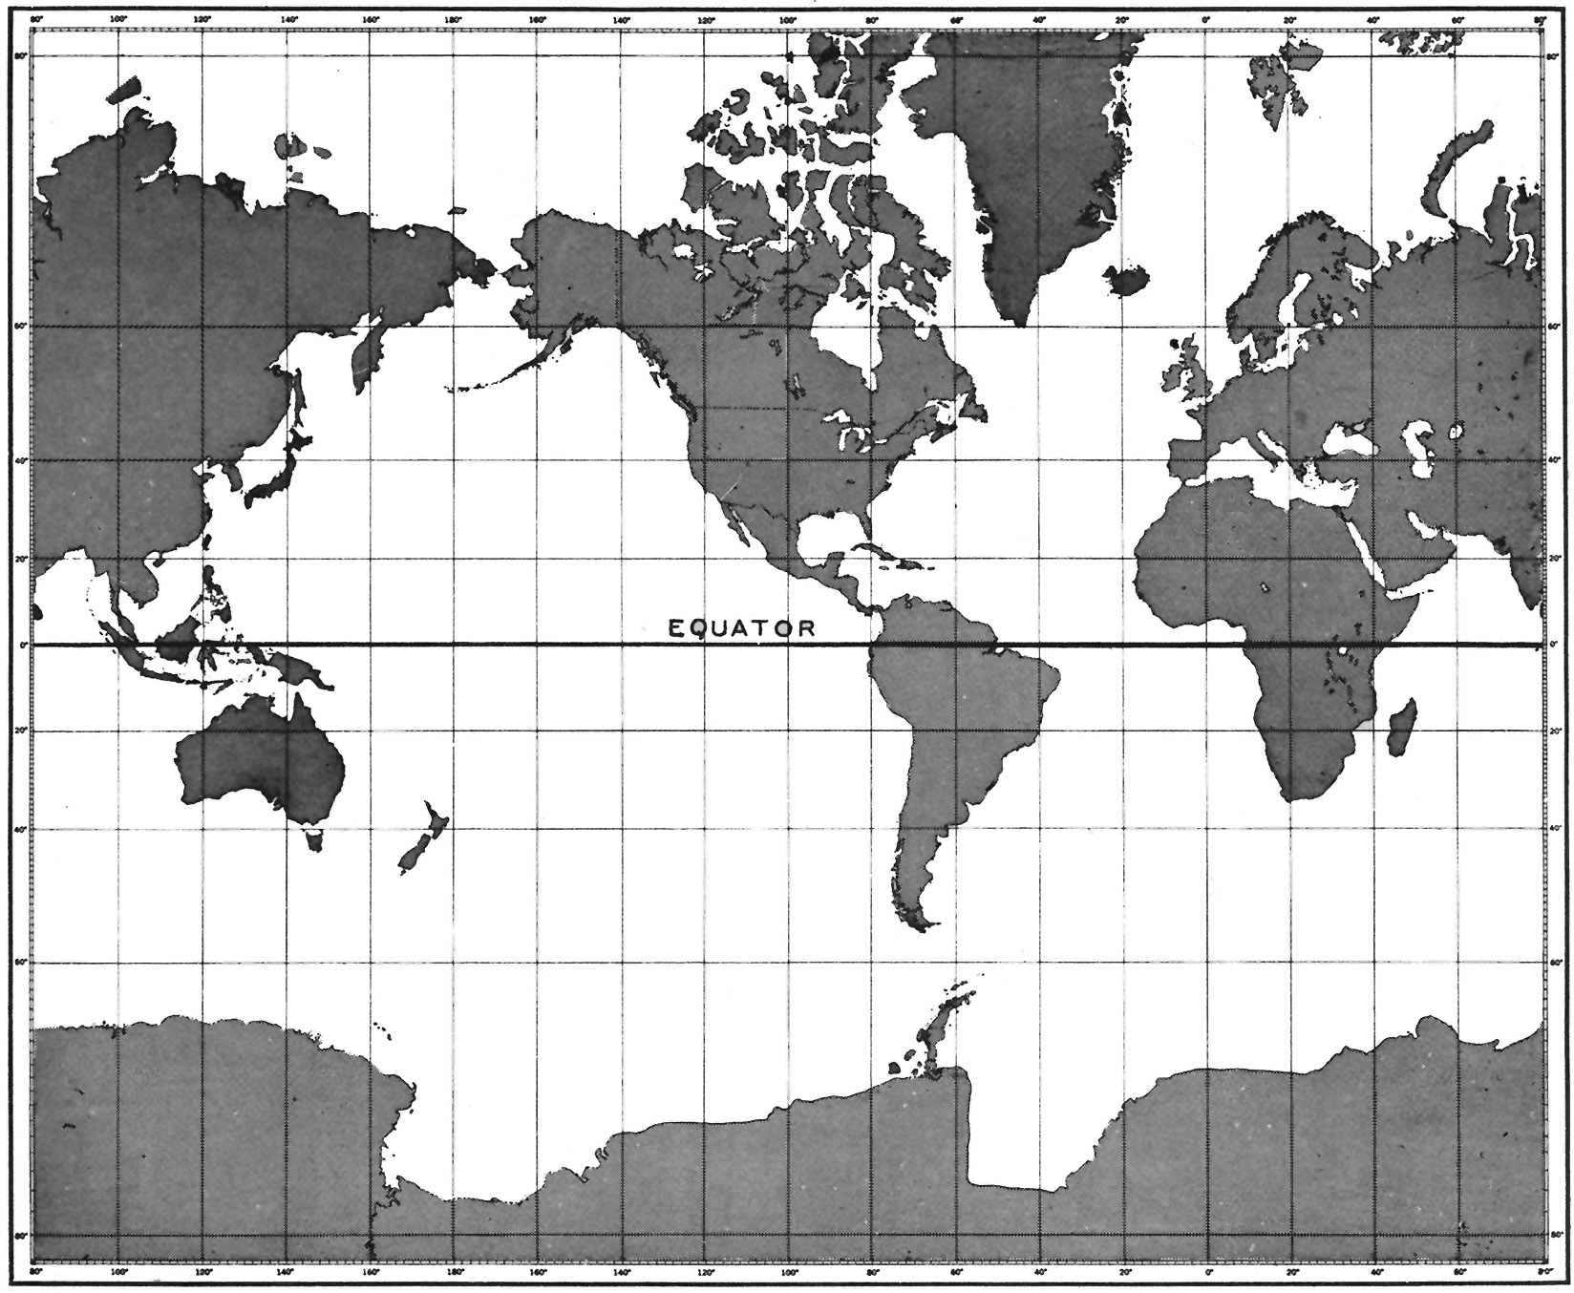
Azimuth
map azimuth β geodetic azimuth α
α
β
Mercator Map Projection

Slide 73
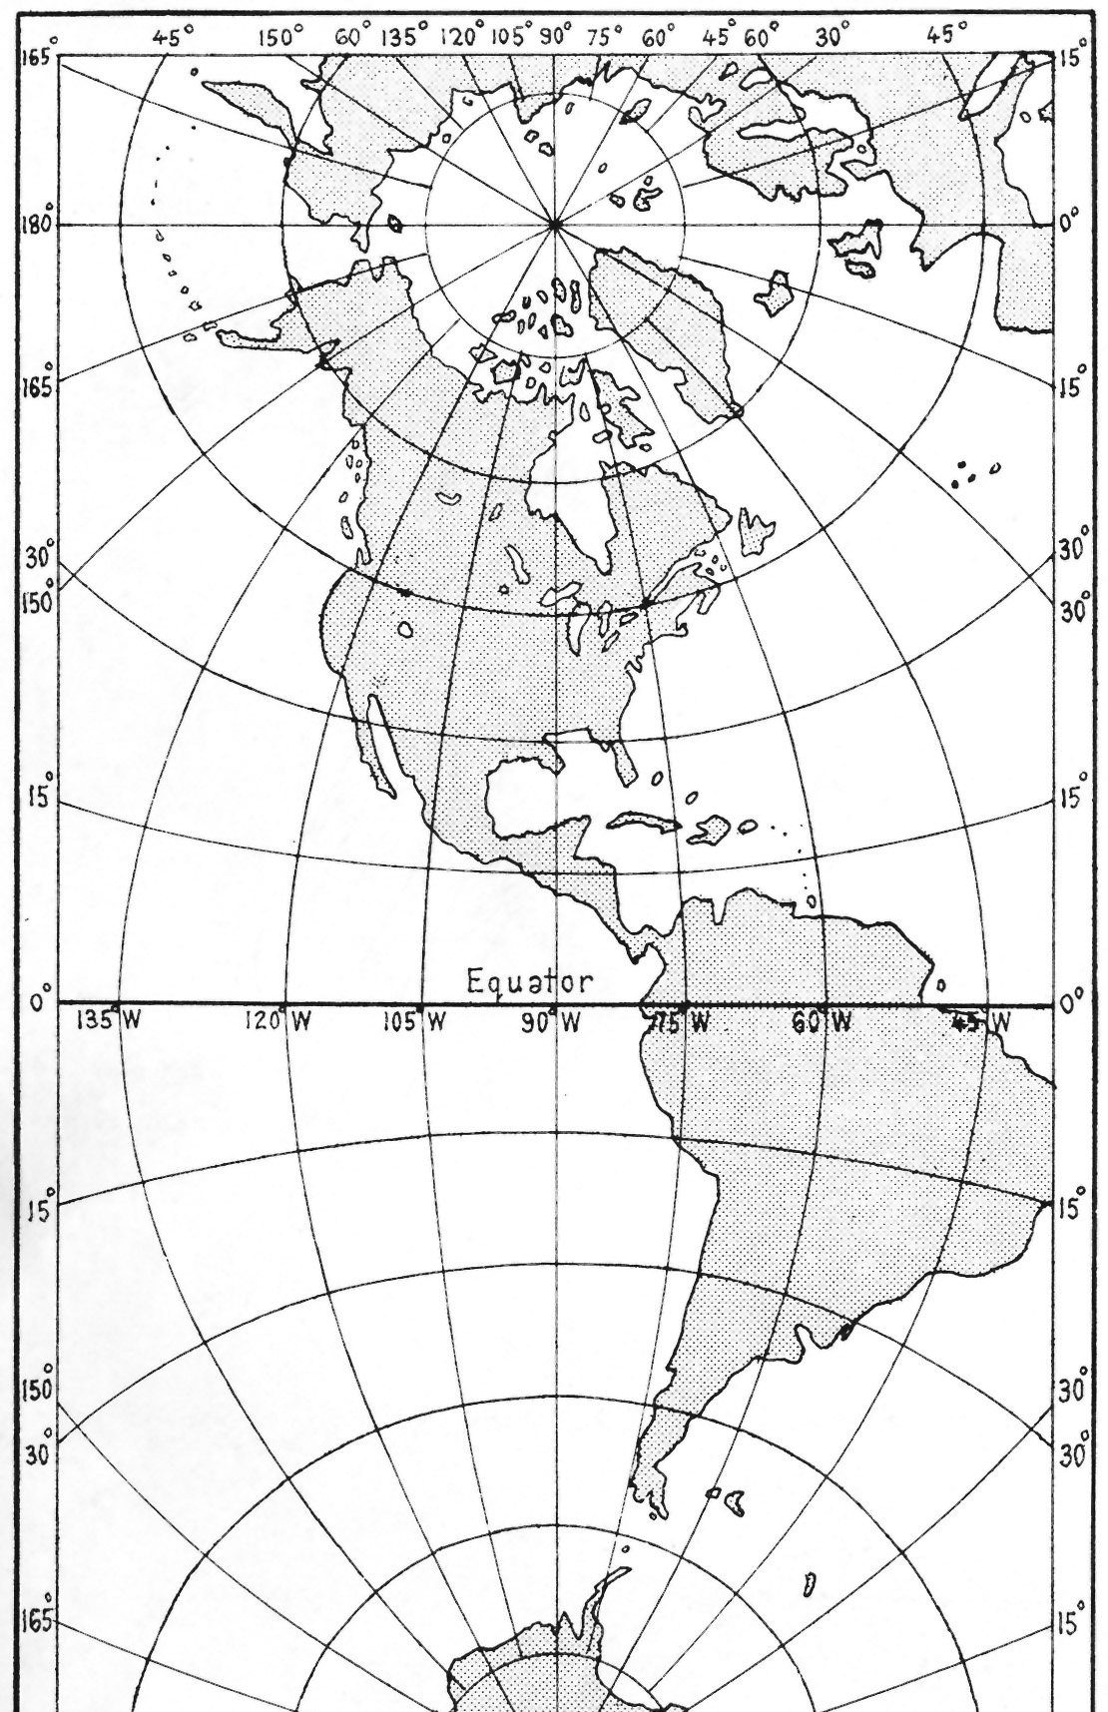
Convergence of the Meridian
v
The convergence of the meridian γ is the angle between MP “North” and true North on the ellipsoid (positive clockwise)
γ
u

Slide 74
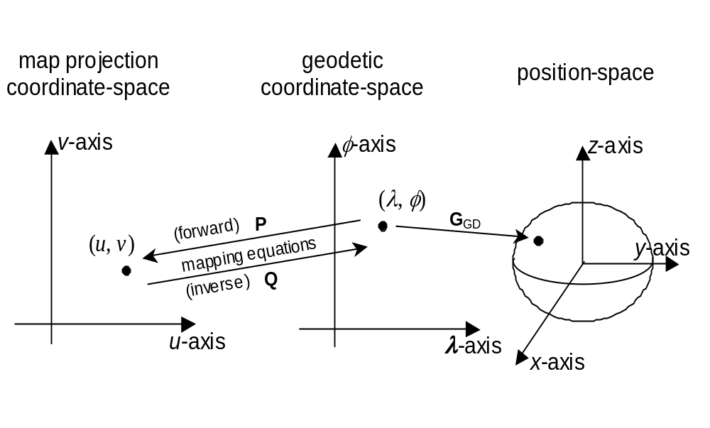
Map projection as a surface CS
geodetic
generating function
G_{MP} = G_{GD} Q
generating function

Slide 75
Augmented map projections
Simulations usually require three dimensions.
Some coordinate systems three dimensional by definition.
Map projections (two surface dimensions) are commonly augmented with a vertical axis to create a three dimensional system.
Various vertical measures are used for these augmentations, such as:
  Mean sea level height, orthometric height, geodetic height, pressure altitude, and others.
These augmentations may be in different units than the other two axes so that the resulting CS may be vertically distorted.
This practice adds additional geometric distortions (now in the third dimension).
Augmented map projection coordinate-space has a (linear) vector space structure, but the CS is a curvilinear CS.

Slide 76
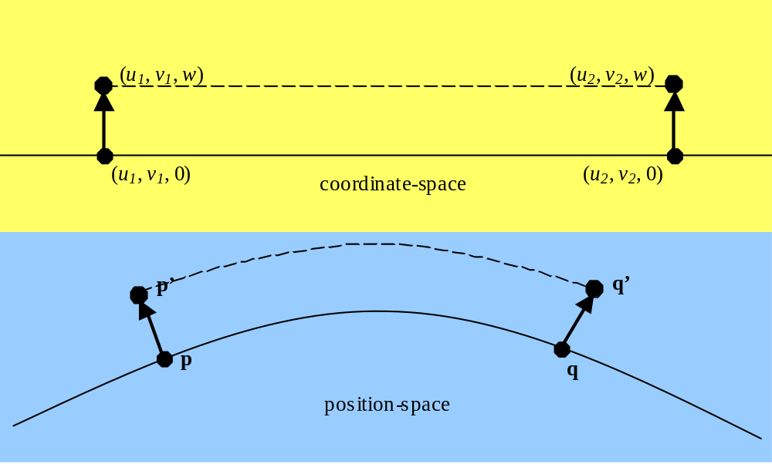
Augmented map projections
Augmenting map coordinates
with ellipsoidal height produces a 3D CS.
MP coordinate (u, v)
(λ, φ) surface geodetic coordinate
Augmented
MP coordinate (u, v, h)
(λ, φ, h) 3D geodetic coordinate
Caution!
Augmented map geometry
in coordinate-space
must not be confused with
position-space geometry

Slide 77
Augmented map projections
Line of sight visibility in
augmented map projection coordinate space...
(
u
1
,
v
1
,
w
)
(
u
2
,
v
2
,
w
)
(
u
1
,
v
1
, 0)
coordinate -space
(
u
2
,
v
2
,
0)
p’
q’
p
position-space
q
… can be an illusion.

Slide 78
Geometry: coordinate-space vs. position-space
A cube in an augmented
map projection coordinate-space ...
… is not a cube position-space.
Only points in the red region are transformed by the map projection.
Every point on the base (red) is on the ellipsoid.
If the projection is conformal interior angles of the base are 90°.
All other angles are generally not 90°.
In general none of the sides are equal.
The vertical lines are not parallel and are not even coplanar.
The 3D volume is no longer convex.
Every point on the base (red) is on the plane.
Interior angles of the base are 90°.
All other interior angles are 90°.
All sides are of the same length.
The vertical sides are parallel planes.
The cube is a convex hull.

Slide 79
Standard coordinate systems
3D CS
Map projection CS
Euclidean 3D
Lococentric Euclidean 3D
Spherical
Lococentric spherical
Azimuthal spherical
Lococentric azimuthal spherical
Geodetic 3D
Cylindrical
Lococentric cylindrical
Euclidean 1D
Mercator
Oblique Mercator
Transverse Mercator
Lambert conformal conic
Polar stereographic
Equidistant cylindrical
2D CS
Euclidean 2D
Lococentric Euclidean 2D
Azimuthal
Lococentric azimuthal
Polar
Lococentric polar
Surface CS
Surface geodetic
Lococentric surface Euclidean
Lococentric surface azimuthal
Lococentric surface polar
Plus those that will be registered
with the ISO standard.
1D CS:
Euclidean 1D

Slide 80
Surface CS induced on a coordinate surface
Geodetic 3D
  Surface geodetic induced on h = 0 surface.
Augmented Map projection
  Map projection induced on h = 0 surface.
Cylindrical
  Surface Polar induced on z = 0 surface.

Slide 81
Temporal CS
An integrated temporal coordinate system
is a Euclidean 1D CS based on a unit of duration
that is derived from a physical phenomenon.
Fixing an origin (called the epoch) and then continuously
accumulating units of the duration specifies an
integrated temporal coordinate system.
The time continuum
0
epoch

Slide 82
Spatial coordinate systems
Abstract CS + position-space normal embedding
= Spatial CS

Slide 83
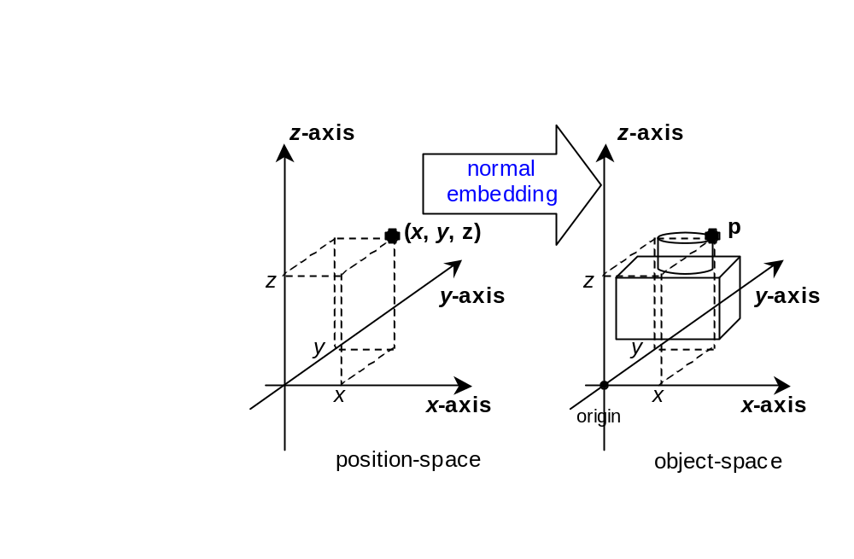
Spatial coordinate systems
3D case
p

Slide 84
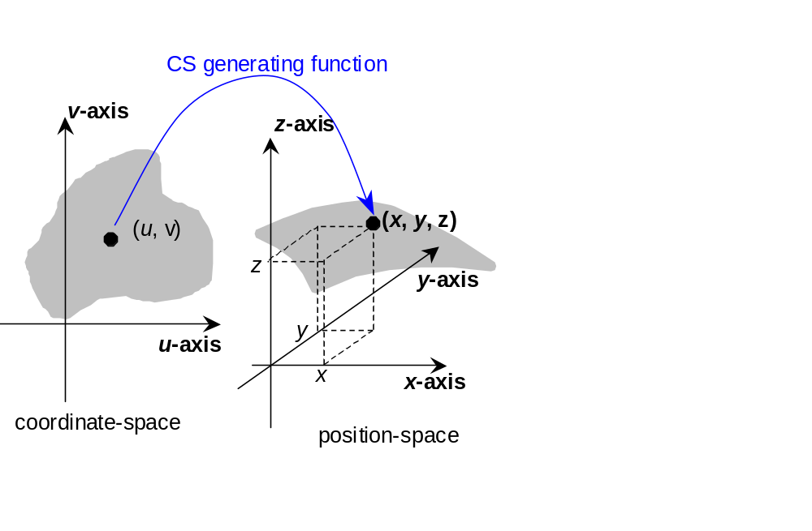
Spatial coordinate systems
3D case

Slide 85
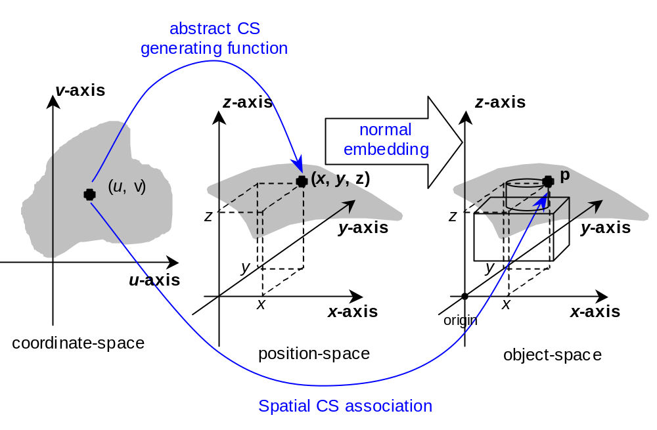
Spatial coordinate systems
3D case

Slide 86
SRM concepts
Spatial objects and object-space
Position-space and normal embeddings
Reference datums
Object reference models
Coordinate systems
  Abstract coordinate systems
    localization
    Induced surface coordinate systems
    map projections
  Temporal coordinate systems
  Spatial coordinate systems
Spatial reference frames
Vertical offset surfaces
Spatial operations

Slide 87
Spatial reference frame (SRF)
Concept
When a CS is bound to the embedding specified by an ORM, the result is called a
Spatial Reference Frame.

Slide 88
Spatial reference frame
Specification
  An ORM with a compatible CS binding
    Example:
    Ellipsoid based CS is compatible with Ellipsoidal ORM only.
    CS binding:
    ORM determines (some) CS parameters.
    Example: geodetic parameters a, b are set to oblate ellipsoid major and minor semi-axis values
  Adds additional domain CS restrictions
    Example: Restrict to a specific region
      Optionally specify a coordinate valid region
      Optionally specify a coordinate extended valid region
  Values for remaining CS parameters
    If any CS parameters are not bound by the ORM

Slide 89
Celestiodetic SRF
Example:
geodetic 3D CS
+
Parameter binding to the ellipsoid of a ellipsoidal ORM
⇒
celestiodetic SRF

Slide 90
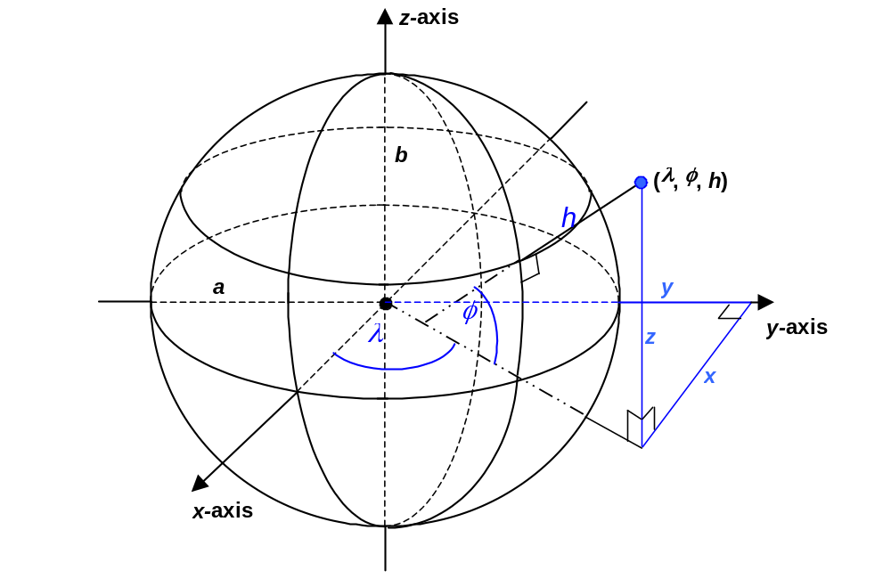
Celestiodetic SRF
Geodetic CS
parameters:
a, b
Bound to
ORM
oblate ellipsoid RD
parameters:
a, b

Slide 91
Local tangent space Euclidean SRF
Example:
Lococentric Euclidean 3D CS
+
Parameter binding to the ellipsoid of a ellipsoidal ORM
⇒
Local tangent space Euclidean SRF

Slide 92
Local tangent space Euclidean SRF
w-axis
v-axis
z-axis
position-space (x, y, z)
s
t
u-axis
Lococentric Euclidean 3D CS
parameters:
vectors q, r, s
(t = r x s)
r
q
x-axis
Lococentric Euclidean 3D CS
coordinate: (u, v, w)
y-axis

Slide 93
Local tangent space Euclidean SRF
ellipsoid ORM
SRF
parameters: λ, φ
s
t
Use ORM to bind
CS parameters:
vectors q, r, s
r
q
(λ, φ)
vectors s and t, lie in
the tangent plane
r is normal to the surface

Slide 94
Local tangent space Euclidean SRF
w-axis
v-axis
u-axis
(λ, φ)
The resulting SRF

Slide 95
Local tangent space Euclidean SRF
v-axis
Additional SRF
parameters:
w-axis
α
α: azimuth
α
(λ, φ)
u-axis

Slide 96
Local tangent space Euclidean SRF
v-axis
w-axis
v-axis
Additional SRF
parameters:
w-axis
h
α
α: azimuth
h₀: offset height
α
u-axis
(λ, φ)
u-axis
h
h

Slide 97
Local tangent space Euclidean SRF
v-axis
v-axis
w-axis
v-axis
w-axis
Additional SRF
parameters:
w-axis
v-axis
α
h
w-axis
α: azimuth
u_{F}
u-axis
h₀: offset height
α
u-axis
v_{F}
(λ, φ)
u-axis
u_{F}: false
easting
v_{F}: false
northing
u-axis
h
h

Slide 98
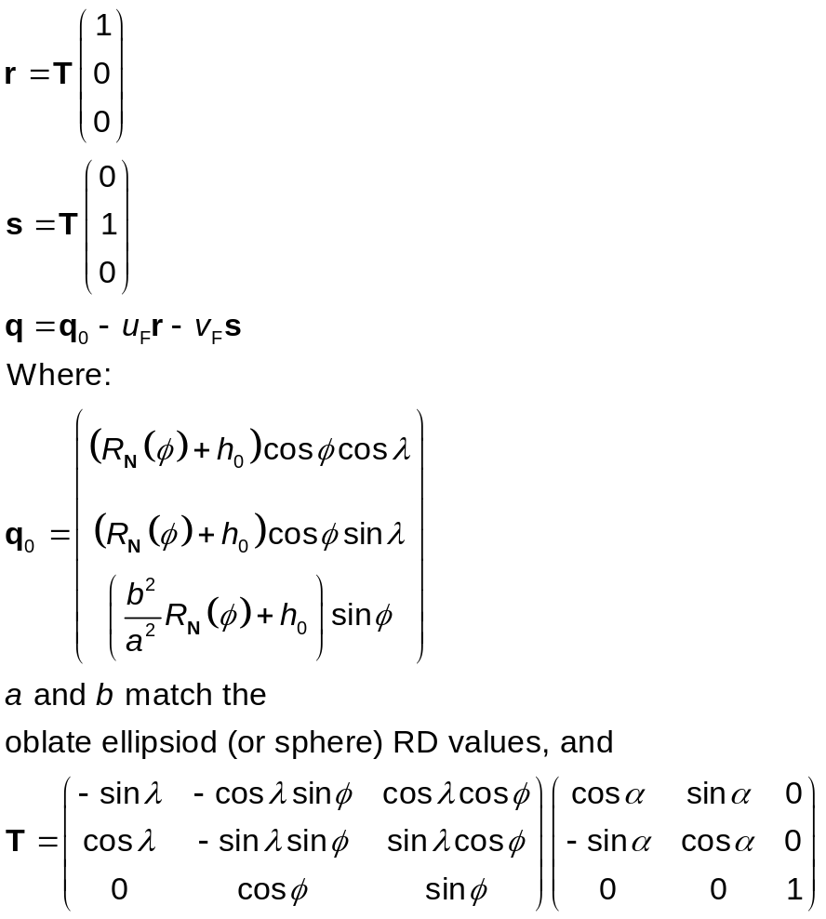
Local tangent space Euclidean SRF
Algebraic specification of the parameter binding

Slide 99
Canonical
Local tangent space Euclidean SRF
Given any SRF based on an oblate ellipsoid ORM (or sphere ORM),
and a point (λ_{o}, φ_{o}) on the ellipsoid, the Canonical
Local tangent space Euclidean (CLTSE) SRF at (λ _{o}, φ _{o}) is the
Local tangent space Euclidean SRF with parameters:
λ = λ_{o}
φ = φ_{o}
α = 0
h₀ = 0
u_{F} = v_{F} = 0
CLTSE SRFs are useful for defining a vector direction in
an SRF with a curvilinear CS.
CLTSE SRFs also useful in instancing an abstract model at a point in an SRF. (E.g.: SEDRIS DRM Geometry/Feature Model Instance.)

Slide 100
SRF templates
SRF Template (SRFT)
  ORM constraints and CS parameters binding.
    Unbound CS parameters (if any) become SRFT parameters.
SRF instance of a template
  ORM specified, and
  SRFT parameters are specified.
  All standardized SRF in the SRM are SRFT instances.
SRF sets
  A fixed (standard/registered) indexed set of SRFT instances for a given ORM.
  Examples : UTM - zone code and hemisphere
  GCS - index code
  PS - polar aspect code

Slide 101
SRFTs for 3D object-space
(augmented) Map projections
Mercator
Oblique Mercator
Transverse Mercator
Lambert conformal conic
Polar stereographic
Equidistant cylindrical
Celestiocentric
Local space rectangular 3D
Celestiodetic
Local tangent space Euclidean
Local tangent space azimuthal spherical
Local tangent space cylindrical
Celestiomagnetic
Equatorial inertial
Solar ecliptic
Solar equatorial
Solar magnetospheric
Solar magnetic
Heliospheric Aries ecliptic
Heliospheric Earth ecliptic
Heliospheric Earth equatorial
Plus those that will be registered
with the ISO standard.

Slide 102
SRFTs for 3D object-space
Surface CS SRFs induced by 3D CS SRFs
3D CS SRF
Celestiodetic
Local tangent space Euclidean
Local tangent space azimuthal spherical
Local tangent space cylindrical
(induced) surface CS SRF
surface Celestiodetic
Local tangent plane Euclidean
Local tangent plane azimuthal
Local tangent plane polar
(augmented) Map projection SRF
Mercator
Oblique Mercator
Transverse Mercator
Lambert conformal conic
Polar stereographic
Equidistant cylindrical
(surface) Map projection SRF
Mercator
Oblique Mercator
Transverse Mercator
Lambert conformal conic
Polar stereographic
Equidistant cylindrical
Compare with ISO 19111 concept of a compound CRS

Slide 103
SRF example
Using Lambert conformal conic SRFT
ORM
  North American 1927 (NAD 27)
    includes: NAD 27 ellipsoid RD (Clark 1866 ellipsoid)
CS
  Lambert conformal conic map projection
SRF parameters (unbound CS parameters)
    longitude of origin 97º West
    latitude of origin 38º North
    central scale 1
    false easting 0
    false northing 0
Additional CS domain/range constraints:
  Restricted to CONUS (expressed as min/max values for map coordinates u and v)

Slide 104
SRFTs for 2D object-space
Local space rectangular 2D
Local space azimuthal
Local space polar

Slide 105
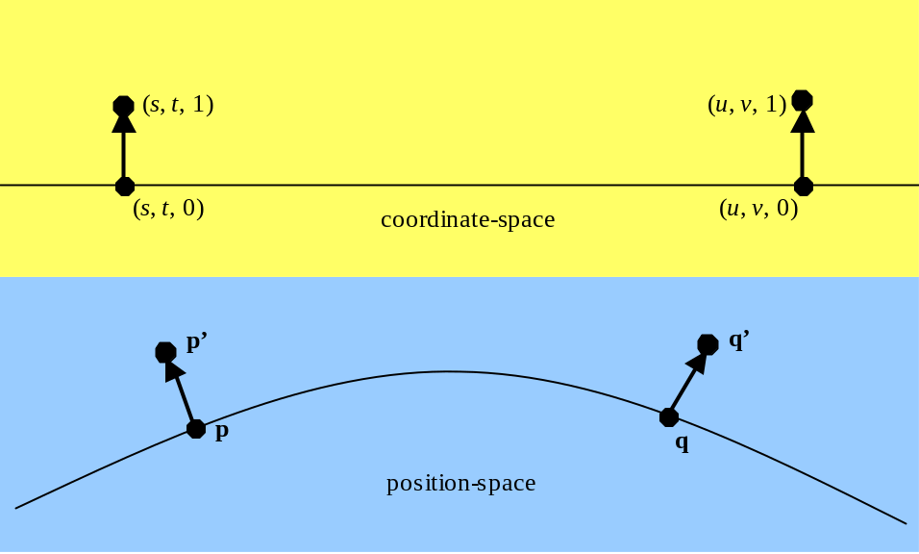
Reference vectors
Represent a direction in object space
Must have reference position
Defined in SRFs with a linear CS:
  Celestiocentric, Local Tangent Space Euclidean (LTSE), Local Space Rectangular
In other cases, defined in Canonical LTSE SRF at the reference location
The “direction” (0,0,1)
depends the
reference location
(p or q)

Slide 106
Reference vectors
Reference vectors are used to specify spatial directions.
In the SEDRIS DRM, reference vectors are restricted to unit vectors associated with a reference position (point).
Reference vectors are specified in the 3D Orthonormal CS of the CLTSE determined by the reference position.
Reference vectors and directions in general must be transformed when changing SRFs.

Slide 107
SRM concepts
Spatial objects and object-space
Position-space and normal embeddings
Reference datums
Object reference models
Coordinate systems
  Abstract coordinate systems
    localization
    Induced surface coordinate systems
    map projections
  Temporal coordinate systems
  Spatial coordinate systems
Spatial reference frames
Vertical offset surfaces
Spatial operations

Slide 108
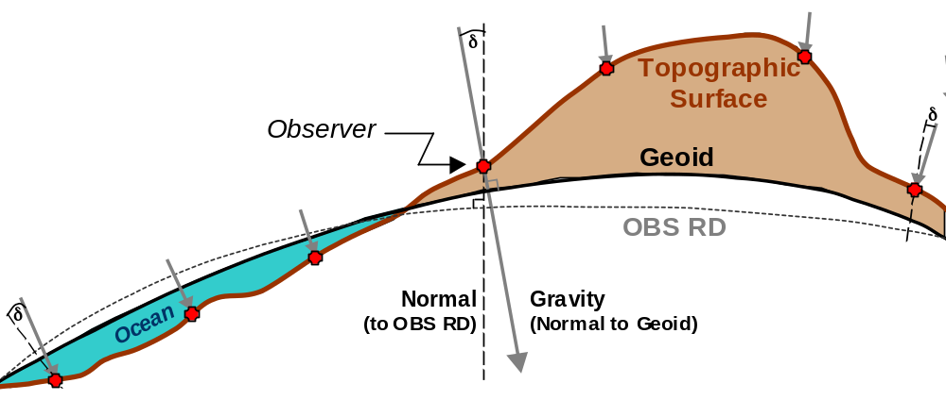
Earth surfaces
Topographic Surface is the interface between the solid and liquid/gas portions of the Earth. It corresponds to the surface of the land and the floor of the ocean.
Geoid Surface excludes the topographic surface, and therefore generally corresponds with mean sea level.
Ellipsoid RD
Normal
(to the
Ellipsoid)
In the SRM, there is no Earth; there are only models of the Earth.

Slide 109
Vertical offset model (VOM)
A VOM is a smooth surface defined by a function the embedded position-space of an ORM
A VOM models a reference surface
  I.e. Mean sea level, gravity equi-potential surface, etc.
Example:
  The geiod for WGS 84 ORM

Slide 110
Vertical offset model (VOM)
Can be used to modify height for a composite SRF:
ellipsoidal height h ⇒ elevation h_{e} = (h- v(λ, φ) )
where v(λ, φ) is the geiodal separation value
p
h_{e}
Geiod
(vertical offset surface)
h
Ellipsoid RD of the ORM
v(λ,φ)
(λ,φ)
Ellipsoidal height coordinate curve

Slide 111
SRM concepts
Spatial objects and object-space
Position space and normal embeddings
Reference datums
Object reference models
Coordinate systems
  Abstract coordinate systems
    localization
    Induced surface coordinate systems
    map projections
  Temporal coordinate systems
  Spatial coordinate systems
Spatial reference frames
Vertical offset surfaces
Spatial operations

Slide 112
Spatial operations
Change SRF
  Coordinate representation
    includes as special cases:
    coordinate transformation
    coordinate conversion
    coordinate validity
  Direction representation
  Change position-space embedding
Map projection based SRFs
  map and geodetic azimuth
  point scale
  Convergence of the Meridian
Euclidean and geodesic distance

Slide 113
Change of embeddings
Case: object-fixed ORMs for same object
H
ORM₁ Embedding position
ORM₂ Embedding position
H is a vector addition
and a matrix multiply
Reference 7 parameter transformation
Inverse reference 7 parameter
transformation
Object reference ORM Embedding position
(Reference ORM for Earth is WGS 84 ORM)

Slide 114
Change of embeddings
Case: dynamic ORMs or two different objects
H
ORM₁ Embedding position
ORM₂ Embedding position
H is a vector addition
and a matrix multiply
Assuming a fixed time coordinate t = t_{o} in the dynamic case:
H=H(t_{o})

Slide 115
Coordinate transformation
Different ORMs (same celestial object)
Same CS
b'
meridian of (
λ
)
b
•
(
φ
,
λ
,
h
) or
h
(
φ
’
,
λ
,
h’
)
•
h’
•
φ
<
φ
’
a
a
h
<
h’
λ
φ
’
φ
b’
<
b

Slide 116
Change SRF operations
Coordinates
SRF₁ = ORM₁ + CS₁
SRF₂ = ORM₂ + CS₂
Source coordinate
in CS₁
Target coordinate
in CS₂
CS₁ Generating function
CS₂ Inverse Generating function
ORM₁ Embedding position
H
ORM₂ Embedding position

Slide 117
Coordinate conversion
Same ORM
Different CS
z-axis
b
•
(
φ
,
λ
,
h
)
or
h
(
x
,
y
,
z
)
•
y-axis
a
y
λ
φ
z
x
x-axis

Slide 118
Change SRF operations
Special Case: Coordinate Conversion
Both SRFs use the same ORM (H not needed)
SRF₁ = ORM + CS₁
SRF₂ = ORM + CS₂
Source coordinate
in CS₁
Target coordinate
in CS₂
CS₁ Generating function
CS₂ Inverse Generating function
ORM Embedding position

Slide 119
Change SRF operations
Direction Vectors
LTP₁
LTP₂
Source direction vector
Target direction vector
LTP₁ rotation matrix
LTP₂ rotation matrix
Rotation
matrix
ORM₁ Embedding direction
ORM₂ Embedding direction
Coordinate frame vector rotation
Inverse Coordinate frame vector rotation
reference ORM Embedding position

Slide 120
Spatial operations
Validation: function for determining coordinate validity after a change SRF operation.
  valid when the coordinate falls within the valid region specification for that SRF;
  extended valid when the coordinate falls outside of the valid region specification for that SRF, but falls within the extended valid region specification for that SRF;
  defined when the coordinate falls within the domain of the CS specified for that SRF; and
  invalid when the coordinate falls outside of the CS domain of the SRF Class of that SRF Class instance.
Example UTM
  Valid region: ±3° of UTM zone central meridian.
  Extended valid region: ±6° of UTM zone central meridian.

Slide 121
Abstract API

Slide 122
SRM API
Abstract specification
  Language bindings are separate documents.
SRF objects are instances of SRFT classes.
Most operations are methods on SRF objects.
  A coordinate object only has meaning in the context of an SRF.
Hierarchical structure: Methods common to a sub-class of SRFT classes are documented in abstract base classes.

Slide 123
SRM API object hierarchy (1 of 6)
LifeCycle Object
Create
Destroy
Coordinate2D
CoordinateSurf
Coordinate3D
Direction

Slide 124
SRM API object hierarchy (2 of 6)
LifeCycle Object
Create
Destroy
BaseSRF
GetCodes
GetORMCode
GetCSCode
BaseSRF2D
CreateCoordinate2D
GetCoordinate2Dvalues
ChangeCoordinate2DSRF
EuclideanDistance
LocalSpaceRetangular2D
Create
GetSRFParameters
Polar
Create
GetSRFParameters
Azimuthal
Create
GetSRFParameters

Slide 125
SRM API object hierarchy (3 of 6)
LifeCycle Object
Create
Destroy
BaseSRF
GetCodes
GetORMCode
GetCSCode
BaseSRF3D
CreateCoordinate3D
CreateDirection
GetCoordinate3Dvalues
GetDirectionValues
ChangeCoordinate3DSRF
ChangeDirectionSRF
EuclideanDistance

Slide 126
SRM API object hierarchy (4 of 6)
BaseSRF3D
CreateCoordinate3D
CreateDirection
GetCoordinate3Dvalues
GetDirectionValues
ChangeCoordinate3DSRF
ChangeDirectionSRF
EuclideanDistance
ConcreteSRF3D
Create
GetSRFParameters
BaseSRFwithEllipsoidalHeight
CreateCoordinateSurf
GetCoordinateSurfValues
AssociateCoordinateSurf
PromoteCoordinateSurf
CreateLocalTangentEuclideanSRF
OffsetVerticalSeparation
GeodesicDistance
EuclideanDistance
BaseSRFwithTangentPlaneSurface
CreateCoordinateSurf
GetCoordinateSurfValues
AssociateCoordinateSurf
PromoteCoordinateSurf
EuclideanDistance

Slide 127
SRM API object hierarchy (5 of 6)
BaseSRFwithEllipsoidalHeight
CreateCoordinateSurf
GetCoordinateSurfValues
AssociateCoordinateSurf
PromoteCoordinateSurf
CreateLocalTangentPlaneSRF
OffsetVerticalSeparation
GeodesicDistance
EuclideanDistance
Celestiodetic
Create
GetSRFParameters
BaseMapProjectionSRF
ConvergenceOfTheMeridian
PointScale
MapAzimuth
ConcreteMapProjection
Create
GetSRFParameters

Slide 128
SRM API object hierarchy (6 of 6)
BaseSRFwithTangentPlaneSurface
CreateCoordinateSurf
GetCoordinateSurfValues
AssociateCoordinateSurf
PromoteCoordinateSurf
EuclideanDistance
LocalTangentEuclidean
Create
GetSRFParameters
LocalTangentAzimuthalSpherical
Create
GetSRFParameters
LocalTangentCylindrical
Create
GetSRFParameters

Slide 129
SRM API non-object functions
CreateStandardSRF3D
Input: SRF_Code
Output: SRF3D
CreateSRFSetMember
Inputs: SRFS_Code
SRFS_Member_Code
ORM_Code
Output: SRF3D

Slide 130
Abstract API examples
Example 1: Find the Euclidean distance between two locations.
--Note: Label in italics denotes a symbolic constant for this example --
Celestiodetic method Create
( Input: ORM_N_AM_1983_CONUS; Output: srf)
srf method CreateCoordinate3D
( Inputs -77º(π/180º), +38º(π/180º), 0; Output: coordinate1)
srf method CreateCoordinate3D
( Inputs +3º(π/180º), +49º(π/180º), 0; Output: coordinate2)
srf method EuclideanDistance
( Inputs coordinate1, coordinate2, 0; Output: distance)
-- use distance result --
coordinate1 method destroy
coordinate2 method destroy
srf method destroy

Slide 131
Abstract API examples
Example 2: Change SRF representation of a location from UTM to Celestiocentric
--Note: Labels in italics denote symbolic constants for this example --
Function CreateSRFSetMember
( Input: SRFS_UNIVERSAL_TRANSVERSE_MERCATOR,
ORM_N_AM_1983_CONUS,
ZONE_23_NORTHERN_HEMISPHERE, Output: source_srf)
Function CreateCoordinate3D
( Inputs 120, 400, 0, Output: source_coordinate)
Function CreateStandardSRF
( Input: SRF_GEOCENTRIC_EARTH_1984, Output: target_srf)
srf method ChangeCoordinate3DSRF
( Inputs source_srf, source_coordinate, Output: target_coordinate)
-- use target_coordinate result --
source_coordinate method destroy
target_coordinate method destroy
source_srf method destroy
target_srf method destroy

Slide 132
SRM API Implementation
STC Tutorial
4 - 6 PM, Tuesday, January 6
SRM for Programmers

Slide 133
Computational considerations
Accuracy
Errors
Testing
Algorithm Design

Slide 134
Error sources in spatial operations software
There are many possible error sources in development of software for coordinate transformations.
  Truncation errors are due to the use of a finite number of terms in an infinite series.
  Approximation error is due to approximating one function with another (simpler to compute) function.
  Iteration error is due to the use of a finite number of iterations in an iterative process.
  Formulation errors are due to the analyst developing the incorrect equations or logic – this includes improper formulations near singular points, improper treatment of signs, incorrect treatment of units and others.
  Implementation errors are due to improper coding of the correct formulation.
  Round-off errors are those caused by finite word length computers.

Slide 135
Bounds checking
Coordinate transformations may only be valid for prescribed regions.
Both input and output should be checked for validity.
For many coordinate frameworks, the mathematical formulation may exist everywhere even though the results may be nonsensical for some regions.
Determining acceptable bounds requires an examination of distortion effects and, in some cases, computational accuracy.
This is an emerging issue for SRM standardization efforts.
The problem is multi-faceted:
  What are the acceptable bounds?
  For which applications?
  Who determines them?

Slide 136
Distortion and computation error tradeoff
The computational complexity and efficiency of series representations depend on the number of terms used.
For map projection-based SRFs, distortion generally increases away from the origin.
Computational accuracy may be swamped by errors due to distortion.
Appropriate tradeoff of these effects are application dependent, and is central to determining validity bounds.
There is little published information to support a cogent decision on how to set the bounds.

Slide 137
How should accuracy be specified?
Published standards for mathematical library routines set a precedent for this Issue.
  E.g., IEEE standards specify a valid operating range and accuracy for each function.
Examples of what happens when the argument is out of range:
  A negative argument for a real square root, or a zero input for a logarithm will generate error messages.
  Too large (or small) an argument may generate a warning or require special handling (overflow-underflow protection).
Computational performance (efficiency) is not specified, but is market driven.
Accuracy is specified in decimal digits (or bits of precision).
  Accuracy is specified for the worst-case application.
  Nominal applications never come close to needing full accuracy.
  No options are provided for reduced accuracy – this leads to ad hoc (non-standard) in-line replacements to reduce computation time.
Standards based implementations require bounds checking
and accuracy specification.

Slide 138
Ground rules for spatial operations algorithm development
A Spatial Operation (SO) for Earth specific applications is a
coordinate transformation, a coordinate conversion, an azimuth
determination, a distance calculation or other computations
associated with elliptical trigonometry and map projections.
GR 1: Consider the current computational environment:
- a surfeit of low cost Dynamic Random Access Memory (DRAM),
- high speed cache available,
- super scalar architectures for pipelined (parallel processing),
- very high speed processing of some standard mathematical functions,
- improved compilers consistent with pipelined processing,
- operating systems with dynamic optimization of resources,
- IEEE double precision as nominal processing mode.
GR 2: Consider the domain of application:
- develop for all regions but recognize that specific regions or
applications may require different approaches,
- do not lose sight of the fact that majority of applications are in the near Earth
region [-12, 35] kilometres (in geodetic height). This region encompasses the
lowest point of Earth bathymetry (Marianas Trench) to the limit of air breather flight.

Slide 139
Ground rules for spatial operations algorithm development (cont’d)
GR 3: Define a meaningful error measure:
- use a Euclidean position error metric where this makes sense,
- convert angular errors to position errors,
- use a maximum position error over the entire region of interest.
- avoid the use of average absolute component errors.
GR 4: Avoid excessive accuracy:
- the SEDRIS goal is a maximum of 1mm position error over a region,
- avoid algorithms designed to yield errors like 10⁻⁰⁸ or 10⁻²⁰ if computational
resources are required to achieve such accuracies.
GR 5: Set an acceptable error goal before starting development:
- for the SEDRIS accuracy goal, 0,000 9 mm, is < 0,022 860 in, is < 1/32 in,
- note that when the maximum position error is small the component errors
are small,
- when angular errors are changed to position errors a small position
error usually implies a very small angular error.

Slide 140
Ground rules for spatial operations algorithm development (cont’d)
GR 6: Use mathematical formulations consistent with GR1:
- use low order piecewise continuous representations when possible
(popularly called table look up). This exploits low cost DRAM,
- do not use in-line table look up for square root or transcendental
functions. It is virtually impossible to compete with built in system
functions for these,
- do use global approximations or piecewise approximation if there is
no high performance system routine. Note that, for example, sin(x) is
not sin(f(x)). Depending on f(x), sin(f(x)) may be better handled by
piecewise approximation,
- if forced to use a series, use only as many terms as required near the
expansion point and more further away from the expansion point,
- for iterative methods determine the number of iterations required
via error analysis and do not use expensive termination tests.

Slide 141
Ground rules for spatial operations algorithm development (cont’d)
GR 7: Use good programming practices:
- modern compilers can repair bad programming practices but do
not depend on that,
- compute global constants once at start up,
- compute local constants once at the highest loop level,
- nest polynomials, etc,
- coding of the publication form of an algorithm is some times referred to
as a naïve implementation. Never code the publication form of an algorithm
without considering the computational aspects. Use trigonometric identities to
simplify, avoid power functions, logarithms, exponentials by re-formulation.
Seek competent counsel if you lack experience,
- naïve formulations and implementations are common in the literature
and even in authoritative codes. Many times the conclusions of a publication
are completely wrong due to the use of naïve implementations.

Slide 142
Ground rules for spatial operations algorithm development (cont’d)
GR 8: Design to context:
- algorithms for computing SOs should be designed for the context in
which they are used. SO algorithms are usually not employed in isolation.
Many SO computations are followed immediately by several more to
form what is called a chain.
- all variables needed for the chain should be retained for subsequent use,
- designing for context may determine which of several procedures is
best.
Example for an ERM: Some algorithms for converting geocentric
coordinates to geodetic naturally compute the trigonometric functions of
latitude and the radius of curvature in the prime vertical to full accuracy
as part of the process. If this conversion is followed by a transformation
to a map projection these variables will be needed. A good design for the
first conversion will retain them. On the other hand some popular
algorithms for the first conversion do not naturally produce these
variables and to get them require more relatively expensive calculations.
This should influence the choice of algorithm.

Slide 143
Ground rules for spatial operations algorithm development (cont’d)
GR 9: Software verification & computational error assessment:
- it is good practice to use authoritative data to confirm results, but do not
be overly surprised that such data bases themselves are too sparse and
are sometimes not accurate enough,
- all formulations in the SRM have closed form solutions in at least the
forward direction. These can be used to automatically generate a dense
set of test points,
- forming localized dense test sets near singular points is a good practice,
- one result of dense testing is to verify that the implementation is working
properly over its intended area of application. Formulation and coding
errors will be evident when dense test sets are used,
- converting a point, then converting that back to the original and then
repeating the process a large number of times is called circular testing.
Circular testing will most likely yield a divergent sequence of results. This
is because round-off error, truncation error and other approximation
errors are not symmetric. Circular testing is not a valid test procedure.

Slide 144
Ground rules for spatial operations algorithm development (cont’d)
GR 10: Performance testing can be difficult :
- in the literature, operation counts and counts of square root and transcendental function
calls are often used to compare algorithms. Such a practice is generally a very poor
predictor of performance and should only be used for rough judgments,
- sometimes algorithms are tested in isolation. A loop is coded and the loop time
determined from system timing utilities. The candidate algorithm is entered into the
loop, timed for a large number of replications, the loop time removed and the average
processing time is computed. This kind of testing is called in situ testing. In situ testing
can also yield misleading results, especially for the systems as outlined in GR 1. For
the simple programs used in situ testing there is no competition for system resources
and all the power of a super-scalar architecture will be used. The performance results
may be very misleading.
- In vivo testing is performance testing in the context of a much larger application
program. In this case there will be competition for system resources and algorithm
performance may be impacted,
- while in vivo testing is always desirable it may not be possible early in a large
development program. The developer must then use the other forms of assessment
that are available while keeping in mind what might happen in the final product,
- it is always advisable to perform in vivo tests as a final confirmation of the algorithm
performance.

Slide 145
Spatial Operations
Quality
Accuracy
Conformance Testing

Slide 146
Quality assurance for spatial operations
Specifying the quality of spatial operations requires error determination.
The meaning of “error” depends on the context and application domain.
Potential sources of error in spatial operations include:
  formulation error, approximation error, round-off error, truncation error and other errors associated with implementing the spatial operation.
Errors of this nature should not be confused with errors arising from modeling the true shape of a celestial object (real or virtual) by an approximate shape.
In the SRM, the reference surface used to approximate the shape of a celestial object, is assumed to be exact.
  How well a reference surface approximates the shape of a celestial object is outside the scope of the SRM.

Slide 147
The meaning of accuracy is context dependent
In geodesy a reference set of measured points is used to develop an Earth Reference Model (ERM)--a mathematical model of the Earth.
ERMs provide a mathematical framework for spatial referencing.
The amount of position error introduced by using an imperfect reference set of measured points is a major technical issue in geodesy but is outside the scope of the SRM.
In the context of the SRM, reference models of spatial objects are taken to be exact when forming spatial reference frames.
Operations on spatial reference frames may contain inaccuracies due to:
  the use of truncated power series representations,
  round off error,
  approximations made to reduce computational complexity to speed up computations.
Accuracy Or Error In The Context Of the SRM Refers To
Computational Error And Excludes Measurement Error Effects.

Slide 148
Conformance verification for the SEDRIS implementation
A fundamental discriminator for level of conformance verification is the numerical difference between a result obtained from the mathematical specifications in the SRM and the corresponding result obtained by an implementation.
  This requires that there be a Reference Implementation.
  A data set produced by the Reference Implementation to support conformance testing is called a Reference Data Test Set.
  For this purpose, the data points obtained from the RDS are taken to be the exact or true data points.
Quantities in the Reference Data Test Set are called test points.
  Each implementation to be tested shall have provisions for recording the information needed to compare to the Reference Data Test Set to support of conformance testing
  This set of output data is called a Test Data Set.
  The difference between the data points of an Reference Data Test Set and the Test Data Set of a particular implementation is referred to as an error.

Slide 149
Acceptance testing methodology
It is desirable to have the number of data points be relatively large and uniformly distributed over the domain of the operation being evaluated
  Else critical points, where implementation is flawed, may be missed.
  The size and spatial distribution of values in the Reference Data Test Set is important and is operation dependent.
  Once the Reference Data Test Set is specified it is relatively easy to evaluate the appropriate error metric over the whole set of values and to find the maximum error on the Reference Data Test Set.
  This maximum error is used to determine the level of compliance of a particular implementation.
Levels of acceptance
  A particular implementation should not be required to meet the standard at the highest level if this induces unnecessary complexity and cost penalties.
  In some applications, users may choose to simplify or approximate the formulations to reduce implementation and computational complexity and in particular to reduce computer processing time.
  In doing so, they are willing to accept some degradation in accuracy for a particular application domain.

Slide 150
The Structure of SRM ISO Standard
ISO/IEC 18026
(Committee Draft)

Slide 151
Structure of the SRM ISO standard
(1 of 2)
The following clauses make up this International Standard:
• Scope defines the problem area that this International Standard addresses.
• Normative references lists the standards normatively referenced in this International Standard.
• Terms, symbols and abbreviations contains the glossary of terminology not other defined in other clauses, symbology and abbreviations used in this International Standard.
Concepts contains introduction to the concepts used in this International Standard.
Coordinate systems defines a common framework for the definition of abstract coordinate systems.
Temporal coordinate systems specifies how to define coordinate systems for time.
Reference Datums, embeddings and Object Reference Models specifies ways of measurably identifying origins and other basic locations in "space" or spatial objects.
Spatial Reference Frames defines spatial coordinates systems and the Spatial Reference Frames included in this International Standard.
Vertical offset surfaces specifies surfaces which model other aspects of a spatial object such as geiods.
Notes:
Introduce the EDCS Standard (an HTML document) and explain the importance and purpose of the specification clauses.
Walk through the WD5 clauses.
These 10 clauses make up the EDCS standard, plus 9 annexes --->

Slide 152
Structure of the SRM ISO standard
(2 of 2)
Operations specifies how to convert coordinates and other geometric concepts among the Spatial Reference Frames defined in this International Standard.
• Application Program Interface defines the functional interface for the operations included in this International Standard.
Registration a defined process for expanding the standardized SRM.
Conformance defines what it means for an implementation to conform to this International Standard.
And several annexes are including:
Annex: Mathematical Foundations -contains required terminology and concepts.
Annex: Implementation notes -contains some relevant computational algorithms.
Reference objects and parameters lists the parameters defining reference objects used in this International Standard including reference ellipsoids and ORMs.
Annex: Change and deprecation plan - defines a process for change and deprecation of both standardized and registered SRM concepts to ensure the long-term coherence and orderly evolution of concepts.
Annex: Conformance testing -provides guidelines for developing conformance requirements.
Bibliography lists the informative, non-standard documents referenced in this International Standard.
Terminology index index to terms defined in the body of the text.
Notes:
Continue the discussion on the EDCS Standard specification document with a walk through of the EDCS standard specification annexes.
These annexes are part of the EDCS standard specification and include sections that
Explain the relationship of the EDCS with other coding methods,
Units of measure whose use is deprecated (not discontinued!),
Group membership and references for definitions of EDCS Classifications, Attributes, and Attribute Enumerants, and
Organizational Schema membership and references for definitions of EDCS Groups within the ‘General’ Organization Schema.
A deprecation plan for the ultimate withdrawal of entries from EDCS Dictionaries.
Abbreviations used to construct Labels.
A bibliography that lists informative, non-standard sources referenced in the standard.

Slide 153
SRM concept management
To support continuous evolution and growth of the SRM International Standard, a process of registration is defined, allowing for the timely addition of new concepts to the SRM.
  Registration shall not be used to modify any existing standardized or registered SRM concept.
  New SRM concepts are registered using the established procedures of the ISO International Registration Authority for Graphical Items.
  These procedures require the proposer to supply all information for a new SRM concept except for its code.
  The code shall be assigned, and the code space managed, by the ISO International Registration Authority for Graphical Items.
The following types of SRM concepts may be registered:
  CSs,
  RDs,
  RDSs,
  ORMs,
  SRF Instances, and
  SRF Sets.
Additionally, a process of deprecation will be defined for designating out-dated or inappropriate concepts from the SRM.
Notes:
Explain use of existing ISO system to register EDCS codes.
We are using an established process and on-line system to register EDCS codes and thus provide a mechanism for rapid and consistent incremental growth of available EDCS dictionary entries.
We will leverage the current ISO/IEC 9973 system which is being expanded to register environmental dictionary entries in addition to its current graphical items.
We are still working out the business rules and mechanics for registering EDCS dictionary entries but we do know that we will have different labels and codes for new registered entries.

Slide 154
Further reading
1. “Handbook for Transformation of Datums, Projections, Grids and
Common Coordinate Systems”, U.S. Army Corps of Engineers,
Topographic Engineering Center, TEC-SR-7, 1998.
2. “Department of Defense World Geodetic System 1984”, National
Imagery and Mapping Agency, Third Edition, TR8350.2, 1997.
3. “Geodesy for the Layman”, National Imagery and Mapping Agency,
on-line at http://164.214.59/geospatial/products/GandG/geolay/toc.htm.
4. Richard H. Rapp, “Geometric Geodesy Part I & II”, The Ohio State
University, Dept. of Geodetic Science & Surveying, 1993.
5. John P. Snyder, “Map Projections -- A Working Manual”, U.S.
Geological Survey Professional Paper 1395, 1987.
6. Paul D. Thomas, “Conformal Projections in Geodesy and Cartography”,
U.S. Department of Commerce, Coast and Geodetic Survey, Special
Publication 251.

