Slide 1
Direct Digital Payments
An Executive Overview
Derk Norton
Founding Partner
Crater Dog Technologies™
March 24, 2015

Slide 2
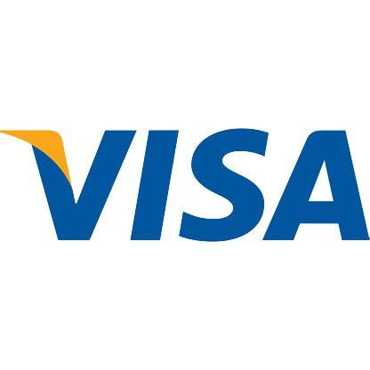



Traditional Payments
Bank
Processor
3
2
1
Consumer
Merchant

Slide 3

Key Observations
Currently:
The processor charges the merchant an interchange fee of 1.5% to 3% plus 10 cents on each sale.
The processor and bank take several days to settle their accounts with the merchant.
Refunds add additional incidental fees to the sale.
The merchant passes along all these costs to the consumer via higher prices.
What if we got rid of credit cards, cash, and perhaps even the banks...

Slide 4
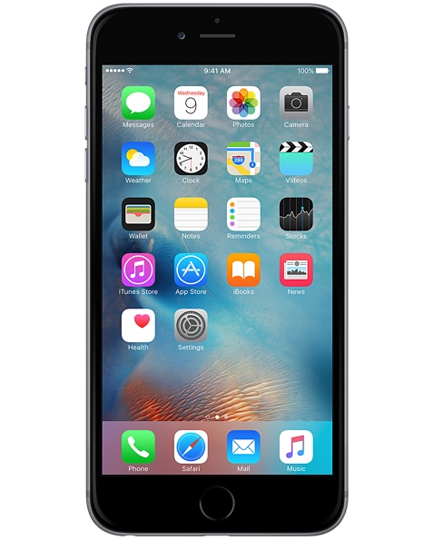

Direct Digital Payments
1
Merchant
Consumer

Slide 5
A Much Better Solution
Key benefits:
Only involves the consumer and merchant.
Allows instantaneous settlement.
Actual processing costs are around 1/10,000th of a cent per transaction.
Can be done in a way that prevents all fraud.
Wait a minute, this sounds too good to be true, is this another Bitcoin pitch...

Slide 6

No Bitcoin Required!
In fact, Bitcoin won't work:
It uses one gigantic shared digital ledger that
cannot possibly handle large scale use.
Its maximum possible transaction rate is only three transactions per second across the entire world.
On average, it takes between 10 minutes and an hour to verify a bitcoin transaction. Do you want to wait that long to get your Starbucks coffee?
A whole lot of VC's that invested in Bitcoin related startups are feeling pretty stupid right now...

Slide 7
Digital Transfer of Value
Anything of value can be transferred between two different parties:
reward points
cellular minutes
fiat currencies
ownership rights
How is this possible? Technically speaking, its called "public/private key cryptography".

Slide 8

The Key Roles Involved
Guarantor (Bank)
  Digitally signs a token of value guaranteeing its value.
Provider (Consumer)
  Digitally signs a transaction transferring part or all of the token of value to the receiver.
Receiver (Merchant)
  Verifies the digital signatures of both the token of value and the payment transaction before accepting them.

Slide 9





Direct Digital Payments Made Easy
2
3
Consumer's
Private Key
Consumer's
Certificate
1
Merchant
Consumer

Slide 10
Benefits to All
Banks
  Can guarantee value that cannot be forged or stolen.
Consumers
  Eliminate their credit card fees and interest payments.
  No more lost or stolen credit cards or cash.
  Offered lower prices from the merchants.
Merchants
  Save a lot of money on each transaction.
  No more fraudulent payments to worry about.
  Enjoy instantaneous settlement.
  Digital ledgers allow much simpler and more accurate bookkeeping.

Slide 11
For More Information
Contact
  derk.norton@gmail.com
Crater Dog Technologies™ - Crypto Payment Framework Open Source Projects
  https://github.com/craterdog-crypto-payments
Technical Deep Dive Presentation
  https://github.com/craterdog-crypto-payments/java-digital-marketplace-example/blob/master/docs/presentations/DigitalCurrency.pdf

