Slide 1
Decoupling Digital Currency Authenticity and Value with Certified Digital Tokens
Derk Norton
Founding Partner
Crater Dog Technologies™
March 24, 2015

Slide 2

A Hypothesis
BitCoin may not become a true digital currency because...
it won't be able to scale up to billions of wallets,
transactions take too long to confirm for most consumer interactions,
and the authenticity and value of each coin are inseparable.
A certified digital token (CDT) based approach may address these issues, we will explore that here today...

Slide 3



Direct Payments
Direct Payment

Slide 4




Digitally Signed Transactions
Consumer
Merchant
Consumer's
Certificate
Signed Transaction
Consumer's
Key
1. certify the transaction with a key
2. send the transaction to the merchant
3. verify the transaction with a certificate

Slide 5

Benefits
Consumer
  convenient
  no credit card fees
  no theft or loss
Merchant
  no processor fees
  immediate settlement
  no fraud or forgery
Direct Payment

Slide 6
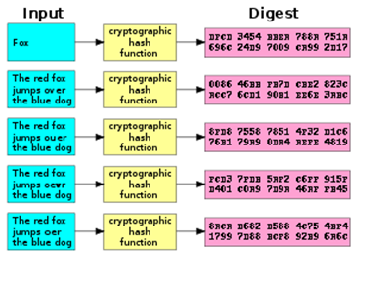

Cryptographic Hashing
hash pointer
sha256 hash
data
if data changes...
hash is invalid

Slide 7
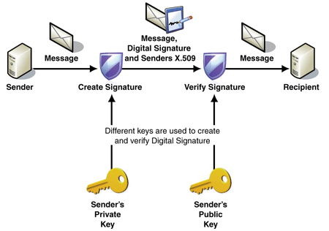
Digital Signatures

Slide 8
BitCoin Global Ledger
Global Block Chain
entry
entry
entry
Merkle Tree
tree node
tree node
tree node
transaction
transaction
transaction
transaction

Slide 9
BitCoin Model
Global Block Chain
block
block
block
Advantages
  incentive driven
  no central anything
  assumes no one is trusted
  public verifiable ledger
  limited supply of coins
Challenges
  doesn't scale
  long confirmation times
  no value guarantor
  complex protocol
  block chain forking
  coins outlive algorithms

Slide 10
CDT Ledgers
Token Block Chain Ledger (one per token)
entry
entry
entry
certified token
transaction
bank signature
receiver signature
merchant signature
sender signature
10 star bucks
Identity Block Chain Ledger (one per identity)
entry
entry
entry

Slide 11
CDT Model
certified token
transaction
bank signature
receiver signature
merchant signature
sender signature
10 star bucks
Advantages
  highly scalable
  token value is guaranteed
  all parties sign transaction
  immediate confirmation
  separate verifiable ledgers
  renewable tokens
Challenges
  no partial transfers
  must trust guarantors
  open transactions?

Slide 12

CDT Architecture
Identity Registry
Digital Bank
Consumer
Merchant

Slide 13
Identity Registry
Identity Registry
Maintains a public list of pseudo-anonymous* identities.
Maps a list of public certificates to each identity.
Certificates are used to verify digital signatures.
*complete anonymity is probably not possible

Slide 14
Digital Bank
Digital Bank
Maintains a public list of all certified digital tokens.
Maintains a public ledger for each token.
Maintains a public ledger for each identity.

Slide 15
Merchant
Has a private signing key.
May ask a bank to certify a batch of digital tokens.
May initiate or receive payment transactions.
Verifies transactions using public certificates.
Merchant

Slide 16
Consumer
Has a private signing key.
May initiate or receive payment transactions.
Verifies transactions using public certificates.
May ask a digital bank to make change.
Consumer

Slide 17
Registering Identities
Identity Registry
Digital Bank
Consumer
Merchant

Slide 18
Certifying Tokens
Identity Registry
Digital Bank
Consumer
Merchant

Slide 19
Awarding Tokens
Identity Registry
Digital Bank
Consumer
Merchant

Slide 20
Paying with Tokens
Identity Registry
Digital Bank
Consumer
Merchant

Slide 21
Demo
Scenario
  a merchant wants to reward its faithful consumers with CDTs in the form of "star bucks"
Identity Registry and Digital Bank
  each is a RESTful web service
  both are running in the Amazon cloud
Consumer and Merchant
  each has its own laptop
  both run RESTful clients to access services

Slide 22
Possible Conclusions
Scalability
  may be many digital banks
  no single block chain as a bottleneck
Settlement
  near instantaneous transactions
  100% verifiable
Value and Authenticity
  token value is guaranteed by the merchant
  token authenticity is certified by the digital bank

