Slide 1

Closures in JavaScript
Web Dev Guild
July 18, 2019

Slide 2
What is a closure?
Prevalent in many languages (Java, Python)
In JavaScript, a closure is the combination of a function and the lexical environment within which that function was declared.

Slide 3
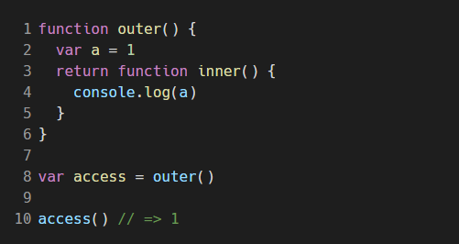
Simple closure
Notes:
So what's happening here?
* We assign the `outer()`function to the variable `access`
* We invoke `access` as a function `access()`, which invokes `outer()`
* Because `outer()` returns the `inner()` function, invoking `access()` essentially executes `inner()`
* Although `inner()`is being executed outside of its original lexical scope, it stil has access to its lexical scope and is a textbook example of closure

Slide 4
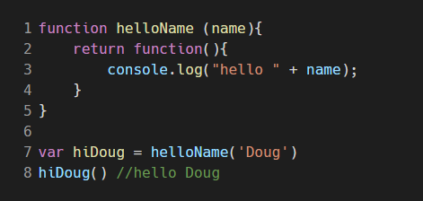
A step further
Passing data using closures
.
Notes:
- So we understand how a function can access its original lexical environment despite it being outside of that environment.
- Let's look at how

Slide 5
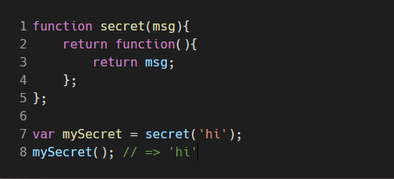
So what?
Why and when would I utilize closures?
Data privacy
Notes:
Cool, so closures are a thing.
Why and when would I use them?
1. Data privacy – closures are commonly used to provide data privacy
The function `secret()` takes the argument `msg` and returns a new function that returns `msg`.
This means that whatever we pass into `secret()` becomes the value of `msg`.
This protects data or makes it private.

Slide 6
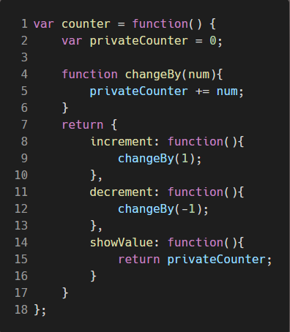
Private methods
We can emulate private methods using closures...
Notes:
We have our variable function counter, which has 2 private items (privateCounter and changeBy()) and returns 3 public methods (increment, decrement, showValue)

Slide 7
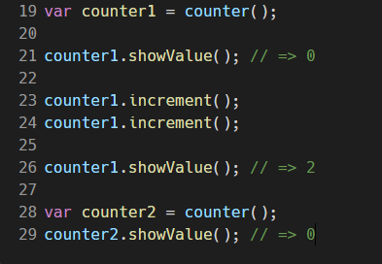
Private methods (continued)
Notes:
Each closure (counter1, counter2) is independent from each other
Each closure references a differenct version of the privateCounter and changeBy function

Slide 8
Private methods
We can emulate private methods using closures...

