Slide 1
Churn Modeling
Doug Kelly
GalvanizeU 6006: Churn Technical Presentation
03/08/3016

Slide 2
Presentation Outline
Data Collection & Processing
Exploratory Data Analysis
Feature Selection Using Lasso and Logistic Regression + Random Forest
Modeling
Initial Results
Tuning (Grid Search)
Validation
Churn Measurements
Losses, Expected Losses, high probability churn candidates

Slide 3
Data Collection & Processing
Binarize features
Scikit-learn Label Encoder for state feature
Dropped area code and phone number columns
Re-scaled numerical features
Split data:
Exploratory Set
Modeling sets X (independent variables), y (churn; dependent variable)

Slide 4
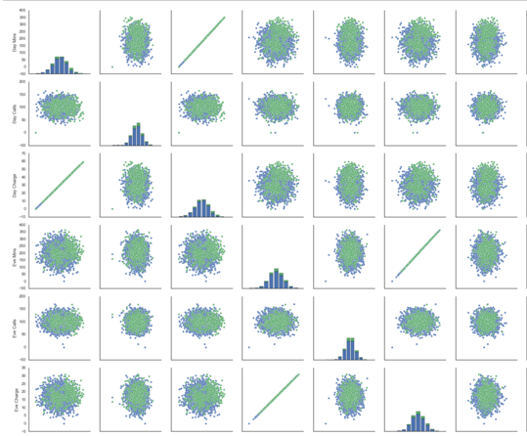
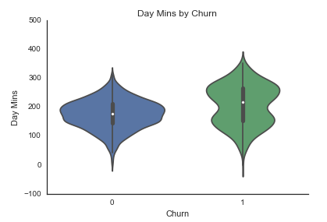
Exploratory Data Analysis
17 Features, 2 Binary
Perfect linearity between call and charge features
Several customer activity features have bimodal distributions
No outliers detected

Slide 5
Feature Selection
Lasso Regression (L1 norm)
Logistic Regression along with Scikit-learn recursive feature elimination
Random Forest

Slide 6
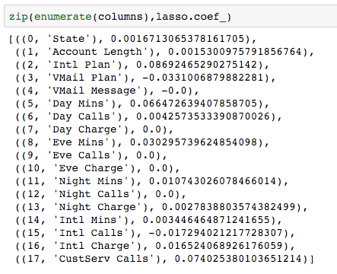
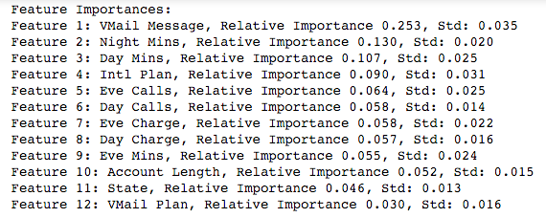
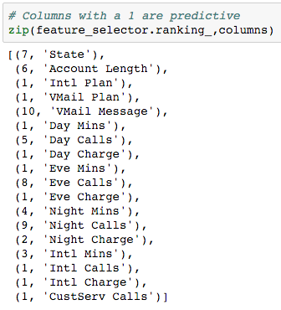
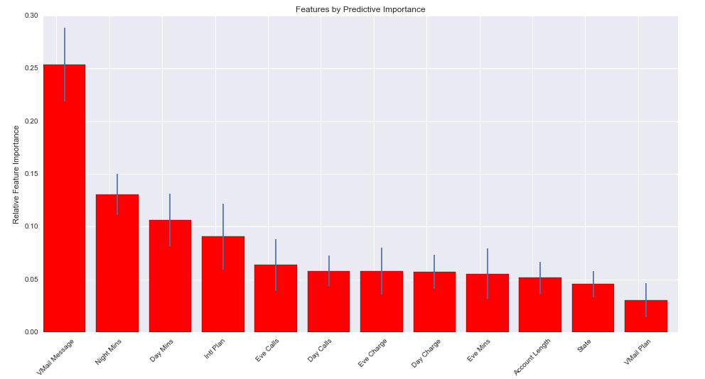
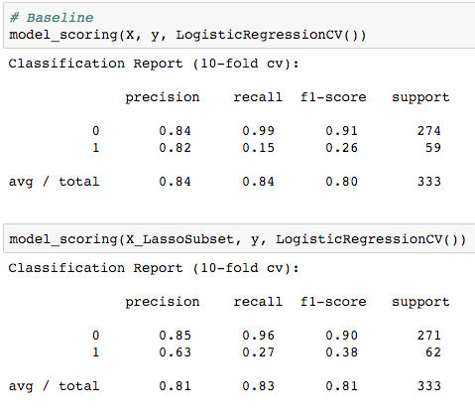
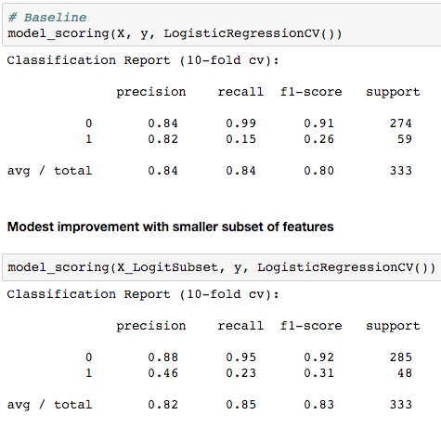
Feature Selection
Lasso (L1 norm)
Random Forest
Recursive Feature Selection

