Slide 1


A COMPLETE GUIDE TO GOOGLE CLOUD PLATFORM
And why Google is winning the Cloud War

Slide 2

AUTHORS
Murali Dodda is a Cloud Technology Specialist with over 15 years of experience in the technology space. He is a product of the prestigious IIT Madras. Murali provides 'technology and business leadership' to startups and has overseen successful exits for several of them. He is currently leading a team of technologists at Bitmin, a hot new startup delivering cloud services. Murali uses his weekends to catch up on the latest developments in technology innovation, product development, and entrepreneurship domains. Being an enthusiastic blogger, he shares exciting developments & his experiences with designing & deploying cloud strategies through his blogs and ebooks. If you want an inside view of cloud deployment for real-world clients, don’t forget to follow his blog.
Follow me on Twitter
Vara Prasad Nulu has a masters degree in computer science and is working as a software developer with BitMin Infosystems. He has extensive experience with web application development involving javascript frameworks, java and app engine. Prasad has published several research papers on data mining and analysis. Being an avid technology enthusiast, he analyses new trends in technology product development. He is currently impressed with the simplicity and breadth of the Google Cloud Platform and Google products.
A COMPLETE GUIDE TO GOOGLE CLOUD PLATFORM // 49

Slide 3
Prologue
On a day in 2006....
I still remember the day Amazon launched AWS, its cloud platform with the S3 (a storage service). It was a bright sunny day with AWS being the only cloud on the horizon.
Fast forward to now... The cloud wars are on.
It’s raining cloud services and there are umpteen number of cloud providers competing as rivals for a bigger pie of the cloud market.
Each day companies add new weap- ons to their arsenal, hoping one of them would win them the war. Google, Amazon and Microsoft are the main rivals and battles of price, perfor- mance, reliability and innovation are fought every day. The price battle seems already won. An independent expert recently benchmarked Google
as the best cloud. Google achieved this feat through its unbeatable pricing.
Does this mean Google has won the Cloud war? No! Because price is only one of the variables that enterprises look at while picking the best cloud, there are a host of others and
we’ll introduce you to some of them here. The current state of the cloud world has been shaped by history among other things. Amazon had the early-mover advantage and used it to capture a signiﬁcant share of the cloud market. But Google is catching up fast.
While we can’t predict who will emerge on the top, we can look at the evolution of cloud computing and understand its current dynamics as well as future prospects. And maybe, just maybe, you'll guess who is winning the cloud war, by the time you turn to the last page.
A COMPLETE GUIDE TO GOOGLE CLOUD PLATFORM // 03

Slide 4

Contents
Authors Prologue
A Brief history of our time on the Cloud
Shifts in Cloud strategies: Rivalry/Evolution?
Starting your cloud Journey with the right partner
Architecture of a Cloud Platform
The 'Compute' in Cloud Computing
Don't Grab a Passing Cloud (to Stash your Data)
Why networking matters
Why DBaaS is in Demand
Big Data Analytics - Data Driven Business success
The (Machine) Learning Enterprise
Why Google Cloud?
Planning your enterprise cloud strategy
Conclusion Annexures
Annexure A: Building blocks of AWS and GCP

Slide 5

CHAPTER 1
A BRIEF HISTORY OF OUR TIME ON THE CLOUD
The story of cloud computing so far
When John McCarthy ﬁrst spoke of computation being delivered as a public utility, it was a distant possibili- ty. But today cloud computing is a reality; we spent a part of our lives on the cloud in our virtual avatars. As more and more services reach us via the cloud, the consumption of cloud services will continue to rise.
A host of developments paved way for the emergence of cloud computing.
The advent of enabling technologies like the internet, virtualization tech, SOA architectures and widespread broadband access were crucial to the realization of the cloud computing paradigm.
John McCarthy
Cloud computing Scientist

Slide 6
How it all began
1999 After Salesforce launched enterprise applications as a service, the SaaS wave caught on and many enterprises launched their own apps via internet.
these vendors to experiment with other deployment models. This led to newer models like hybrid clouds, which combine the best of both public and private cloud models.
Google is a late entrant but is adding product families and new services to its cloud portfolio faster than others. Even on the price front, the massive price cuts by major cloud vendors are driving down the costs of cloud services quickly. Google is constantly lowering the cost of cloud services as a part of its avowed mission to democ- ratize technology, especially IT.
2006 The next development was the arrival of Amazon Web Services (AWS) in 2006. AWS was the ﬁrst to launch a suite of cloud-based services. AWS allowed enterprises to rent both stor- age and computing resources through its S3 and EC2 services. Amazon is celebrating 10 years in the cloud in 2016 and is still the market leader among Public cloud service providers.
Evolution of Cloud Computing: Competing to Contribute
The massive demand for cloud services is spurring innovation through competition. Cloud providers are dropping prices and launching new products to win new clients.
2008 Google entered the fray with its Google App Engine and is competing with other cloud vendors like AWS and Microsoft Azure in the provision of cloud services.
2009 Launch of browser-based enterprise applications from vendors like Google and Microsoft, Google Apps and Microsoft ofﬁce web apps provided proof of concept for cloud enabled service delivery by demonstrating that online services were both easy to consume and reliable.
The silver lining
The ﬁerce rivalry between Amazon and Google in the cloud space, has resulted in cutting edge tech getting mainstreamed to the masses quickly. Let's look at a timeline of services launched by Google and Amazon to see how they are contributing to cloud evolution.
2011 Although Amazon, Microsoft and Google are primarily public cloud providers, enterprise concerns on data security and control, have pushed

Slide 7
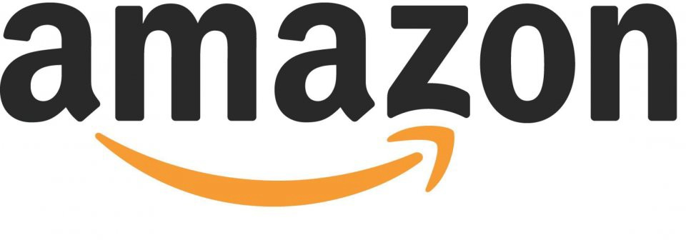
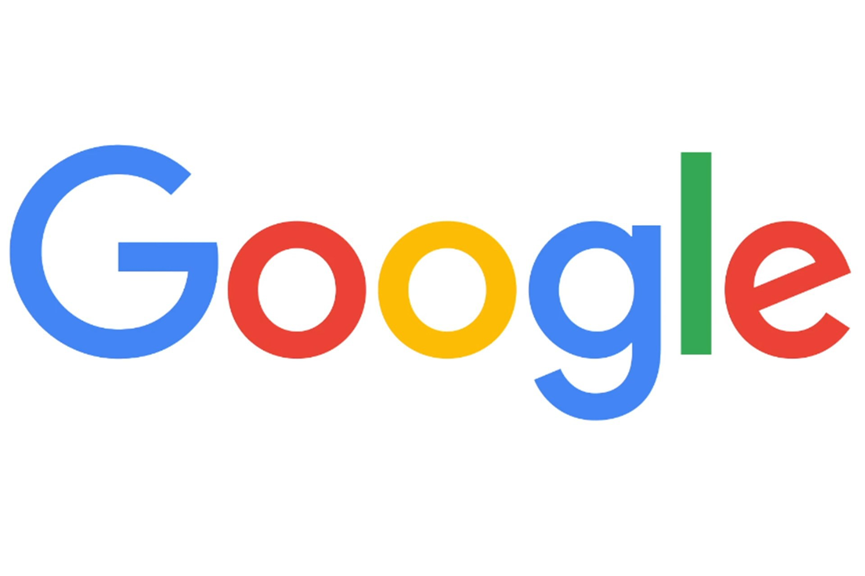
Cloud Services Launched by Google & Amazon
Amazon Glacier
AWS
Elastic
Amazon Dynamo DB
Amazon EC2
Container
Amazon EC2
Amazon S3
Amazon Relational Database Service
Beanstalk
Registry
AWS
Direct Connect
Amazon Redshift
Amazon Kineses
AWS
Data
Amazon Elastic Load Balancing
Amazon
Pipeline
Amazon EMR
AWS
Amazon
EC2
Container
Amazon Route 53
Cloud Formation
Cloud Watch
Service
2006
2008
2009
2011
2012
2013
2014
2015
2016
Google App Engine
Google Cloud SQL
Google Compute Engine
Google Cloud Datastore
Google Container Engine
Google Cloud Storage Nearline
Cloud Vision API
Google
Google
Cloud Speech API
Cloud Storage Standard
Cloud Dataflow
Google Container Registry
ML
Platform
Google BigQuery
Google Cloud Load Balancing
Cloud Bigtable
Google Data Studio 360
Network Load Balancing
Google Cloud Pub/Sub
Google Data Proc
Google entered the cloud game late, but the Alphabet Inc is not one to be left behind! Google is launching new products at a rapid pace to power the next wave of cloud evolution.

Slide 8


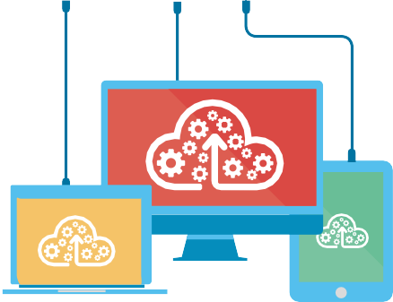
CHAPTER 2
SHIFTS IN CLOUD STRATEGIES: RIVALRY / EVOLUTION?
Why it’s time to take a closer look at enterprise cloud strategies!
The Cloud race is getting hotter; the New Year began with major cloud vendors like Amazon and Microsoft announcing price cuts. Google responded to these price changes by announcing that its platform was still the most economical option through a company blog. So is the cloud rivalry all about pricing? Deﬁnitely not! So what shapes an enterprise cloud strategy if not pricing? The past few months saw some high-proﬁle enterprises make changes in their cloud strategy. They tell the story of how the cloud space is evolving and how enterprises are getting over their fears of storing restricted data on somebody else’s servers, as the cloud keeps getting more secure.
Amazon Web Services (AWS) has a product release schedule that’s enviable! It rolls out new features and services to millions of its users every year. News of high proﬁle AWS users like Spotify and Apple shifting to Google has generated a lot of debate in the recent months.
Let’s take Amazon, it not only pioneered cloud computing but has spent the last decade popularizing the concept in the enterprise world.

Slide 9
From a Trickle to a Roar
What is driving the shift in Cloud strategies?
The proponents of cloud computing marketed the paradigm as a solution to all, if not most enterprise IT challenges. Moving operations
off-premise was not only going to bring signiﬁcant cost and time savings but would also free enterprises from vendor lock-in. Adoption of cloud services would imply enterprises could shift all or part of their workloads to rival vendors if they were delivering better value on cost, performance and security aspects. This was the promise of Cloud computing.
Enterprises are now seeing this promise delivered.
When Spotify announced its plans to migrate to Google Cloud Platform, it left everyone baffled. The company had often been cited as a reference customer for amazon services. What was dismissed as a one-off instance by supporters of Amazon, soon turned into a headache when reports of Apple following spotify to Google Cloud surfaced.
So, are AWS users really looking for a better host?
Not really, unless you believe the overexcited folks on twitter who see this as the beginning of an end to Amazon’s dominance over the cloud market.
Why you need a fluid cloud strategy?
Cloud technology is only a decade old and is still evolving. Different vendors in cloud space are accumulating advantages in niche segments. For example, Google is leveraging its strengths in data processing to estab- lish its dominance in big data seg- ment. A small enterprise might do better with a vendor that’s having an edge in a particular segment. While large enterprises may use different vendors for different product/service lines for the same reasons. Shifts in consumer preferences, data laws and
disruptive tech innovations are all capable of
Let’s take a reality check
Dropbox reduced its use of Amazon’s storage service (s3) as it was pursuing an on-premise cloud strategy, which would require most of it users’ data to be stored in in-house data centers.
Apple may have shifted some of its workloads to Google Cloud Platform but it still continues to use AWS too. Apple also runs some of its operations on Microsoft Azure cloud. In Apple’s case, it’s simply following a multi-provider cloud strategy.

Slide 10
engineering a change in an enterprise cloud strategy and are unrelated to vendor-side dynamics. Most companies are still experimenting with their supplier and product strategy to ﬁgure the best vendor mix for their product/service matrix. Therefore it’s pointless to discuss enterprise cloud strategies in absolute terms. All of the enterprise IT workloads may not operate on the cloud, only some of them might be. Similarly, an enterprise may have multiple cloud vendors servicing its different product or service lines. The reality is, ﬁrms are keeping their cloud strategy fluid to respond to changes in vendor and business environments. A fluid strategy also has a positive impact on the cloud ecosystem as it pushes providers to innovate.
But one thing is certain, as prices of cloud services continue to drop and providers add
more functionality and features to their cloud plat- forms we will see greater adoption of cloud ser- vices in the future.
A COMPLETE GUIDE TO GOOGLE CLOUD PLATFORM // 10

Slide 11

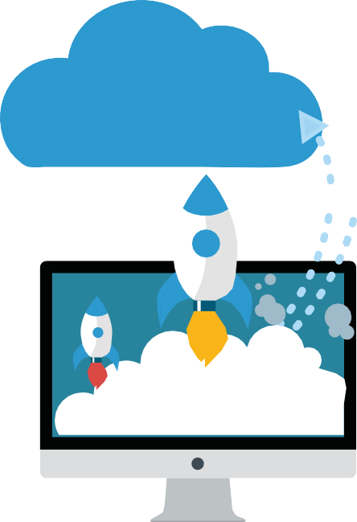

CHAPTER 3
Starting Your Cloud Journey With The Right Partner
Why startups must adopt a Cloud-First Strategy!
The cloud computing space is evolving. Vendors are ﬁnding their niche segments and owning them. But, why should all of this brouhaha about cloud migration matter to you? Is the ‘Anytime, Anywhere, Any Device’ computing model for everyone?
Is there a compelling business case for universal cloud adoption?
Business Drivers for Cloud Adoption
1) The Cost Argument
Cloud computing is an efﬁcient and cost-effective way to deploy IT. Large cloud providers leverage economies of scale to deliver low-cost computing resources to cloud users. If you are operating on a cloud platform, you pay for the exact amount of resources you
Find Out!
Moving to the cloud is not just about adopting newer tech but there is a compelling business case to make the shift.

Slide 12
consume. For SMBs and startups working on a lean model, avoiding expenditure on installation, maintenance, upgrades and support costs can make a lot of difference.
collaboration tools are efﬁcient and easy-to-use. Cloud-delivered enterprise mobility management systems allow companies to implement
Bring-Your-Own-Device (BYOD) policies without worrying too much about data security.
2) Investment
Startups and SMBs are often constrained by tight budgets and using the cloud to deliver services will imply costs are incurred as operational expenditure instead of capital expenditure. Operating on the cloud will also mean they don’t have to worry about infrastructure provisioning. The cloud provider would take over the responsibility of upgrading infrastructure and maintaining it, letting the enterprise focus on application development.
5) Speed
Virtual computing resources can be commissioned in a few hours whereas traditional mode of setting up IT infra- structure takes weeks, if not months. For startups with ideas that need to be out in the market yesterday, adopting a cloud-ﬁrst strategy is the only means to speed up product development.
Finally, each enterprise will differ in why it embraces cloud computing. Irrespective of why you migrate to the cloud, the approach to cloud adoption must be properly planned and executed. It begins with choosing the right vendor for your ﬁrm.
3) Scalability
Easy scalability is another advantage of cloud adoption. Cloud providers offer automatic scaling whenever computing needs peak. If not for the cloud, ﬁrms would have to create the infrastructure to meet peak trafﬁc demands and keep it idle for most of the year. Being able to avoid
over-provisioning is a signiﬁcant
advantage of moving to the cloud.
So, how to find your cloud match?
What you must look for in a cloud vendor
1) Performance & Uptime
For high-speed delivery of applications, network performance is crucial. Check if your cloud provider has a low uptime.
4) Enterprise mobility
Cloud adoption furthers enterprise mobility by allowing users to work from anywhere, at any time, and from any device. Cloud-based business

Slide 13
Not all cloud providers are made equal. Apart from the above attributes, it’s also important to check which cloud vendor matches your
business objectives and your enterprise philosophy best.
2) Service Level Agreements and Reliability
Some cloud providers offer higher levels of service and customer support to differentiate themselves from their competitors.
safety regulations.
7) Deployment models
For most large enterprises uprooting their entire on-premise cloud work- loads and migrating them to a public cloud maybe challenging and
unneces-sary. Enterprises may choose
to migrate only some of their workloads to the cloud and work with a hybrid cloud strategy. It’s important to check if your cloud provider supports hybrid cloud conﬁgurations.
3) Costs
Some cloud providers charge you for the actual number of servers you use, whereas others charge you for the amount of time you keep them online. Few vendors compute costs per hour whereas others compute costs by the minute.
8) Regional support
If business requirements or data safety laws mandate data localization in a particular country or region, then it is necessary to check for regional avail-ability of your cloud provider.
4) Technology Stack
Cloud providers have services that work on particular software stacks. If your app is built on a particular soft- ware stack, you can simplify your cloud migration by choosing a provider that supports the same software stack.
9) Autoscaling Autoscaling is important for applications that are likely to experience demand peaks and
troughs. Bringing more servers online for handling higher workloads and taking them offline when not necessary ensures you
pay-as-you-use.
5) APIs and Vendor lock-in
It is better to choose APIs backed by multiple providers and vendors as it reduces chances of vendor lock-in. This makes cloud migration from one provider to another easier.
10) Network connectivity Evaluating your cloud provider’s network connectivity is crucial, particularly so if you are running latency-sensitive applications on the cloud.
6) Security and compliance
Data security concerns weigh heavily on the minds of enterprises wanting to migrate to the cloud. Make sure that your cloud platform provider is compli- ant with security standards and data

Slide 14
CHAPTER 4
ARCHITECTURE OF A CLOUD PLATFORM
Piecing the Cloud Puzzle together
What is a Cloud Platform?
A Cloud is a comprehensive platform providing services that support appli- cation development and hosting. The services offered by a cloud platform may be categorised into fundamental services and higher level services. The higher level services are built on top of the fundamental layer.
Compute
Storage
Networking
Databases
The fundamental services offered by Amazon and Google Cloud platforms are:
Let’s explore the essentials and add-ons of a cloud ser- vices suite:
Compute
Storage
Networking
Databases
A. Building-block services
Any self-respecting cloud provider will have these fundamental services in his arsenal.

Slide 15
B. Higher-level services
Both vendors also offer higher level Services built on top the core stack of services. The services provided are diverse and mostly meant to make working on cloud easy by offering an additional layer of abstraction or easier management of deployments.
Management services Function: To track performance of applications running on the cloud
Examples: Amazon CloudWatch and Google Cloud Monitoring
Both Amazon and Google cloud plat- forms are backed by a robust set of basic services. But that’s not all! Both are constantly innovating to strengthen core architecture further and add higher level services. Both Amazon and Google recently launched machine learning services as a new product family. Machine Learning is expected to power the next wave of enterprise IT products. Offering such cutting edge tech as a cloud service is the fastest way to mainstream its beneﬁts, as developers everywhere can now build apps that harness its potential.
Application services
Function: To optimise applications using the cloud.
Examples: AWS SNS and Google Cloud Pub/Sub.
Data services
Function: To enable processing of Big Data.
Examples: Amazon Kinesis and Google Cloud Dataflow
Google entered the cloud game late, but the Alphabet Inc is not one to be left behind! Google is launching new products at a rapid pace to power the next wave of cloud
evolution.

Slide 16

CHAPTER 5
The ‘Compute’
In Cloud Computing
Cloud computing, as the name suggests, refers to the provision of computing power over the internet. Let’s compare what our favorite vendors Amazon and Google offer in the IaaS-PaaS segment.
Amazon’s IaaS is called Elastic Compute Cloud (EC2) and Google’s IaaS is known as Google Compute Engine (GCE)
Both IaaS services are robust and offer similar features under different names.
Feature | Amazon Elastic Compute Cloud | Google Compute Engine
Virtual Machines VMs | Instances | Virtual Machines, Instances
VM template | Amazon Machine Image | Image
Temporary VMs | Spot Instances | Preemptible VMs
Firewall | Security Groups | Google Compute Engine Firewall Rules
Scale-out | Auto Scaling | Autoscaler
Local attached disk | Ephemeral disk | Local SSD

Slide 17
Virtual machines (VMs)
Both EC2 and GCE let you launch and terminate VMs/instances as required. Users have complete control over the instance. Both platforms support several instance types.
Instance types
Both EC2 and GCE provide some standard instance types each of which has deﬁned amounts of CPU, RAM and network assigned to it. GCE also allows customised instances that you can conﬁgure to ﬁt your particular workload.
Let’s look at the common instance types offered by both services: Machine Type
Shared Core
VMs for tasks that don’t require too many resources but have to stay online for longer durations.
Standard
VMs which provide a ﬁne balance of compute, network and memory resources
High Memory
VMs for tasks that need more memory relative to CPU resources
High CPU
VMs for tasks that require more virtual CPUs relative to memory
GPU
VMs that come with discrete GPU’s. Google doesn’t have this machine type.
SSD Storage
VMs that come with SSD local storage
Dense Storage
VMs that support greater amounts local HDD storage. Not Available in Google
GCE and AWS support many of the same families of instance types but Google doesn’t offer two specialised families: GPUs and Large magnetic storage.

Slide 18
Operating system sup- port
Both support a variety of operating systems and charge licence fees. Google lists the OS price separately, whereas Amazon lists the combined cost of OS plus instance.
instead of network connected ones to enjoy faster transfer rates. The number and size of disks offered to users by both services are ﬁxed and not adjustable. Using a Local SSD in place of instance storage incurs extra cost.
Virtual machine import
Both AWS and GCP allow you to import VM images created on other platforms to their platform. The actual import process is easier in AWS where- as Google requires conversion to compatible format and upload to Google cloud storage to allow import. But VM import ensures the workloads run on on-premise servers are usable and need not be repeated.
Firewall
Both services offer programmable ﬁrewalls based on software-deﬁned networking. You can conﬁgure a ﬁrewall to protect virtual machines and networks used by your applications.
Scale-out
Auto scaling brings elasticity to cloud deployments. Both services support auto-scaling that scale up or down in response to conditions set out in Scaling Plan or Policy. These instances are launched from pre-deﬁned templates. The auto-scaling in Amazon can be set in motion in three ways: Manually, scheduled to start based on time or dynamically based on an Alarm (Cloudwatch/SQS queue). But Google offers only dynamic auto-scaling option.
Pricing model
EC2 and GCE offer very similar pricing models. Both services only charge you for instances for the length of time that you use them. With Amazon, each instance type is charged per hour, and in Google you are charged by the minute.
Both offer discounts for long duration usage but differ in how they do it.
Amazon lets you barter flexibility for a lower price through its Reserved instances (RIs). RIs work by asking you to commit to a certain number of instances for 1-3 years and also pay upfront. The discount is proportional to
Local attached storage
In both EC2 and GCE, users can commission disks local to a VM

Slide 19
the term and amount of upfront payment.
AWS’s Elastic Beanstalk and GCP’s App Engine. AWS Elastic Beanstalk (EBS) and App Engine (GAE) are similar services with slightly different approaches. Both the services offer auto-scaling, load balancing and moni- toring services. EBS requires the kind of system administration that raw VMs require whereas GAE is a fully man- aged service in which all admin tasks are managed by provider. EBS gives greater control and flexibility to devel- opers whereas GAE is easier to manage and can be launched quickly. GAE frees developers from routine tasks of infrastructure management and lets them focus on developing product features.
Google’s discounts work automatically without any upfront payments or
long-term commitments. Google applies a discount proportional the length of instance usage once the instance runs for a speciﬁed duration. It calls this a Sustained Use discount and the savings from this sometimes amount to almost 30% off on the standard on-demand rate. No wonder Google is winning the price war!
Apart from these basic services, both Google and amazon offer greater abstraction through their
Platform-as-Service (PaaS) services,
The choice of a particular IaaS/PaaS will hinge on the requirements of a speciﬁc workload and the preference of developer team for
greater/lesser control over the underlying infrastructure. Take the case of Snapchat, they needed their product to be launched quickly and choose a fully managed service, GAE to fulﬁll this objective.

Slide 20

CHAPTER 6
Don’t Grab a Passing Cloud (to stash your data)
Learn which cloud storage solutions are the best!
Cloud vs. Cloud: Where to Keep Your Valuables
Data is the new currency; we live in a digitised world that generates Zettabytes of data each year. The world’s biggest enterprises are sitting on vast data gold mines. But, enterprises are struggling to safely store the increasing amounts of data coming their way. They have to commit a lot of resources to building, maintaining and upgrading enterprise storage infrastructure. Here, the cloud comes to their rescue!
Cloud storage is akin to leasing a bank vault. Vendors maintain these for enterprises at low costs. Additionally, moving data to cloud storage automatically ensures data redundancy and data security.
Why, enterprises are moving to on-cloud storage solutions is no-brainer!
A COMPLETE GUIDE TO GOOGLE CLOUD PLATFORM // 20

Slide 21
Quick deployment, low operational burden, zero maintenance headaches and Pay per use costing offered by the Cloud are hard to ignore.
COLD — data archiving
Amazon Glacier
Comparing the Storage services of AWS and GCP
First, let’s compare the ‘cold storage’ services provided by Amazon and Google:
Both Amazon and Google offer
cloud-based storage solutions as part of their cloud platform services.
Their services are roughly similar with no clear frontrunners in pricing, performance and reliability aspects as of now.
Types of Cloud Storage Classes
Cloud providers offer different cloud storage classes that can be grouped into four tiers: Hot, Warm, Cool and Cold. These services differ in parameters like speed of access, cost, frequency of use and durability.
A. Google Nearline vs. AWS Glacier
Google launched Nearline in 2015 with a promise of very quick retrieval time at a very low cost. Nearline’s 2-5 second retrieval time created a stir among users, but we all know when something’s too good to be true, right? Nearline limits data retrieval to 4MB/sec for every TB stored, while Amazon has no such restrictions.
What this caveat means for users is: downloads will start within 2-5 secs but will take a long time to complete. Unless users are working with massive amounts of data, Amazon Glacier will deliver better on retrieval times than Nearline.
HOT — object storage for frequently accessed data
Amazon S3 Standard
Google Cloud Storage standard
WARM — frequently accessed non-critical reproducible data
Amazon S3 RRS
Google Cloud Storage DRA
COOL — less frequently but rapidly accessible data
Amazon S3 Standard I/A
Google Cloud Storage Nearline
Google recently released a feature called on-demand I/O to address this challenge. On-demand I/O lets users increase throughput when they have to retrieve content at a faster rate than the default 4MB/s.

Slide 22
A more detailed comparison of Nearline and Glacier:
While Nearline is the winner in accessi- bility and speed, there is no real big difference in price between the two services. Would Nearline kill Amazon’s Glacier service? Not in the near future. The war has just begun in this segment; and enterprises should watch out for upgrades.
1. In Retrieval and Transfer of data, Glacier is better
Amazon gives 5% free retrieval on amount of data stored and has a low charge after that, Google’s costs are higher. But though it’s cheaper than Nearline, Amazon has different pricing for different regions unlike Google which offers the same price world- wide.
Now let’s make a quick comparison of S3 and Google Cloud Storage services:
B. Amazon S3 vs. Google Cloud Storage
2. In Data Override and Deletion, Near- line is the winner
Both S3 and Cloud Storage are similar services with some minor differences, let’s consider the important ones:
If you need to delete data often, say every month or two, then Nearline is the better option as it charges lower for early deletion.
1. Google supports chunked encoding and resumable uploads. Both of these features are handy when you are streaming.
3. In Data Access Time, Nearline provides hassle-free access
No need to request access and wait for a couple of hours for the data to be made available, in Nearline the data can be accessed at will in 3secs!
2. Amazon gives users more regions to choose from, while Google only sup- ports US and EU at the moment.
4. In Download Speed, Nearline beats Glacier for larger datasets but is a poor performer otherwise.
3. Google lacks explicit regional control like S3.
4. The best part about S3? It is well integrated with other AWS services like CloudFront and EC2. But, Cloud Stor- age is mostly a standalone service. Amazon also allows free access between S3 and EC2, unlike Google, which charges users for accessing its
Amazon’s Glacier has long been the industry standard when it comes to secure, low-cost storage services used for data archiving and online backups.

Slide 23
Cloud Storage from App Engine. Amazon’s Simple Storage Service (S3) has long been the industry standard for object storage. Google has to offer something far better than what it does now to really make a dent in Amazon’s armour.
move to cloud-based storage:
Don't let capacity pricing lead your decision process.
Don’t forget to consider transaction and management costs
Lastly, look at the provider ecosys- tem and how it ﬁts your cloud adoption plan.
Tips to help pick the right Cloud Storage service:
Here are some criteria to consider when choosing a cloud storage service:
Once the features and pricing are considered, the ﬁnal item on an enter- prise checklist should be the ease of management inherent in a solution.
The best cold storage architecture will offer a well-developed management layer. Enterprises must look for innovative products that allow intelligent management of data and its seamless integration with other business processes.
1. Durability
2. Availability
3. Performance
4. Capacity cost
5. Monitoring and Access
If you are an enterprise looking to
6. Life Cycle Management
Google came to the storage segment late but is trying to stand out by shining on the price front.
Having been around longer, AWS has a larger set of partners, integrators and network providers working with it compared to Google. Google will need some ‘Killer’ upgrades to popularize its
storage services among non-GCP users.

Slide 24

CHAPTER 7
Why Networking Matters
The right network is fast, reliable and scalable
When the Music Stops Playing
applications unlike Amazon which hosts popular apps like Netflix.
‘The show must go on’ is what Netflix users might say to Amazon regarding its network outage last June. The brief outage took down popular services like Netflix and pinterest for almost an hour.
Is Networking the Achilles heel of cloud vendors?
The Google cloud outage on April 11, 2016 was a setback for Google’s efforts to win over enterprise IT customers. The outage didn't just affect one availability zone, but all regions. In comparison, rival Amazon has suffered regional outages but has so far avoided its entire platform going down. These episodes tell us that:
Network outages are an issue for most public cloud providers. Google which prides itself on its strong networking architecture also experienced an outage just this month (April 11, 2016). Google’s outage affected users in all zones but went mostly unnoticed.
Reason?
Google has a relatively small market share in the cloud space
Very few GCP clients run
low-latency interactive web trafﬁc
Sending your IT ops to the cloud
carries signiﬁcant risk.

Slide 25
The curious case of empty inboxes
Outages are not new to the cloud world, some of the worst ones saw users logging into empty email accounts wiped of all data. Vendors could restore the data in some cases and not in the others. So what do the networking failures of the past teach enterprise cloud users? Let’s ﬁnd out!
go ahead and create backups of your important data independently. When it comes to crucial data, never assume someone else is automatically protect- ing you.
Lesson 4: Even the best laid plans don’t work
Google had anticipated the problems that caused the April 11, 2016 outage. It has the necessary measures in place to avoid disruptions, but they failed to work. In rare but real instances bugs can bypass safety mechanisms and multi-layered data protection networks to cause signiﬁcant damage. Test your safety measures rigorously.
Lesson 1: Assume it will fail
It’s natural for networks and data centers to suffer glitches. Just because your cloud provider is now handling network reliability doesn’t mean it will never fail. While planning your cloud strategy ensure adequate redundancy by avoiding over-reliance on any single vendor or service to drive your core architecture.
Lesson 5: Don’t keep all your eggs in one basket
We have talked a lot about redundan- cy. You already have crucial data tucked away on multiple servers, in different regions, there seems to be nothing more you can do! Well, it never hurts to go the extra mile and spread it across vendors too, as the ultimate failsafe.
Lesson 2: Build Redundancy
Reliability is dependent on redundancy. Multiple copies of data spread across different availability zones are key to weathering a cloud failure storm.
Lesson 3: Have a Contingency Plan
Feel like revisiting your decision to migrate?
The whole point of getting on the cloud was to sign away the ‘grunt work’ of infrastructure and network
Even the most sophisticated disaster recovery systems are not completely fool-proof. It’s ok to be paranoid here,

Slide 26
maintenance to your cloud host.
The responsibility for building a resilient cloud network certainly rests with the cloud provider. So, while choosing a cloud vendor cross-check the level of redundancy they offer to users.
Things you can do with GCP
Create secure ﬁrewalls for VMs in Google
Compute Engine
Design faster connections between database nodes in Cloud Bigtable
Provision network resources for faster delivery of query results in BigQuery
Outages or Not, the cloud is here to stay!
Service disruptions due to cloud outages may make the cloud seem unreliable, which is not true. The cloud will continue to have a lot more operational success than an individual enterprise network. But since the cloud operates web scale its failures often get ampliﬁed.
Comparing the Network- ing Product Suites of AWS & GCP
I. Load balancing
Load balancers when conﬁgured properly distribute incoming trafﬁc across multiple VMs making apps more fault tolerant.
Comparing the Networking Services of Google and Amazon
AWS networking and Google Cloud Platform (GCP) networking have considerable differences in their design. GCP networking is global and is available to all its services unlike Amazon which limits it to compute instances. GCP boasts of a soft- ware-deﬁned networking architecture based on Google’s Andromeda. This architecture allows the creation of networking elements at any level and
supports customization of the network to your needs.
Scaling pattern
Both Amazon’s Elastic Load Balancer (ELB) and Google Compute Engine Load Balancer respond to trafﬁc by scaling up or down the amount of capacity necessary to meet the trafﬁc being passed through it. Google Compute Engine Load Balancer responds in real time without a delay or pre-warming unlike Amazon’s ELB.
Pricing model
Both load balancing services use the same pricing model. An hourly rate for load balancer and a separate charge on the amount of trafﬁc handled by the load balancer are billed to customers.

Slide 27
II. Peering
A peering service allows customers to connect to a cloud service directly over a network.
The peering services offered by AWS & GCP
Feature | AWS | Google Cloud Platform
Virtual Private | VPC-VPN | Cloud VPN
Network
Carrier Peering | Direct Connect | Carrier Interconnect
Direct Peering | N/A | Direct Peering
CDN Peering | N/A | CDN Interconnect
A. Virtual private network
Creating a virtual private network, or VPN, from one location to another allows you to create a secured, private link between two networks over the public internet. Both AWS and Google Cloud Platform offer this as a service.
private, dedicated line, and not via a 3rd party provider. Amazon does not offer this service, Google does.
D. Content delivery network (CDN) peering
Content delivery network (CDN) peering is similar to carrier peering but instead of peering your facility with the cloud provider, it connects your cloud resources to a CDN. Google offers this service through CDN Interconnect and Amazon through its own CDN service, Cloudfront.
B. Carrier peering
Sometimes connecting to a cloud through a VPN won’t satisfy your speed/ security needs, in which case, leasing a private network connection with guaranteed capacity assigned to it is beneﬁcial. Both Amazon and Google offer this service in conjunction with partners.
Pricing of Peering Services
AWS and GCP charge for VPN services the same way, at an hourly rate.
For peering services, Google is the more economical option, as it does not charge for direct peering and CDN Interconnect.
C. Direct peering
In Direct peering you directly connect to your cloud provider through a

Slide 28
III. DNS
geographic-based routing or laten- cy-based routing queries.
DNS translates domain names into a numeric IP that servers can use to connect with each other. Managed DNS services like Amazon Route 53 and Google Cloud DNS are close in feature parity. However, Amazon offers two additional routing options not available to GCP users,
geography-based routing and latency-based routing.
IV. BONUS! Live Migration in GCP
Another advantage of working with GCP networking is the availability of live migration. Hardware failures happen in all data centers; in the event of a hardware failure GCP can move VMs from affected hardware to functioning hardware automatically without customer intervention.
Pricing
Both services charge similar prices but AWS charges higher for
All major vendors suffer the occasional network glitches that affect their Service Levels. A recent benchmarking of cloud providers by an independent expert ranked Amazon higher for "Ser- vice Level". But Google ranked best on pricing, making it clear that GCP offers the best networking performance for the money.

Slide 29
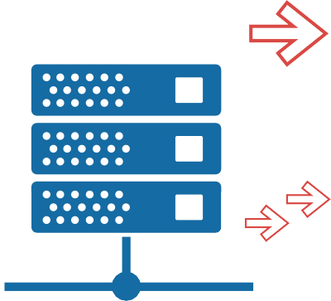
CHAPTER 8
Why DBaaS is in Demand
Demand New Enterprise Warehouse Address: ‘The Cloud’
Database as a service (DBaaS) joins the ranks of IaaS, SaaS and PaaS on the list of enterprise favourite cloud services. Why? Because, DBaaS lets you have ‘IT’ your way and solves challenges inherent in the traditional on-premise model.
Learn how DBaaS does data- base management better
DBaaS reduces database sprawl. You probably have your data spread across many collections, and operating in silos, if you are working with a legacy data warehousing model. With DBaaS, you move your data out of silos to a single powerful database cloud.
DBaaS enhances security.
Centralised management of databases is also made possible by automation. Cloud Databases are undoubtedly the future of enterprise database systems.
DBaaS supports rapid provisioning and auto-scaling to any size.
Let’s take a look at the cloud database model:

Slide 30
Cloud Database
A cloud database runs on a cloud computing platform. Cloud users can purchase access to a database service managed by a cloud provider.
Because DBaaS:
1. Is a scalable on-demand platform
2. Is more manageable
3. Provides improved security
Database as a Service (DBaaS) model
In this model, DBaaS provider takes responsibility for installing and main- taining client’s database and, applica- tion owners will have to pay according to their usage.
4. Has monitoring capabilities to track performance, issue alerts on threats.
5. Supports simple data analytics
6. Offers better Price-to-performance ratio than legacy systems
What is "managed" by the Provider?
If you sign a DBaaS provider to manage your enterprise database, it does:
Architecture of DBaaS Service
DBaaS service lets end user launch, conﬁgure and track database instances through a web-based console. The user communicates with the database instance using an API, and can perform maintenance and scaling operations.
1. Patches and Updates
2. Manages Backups
3. Conﬁgures replication
4. Provides for automatic failover in event of zone outage
A managed service vests the responsibility of ensuring scalability and high availability with the service provider.
5. Ensures data security through auto-updating security and data encryption. Additionally, in Google
DBaaS users get to achieve a high level of customization. The user can conﬁg- ure availability, replication and backups to suit a particular database instance need. For example, users can skip replications and automatic failover for
Why should enterprises shift to DBaaS from on-premise legacy systems?
A COMPLETE GUIDE TO GOOGLE CLOUD PLATFORM // 30

Slide 31
development instances while keeping production instances fully protected.
Cloud SQL is flexible on three important fronts:
Cloud databases are of two types:
1. Relational (SQL) databases
Flexible scaling, something not usually associated with relational databases.
Flexible connectivity from any application, running anywhere. Users can connect to their database from any application (e.g. Compute Engine, Managed VMs, etc.,) through the internet.
2. Non-relational (NoSQL) databases
Comparing Amazon & Google cloud platform DBaaS services
Amazon and Google’s DBaaS services were born out of their internal data- base management models. Both Amazon and Google offer differentiat- ed products in this category:
Flexibility in launch and termination of database instances. This can be accomplished using the Cloud console provided by the service.
Flexibility helps deliver cost savings by keeping databases live only when needed.
AWS has three main database services lined up for its clients
Google also has a strong partner ecosystem to help make Cloud SQL use easier. Itspartners have launched tools that streamline the loading of data into Cloud SQL, besides monitoring and visualisation tools to help better CloudSQL implementation.
Amazon Relational Database Service (RDS)
Amazon DynamoDB
Amazon Simple DB
Google also offers three DBaaS products that are equivalent to AWS services
Amazon’s RDS service is similar to Google’s Cloud SQL in its feature set.
Google, however, has a better price-performance ratio.
A. Google Cloud SQL
An Easy-to-use, fully managed MySQL database service. Amazon offers a similar service, Amazon RDS.
B. Cloud Datastore
Cloud Datastore is a NoSQL database service. Like other Google DBaaS

Slide 32
services it is highly Scalable and has high availability and reliability. It is designed to easily integrate with other Google Cloud Platform Apps.
the same price for an operation irrespective of its nature. Amazon, charges more for writes than reads and consistent reads are more expen- sive than eventually consistent reads.
C. Google Cloud Bigtable
Google uses this NoSQL database service to power its own core services like search, analytics, maps and Gmail. It is a tried and tested tool for handling large analytical and operational work- loads. It can handle big data workloads at low latency and deliver high throughput. BigTable was introduced in 2015. Amazon has an equivalent service in Dynamo DB, which was launched much earlier in 2012.
DynamoDB was Amazon’s second managed NoSQL service after SimpleDB (2007).
Google doesn’t have differentiated pricing for read-heavy and write-heavy applications, making its services cheaper. Additionally, Google’s Bigtable scales seamlessly and is well integrat- ed with the rest of the Google Cloud Platform services like Cloud Dataproc and BigQuery.
Pricing
Cloud Bigtable has two pricing param- eters: price per node and price for the amount of data stored. DynamoDB charges users based on the amount of data stored. As usual, Amazon offers discounted prices for DynamoDB Reserved Capacity (RC). But, RC requires an upfront payment and 1-3 year commitment. Google is yet again the economical option thanks to its sustained use discount model and no upfront charges or long-term signup clauses.
Comparing BigTable and DynamoDB when used on-demand
Bigtable is the cheaper option and unlike its counterpart Amazon charges
Google is fast closing the gap with rival Amazon in the cloud com- puting space. Google’s busy launch calendar sees it debut prod- ucts similar to AWS in all major product families
throughout the year. Despite being a late entrant, Google has quickly risen to deliver the best performance for the price in the DBaaS segment too.

Slide 33

CHAPTER 9
BIG DATA ANALYTICS:DATA DRIVEN BUSINESS SUCCESS
Don’t be data rich & Insight Poor anymore!
Data is growing exponentially and more of it is generated every day and the trend shall continue in future.
Enterprises are struggling to stay on top of this data deluge! The IoT revolution is set to further fan this data avalanche. So, what does the future hold?
Well, companies like to hoard data, atleast the ones with resources do. Unfortunately, data has a limited lifespan within which it can generate actionable business intelligence for enterprises. But, getting meaningful insights from terabytes of data requires computing and storage muscle, something only large enter- prises could afford until sometime ago.
Democratization of Big Data
Public cloud data processing services
from vendors like amazon and google put big data analytics within the reach of startups and SMBs. This move towards democratization of Big Data is gaining steam with major players competing along cost and innovation fronts. A lot of this innovation is fuelled by the digital transformation happening in enterprise landscape.
Then came…

Slide 34
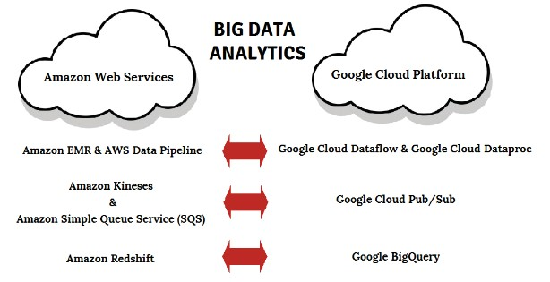
So, why are enterprises betting big on ‘Big data’?
Companies are now looking to improve savings and increase ROI through evidence based decision making, largely driven by Big Data Analytics.
Firms are now making resource alloca- tion decisions and judging marketing effectiveness using real-time analysis of consumer behavior.
The massive demand for analytics services means that all the major cloud vendors now offer real-time data stream processing and analytics to their consumers. Google has gone further and launched a uniﬁed programming model that combines batch and stream processing in one product, Google’s cloud Dataflow.
Google is adding new features and cutting down prices in its Data warehousing and analytics segment. It announced a reduction in the prices of BigQuery at the NEXT customer conference in 2016. The change made long term storage cheaper for its customers by automatically reducing storage price by 50% after 90 days.
Google also keeps simplifying the analytics game by adding sophisticated data visualization tools like Google Data Studio 360 that aggre- gate all analytics workflows into one tool.
Use cases of Google’s Big Data Analytics
1.Spotify
Take the case of Spotify, Spotify uses Google’s Big data analytics services like Big query and Dataflow to generate personalized music recommendations for its users.
2.Dominos
Dominos aggregates all the data from its multi-channel distribution network and uses Google analytics premium services and BigQuery to ascertain which of its marketing campaigns are working.
Comparing Google’s Analytics services with Amazon
Both Amazon and Google offer comparable services in analytics segment.

Slide 35
Often comparisons are drawn between Amazon’s RedShift and Google BigQuery, but both differ in pricing, ease of use and flexibility.
Amazon’s Redshift runs on a self-provisioning model and you pay for the amount of time that the servers are kept online.
In Google BigQuery, there is automatic provisioning of resources as it is a completely abstracted system that works on a No Ops model. The pricing is more economical when compared to amazon. And with the recent drop in prices for long term storage, Google surely wins the price battle vis-a-vis other Big Data Cloud Service vendors.
Plus, Google strengths lie in data management and its data centers are optimized for scaling and analytics. The reason cited by Spotify for its shift to Google cloud platform also talks of google’s superiority in the provision of data services.
“Spotify chose Google in part because its services for analyzing large amounts of data, tools like BigQuery, are more advanced than data services from other cloud provides.”
-Nicholas Harteau, VP of Infrastructure, Spotify
The next round of cloud adoption will be driven by enterprises launching IoT products. Since IoT prod- ucts are inherently data-intensive, they will drive fur- ther adoption of Google cloud
platform services.

Slide 36
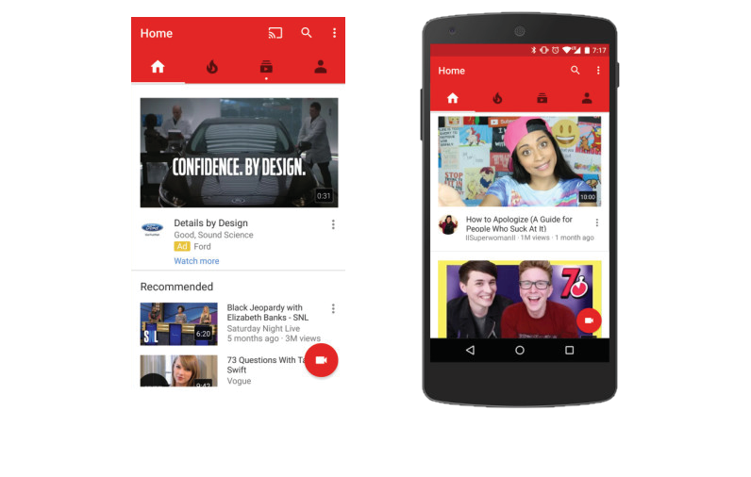
CHAPTER 10
The (Machine) Learning Enterprise
Why plain ole SaaS is passé
IBM Is About to Become the Best Weather Forecaster Ever – WIRED, 10.28.15
Machine learning technique boosts lip-reading accuracy – TechCrunch, Mar 24, 2016
reasons to write another article around machine learning possibilities. Google is adding to the buzz with the launch of its machine learning platform and ML email app Inbox.
How Google’s AI Auto-Magically Answers Your Emails –
WIRED, 03.17.16
Before we compare how public cloud mega vendors like Amazon and Google are mainstreaming this powerful tech for everyone, everywhere, let’s under- stand what Machine Learning (ML) is and does:
The Next Wave Of Enterprise Software Powered By Machine Learning – TechCrunch, Jul 27, 2015
Machine Learning (ML)….you can’t ignore the buzz around it these days. Every tech conference you attend people are waxing eloquent about how it’s the future of enterprise IT. Tech magazines too seem to be ﬁshing for
Machine learning is the science of recognizing patterns in large data sets and making predictions based on mining Big Data. ML applications work with not just large but wide data to

Slide 37
generate predictive and prescriptive insights to guide enterprise deci- sion-making. ML algorithms improve over time and with every use.
4. It currently doesn’t allow extension/ creation of algorithms and also has limited settings for tuning the algo- rithm for optimization.
ML is powering many services we use ranging from the recommendation engines on Netflix, Youtube to the Smart Reply feature in Gmail.
5. Amazon ML also supports evalua- tion of algorithms using performance metrics
Looks like machine learning will be the magic potion that
spices up the next wave of apps we use.
Now let’s see what Google did for cloud machine learning…
Google launched its Machine learning Platform at the GCP NEXT conference in 2016. Google’s ML services include Google Prediction API and its
pre-trained models Cloud Vision API, Cloud Speech API and Cloud Translate API. It also open sourced the machine learning technology that powers its apps to developers all over the world. Google TensorFlow machine learning library can now be used by developers to build sophisticated new algorithms.
Now let’s compare AWS and GCP Machine learning Services:
Amazon launched its machine learning services in April 2015 for existing AWS customers.
Some features of Amazon ML
1. Amazon ML includes a wizard that helps those with little or no-prior intro- duction to ML get started with the service.
Google Machine Learning Platform
The platform has two main parts
2. Amazon ML is designed to work with other AWS services like Redshift and S3. But if you are not an AWS user you will ﬁrst need to move your data to Amazon to use its ML service.
1. One which allows developers to build ML models from their own data
2. Another offers developers pre-trained models
3. Amazon ML offers limited data cleaning and data transformation capabilities

Slide 38
Google ML allows developers to train their ML models by allowing easy access to other Google Cloud services.
Developers can access data from services like Dataflow, Bigquery, Dataproc, Cloud Storage and Cloud Datalab and train their algorithms on this data.
Some of the pre-trained models offered on GCP:
Cloud Vision API
Translate API
Cloud Speech API
Several apps built atop these pre-trained models are already being launched to cus- tomers.
The Buzz seems real and looks like Machine Learning as a Service will drive the next round of enterprise cloud adoption. Google is the clear frontrunner vis-à-vis rival Amazon in Machine Learning Services.

Slide 39
CHAPTER 11
Why Google Cloud?
Hear what Spotify & Snapchat say!
Spotify, a popular music streaming service announced a shift to GCP in Feb 2016.
Spotify - Google Music to ears
The story of Spotify’s shift to Google in their own words:
providing a streaming experience that feels as though you have all the music in the world on your phone.
Note: Excerpts from Spotify’s company blog explaining the shift have been used.
How we did it until now:
Historically, we’ve taken a traditional approach to doing this: buying or leasing data center space, server hardware and networking gear as close to our customers as possible.
Let us introduce ourselves:
Company most often associated with amazing music recommendations and awesome parties
We are:
Announcing Spotify Infrastructure’s Googley Future
Why not use the Cloud like others? Operating our own data centers may be a pain, but the core cloud services were not at a level of quality, perfor- mance and cost that would make
Why it’s a big deal:
At Spotify we are obsessed with

Slide 40

cloud a signiﬁcantly better option for Spotify in the long run. As they say: better the devil you know…
Snapchat - Google
What changed now?
Recently that balance has shifted. The storage, compute and network services available from cloud providers are as high quality, high performance and low cost as what the traditional approach provides. This makes the move to the cloud a no brainer for us.
Snap & Share via Google!
Unlike others of its ilk, Snapchat, the de facto social platform for millennials built its wildly successful app on Google bypassing AWS.
Why Google?
What really tipped the scales towards Google for us however has been our experience with Google’s data platform and tools. Good infrastructure isn’t just about keeping things up and running it’s about making all of our teams more efﬁcient and more effective and Goo- gle’s data stack does that for us in spades.
Here is what Snapchat co-founder Bobby Murphy said about why they chose to develop on Google’s App Engine:
Easy to Use
“App Engine enabled us to focus on developing the application. We wouldn’t have gotten here without the ease of development that App Engine gave us.”
Bobby Murphy CTO and co-Founder
The one thing that tipped the balance: Google has long been a thought leader in this space (data warehousing & analytics), and this shows in the sophistication and quality of its data offerings. From traditional batch processing with Dataproc, to rock solid event delivery with Pub/Sub to the nearly magical abilities of BigQuery, building on Google’s data infrastruc- ture provides us with a signiﬁcant advantage where it matters the most.
Auto Scaling
"Cloud Platform gives you upfront ease of use with the added comfort of knowing whatever you are building, if it needs to, will scale ad inﬁnitum."
— Bobby Murphy, CTO, and co-founder
Our Final thoughts:
We’re pretty excited about our Googley future and hope you’ll ﬁnd it interesting too.
Launch Quickly
“And, at the time, obviously our biggest priority was to get a product in the
A COMPLETE GUIDE TO GOOGLE CLOUD PLATFORM // 40

Slide 41
hands of users in the world - in the real world - as quickly as possible”
-Bobby Murphy, CTO, and co-founder
interest, with some speculating that it signaled an end to Amazon’s domina- tion of the cloud computing world.
Let us focus on Adding New features “Biggest beneﬁt is just the fact that we can focus much less on maintaining infrastructure, and much more on building new stuff.”
-Bobby Murphy, CTO, and co-founder
But truth is, Apple has not migrated to Google Lock, stock and barrel. It still uses AWS, Microsoft Azure alongside its own data centers to host its inter-net services.
Update: Snapchat is now the third most popular social app among millen- nials.
In Feb 2016, Morgan Stanley had reported that Apple spent around $1 billion per year on Amazon’s AWS. A part of this money will now flow to Google’s coffers.
#Snapchat: 100 million active users, 9000 snaps shared every second Click to Tweet
But, Apple’s move to GCP should be seen as a diversiﬁcation strategy instead of a competitive defection.
Despite rapid growth, the app built on Google App Engine hasn't expe- rienced any major outages
Why?
It still uses AWS and Microsoft
Azure platforms besides GCP and its own data center
Apple - Google
It is spending billions of dollars on building new data centers to reduce its dependence on cloud vendors.
But Apple’s move is a ‘shot in the arm’ for Google. The deal said to be worth
$400-$600 million in revenue, comes at a time when Google is trying hard to win new enterprise clients to its plat- form. The deal puts a stamp of approv- al on Google’s Cloud services from its major rival Apple.
Data meets design
Tech news site CRN reported that Apple signed a deal with Google to use the search giant’s Cloud Platform for some of its iCloud services in March 2016. The news generated a lot of

Slide 42



CHAPTER 12
Planning Your Enterprise Cloud Strategy
What You Should Put On Your Wish List!
Enterprise Cloud Strategy Planner
Identify business objectives to be met by migration
Design a Cloud strategy
(Hire an outside specialist if required)
Identify applications/workloads that can be moved to the cloud
Decide upon a cloud deployment model (Private/Public/Hybrid)
Decide on a vendor strategy (Single or Multi-vendor)
Select Cloud Platform(s) & Implementation Partner
Create a Roadmap
Break strategy into a set of actionable items
Map each actionable item to accompanying beneﬁts
Identify quick wins for early implementation
Develop Benchmarks to assess Cloud success

Slide 43
Startup?
b. Has handled similar projects in the past
Let’s tweak the plan a little….
1. Set out the Idea
c. Offers competitive pricing
d. Has some understanding of business/industry being targeted
2. Explore both on-cloud and off-cloud development options
e. Takes ownership of development, testing and deployment.
3. List business objectives to be met by cloud adoption
f. Agrees to meet quality bench marks
4. Find the Right Cloud Vendor (Hire a Cloud tech specialist)
g. Promises timely delivery
5. Make a list of requirements (Current, Future)
h. Can ensure coordination and regular progress updates
6. Identify Cloud Platform that meets your needs
i. Look for a long-term partner who will handle post-launch product upgrades
Product development process
9. Launch Product/Service
In-house
If you are not familiar with technology, this is a bad idea
Outsource
Outsource it and focus on core business functions like marketing and sales.
What to look for in your Product Development Partner?
a. Comes through a referral/ Has good client testimonies

Slide 44






Conclusion
Now, we are nearing the end….
You know all about Google Cloud Platform and how it compares to Amazon Web services. You now have the tools to script a successful cloud strategy for your ﬁrm. It’s ﬁnally time to begin your cloud journey!
Wait! Don’t leave before you read this cautionary tale….
This was a time when the social gaming wave was sweeping the world. Zynga, a social gaming ﬁrm saw its user base skyrocket. The company was using AWS for its services. Both surprised and pleased with its phenomenal success, its top manage- ment decided it was time to ditch the hired accommodation. They set out on an ambi- tious plan to build their own datacenters. But in their excitement they forgot two facts:
Consumer loyalty is a fickle thing.
The next big disrupt or is just around the corner
While the executives at Zynga were busy changing their strategy, their customers were busy acquiring a new preference, a love for mobile gaming. The demand for Zynga’s desktop and browser-based games soon crashed. Thankfully, Zynga could abandon its plans of building datacenters and return to the safe conﬁnes of AWS. The Cloud was after all the better place for Zynga.

Slide 45
Annexure A
AWS building-block services
The fundamental AWS products are:
Amazon Elastic Compute Cloud for virtual compute
Amazon Simple Storage Service and Amazon Elastic Block Store for storage Amazon VPC for networking
Amazon RDS and Amazon DynamoDB for databases
Higher-level building block services are built on these fundamental services. These can range from a platform as a service (PaaS), such as AWS Elastic Beanstalk, to more abstract services, such as Amazon Kinesis.
Application
AWS data services
AWS Application services
AWS Management services
Amazon EC2 AWS Elastic Beenstalk Amazon ECS
Amazon S3 Amazon EBS
Amazon VPC Amazon Route 53 Amazon ELB
Amazon RDS Amazon DynamoDB
Physical Infrastructure

Slide 46
Google Cloud Platform building-block services
The fundamental Google Cloud Platform services are:
Google Compute Engine and Google App Engine for virtual compute
Google Cloud Storage, which allows you to store large or unstructured data objects
Google Cloud DNS and Google Cloud Interconnect for networking basics
Google Cloud SQL, Google Cloud Datastore, and Google Cloud Bigtable for databases.
Like AWS, GCP too layers a number of higher-level services on top of these fundamental ones.
Application
GCB data services
GCB Application services
GCB Management services
Google computer engine
Google App Engine
Google container Engine
Google cloud storage
Google cloud DNS Google cloud interconnect
Google cloud SGL
Google cloud Data Store Google cloud Bigtable
Physical Infrastructure
Some higher level services offered by Google include: Stackdriver for monitoring cloud operations, the Cloud Deployment manager and Google’s Machine Learning Platform.

Slide 47
Mapping services of AWS to GCP
Service Category | Service | AWS | Google Cloud Platform
Compute | IaaS | Amazon Elastic Compute Cloud | Google Compute Engine
 | PaaS | AWS Elastic Beanstalk | Google App Engine
 | Containers | Amazon Elastic Compute Cloud Container Service | Google Container Engine
Network | Load Balancer | Elastic Load Balancer | Google Cloud Load Balancing
 | Peering | Direct Connect | Google Cloud Interconnect
 | DNS | Amazon Route 53 | Google Cloud DNS
Storage | Object Storage | Amazon Simple Storage Service | Google Cloud Storage
 | Block Storage | Amazon Elastic Block Store | Google Compute Engine Persistent Disks

Slide 48
Service Category | Service | AWS | Google Cloud Platform
 | Cold Storage | Amazon Glacier | Google Cloud Storage Nearline
 | File Storage | Amazon Elastic File System | ZFS / Avere
Database | RDBMS | Amazon Relational Database Service | Google Cloud SQL
 | NoSQL: Key- value | Amazon DynamoDB | Google Cloud Bigtable
 | NoSQL: Indexed | Amazon SimpleDB | Google Cloud Datastore
Big Data & Analytics | Batch Data Processing | Amazon Elastic Map Reduce | Google Cloud Dataproc, Google Cloud Dataﬂow
 | Stream Data Processing | Amazon Kinesis | Google Cloud Dataﬂow
 | Stream Data Ingest | Amazon Kinesis | Google Cloud Pub/Sub

Slide 49
Service Category | Service | AWS | Google Cloud Platform
 | Analytics | Amazon Redshift | Google BigQuery
Application Services | Messaging | Amazon Simple Notiﬁcation Service | Google Cloud Pub/Sub
Management Services | Monitoring | Amazon CloudWatch | Google Cloud Monitoring
 | Deployment | AWS CloudFormation | Google Cloud Deployment Manager
Note: The contents of this annexure have been sourced from Google

Slide 50


BitMin is a global cloud advisory and technology services firm. It is primarily looking to serve clients interested in Google Cloud Platform. The company can work on fulfilling enterprise cloud needs, whatever they maybe. From handling cloud application development to Google marketplace integration of existing apps, BitMin has done it all. Some of their startup clients have trusted BitMin with bringing their ideas to life by outsourcing the entire product development to them. Enterprises large and small have also availed BitMin’s in-house expertise in cloud planning and in scripting successful cloud strategies. The company has some of the best talents in cloud computing space working with it and is able to leverage them to deliver world-class solutions for its clients. As a Google Cloud Partner, BitMin publishes regular blogs, newsletters and e-books to inform its audiences of the developments in the cloud computing space and also gives helpful advice on navigating any changes.
© Copyright 2016 BitMin All Right Reserved
BitMin Infosystems Private Limited Jayabheri Silicon County, Hitech City Road Kothaguda, Hyderabad -500084
info@BitMin.net
+1 408 520 9294

