Slide 1
Docker: The Linux Container Engine
Security Aspects

Slide 2
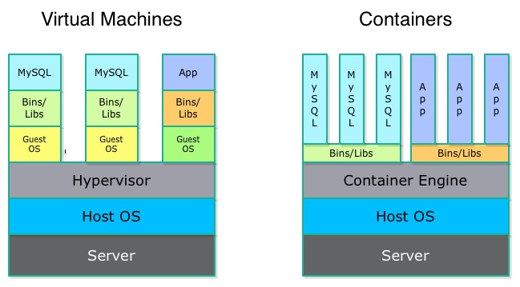
What is Docker?
Notes:
Docker is a framework that allows developers to quickly and effectively deploy distributed applications in mass and alleviate many issues commonly found in production cycles; allowing them to be more flexible and agile.
So rather than hosting multiple virtual machines where the Guest OS can take up a lot of room, time to setup and requires maintenance, containers can be deployed on top of any system.

Slide 3
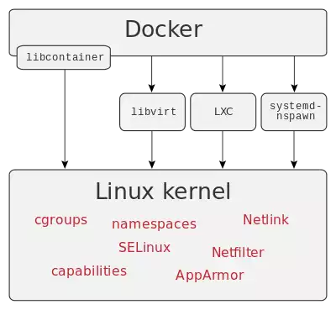
Docker Internals
Notes:
Docker takes advantage of a few key aspects of the Linux kernel to get the desired results; namely cgropus and namespaces.
There is more than one way to take advantage of the ease that Docker provides. Currently Docker has support for libvirt, LXC and systemd-nspawn virtualization libraries as well as their own libcontainer.
Use any of these solutions, Docker allows for containers to be made that are fully isolated from the host OS and are secure and easily updated.

Slide 4

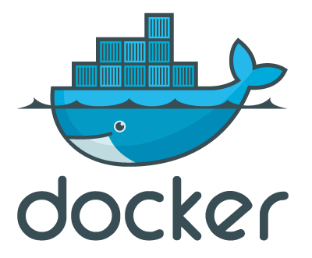
Docker Security
Growing pains
Linux Kernel
Linux Containers
Trusted containers
Notes:
Docker has seen a massive growth in popularity over the past two years. In that time there were many issues that popped up and exploits that were found that yielded far from secure containers. Since its release though, the docker team along with the linux kernel group have put a large focus on security and docker running on kernel’s newer than 3.14 are fairly secure.
The linux container team has also taken steps to enhance security which has trickled down to the kernel and up to docker.
One potential security hole is still the docker container repository. This repo serves as a place for devs to showcase their containers and allows others to grab instances of their containers and deploy them. These containers have the potential to contain malicious code and should be used with caution and proper steps to limit their access to one’s host system.

Slide 5
Linux Kernel Namespaces
Isolates processes into namespaces:
Process ID: Isolates process IDs and gives own process numbering that is only seen by parent
Network: Isolates network devices, stacks, and ports. Own routing table, iptables chains and rules.
Mount: Isolates mount points and translates paths to root rather than relative.
UNIX Time-Sharing: Allows for processes to have different hostname.

Slide 6
Linux Kernel Control Groups
Monitors, isolates and limits resources
Separate controllers for each resource:
Memory e.g. Limit RAM caching
CPU e.g. Limit CPU time
Block I/O e.g. Limit operations per second

Slide 7

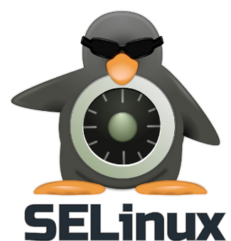
Security: AppArmor and Common Sense
Use non-privileged containers
Use newer kernel, 3.14+, and update often
Use a MAC System (AppArmor, SELinux)
Remove unneeded risks, i.e. SUID binaries
Notes:
MAC: Mandatory Access Control system

Slide 8
Conclusions
Docker is secure*
Depending on your setup, your needs and your willingness to configure internals
Namespaces, Cgroups, AppArmour
* As secure as other options with easier setup

Slide 9
Questions?

