Slide 1
A Rejoinder to Polonius
Modeling Lending Club Loan Data
Douglas H. Wood
Thinkful Data Science Intensive

Slide 2
Hamlet
“Neither a borrower nor a lender be.”
Polonius, in Hamlet,
William Shakespeare
Act I, Scene 3

Slide 3
About the Data Set
Lending Club – peer to peer lending for personal loans. Applicants pay an origination fee, and interest rate is determined by credit score. Once originated, investors can provide some of the principal for loans (for a fee).
Kaggle – a platform for predictive modeling and analytics competitions for data uploaded by users.
Lending Club Loan Data from 2016 is available for download on Kaggle.

Slide 4
Perspectives on the Data
Lender
Peer Lender
Borrower
Data Scientist
We are going to predict defaults

Slide 5
Loan.csv
Lending Club Loan Data in comma separated values format (csv)
Details:
887,379 unique loan records
74 columns of possible features
Integers, floats, strings, lender-provided short narratives
Also an accompanying “Definitions” file

Slide 6
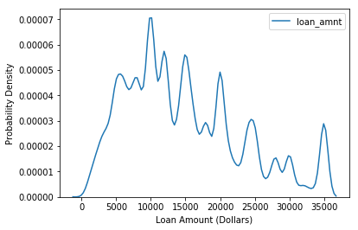
Exploring the Data Univariate Analysis I

Slide 7
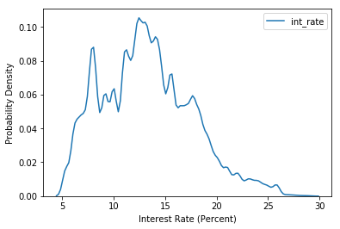
Exploring the Data Univariate Analysis II

Slide 8
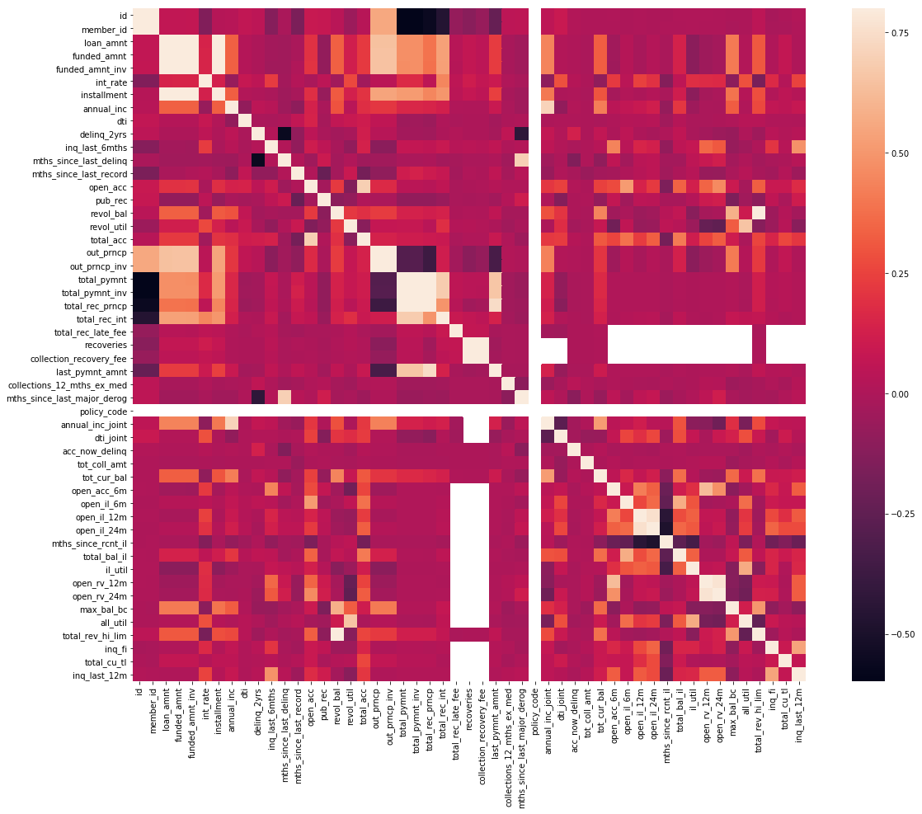
Exploring the Data – Correlation Matrix Heatmap

Slide 9
The Goal: Model Loan Status
Loan Status values: Current, Fully Paid, “Charged Off,” Late (31-120 days), In Grace Period, Late (16-30 days), “Default”
Processing the target: exclude “Current” loans, otherwise any loans not “Fully Paid” are in default.
Result: a Boolean outcome, “Defaulted”

Slide 10
Processing the Data Frame
Inventory of all possible features, referring to Lending Club definitions file
Missing Data (“NaN”)
Term to Binary (36 months or 60 months)
Employment Length to number from string with, e.g. “10+ years”
Earliest Credit Line to number (January 1985)
Get dummies for Grade (A, B, C, …) and Home Ownership (Rent, Own)
Create Training Features, Training Target; Test Features, Test Target Data Frames

Slide 11
Developing the Models
For contrast, tried a “hunch” based on groups of features in the correlation matrix, using a linear regression
Tried all possible features using random forest, in order to access the “feature importances” method

Slide 12
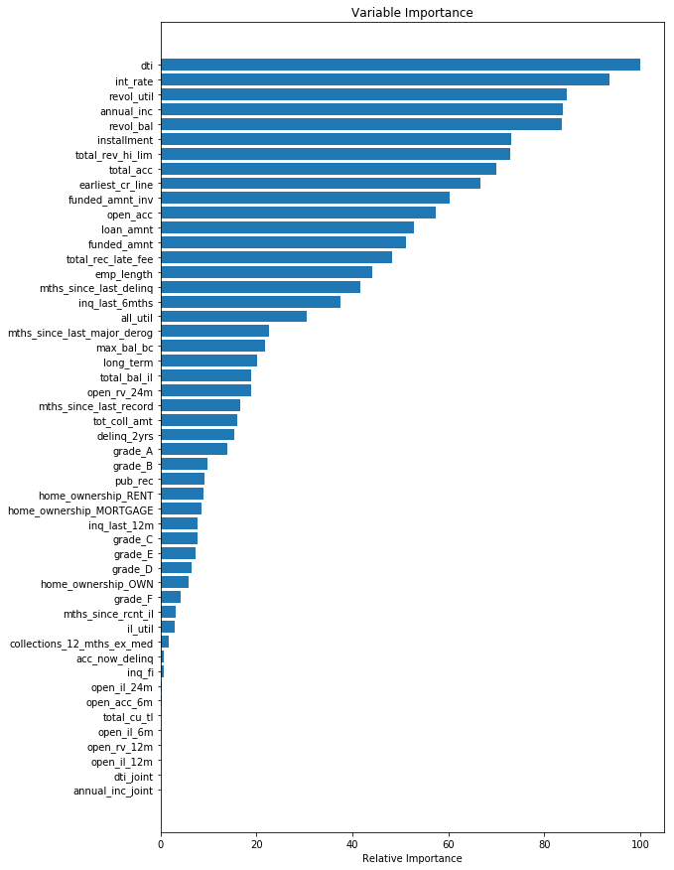
Feature Importances

Slide 13
Lending Club Definitions for Top Features, I
dti: “A ratio calculated using the borrower’s total monthly debt payments on the total debt obligations, excluding mortgage and the requested LC loan, divided by the borrower’s self-reported annual income.”
int_rate: “Interest rate on the loan.” Apparently calculated by Lending Club using Loan Grade which is calculated from applicant’s Credit Score.

Slide 14
Lending Club Definitions for Top Features, II
revol_util: “Revolving line utilization rate, or the amount of credit the borrower is using relative to all available revolving credit.”
annual_inc: “The self-reported annual income provided by the borrower during registration.”

Slide 15
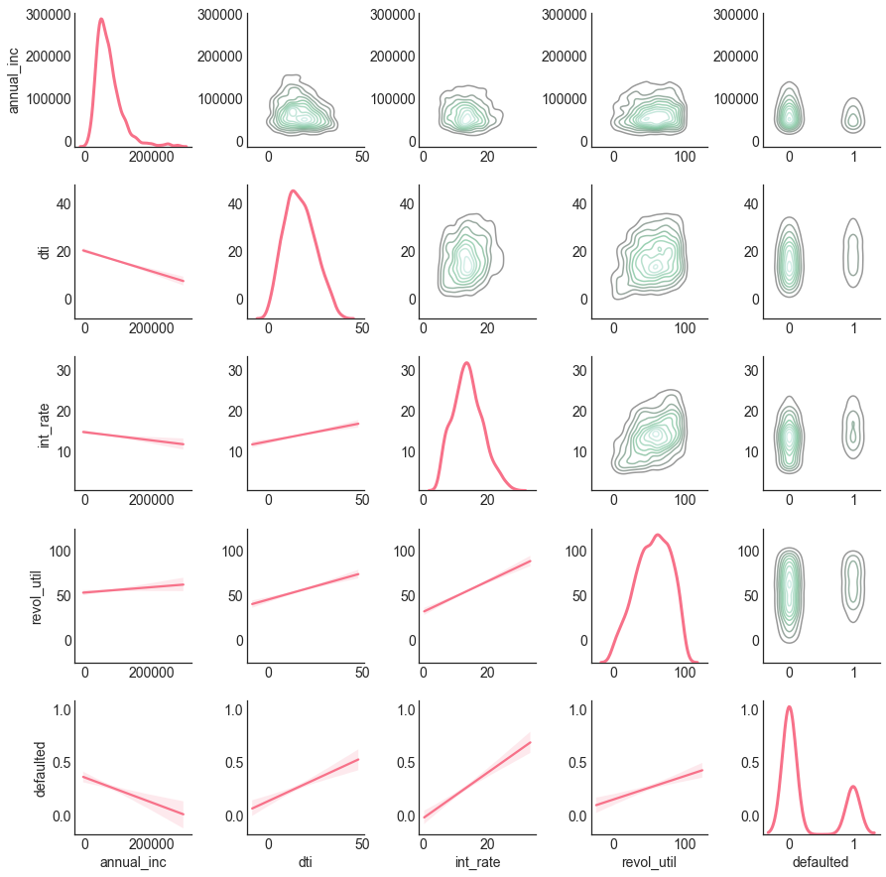
Bivariate Analysis with Four Continuous Variables and Boolean Outcome

Slide 16
The Models
Random Forest of all features, then the top 24 identified in feature importances, then different number of trees and max depths, and the top 10 features
Gradient Boosting Classifier with top four features
Logistic Regression using various combinations of L1, L2 regularization and parameter regularization coefficients on the four top features
K Nearest Neighbors Classifier with the four top features and a grid search for various values of “k”

Slide 17
Model Performance
Accuracy in perspective – compare to balance of target:
104,036 not defaulted / 142,785 loans =
0.728619 of the target variable is “False”

Slide 18
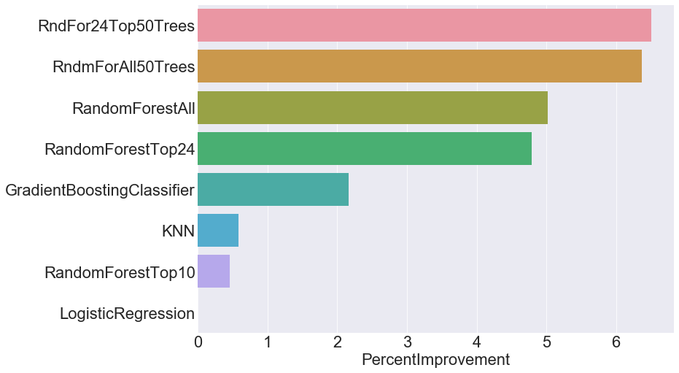
Model Performance II

Slide 19
Model Performance III
From the lender’s perspective, weighing relative costs of Type I and Type II error:
loss of interest income if loan is not originated v.
default at some stage during repayment causing loss of principal if loan is originated
after how many payments – balance changes if default occurs late in the repayment period
possible solution: the origination fee

Slide 20
Best Model and Features
The model with the best performance was a random forest classifier using the top 24 features first identified by features importances, with 50 trees and a max depth of 10.
The top features that predict default rates are: debt to income ratio, interest rate, revolving credit utilization ratio, and annual income.

Slide 21
Rejoinder
To Polonius:
“You can be a borrower, but if you borrow too much, don’t repay it, and don’t earn much, you are at higher risk of default.”
“You can be a lender, but be sure to increase potential interest income, share lost principal with peers, and cover the risk of borrower default with an origination fee.”

Slide 22
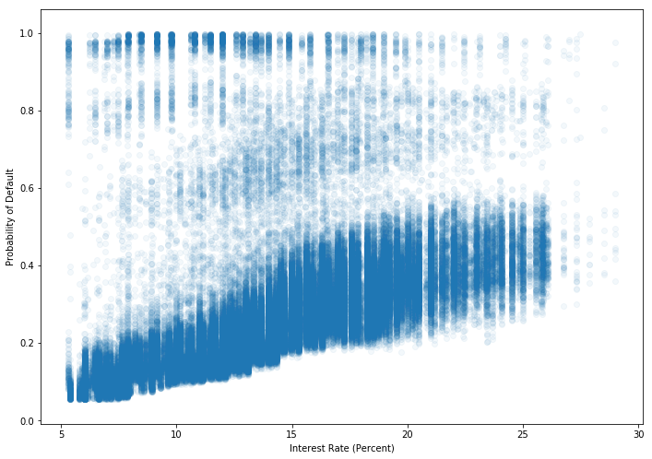
Bonus Round: Peer-Lending Investor Perspective Lending Club Interest Rate v. Predicted Default Rate

