Slide 1
Lab 1
A Single Cycle CPU by Verilog
Contact: eclab.ca.ta@gmail.com
1

Slide 2
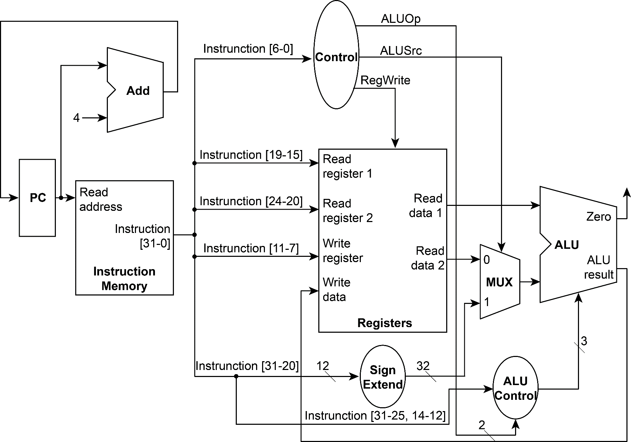
Data Path
2

Slide 3
Hardware Specification
Register file: 32 registers
Instruction Memory: 1KB
Your program should read “machine code” rather than “assembly code”
Machine code:
funct7 | rs2 | rs1 | funct3 | rd | opcode
R-type
7 bits
[31:25]
5 bits
[24:20]
5 bits
[19:15]
3 bits
[14:12]
5 bits
[11:7]
7 bits
[6:0]
immediate | rs1 | funct3 | rd | opcode
I-type
12 bits
[31:20]
5 bits
[19:15]
3 bits
[14:12]
5 bits
[11:7]
7 bits
[6:0]
3
Notes:
3

Slide 4
Instructions
Required Instruction Set
  and rd, rs1, rs2 (bitwise and)
  xor rd, rs1, rs2 (bitwise exclusive or)
  sll rd, rs1, rs2 (shift left logically)
  add rd, rs1, rs2 (addition)
  sub rd, rs1, rs2 (subtraction)
  mul rd, rs1, rs2 (multiplication)
  addi rd, rs1, imm (addition)
  srai rd, rs1, imm (shift right arithmetically)
  Eof (all 0, TB will terminate once received this0
4

Slide 5
Input Format
0000000_00000_00000_000_01000_0110011 //add $t0,$0,$0
000000001010_00000_000_01001_0010011 //addi $t1,$0,10
000000001101_00000_000_01010_0010011 //addi $t2,$0,13
0000001_01001_01001_000_01011_0110011 //mul $t3,$t1,$t1
000000000001_01001_000_01001_0010011 //addi $t1,$t1,1
0100000_01001_01010_000_01010_0110011 //sub $t2,$t2,$t1
0000000_01010_01001_111_01011_0110011 //and $t3,$t1,$t2
Input file
00000000000000000000010000110011
00000000101000000000010010010011
00000000110100000000010100010011
00000010100101001000010110110011 00000000000101001000010010010011
01000000100101010000010100110011
00000000101001001111010110110011
What machine actually reads
5

Slide 6
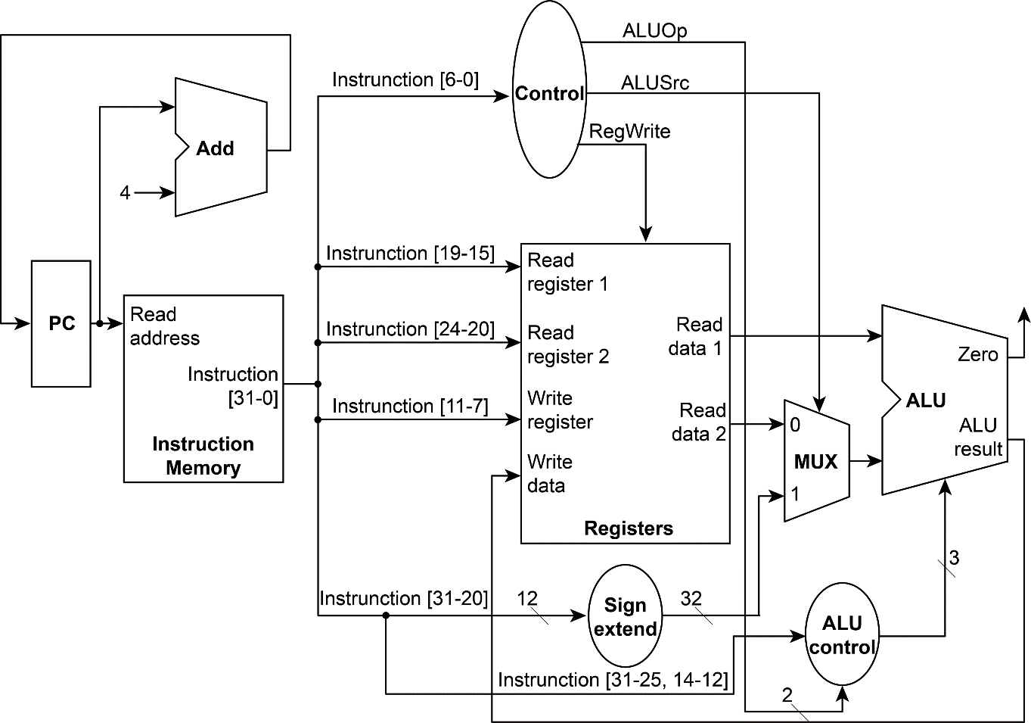
Control.v
Modules
Adder.v
PC.v
Instruction_Memory.v
testbench.v
CPU.v
Registers.v
MUX32.v
Sign_Extend.v
ALU.v
ALU_Control.v
6

Slide 7
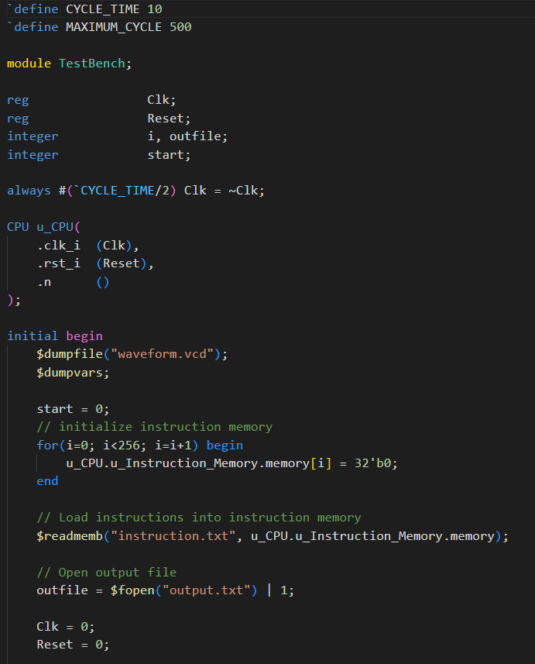
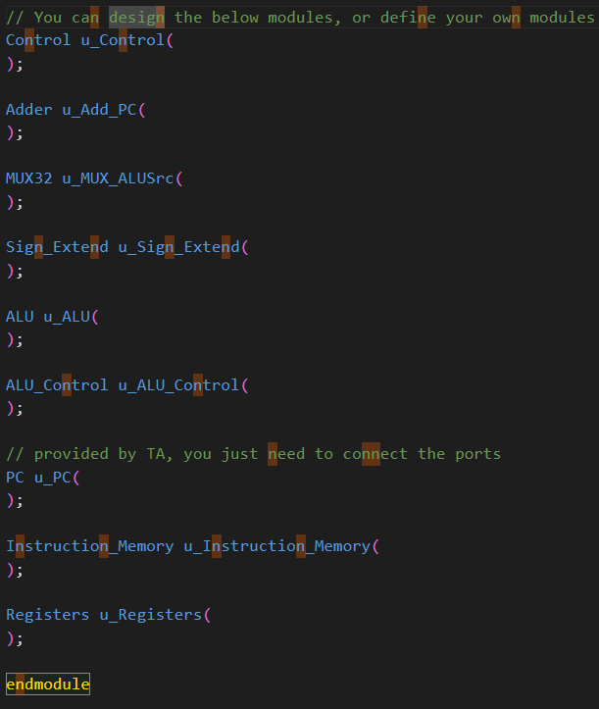
testbench.v
CPU.v
7

Slide 8
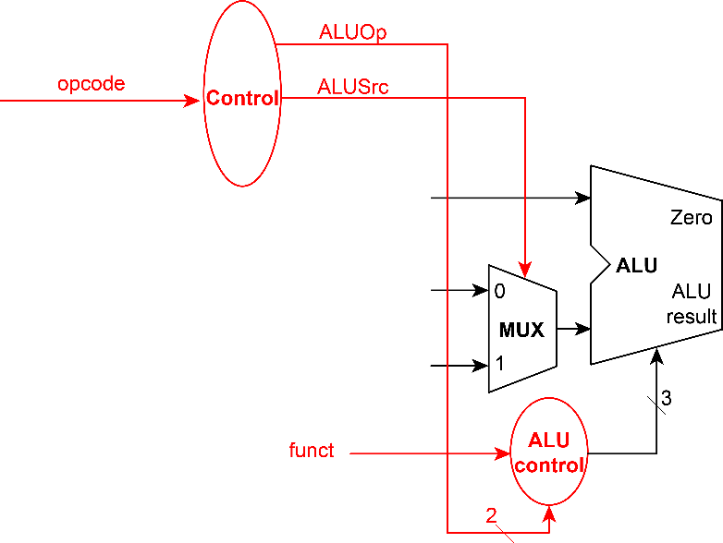
Control.v / ALU_Control.v
funct7 | rs2 | rs1 | funct3 | rd | opcode | function
0000000 | rs2 | rs1 | 111 | rd | 0110011 | and
0000000 | rs2 | rs1 | 100 | rd | 0110011 | xor
0000000 | rs2 | rs1 | 001 | rd | 0110011 | sll
0000000 | rs2 | rs1 | 000 | rd | 0110011 | add
0100000 | rs2 | rs1 | 000 | rd | 0110011 | sub
0000001 | rs2 | rs1 | 000 | rd | 0110011 | mul
imm[11:0] |  | rs1 | 000 | rd | 0010011 | addi
0100000 | imm[4:0] | rs1 | 101 | rd | 0010011 | srai
8

Slide 9
Reminder
Lab 2 and 3 will be strongly related to this homework
This homework is rather simple, it is recommended that you get familiar with waveform visualization tool (e.g. gtkwave) in this homework
9

Slide 10
Submission Rule
Source codes (*.v files) CPU.v … MUST REMOVE testbench.v, Instruction_Memory.v, Registers.v, PC.v instruction.txt, output.txt | Report (<student_ID>_lab1_report.pdf) Development environment Module implementation explanation Either English or Chinese is fine No more than 2 pages
10
Notes:
10

Slide 11
Module Explanation Example
PC module reads clock signals, reset bit, start bit, and next cycle PC as input, and outputs the PC of current cycle. This module changes its internal register “pc_o” at positive edge of clock signal. When reset signal is set, PC is reset to 0. And PC will only be updated by next PC when start bit is on.
11

Slide 12
Module Explanation
The inputs of PC are clk_i, rst_i, start_i, pc_i, and ouput pc_o.
It works as follows:
always@(posedge clk_i or negedge rst_i) begin
if(~rst_i) begin
pc_o <= 32'b0;
end
else begin
if(start_i)
pc_o <= pc_i;
else
pc_o <= pc_o;
end
end
12

Slide 13
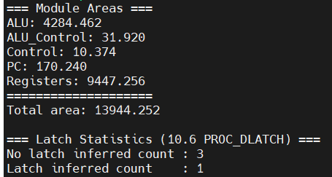
Latch & Area
You need to show all information regarding latches in ./log/synth.log. Latches synthesized from your code will result in a score deduction.
Run parse.py
13

Slide 14
Submission Rule
Submission format
  <student_ID>_lab1/
    <student_ID>_lab1/<student_ID>_lab1_report.pdf
    <student_ID>_lab1_/src/*.v
  Pack the folder into a .zip file
    e.g. b13901053_lab1.zip
  Case sensitive (all alphabets being lower cases)
Deadline: 11/04/2025 (Tue.) 14:20
Upload to NTU COOL
14
Notes:
解壓縮變成一個directory
Debug問的時候規範
14

Slide 15
Directory Structure
We should see a single directory like following structure after we type
$ unzip b13901053_lab1.zip
in Linux terminal:
      b13901053_lab1/
      b13901053_lab1/src
      b13901053_lab1/src/CPU.v
      b13901053_lab1/src/ALU.v
      …
      b13901053_lab1/b13901053_lab1_report.pdf
15
Notes:
解壓縮變成一個directory
Debug問的時候規範
15

Slide 16
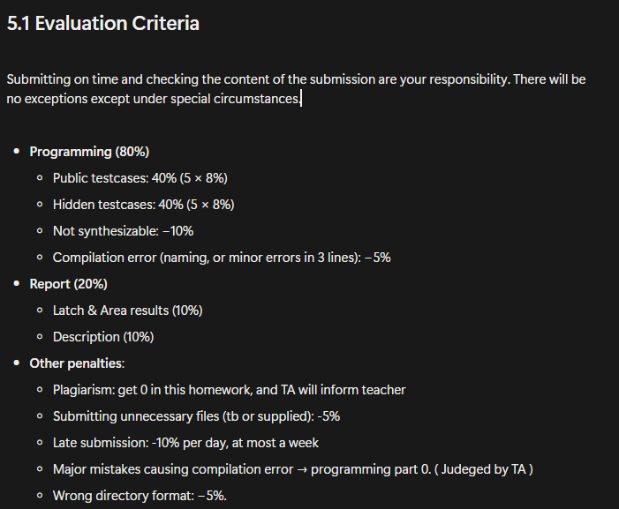
Evaluation Criteria
Submitting on time and checking the content of the submission are your responsibility. There will be no exceptions except under special circumstances.
16
Notes:
16

