Slide 1

Introduction to R
Douglas Adamoski Meira – 21.09.2026
https://github.com/douglasadamoski/rcourse/
Evaluate the course >
https://survey.academiccloud.de/f/618496?lang=en

Slide 2
Part 1: Why learn R?
Reproducibility
  Reproducibility: R scripts record every analysis step. Others (and you in the future) can re-run the exact code to reproduce results. This transparency is crucial for reliable science.
Automation
  Automation: R is a scripting language, not a point-and-click GUI. You can write loops and functions to automate repetitive tasks (e.g. re-running analyses on new data). This saves time and reduces errors.
Visualization
  Visualization: R has powerful plotting libraries. For example, the ggplot2 package greatly improves the quality and aesthetics of graphics. You can easily build scatterplots, bar charts, and more with a few commands.
Real-world bio examples (e.g., RNA-seq, qPCR, statistical analysis)
  Real-World Biology Use: R is widely used in bioinformatics. The Bioconductor project provides thousands of packages for genomic and omics data analysis (e.g. RNA-seq, qPCR, statistical tests). R helps you analyze differential expression (heatmaps, volcano plots) and other experiments in a rigorous, reproducible way.

Slide 3
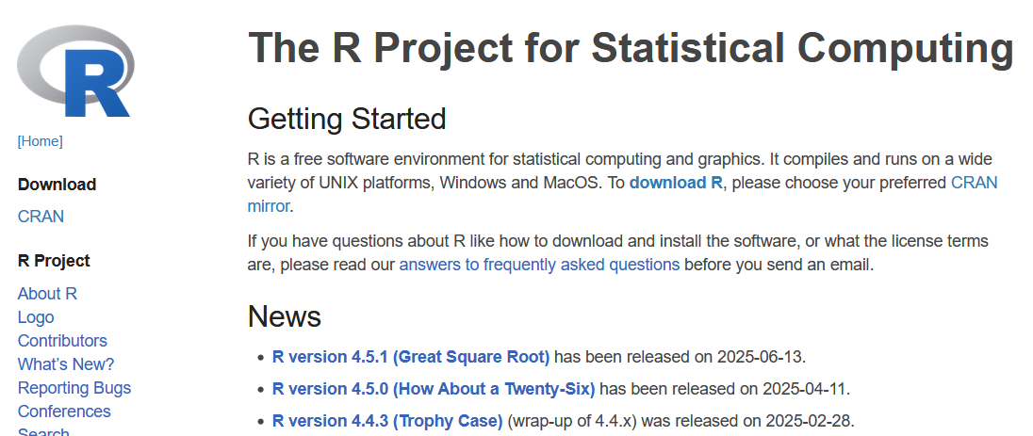
Part 2: Introduction to R and RStudio
What is R?
  R is both a programming language and a software environment for data analysis. It’s an alternative to tools like SPSS or Excel, designed for statistics and graphics. You write commands or scripts in R to perform analyses.
  https://www.r-project.org/

Slide 4
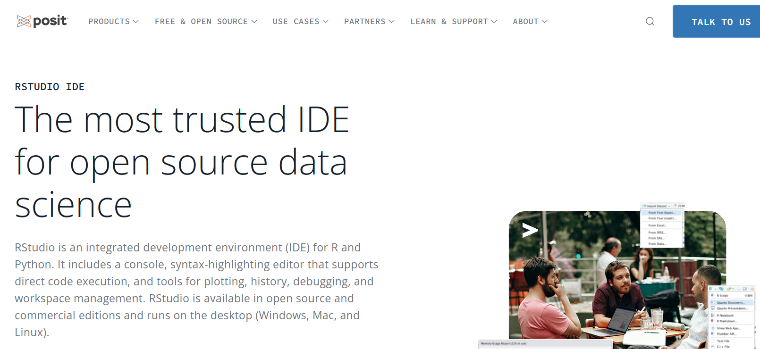
Part 2: Introduction to R and RStudio
What is RStudio?
  RStudio is a popular Integrated Development Environment (IDE) for R. It provides panes for the Console (interactive commands), Script Editor (write and save .R files), Environment/History (your variables and past commands), and Plots. RStudio requires R to be installed, and together they form a powerful workflow

Slide 5
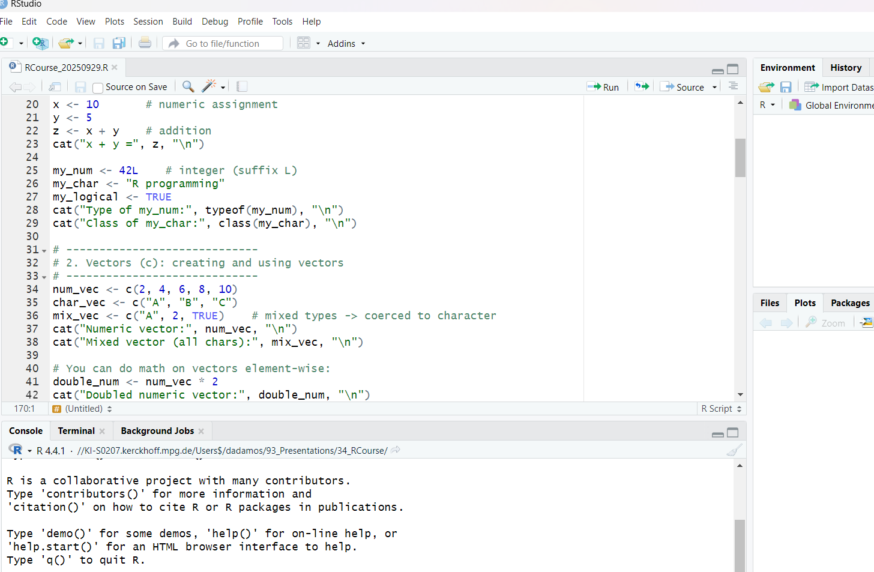
Part 2: Introduction to R and RStudio
Scripts & Projects:
  You can write code in script files (e.g. analysis.R) and run it in the console. Saving scripts (.R files) documents your work. RStudio projects help organize files and set working directories. Learn to send code from the script pane to the console and save your workspace.

Slide 6
Part 2: Introduction to R and RStudio
Running Commands:
  Type commands (or source entire scripts) in the Console to see results immediately. All your variables (data frames, vectors, etc.) appear in the Environment pane. You can clear or restart R as needed.

Slide 7
Part 3: R Basics - Syntax and Data Types
Variables and assignment (<-)
Data types: numeric, character, logical
Vectors and indexing
Basic functions (mean(), sum(), length(), class())
Creating and using data frames

Slide 8
Part 4: Data Manipulation and Visualization
Importing data into R
Reshaping data
Basic plots with ggplot2
Scatter plot, Bar plot
Adding titles, colors, themes

Slide 9
Part 5: Automating Analysis
Looping through samples (for loops)
Writing simple functions
Automating qPCR normalization and delta-delta Ct

Slide 10
Part 6: Visualizing Omics Data – Heatmaps
Overview of RNA-seq results (log2 fold changes, expression matrix)
Heatmaps and volcano plots

Slide 11
Part 7: Sharing Your Work — Shiny
Shiny turns an R script into a small web page
  Your colleagues click; your code runs in the background
See one running right now: shiny::runExample("01_hello")
  Ships with the package — nothing to download, ~20 lines of code
Every app has the same two halves
  ui — what the user sees: dropdowns, sliders, a space for a plot
  server — what R does about it: the plotting code we already wrote
Today's bar plot as an app: a dropdown instead of gene_of_interest
Gallery and tutorial — shiny.posit.co

Slide 12
Part 8: Wrap-up and Q&A
Where to go next
  R for Data Science, free book — r4ds.hadley.nz
  Bioconductor, packages for omics — bioconductor.org
  Posit cheatsheets — posit.co/resources/cheatsheets
  Shiny gallery, with source code — shiny.posit.co/r/gallery
  CRAN task views, packages by topic — cran.r-project.org/web/views
Everything from today — github.com/douglasadamoski/rcourse
Questions

Slide 13
Introduction to R
Douglas Adamoski Meira – 21.09.2026
https://github.com/douglasadamoski/rcourse/
Evaluate the course >
https://survey.academiccloud.de/f/618496?lang=en

