Slide 1
Benchmarking the Internet computer

Slide 2
Blockchain, a popular technology
Blockchain is a popular technology, with a broad range of applications:
NFT, Decentralized finance apps, Cryptocurrencies
Some projects aiming at using it to run any possible applications
Dfinity project
Is it possible to use Blockchain to help for heavy computational tasks ?

Slide 3
An heavy application: Machine learning
Power full machine learning models:
Dall-E, GPT3, …
These models require huge amount of data and computational power to be trained
To train GPT3, assuming you can fit all data inside one GPU:
288 years using a single v100 Nvidia GPU
Need find a way to scale up computation

Slide 4
The three main goals of scaling up computational power
1. Provide reasonable performances
2. Reward those that participate in the process
3. Shouldn’t be specific to machine learning

Slide 5

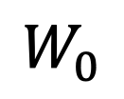

Base case: Federated Learning
Model update
$$W_{0}$$
Updated weights
Model weights
Server
Model weights
$$W_{1}$$
Updated weights
ML model
Model weights
Updated weights
Aggregate results
$$W_{N}$$

Slide 6
My contribution using Blockchain to coordinate workers
Scaling: Anyone could join the process, potential infinite number of workers (Goal 1)
Easy way to reward workers using gas (Goal 2)
Redundancy: replicate tasks. Make sure data is stored securely and isn’t tampered, nice for any application (Goal 3)
Security: Bad workers could be detected based on works they previously provide

Slide 7
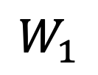
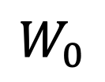






Including the blockchain, a naïve approach
Smart contract
Model update
ML model
ML model
Send Model
$$M_{W0},{Pk}_{0}$$
$$W_{0}$$
Server
$$M_{W0}{,Pk}_{0}$$
$$W_{1}$$
ML model
$$M_{WN},{Pk}_{N}$$
New Model
ML model
Update model
$$M_{elected}$$
$$M_{WN},{Pk}_{N}$$
$$W_{N}$$
Model Stealing !
Worker group
7

Slide 8
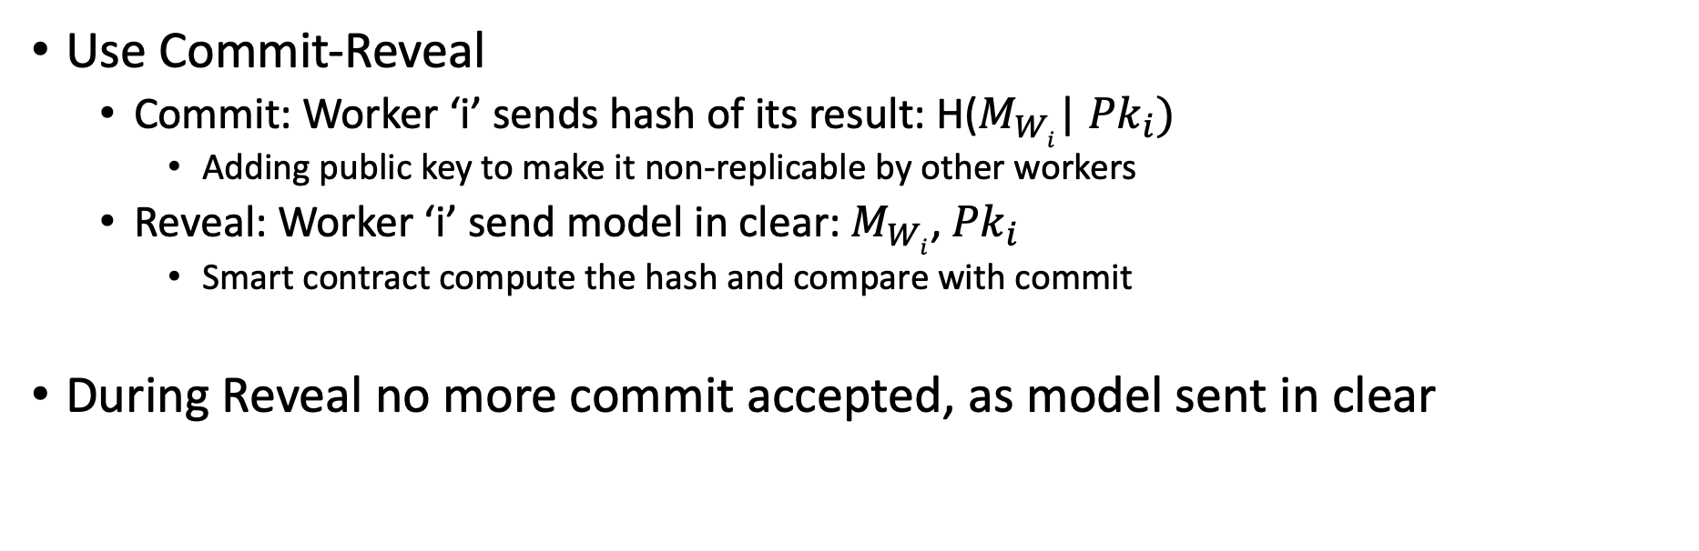
Solving the model stealing problem
Use Commit-Reveal
Commit: Worker ‘i’ sends hash of its result: H($M_{Wi}$| ${Pk}_{i})$
Adding public key to make it non-replicable by other workers
Reveal: Worker ‘i’ send model in clear: $M_{Wi}$, ${Pk}_{i}$
Smart contract compute the hash and compare with commit
During Reveal no more commit accepted, as model sent in clear

Slide 9
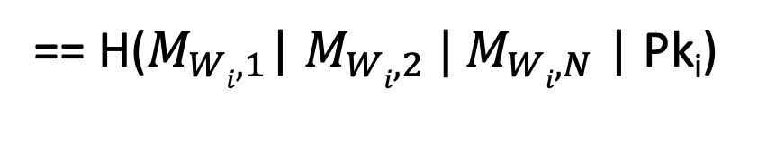
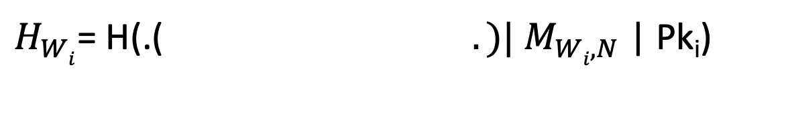
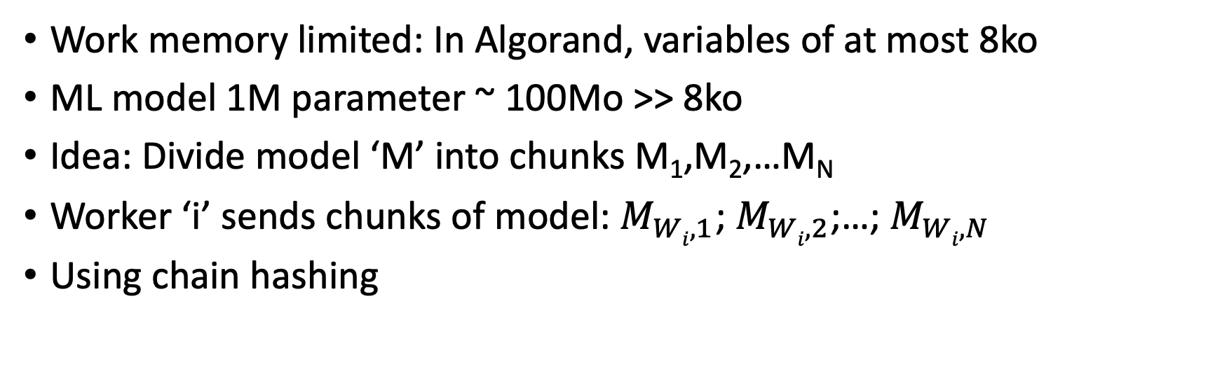
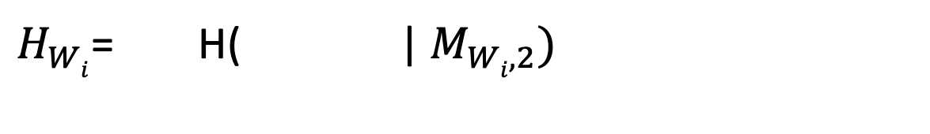
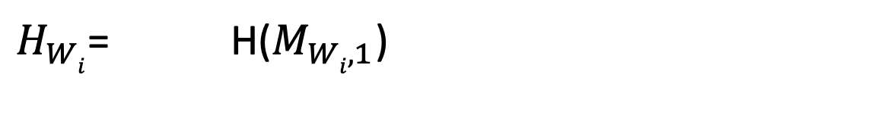
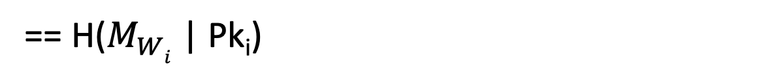
Dealing with limited memory
Work memory limited: In Algorand, variables of at most 8ko
ML model 1M parameter ~ 100Mo >> 8ko
Idea: Divide model ‘M’ into chunks M₁,M₂,…M_{N}
Worker ‘i’ sends chunks of model: $M_{Wi,1}$; $M_{Wi,2}$;…; $M_{Wi,N}$
Using chain hashing
$H_{Wi}$= H(.($. )|{ M}_{Wi,N}$ | Pk_{i})
$H_{Wi}$= H( |${ M}_{Wi,2})$
$H_{Wi}$= $\text{H}\text{(}M_{Wi,1}\text{)}$
Merkle-Damgard
== H($M_{Wi,1}$|${ M}_{Wi,2} |{ M}_{Wi,N}$ | Pk_{i})
== H($M_{Wi}$ | Pk_{i})

Slide 10
Let’s see if possible to train a Machine learning Model using Blockchain
Real case implementation using Diablo
Blockchain has 8 nodes from AWS, each one with 2vCpu and 4Gb RAM
Nodes in the same AWS region

Slide 11
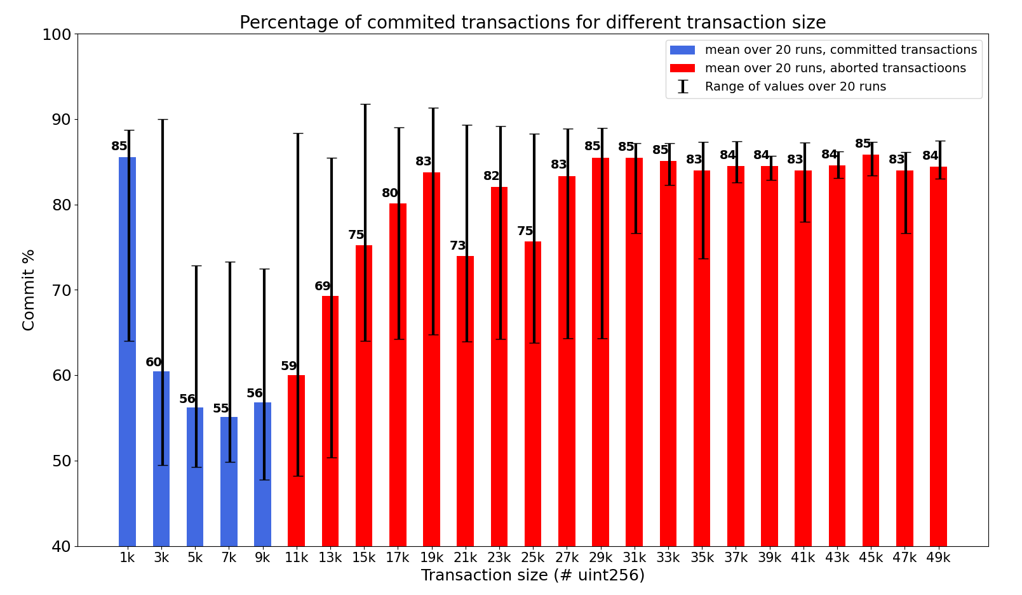
Tuning the transaction size
Calling a smart contract function that copy elements into an array
100 transactions per second during 20 seconds
In quorum abort == commit

Slide 12
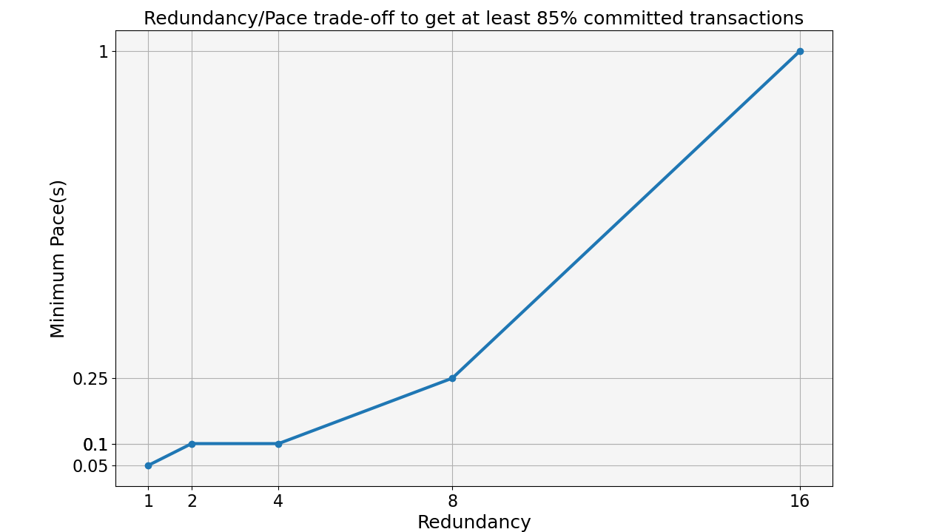
The Redundancy/Pace Trade-off
Pace = how much time between sending each chunk
Redundancy = how many workers we ask the same job
Learning a 1 Million parameters model

Slide 13
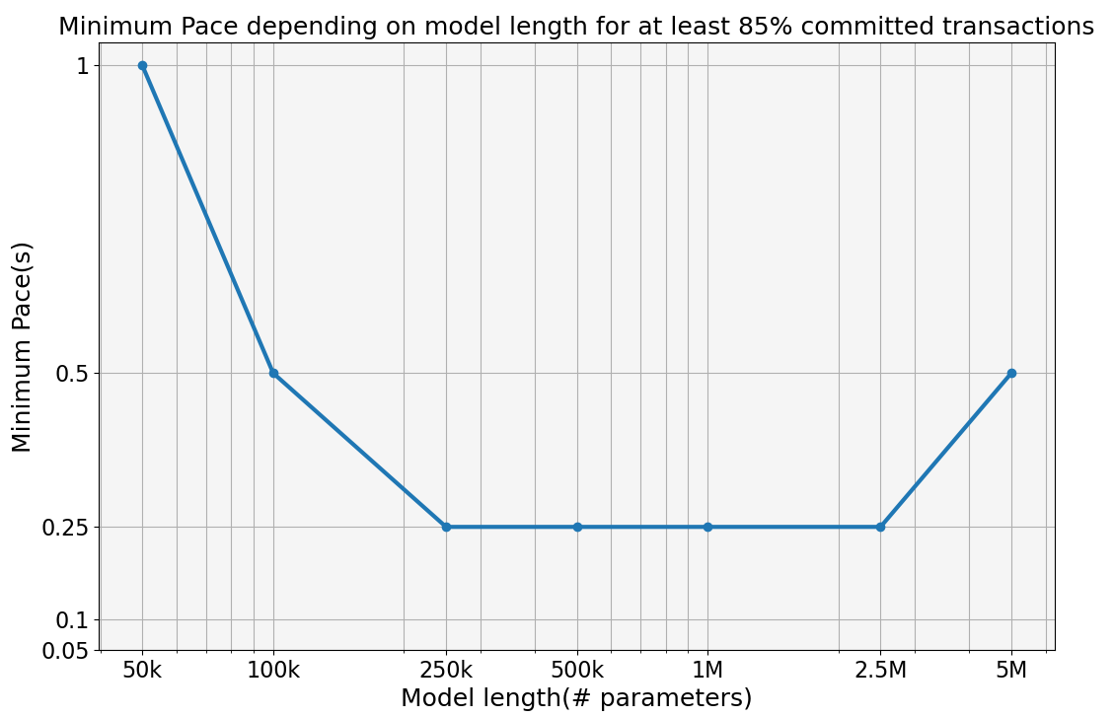
Minimum Pace depending on Model length
Fix redundancy to 8 (Dfinity foundation use 7)

Slide 14
Estimated time to train ML model using Blockchain
Using 0.25 seconds chunk sending pace to train the following models:
Model | # epochs | Training Time
CNN for MNIST (1 million parameters) | 100 | 7 hours
BERT (100 million parameters) | 100 000 | 8 years
GPT-3 (175 billion parameters) | 10 000 | 1400 years

Slide 15
Conclusion
Currently, Blockchain not adapted to help for machine learning tasks
Txs size, Redundancy/Training time trade-off, Relatively small redundancy
May be explored for smaller model
Fine tuning in transfer learning
Only update a subsets of the weights for specialization -> less data to exchange

