Slide 1
Preparing Purpose-Ready Graduates for an AI-Augmented Workforce:
A Cross-Functional Model for Recruiting, Academic Pathways, & Career Readiness
Lisa Keegan
lakeegan01@wm.edu
Douglas C. Schmidt
dcschmidt@wm.edu
Kathleen Powell
kipowell@wm.edu
Vice Provost for
Enrollment Strategies
Dean of Computing,
Data Sciences & Physics
Chief Career
Officer

Slide 2
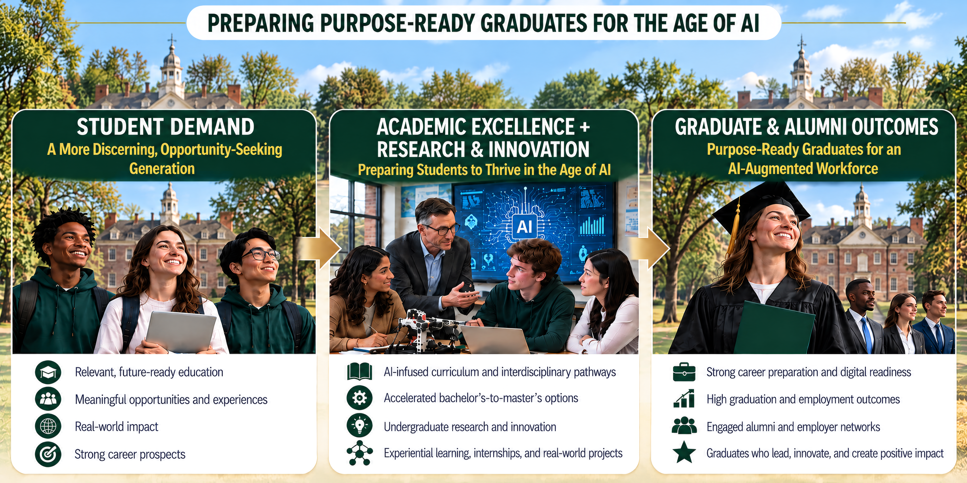
AI is Rewriting Student Demand, Academic Preparation, & Career Outcomes

Slide 3
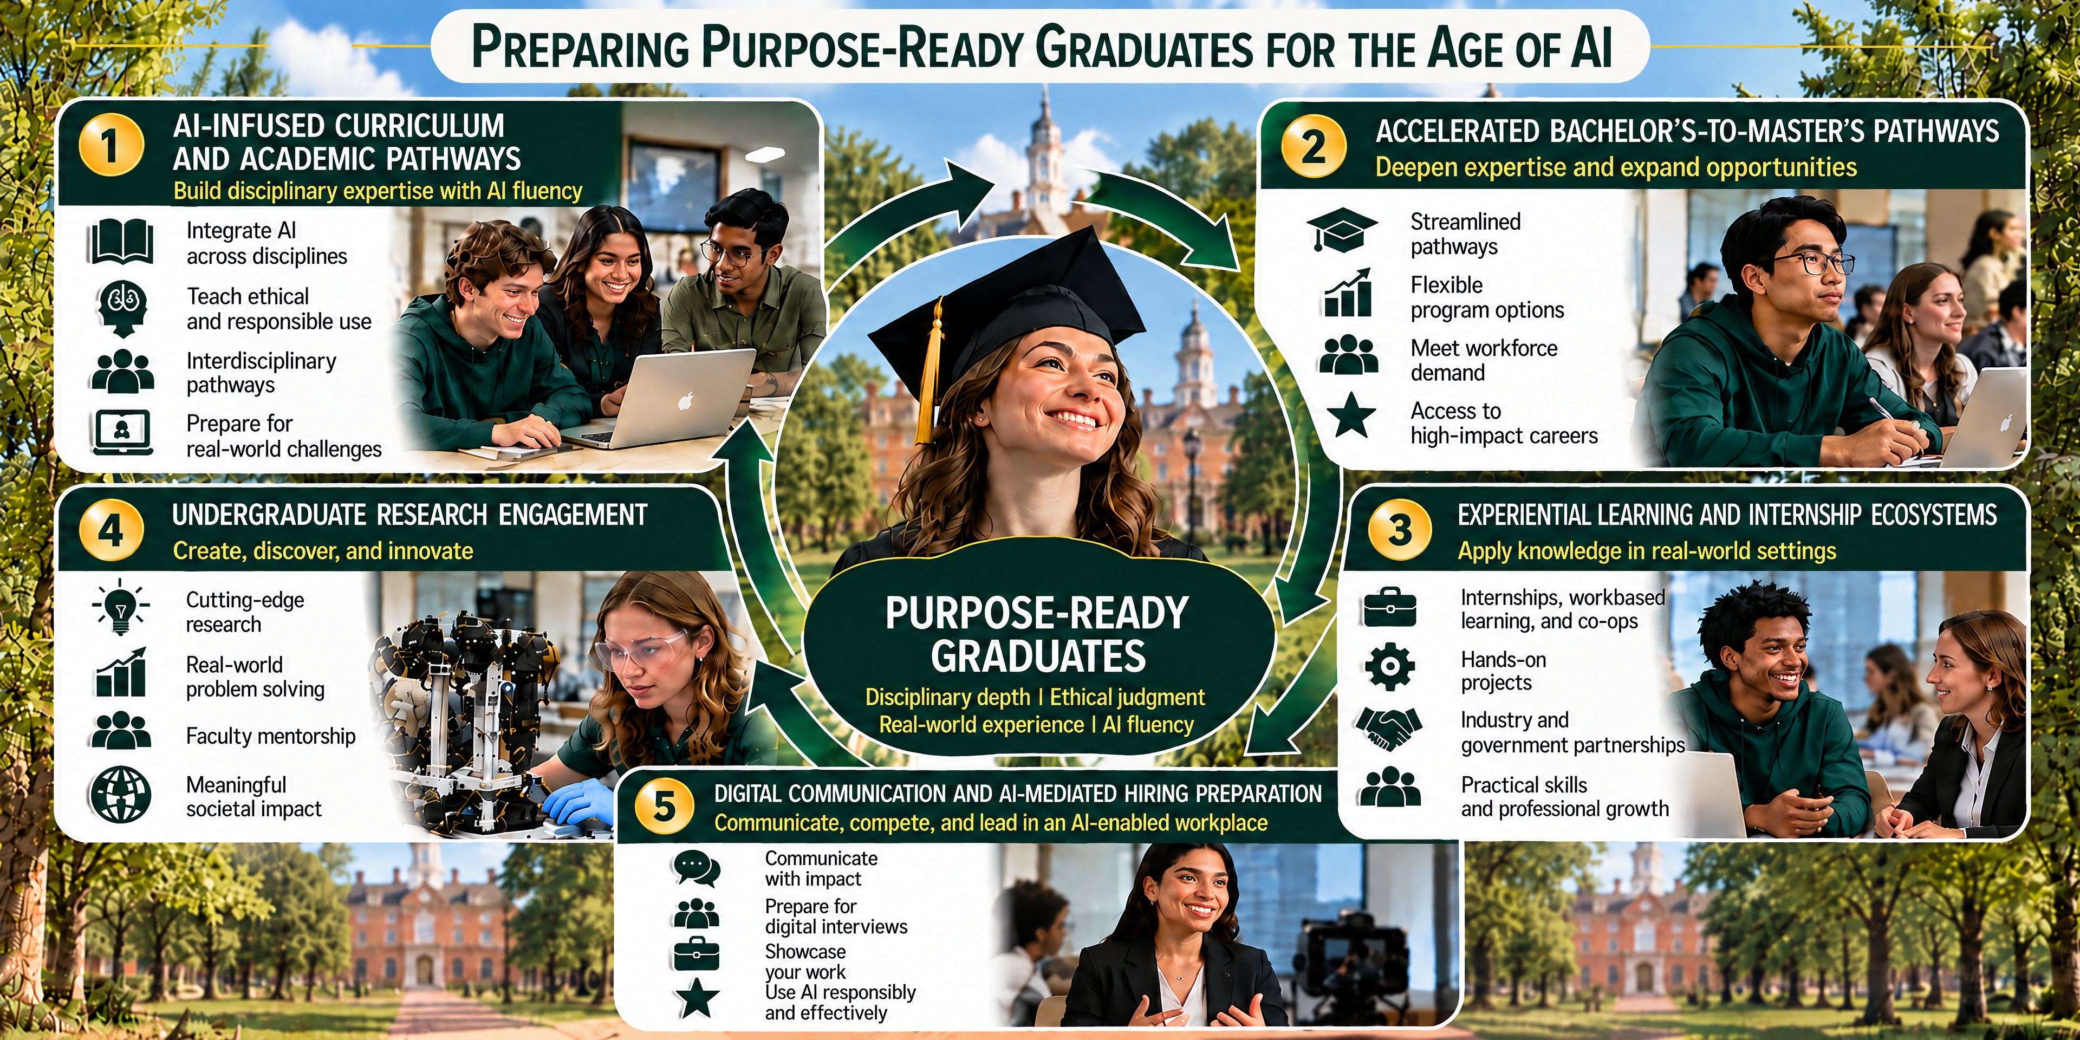
Building Purpose-Ready Graduates Thru Curriculum, Research, & Applied Learning

Slide 4
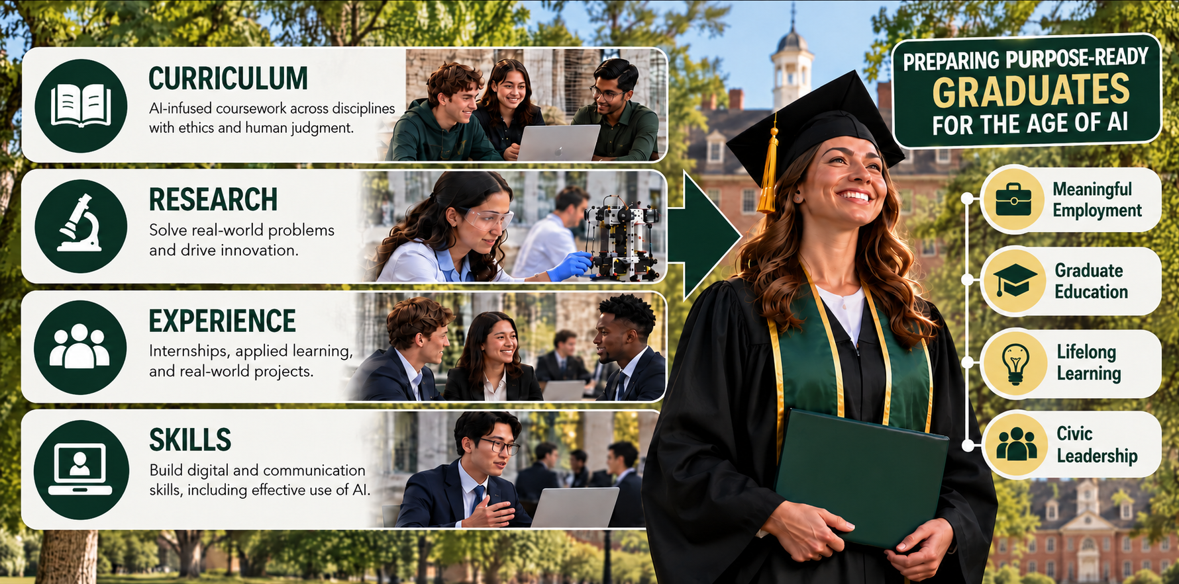
From Preparation to Outcomes: Making AI Readiness Visible

Slide 5
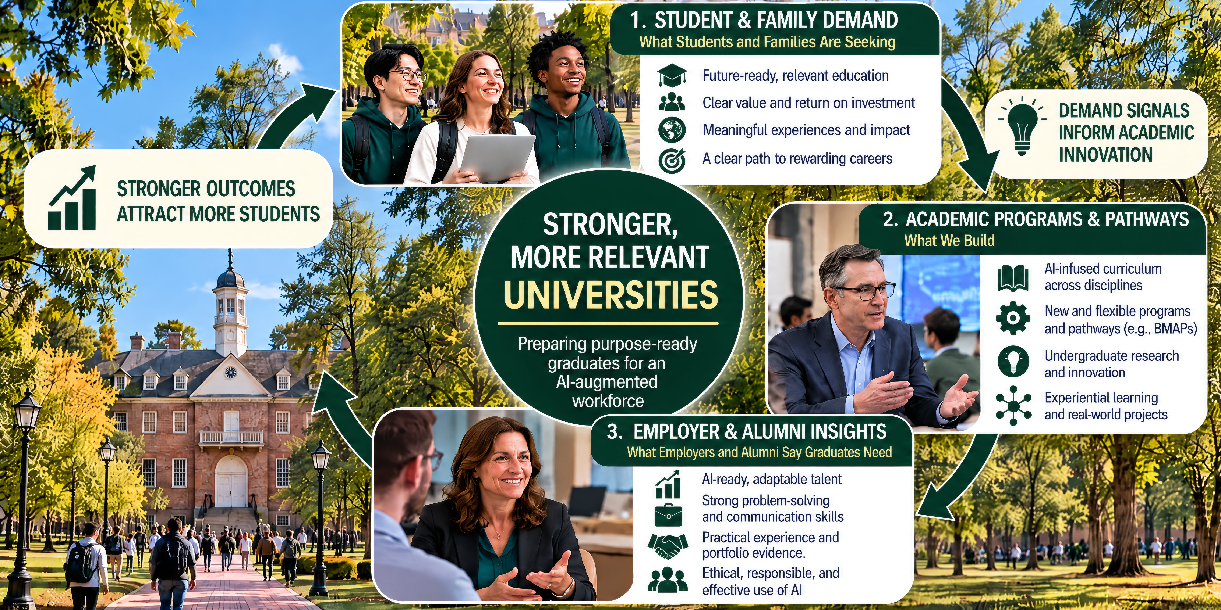
Synergizing Student & Employer Demand to Move at the Speed of Need

Slide 6

How Do We Break Down Institutional Silos to Prepare Purpose-Ready Graduates?
Discussion Question #1
What would change if faculty, academic leadership, enrollment management, career services, & employer partners jointly designed the student experience rather than pursuing separate initiatives?
What practical barriers must we overcome?

Slide 7
Are We Preparing Students for the Workforce They're Actually Entering?
Discussion Question #2
As AI transforms entry-level jobs & employer expectations, what skills, experiences, & human capabilities must our graduates demonstrate to succeed—
& where are our current educational approaches falling short?

Slide 8
Where Are the Biggest Gaps in Our Student Success Ecosystem?
Discussion Question #3
Across AI-infused curricula, accelerated degree pathways, experiential learning, undergraduate research, & career preparation, which opportunities are we missing—& what prevents us from connecting these experiences into a coherent student journey?

Slide 9
What One Action Could We Take in the Next 90 Days?
Discussion Question #4
If you could launch one cross-functional initiative to better prepare students for an AI-augmented workforce, what would it be, who would need to participate, & how would you measure whether it improves student learning or career readiness?

Slide 10

Notes:
You can change the color of an image within PowerPoint. Click on your image, then click “Picture Format” and look for the dropdown icon called “Color”. For more information, please go to the Microsoft Support page.

