Slide 1
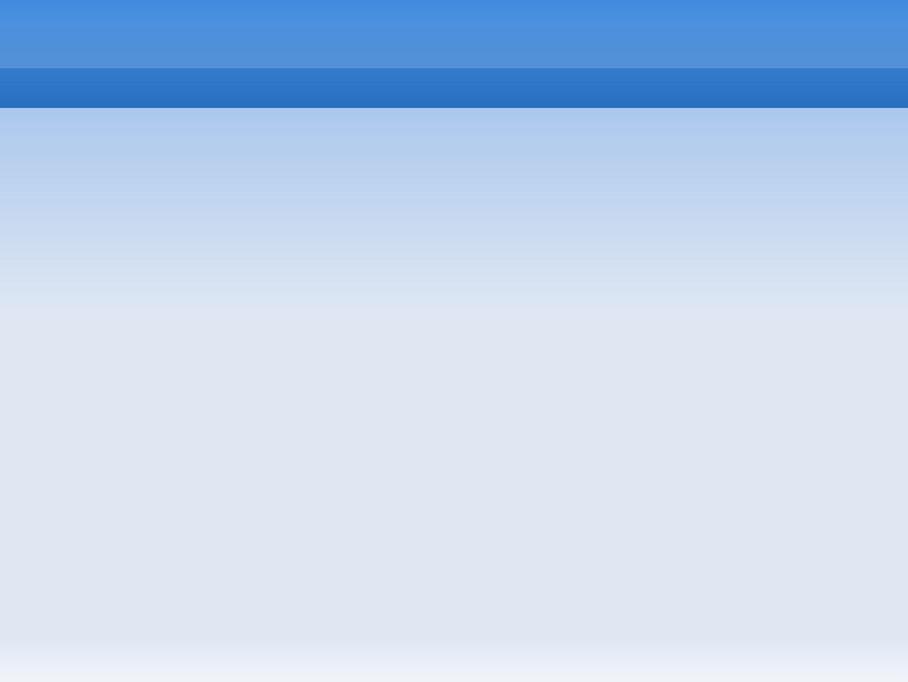
  Build an Operating System
  from Scratch:
  A Project for an Introductory Operating Systems Course
  Michael Black
  American University
  mblack@american.edu

Slide 2
  Operating Systems Course Should Have an Operating Systems Project

Slide 3
"Bare Metal" System
No simulator
No underlying system
No prewritten code

Slide 4
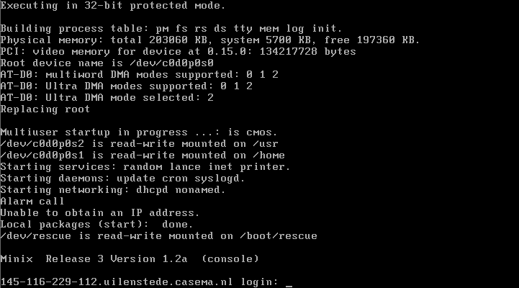

Existing Bare-Metal Systems
Minix
GeekOS
Good for upper-level or graduate courses

Slide 5
AU CS Program
Small, offer OS every two years
Many students have CS1 only
  no assembly, no hardware exposure
Need a simpler OS project

Slide 6
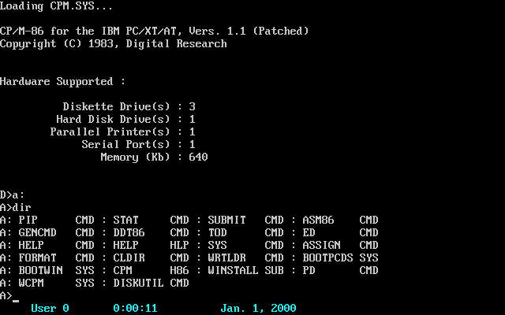
Want vs. Need
Functionality of CP/M
Teach essential concepts
Accessible to sophomore students

Slide 7
Key Characteristics
Be bare metal:
  boot loading, disk drivers, console drivers
Be "real":
  program execution, interrupts, processes
  file system, shell
Would be nice:
  GUI, virtual memory

Slide 8
Finished OS Characteristics
Has all functionality of older OS like CP/M
Can execute a program from a file
Command-line shell with necessary commands:
  Directory listing, type, copy, delete, execute
Multiprocessing and basic memory management

Slide 9
Goals
Minimize total lines of code
Minimal pre-written assembly code
  Students write own kernel and all C functions
3 components - bootloader, kernel, shell
Run on Bochs simulator to develop and debug, also bootable from floppy disk

Slide 10
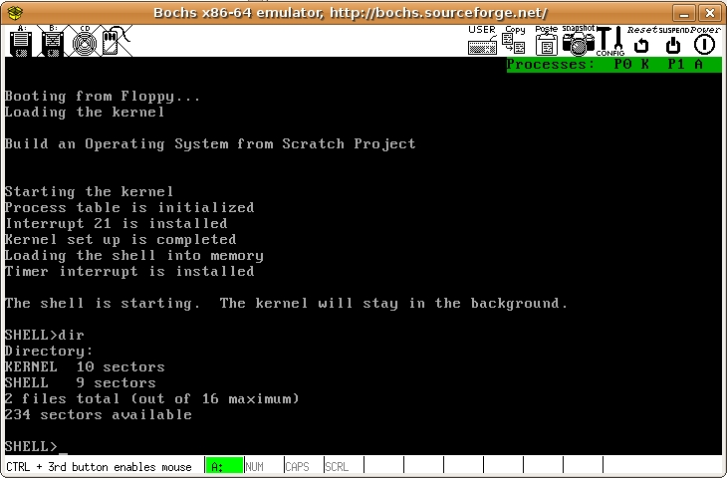

Slide 11
Skills needed
Students need skills to create the project
Topics covered:
  x86 Segmentation
  UNIX Commands
  C Programming Language basics

Slide 12
Project Outline
5 Projects (plus Warm-Up)‏
2 Weeks each, progressively more difficult
Tested on Bochs - http://bochs.sourceforge.net/
Standard Linux tools
  16-bit tools: bcc compiler, as86 assembler
  dd command for floppy image
  hexedit for binary files

Slide 13
Project A - Hello World
Provided two assembly files:
  bootloader assembly file
  kernel assembly file that writes to memory
Students wrote a simple kernel in C
Printed Hello World by writing to video memory

Slide 14
Project B - Kernel Interrupts
Provided 3 assembly routines:
  Make interrupt call
  Modify Interrupt Vector Table for Interrupt 21
  Call students' C functions
Students write:
  Print String to console
  Read string from keyboard
  Read sector to buffer
Result: Print a text file from disk to the screen

Slide 15
Project C - Read, Execute, Kill
Read a file from disk to a buffer, using a directory sector
Execute a program: Read file, copy to 0x2000 memory block, call LaunchProgram (provided)‏
Shell: prompt user, print text files, execute program files
Terminate program system call: reloads the shell when programs finish

Slide 16
Project D - Single-Process OS
Write - create new file, copy buffer to new file
Delete - remove file
Add commands to shell:
copy, delete, create a text file, print directory

Slide 17
Project E - Multi-Processing
Provided assembly functions: initialize system timer, receive timer interrupts, call user routine, set up stack
Students wrote round-robin scheduler, runs on timer interrupts
Additional shell commands: execute as a background process, kill processes.

Slide 18
Student Reactions
Unanimous responses:
Enjoyed the project
Contributed to their understanding
Recommended project to future classes

Slide 19
Success Factors
Provide detailed step-by-step instructions
Minimize prewritten assembly code
Give clear instructions on calling functions
Keep it simple - approximate DOS, not UNIX
Use BIOS calls, not device drivers
No advanced data structures, binary math, stack handling, or extra assembly

Slide 20
Future Work
Adapt project for use at other universities
Add a graphical shell component
Boot from USB Key instead of Floppy Disk
Collaborators wanted!
mblack@american.edu

