Slide 1
Simulated historic fire
Hantson et al. In prep

Slide 2
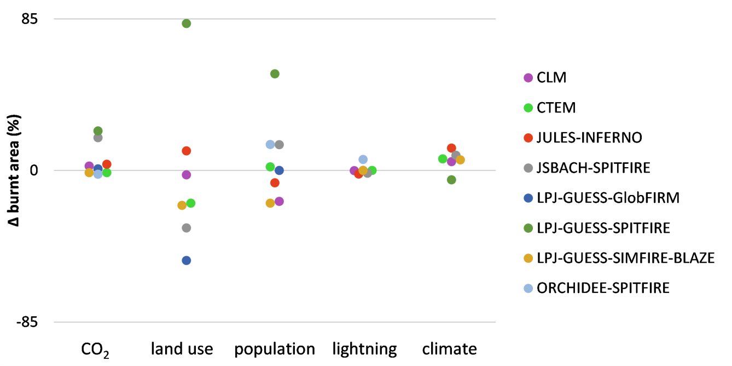
Sensitivity to drivers
Hantson et al. In prep

Slide 3
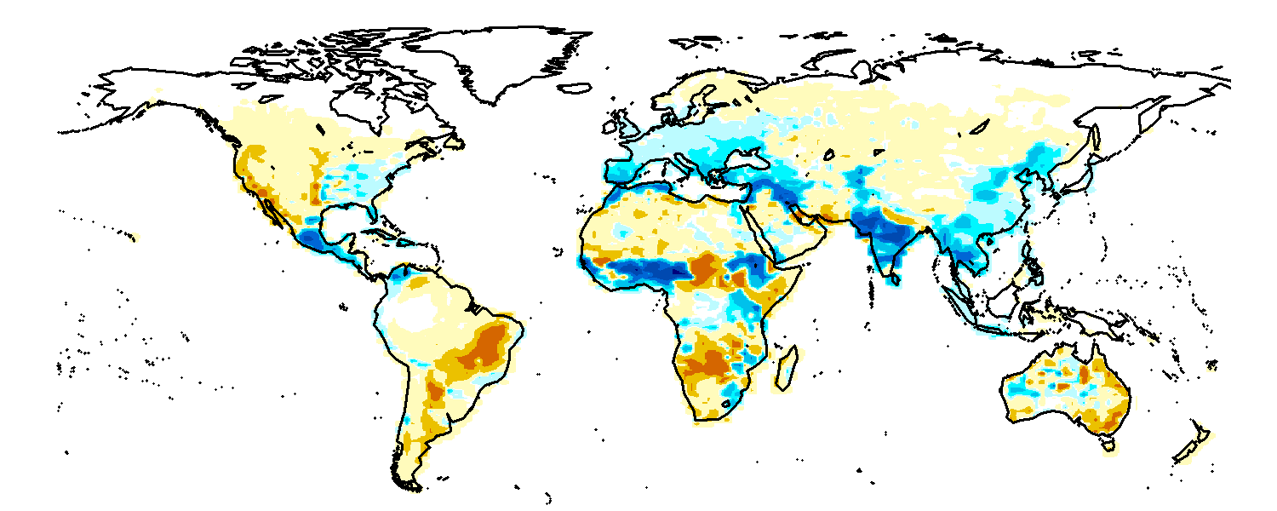
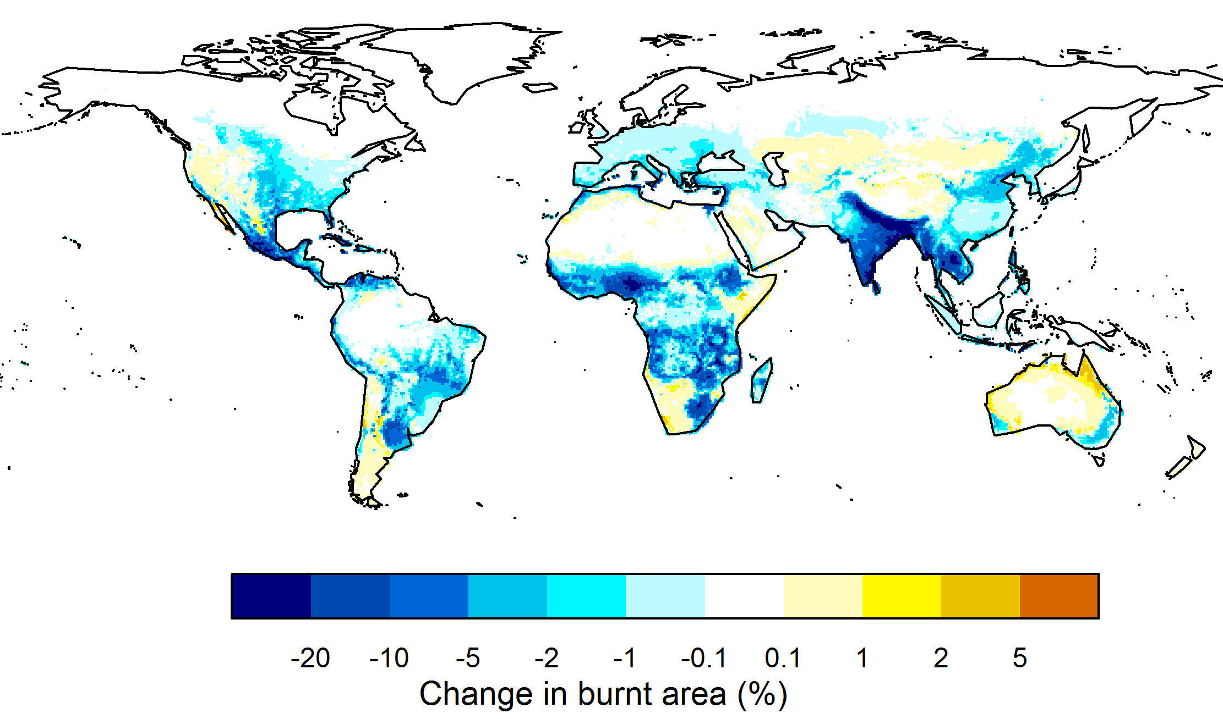
Sensitivity to drivers
Hantson et al. In prep
Impact of Humans
JULES-INFERNO
JULES-INFERNO
Fire Limitation (Kelley et al. In prep)
Fire Limitation (Kelley et al. In prep)

Slide 4
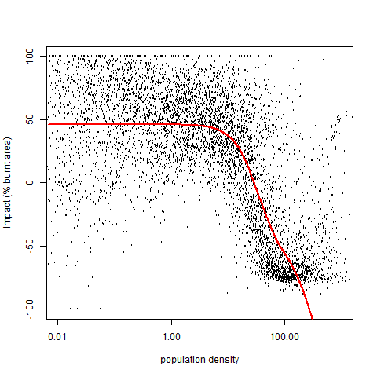
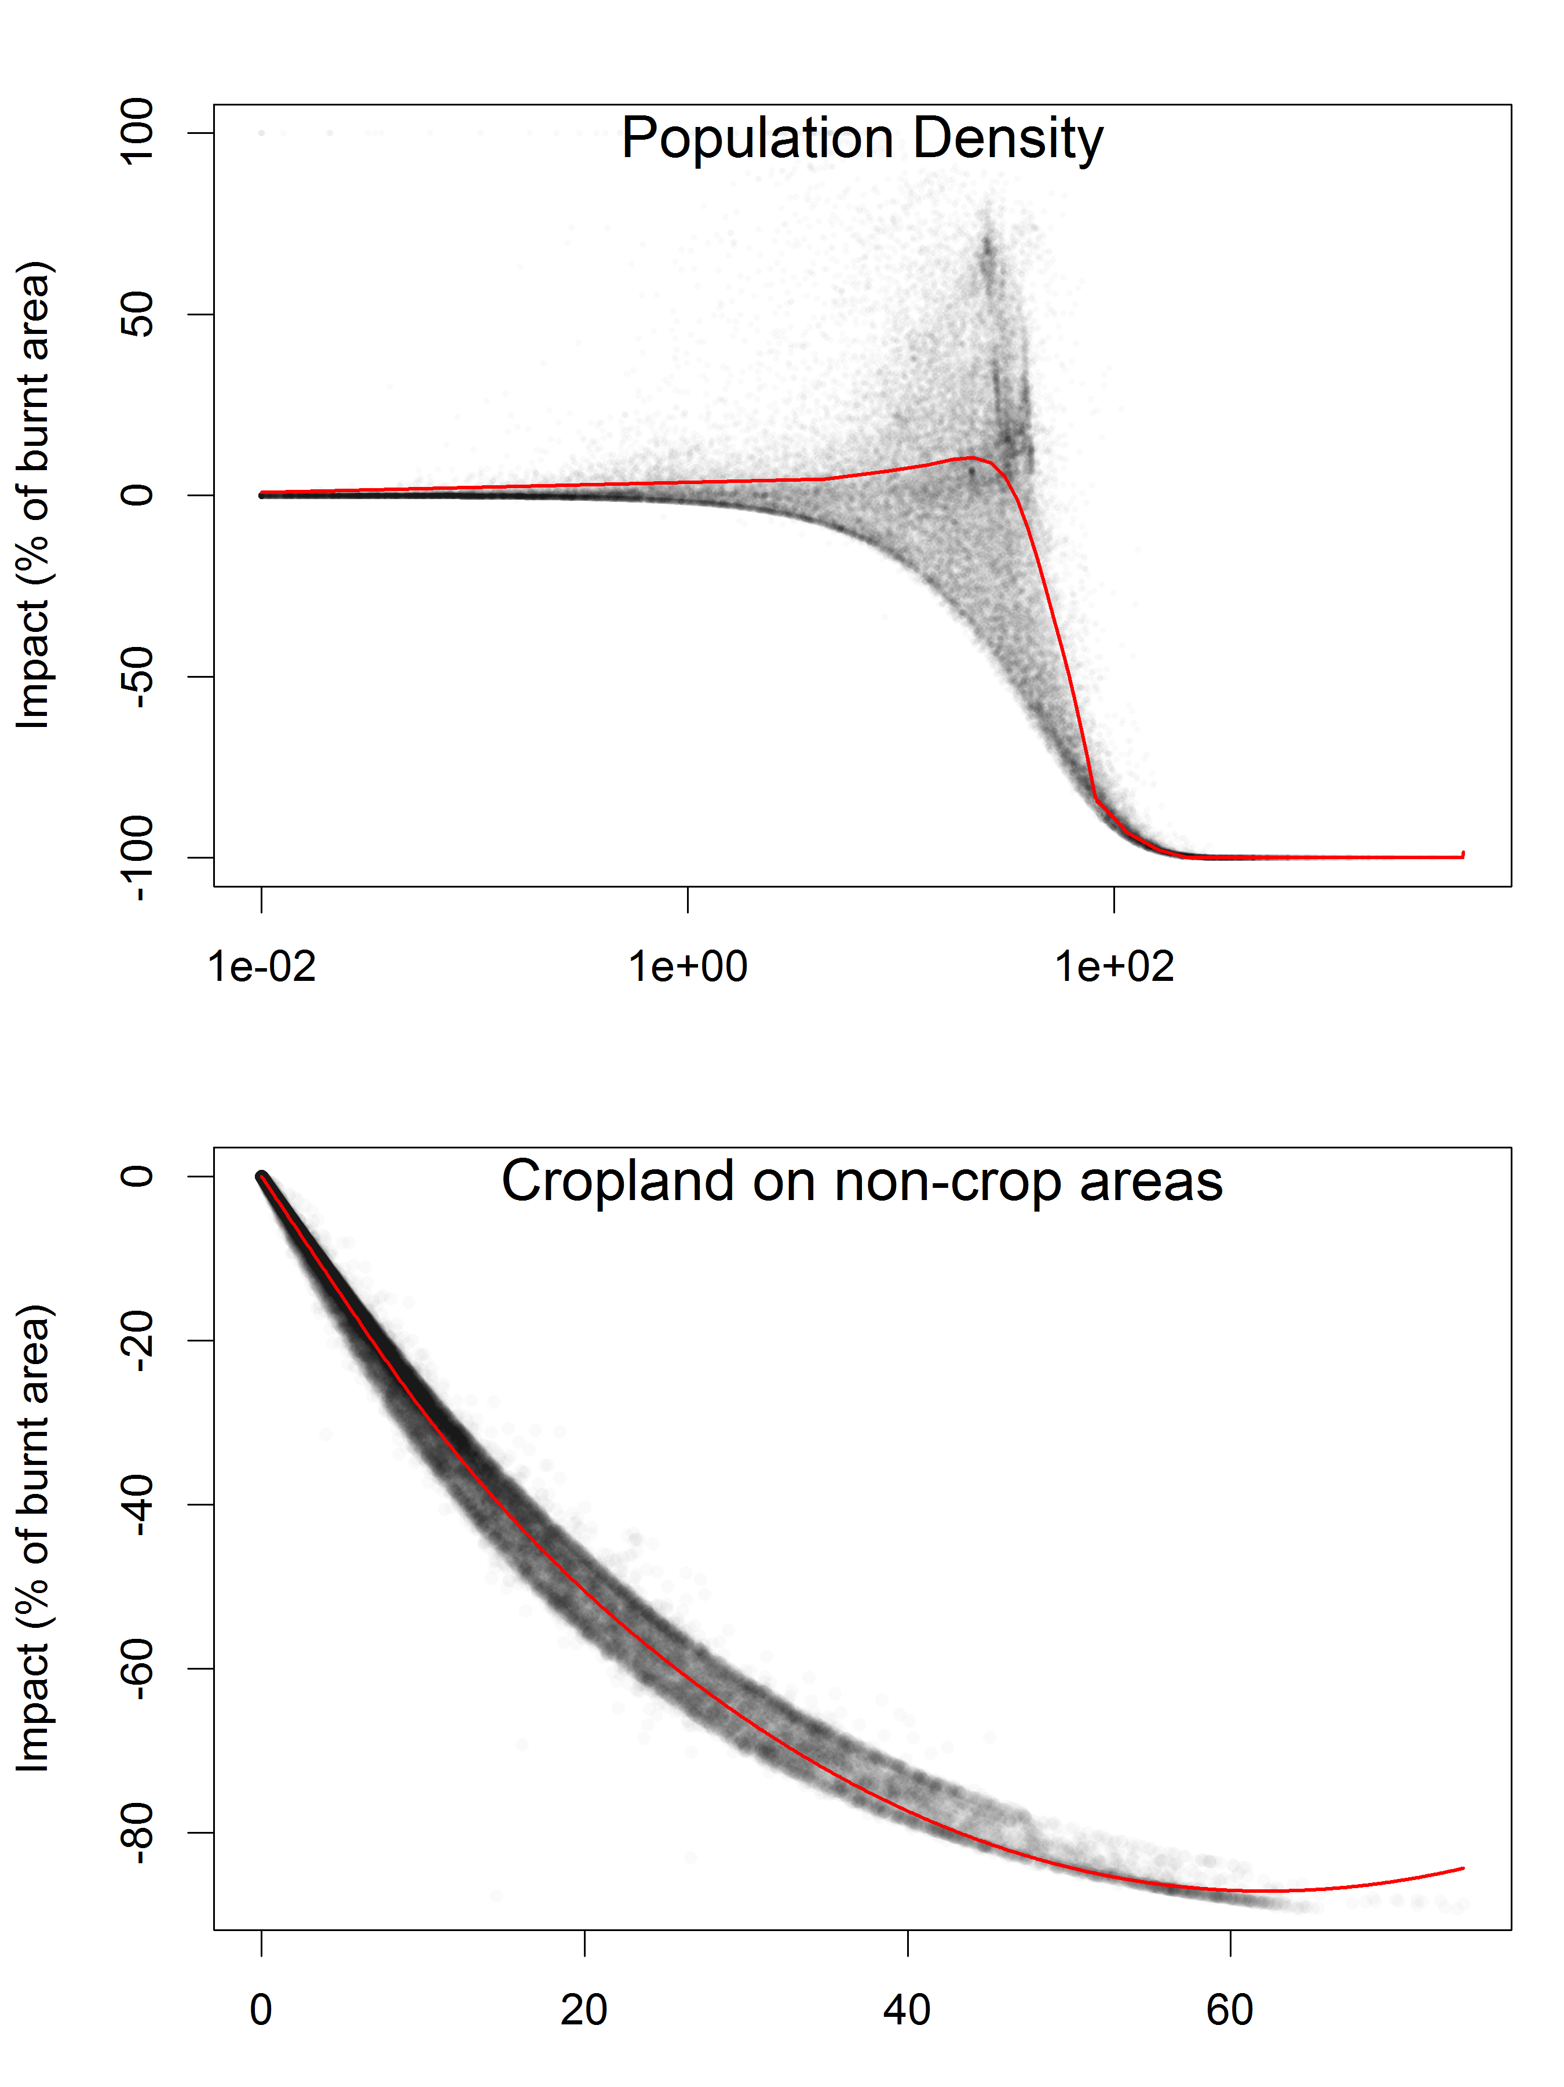
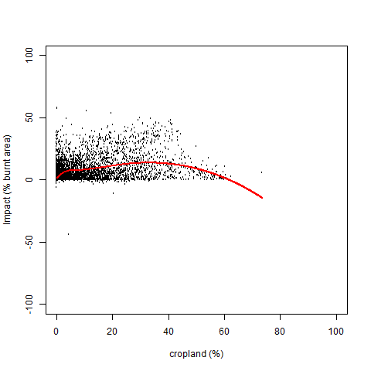
JULES-INFERNO
Fire Limitation (Kelley et al. In prep)

