Slide 1
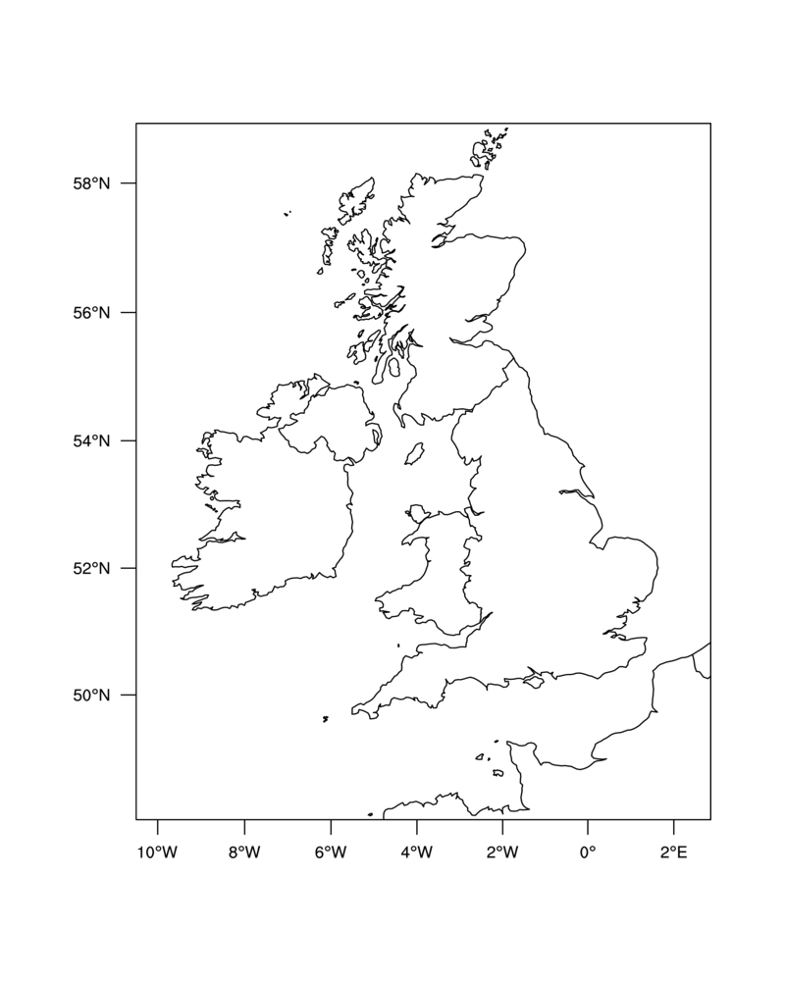

Slide 7
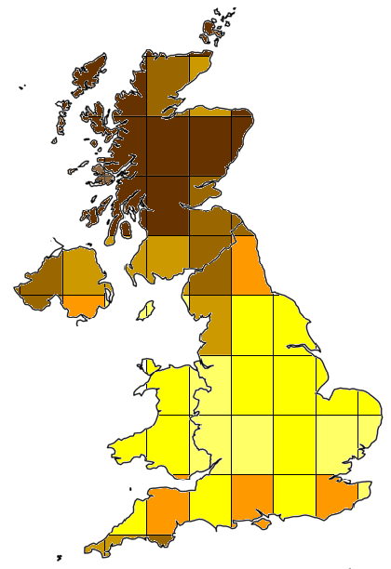
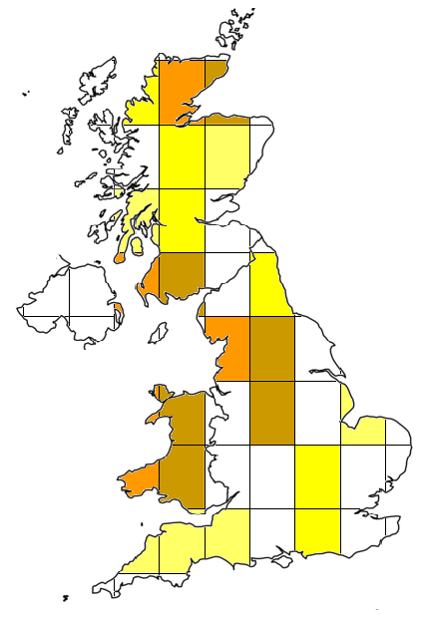
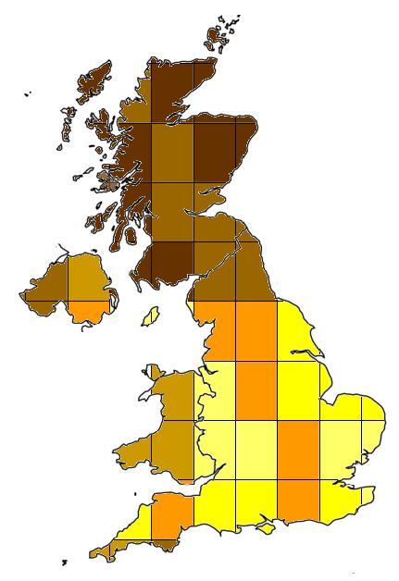
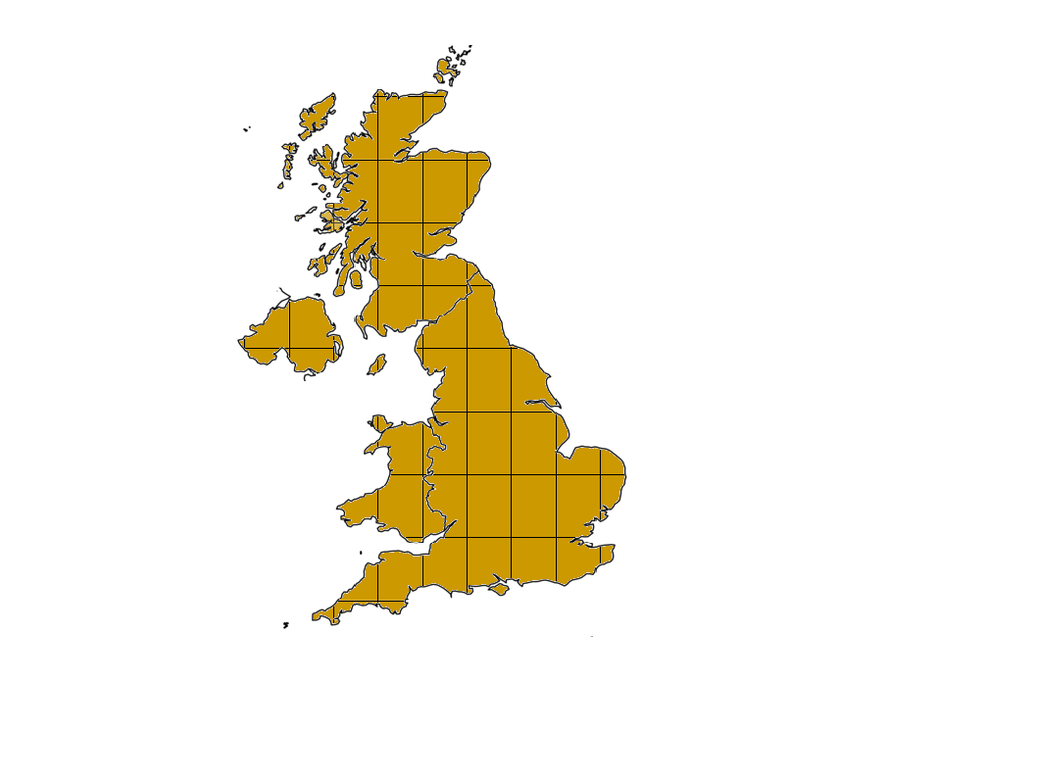
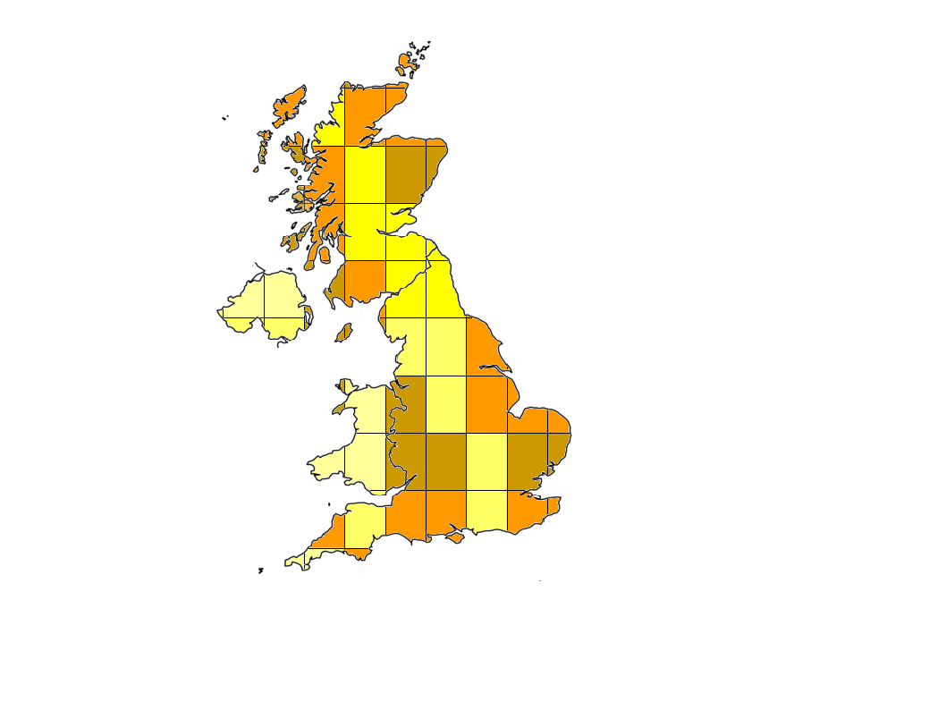
Simulated
Sum
192
243
= 0.79
Observed
Observed Mean
Difference

Slide 8
Sum &
normalise
0.79
Observed
Simulated
Difference

Slide 9
Observed
Remove
mean
NME
1.96
Simulated

Slide 10
J F M A M J J A S O N D
D
J
N
F
O
M
S
A
A
M
J
J
J F M A M J J A S O N D

Slide 11
J F M A M J J A S O N D

Slide 12
J F M A M J J A S O N D
D
J
N
F
O
M
S
A
A
M
J
J
J F M A M J J A S O N D

Slide 17
D
J
N
F
O
M
S
A
A
M
J
J

Slide 18
D
J
N
F
O
M
S
A
A
M
J
J

Slide 19
D
J
N
F
O
M
S
A
A
M
J
J

Slide 20
D
J
N
F
O
M
S
A
A
M
J
J

Slide 21
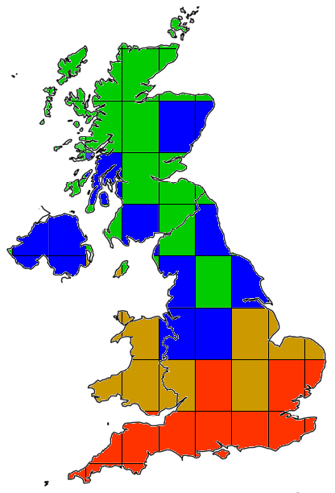
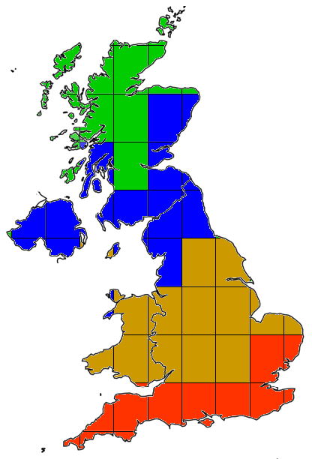
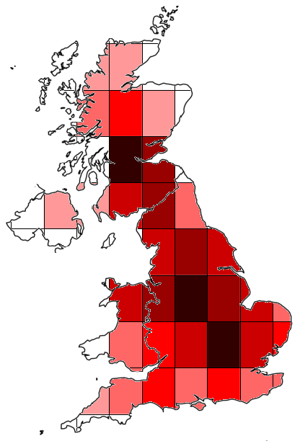
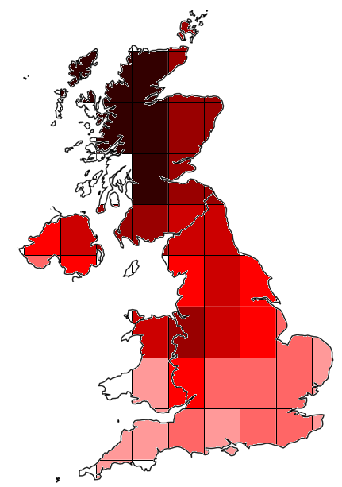
Mean Phase
Difference (MPD)
0.23
D
J
Phase
N
F
O
M
S
A
A
M
J
J
0.17
Concentration
NME
Observed
Simulated

Slide 22
Winter
Spring
D
J
Phase
Summer
N
F
Autumn
O
M
S
A
A
M
J
J
0.17
Concentration
NME
Observed
Simulated

Slide 23


Slide 24
Tree Cover

Slide 25
Tree Cover
Grass Cover

Slide 26
Tree
Grass
Simulated
2.5
12
Difference
Sum
= 0.21
Observed

Slide 27
2.5
12
Sum
= 0.21
Difference

