Slide 1
LIS lightning
Flash Count
Scaling
Ignition
Source

Slide 2
LIS lightning
Flash Count

Slide 3
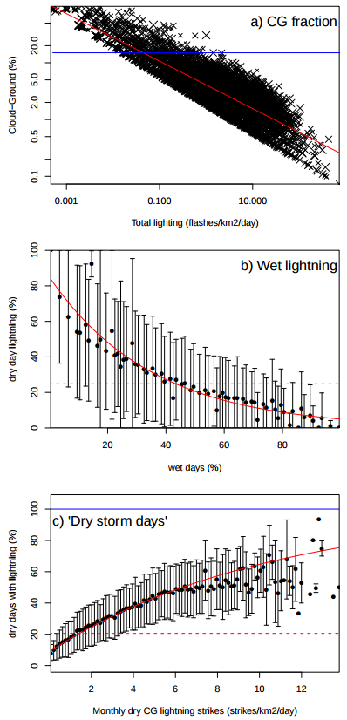
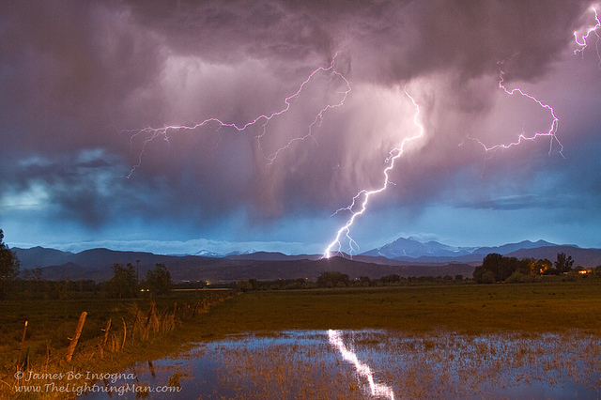

LIS lightning
Flash Count
Remove
cloud-cloud

Slide 4
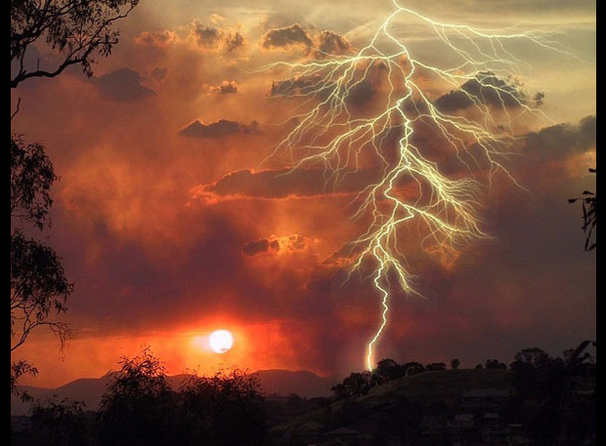

LIS lightning
Flash Count
Remove
cloud-cloud
Remove
wet lightning

Slide 5


LIS lightning
Flash Count
Remove
cloud-cloud
Remove
wet lightning
Distribute on
Storm Days

Slide 6
LIS lightning
Flash Count
Scaling
Ignition
Source

Slide 7
LIS lightning
Flash Count

Slide 8
LIS lightning
Flash Count
Remove
cloud-cloud

Slide 9
LIS lightning
Flash Count
Remove
cloud-cloud
Remove
wet lightning

Slide 10
LIS lightning
Flash Count
Remove
cloud-cloud
Remove
wet lightning
Distribute on
Storm Days

Slide 11
LIS lightning
Flash Count
Remove
cloud-cloud
Remove
wet lightning
Distribute on
Storm Days
Ignition
Source

Slide 12
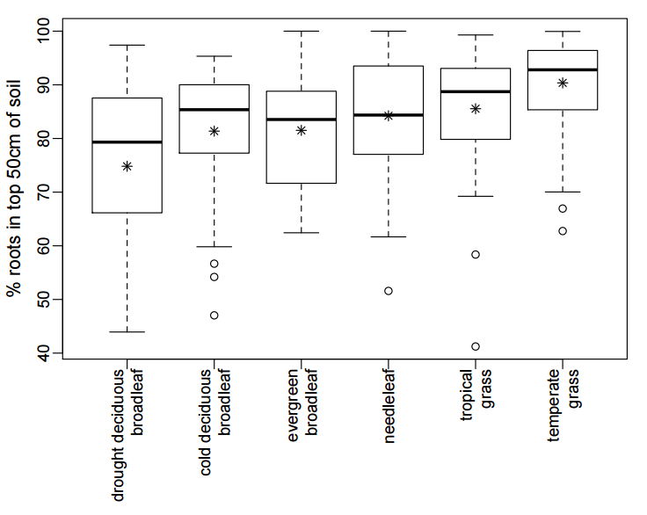

Slide 13

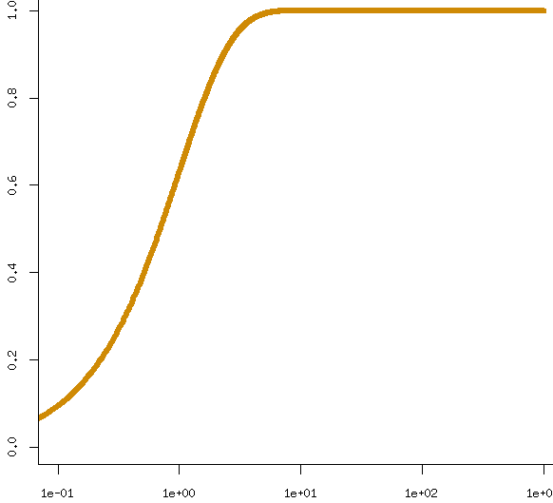
1
10
100
1000
hours

Slide 14
1/e = 36.8%
1
10
100
1000
hours

Slide 15
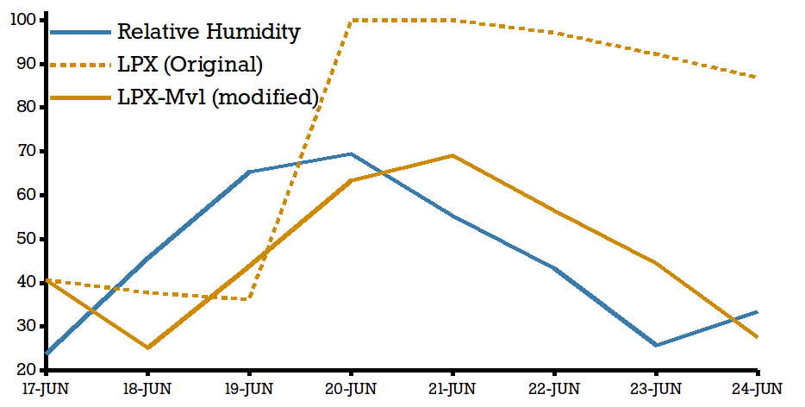

Slide 17
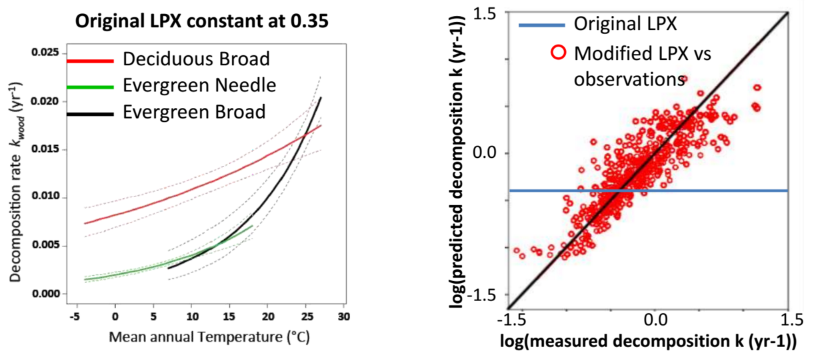

Slide 18
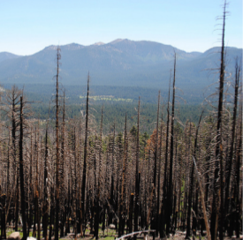
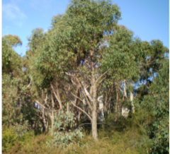
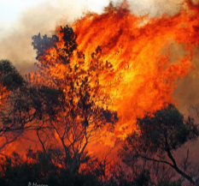
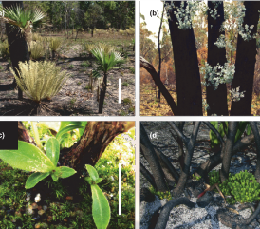
Dead biomass enters litter pool
Trees re-establish from seed and wood.
Long recovery time
Much aboveground plant matter destroyed
Sapwood & belowground carbon remain
Re-establishes as weakened mature tree

Slide 19
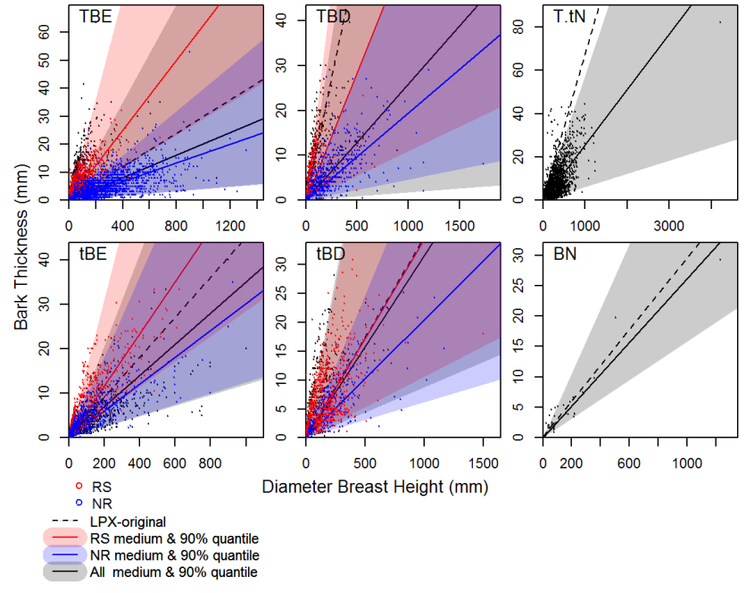

Slide 20
