Slide 1
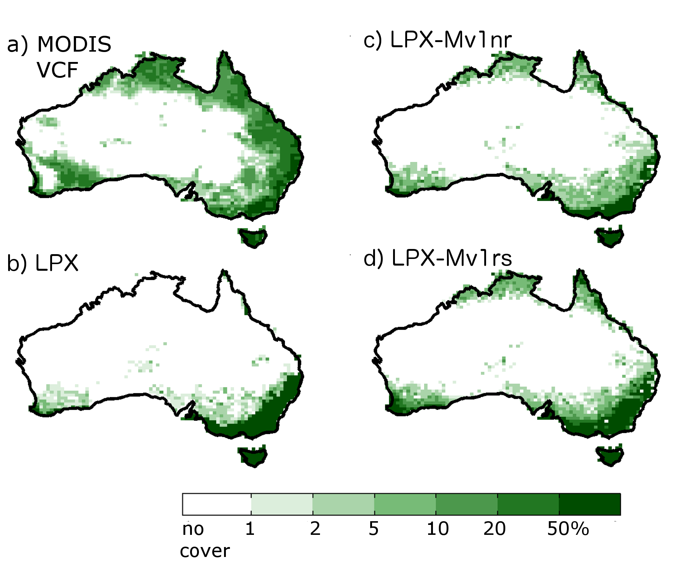
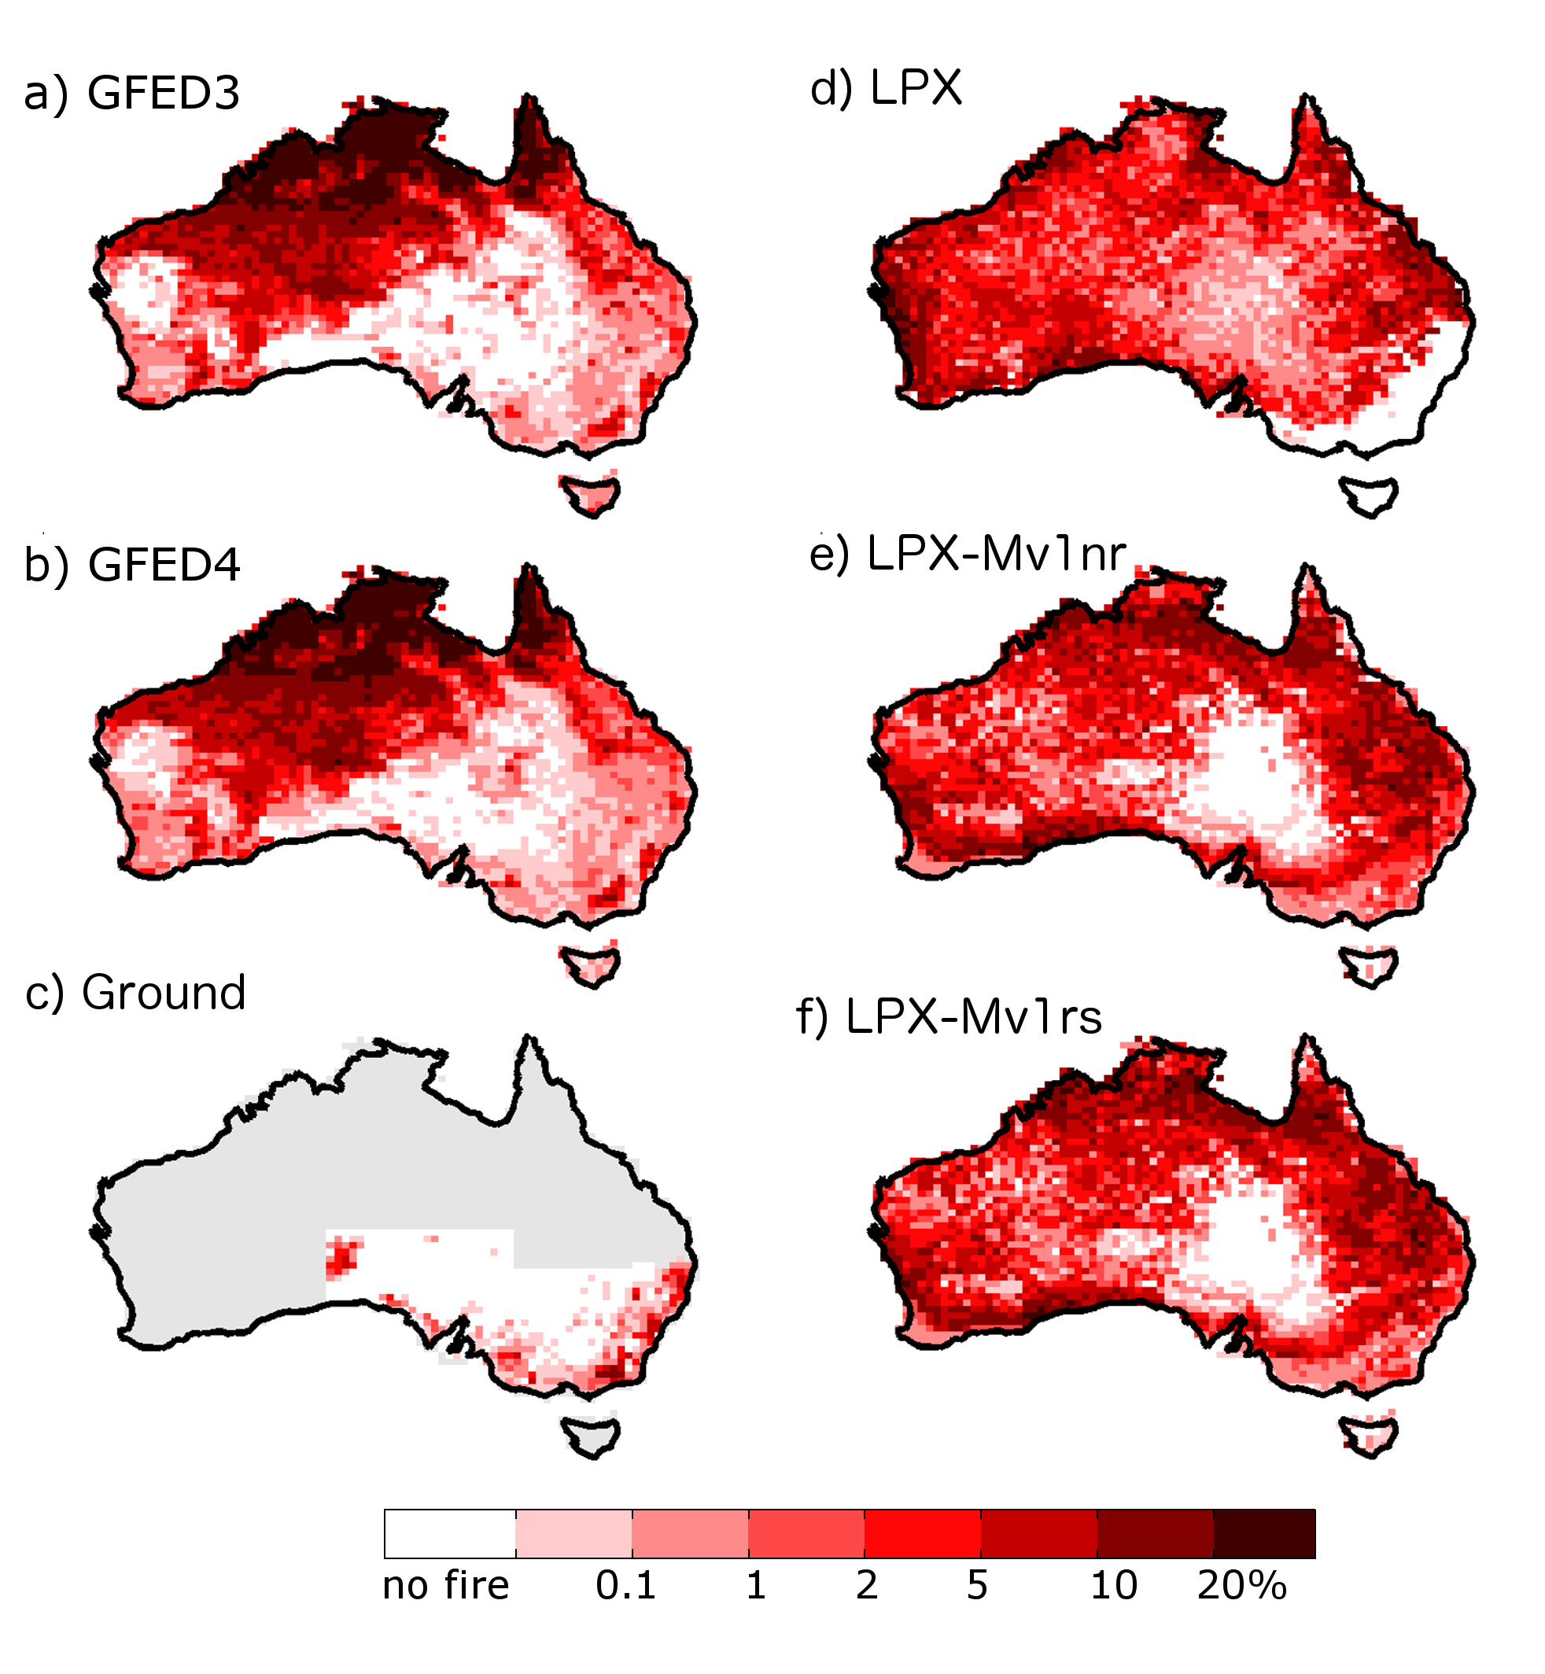
Observations
LPX
Tree Cover
Burnt Area

Slide 2
Observations
LPX
Tree Cover
Burnt Area

Slide 3
Observations
LPX
LPX-Mv1
Tree Cover
Burnt Area

