Slide 1
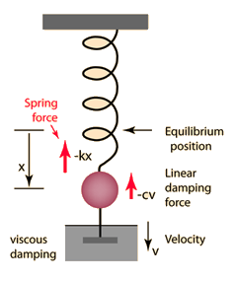

Slide 2
“Spring” force
Ideal Phenology
Inertia (Change already in motion)
Change in Phenology

Slide 4
Moisture force

Slide 5
Moisture force
Damping force

Slide 6
Moisture force
Damping force
Resistance force

Slide 8
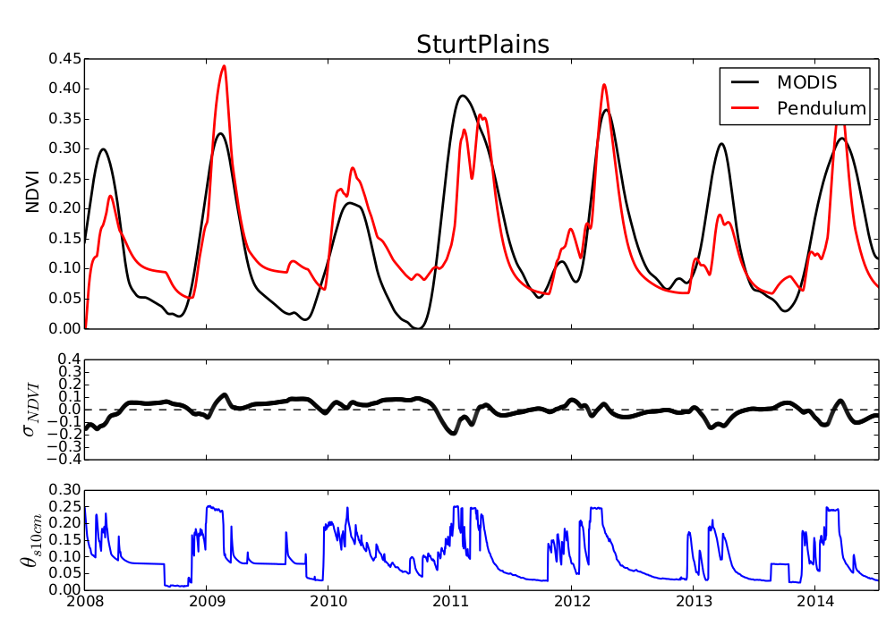

Slide 10
