Slide 1
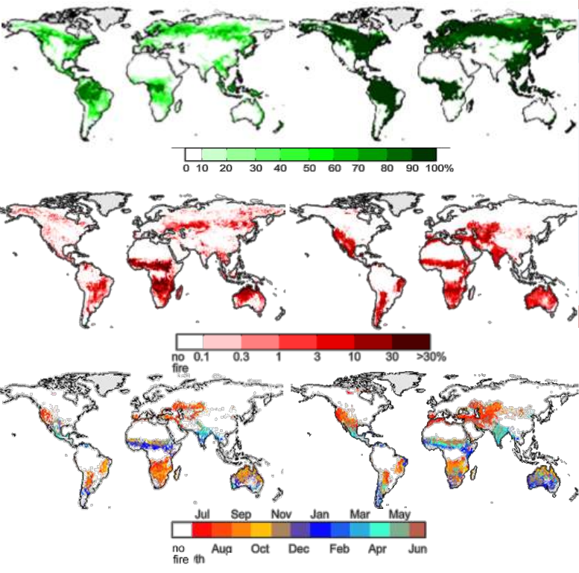
Observations
Simulation
Tree Cover
Burnt Area
Fire Season

Slide 2
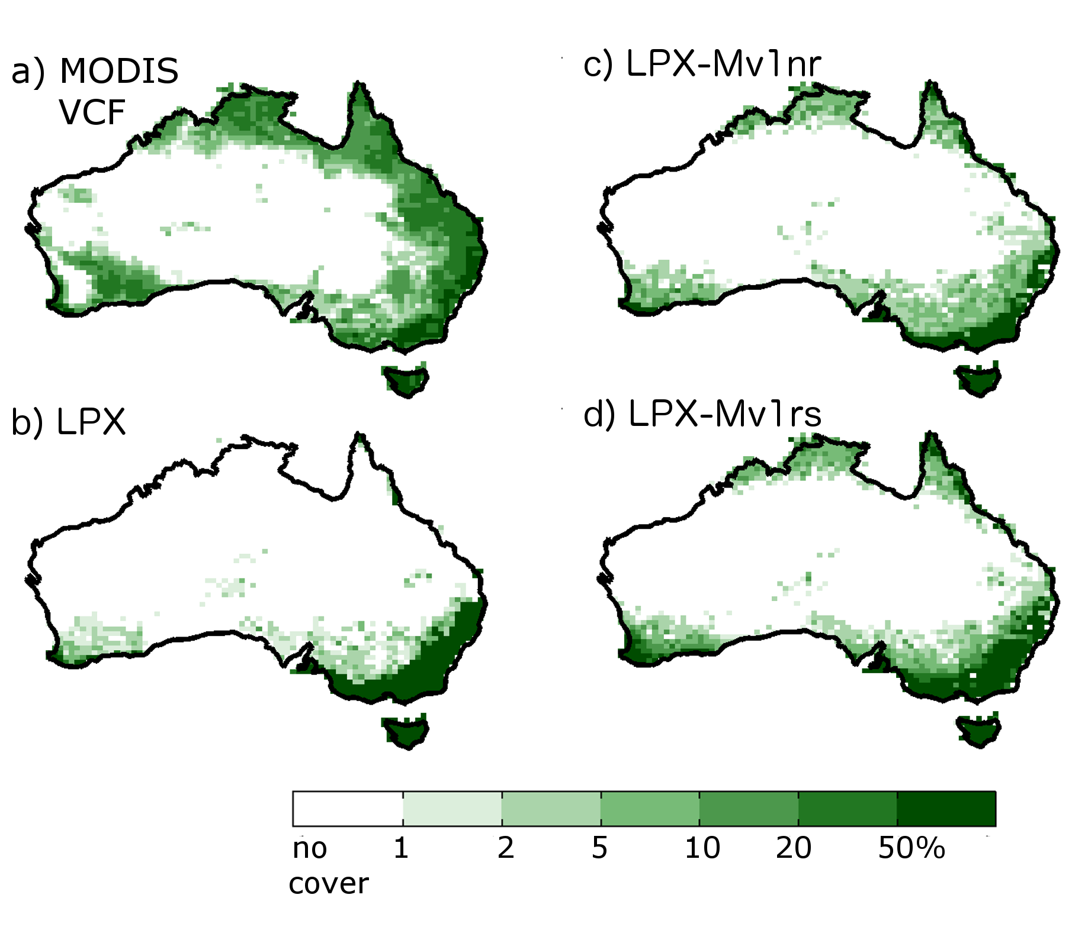
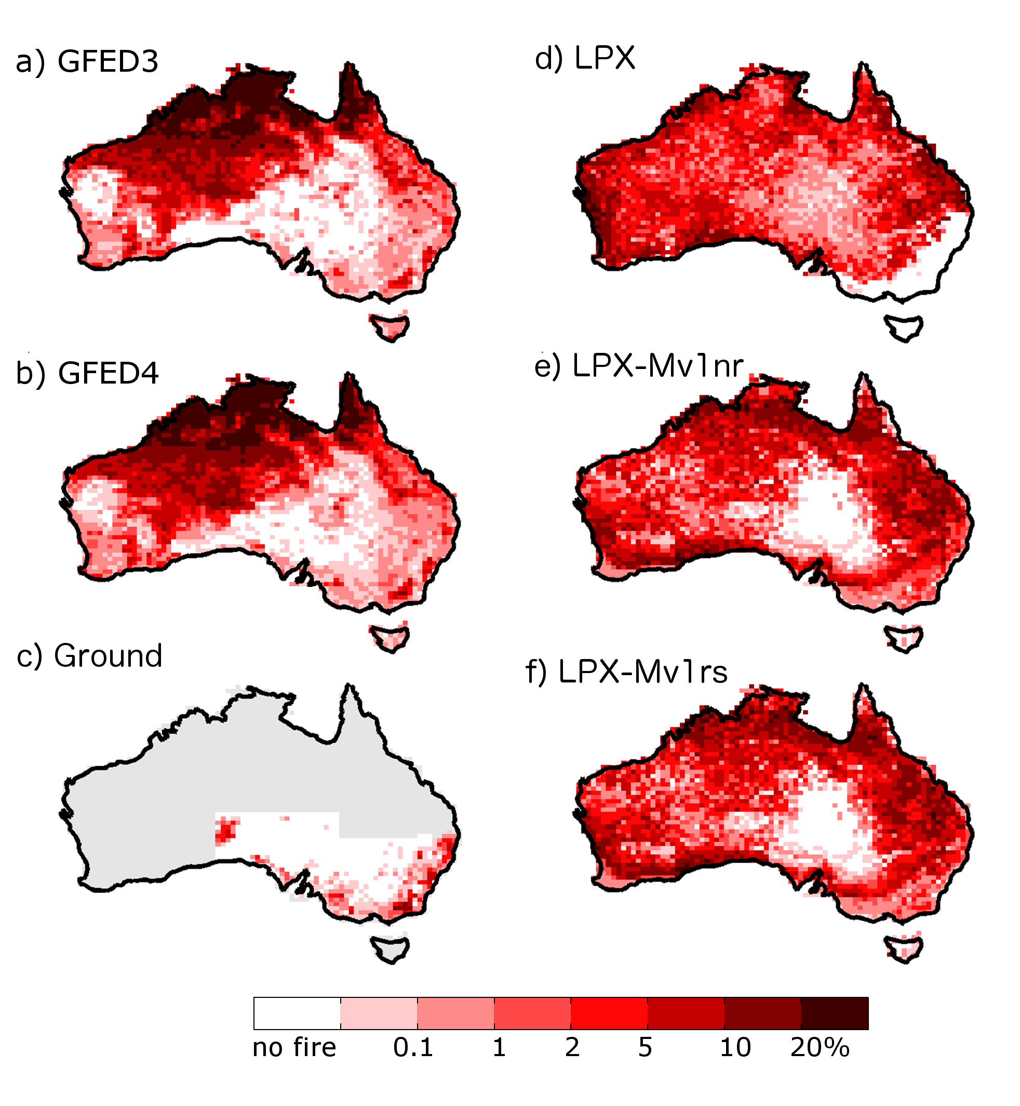
Observations
Simulation
Tree Cover
Burnt Area

Slide 3
Observations
Simulation
Tree Cover
Burnt Area

Slide 4
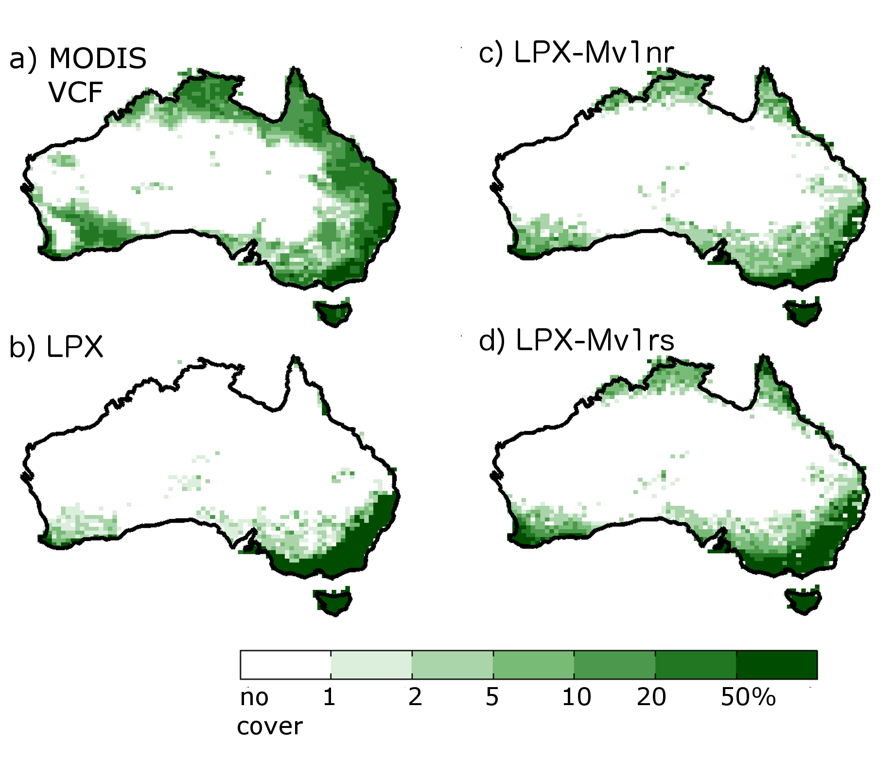

Slide 5
