Slide 1
Random
Resampling
1
Mean
0
Spatial
Inter Annual
Site
Items
Season Length
Seasonal Time

Slide 2
NULL
Models
NME
Spatial
Inter-annual
Site
Season Length
MM
Fractional Cover
MPD
Season Timing
Inter-annual oscillations
Interpretation
Perfect
Worse
0
0
0
∞
2
1
~ 6 months out of phase
Better than Mean

Slide 3
NULL
Models
NME
Spatial
Inter-annual
Site
Season Length
MM
Fractional Cover
MPD
Season Timing
Inter-annual oscillations
Interpretation
Perfect
Mean
Random
Worse
0
0
0
1
≈ 1
Data Dependant
Data Dependant
As Good as Mean
≈ 1.2-1.4
Data Dependant
≈ 1
Data Dependant
Data Dependant
As Good
as Random
∞
2
1
Better than Mean
Better than Random
Worse than Ramdom

Slide 4





NULL
Models
NME
Spatial
Inter-annual
Site
Season Length
MM
Fractional Cover
MPD
Season Timing
Inter-annual oscillations
Interpretation
Perfect
Mean
Random
Worse
0
0
0
1
≈ 1
Data Dependant
Data Dependant
≈ 1.2-1.4
Data Dependant
≈ 1
Data Dependant
Data Dependant
∞
2
1

Slide 5
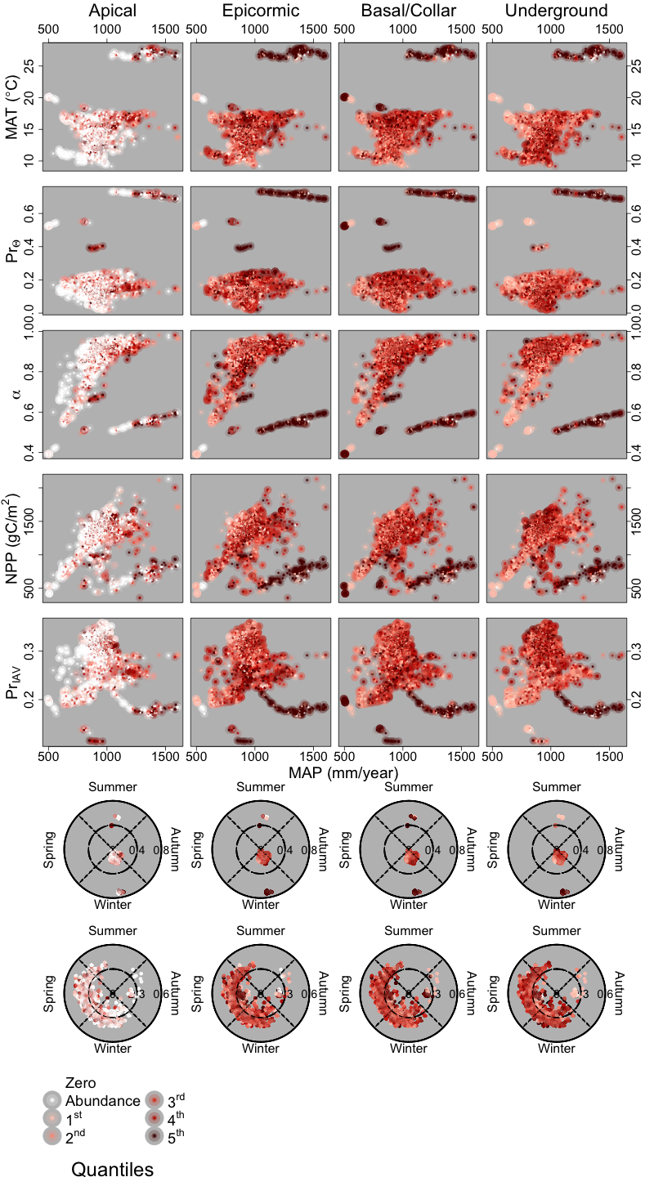
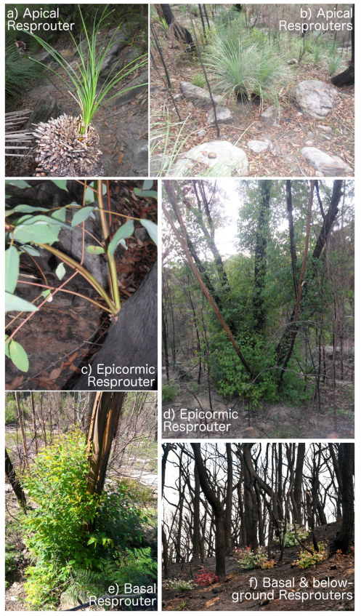

Slide 6
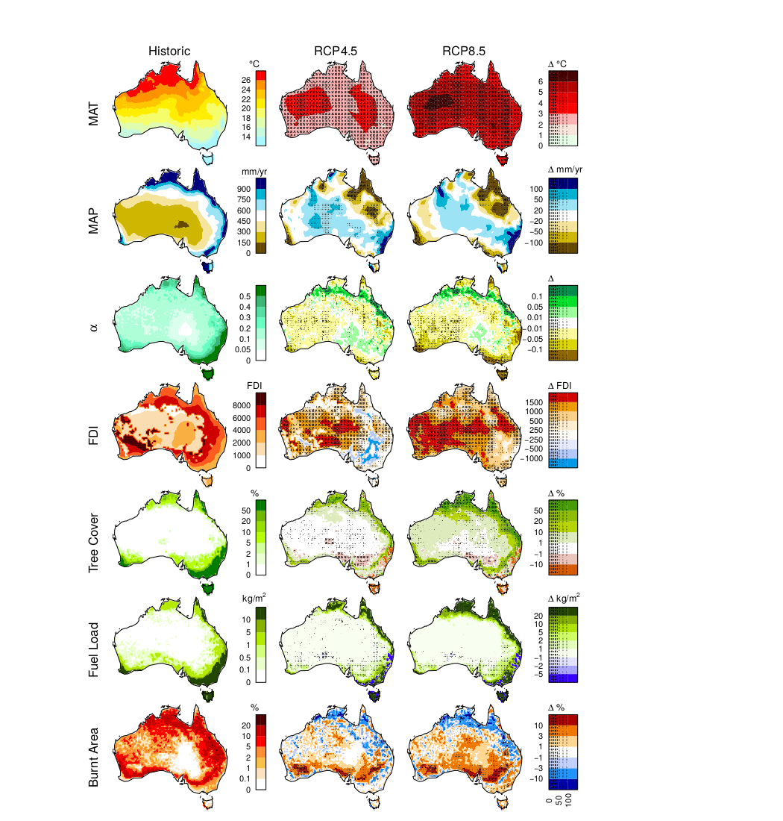

Slide 7
