Slide 1
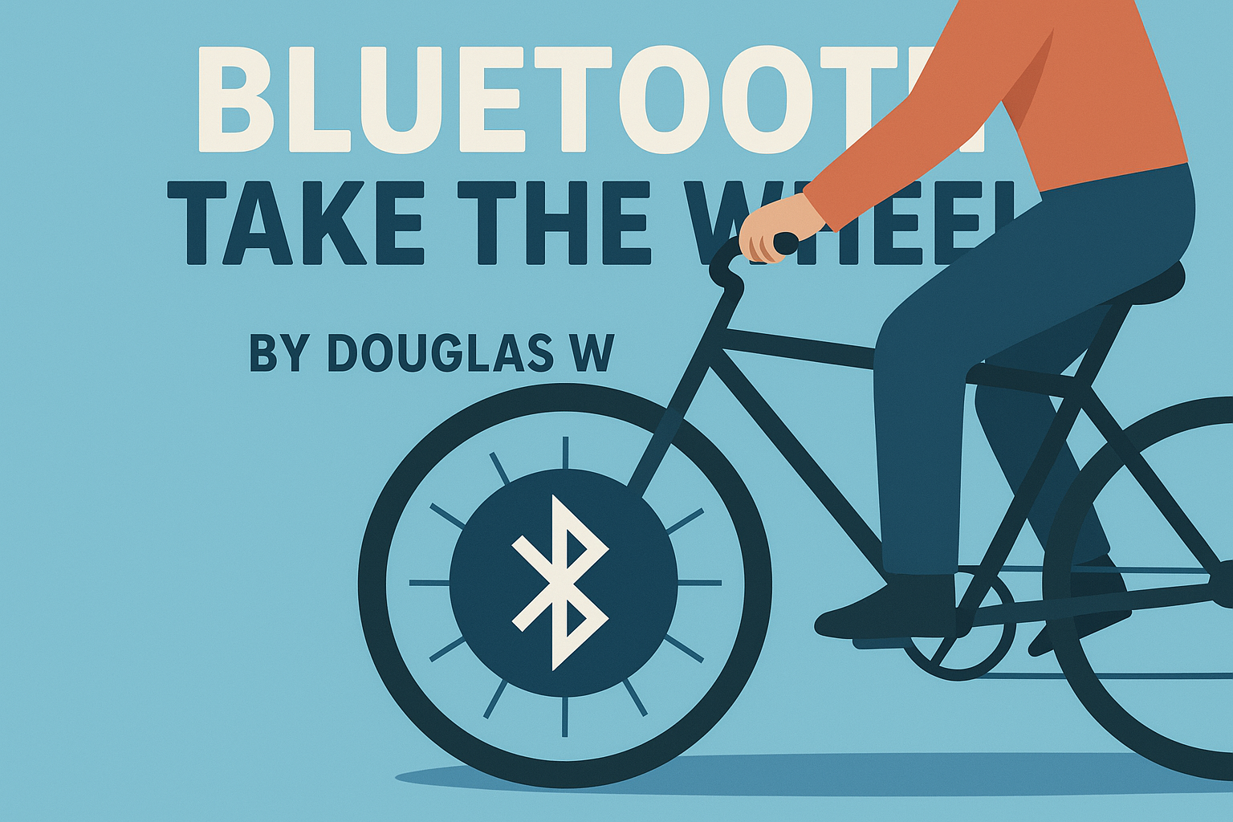
Notes:
Hi all, welcome to my presentation about Bluetooth and connecting to devices.
This is called Bluetooth take the wheel where I will tell you all about Bluetooth its fun and games as well as a project I created at the end.

Slide 2
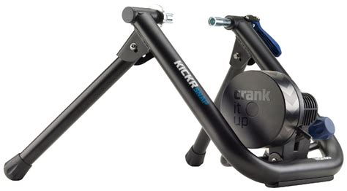



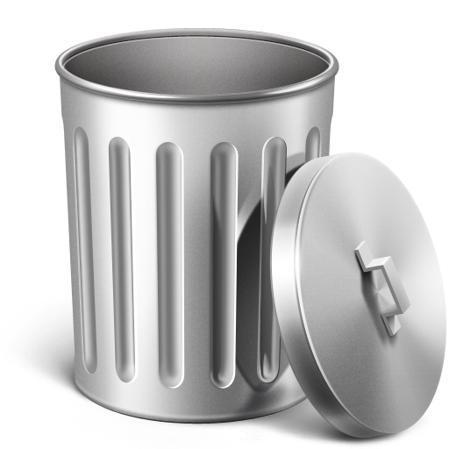
Storytime
Why am I looking into Bluetooth
https://uk.wahoofitness.com/devices/indoor-cycling/bike-trainers
  Applications that use it
  Zwift £17.99/month
  Wahoo £12.99/month
  Rouvy £10.75/month
  TrainerRoad £21/month
Notes:
Why did I decide to look into this

Slide 3
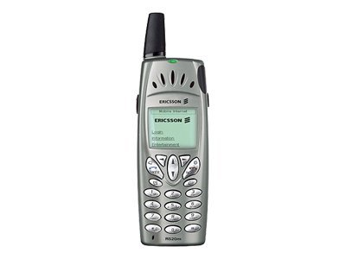
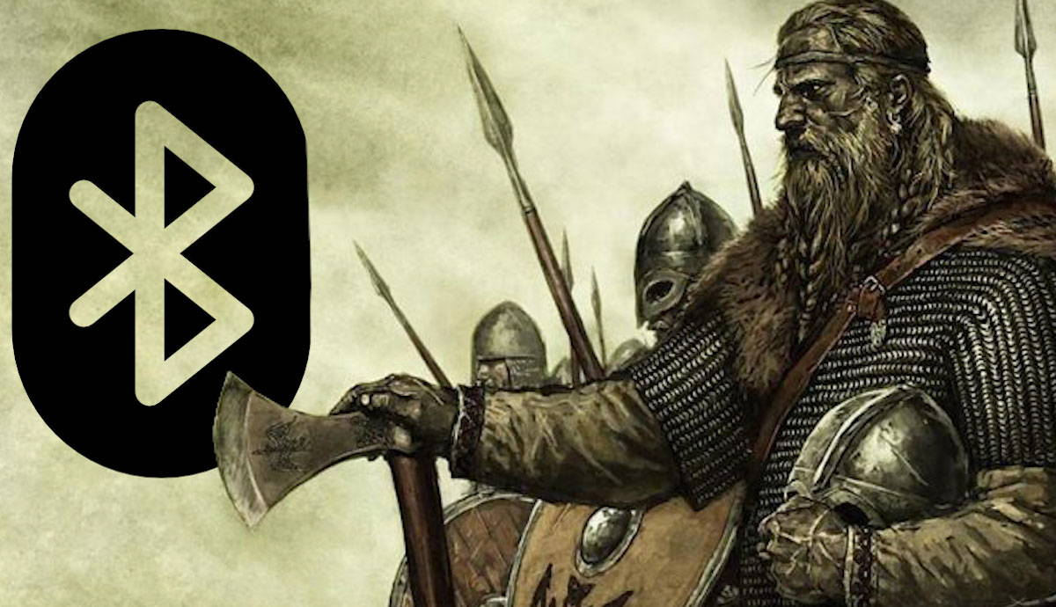
So, what is Bluetooth:
- Operates at frequencies between 2.402 and 2.480 GHz
low power radio waves
- Each Bluetooth device has a unique 48-bit address [XX:XX:XX:XX:XX:XX]
- You can either be a central or peripheral
- Very good for battery life as Bluetooth devices communicate directly with each other
- Technology was named after the Viking “Harald Bluetooth” king of Denmark who united Denmark and Norway
Notes:
Bluetooth is wireless communication tech
Central: the object that receives the data from a Bluetooth device.
Peripheral: the Bluetooth device that shares data to be consumed by other devices.

