Slide 1
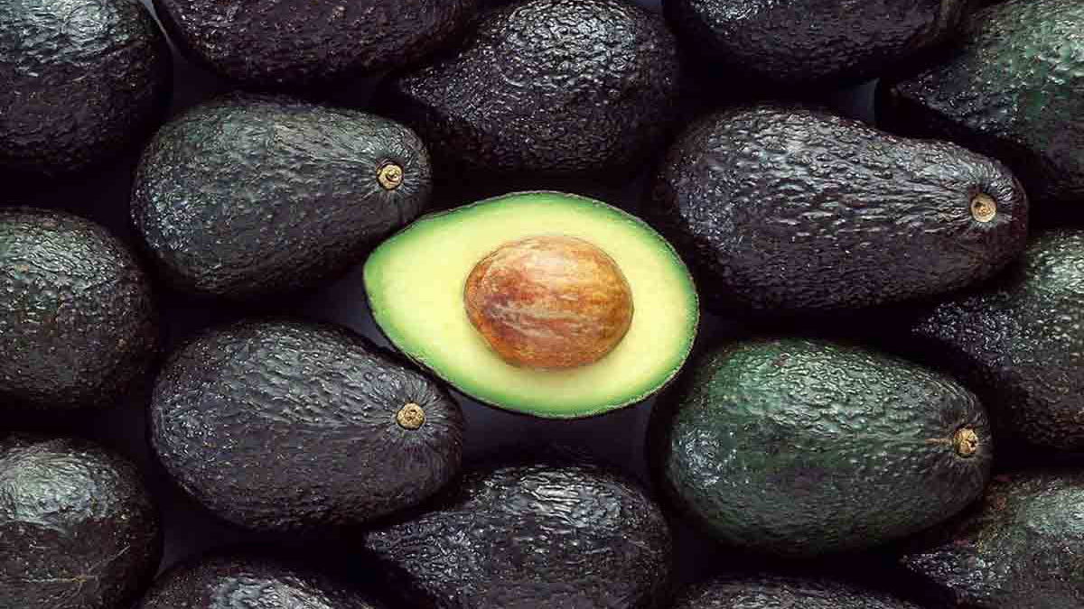
Hass Avocado Data Analysis
This Photo by Unknown Author is licensed under CC BY-NC-ND

Slide 2
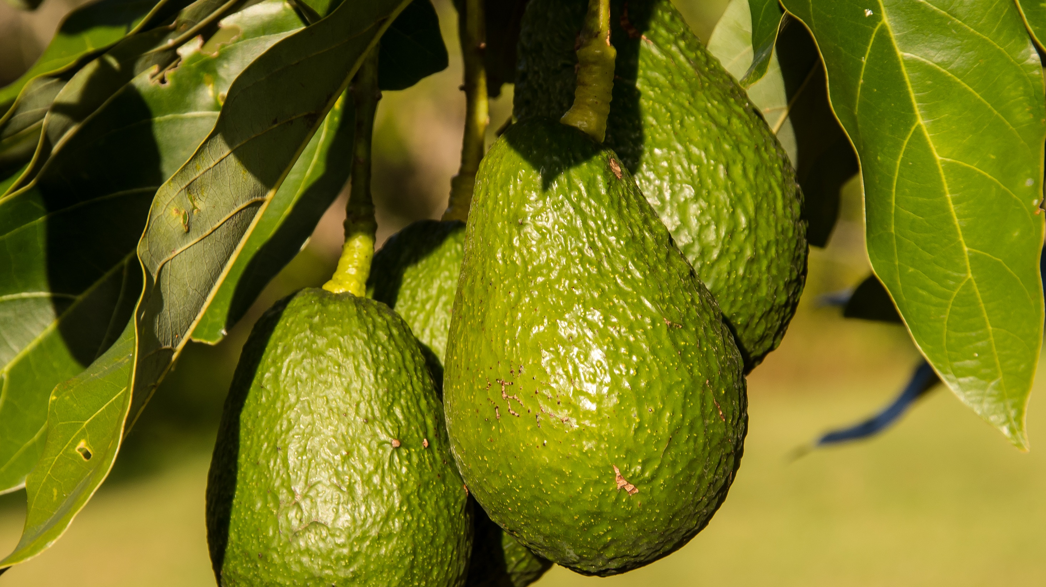
This dashboard was built to understand better the sales by region of avocado by region to improve sales.

Slide 3

THE PURPOSE OF THIS ANALYSIS IS TO IDENTIFY THE REGION THAT WE ARE DOING A GOOD JOB AND THE ONES WE NEED TO IMPROVE FOR BETTER RESULTS.
This Photo by Unknown Author is licensed under CC BY-ND

Slide 4
adding a calculated column to the table and concatenate “Country” and “City” columns so that the Bing Map engine finds the correct cities.
This Photo by Unknown Author is licensed under CC BY-ND

