Slide 1

Predicting Professional Soccer Match Results Using Machine Learning (ML) Algorithms
Doug Steen
2/8/2020

Slide 2

Soccer is among world's most popular sports
Estimated 3.5 billion followers in 2020
High demand = High revenue for biggest clubs
Real Madrid (Spain) generated approximately € 750 million during the 2017-2018 season
Financial success of a soccer club heavily influenced by results on the pitch
Data science increasingly used to gain a competitive edge

Slide 3
Questions
1) Can match statistics (excluding knowledge of goals scored) be used to predict the outcome of a soccer match?
2) Which match statistics are most important when attempting to predict a match outcome?
(Feature Importance)

Slide 4

Dataset
Match statistics for 1,379 games in English Premier League (Aug. 2016 – Jan. 2020)
Key Data Features:
Ball Possession
Shots (Total, Close, Far)
Corner Kicks
Fouls
Red, Yellow Cards
Goalkeeper Saves
Offsides
Passes, Pass Accuracy
Target (Prediction) Variable:
Match Outcome
Home Team Win Away Team Win Draw
https://www.api-football.com/

Slide 5
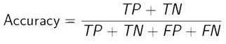
Methods
Fit machine learning (ML) algorithms to training data
75% of soccer matches
Algorithm ‘learns’ from data
Use same algorithms to predict match outcomes for test data
25% of soccer matches
Evaluate algorithm performance
Evaluation Metric:
Accuracy = % of Correct Predictions
For a binary classification problem:

Slide 6

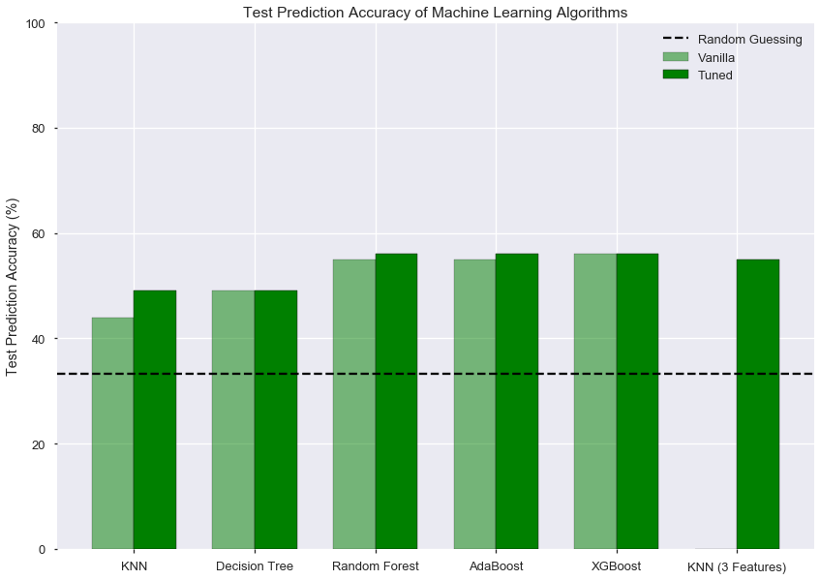

Slide 7
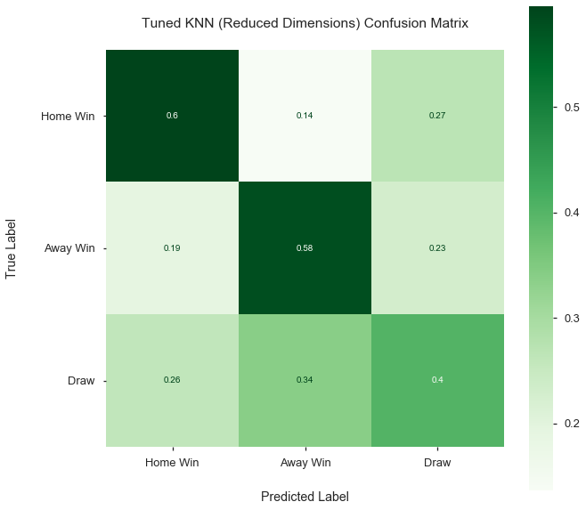

Slide 8
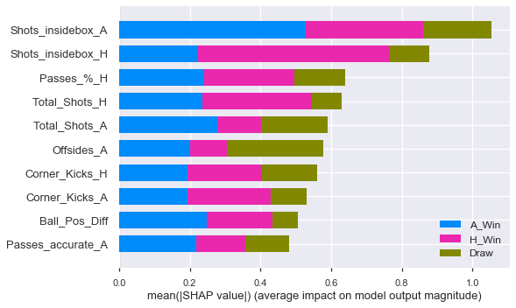
Feature Importance

Slide 9
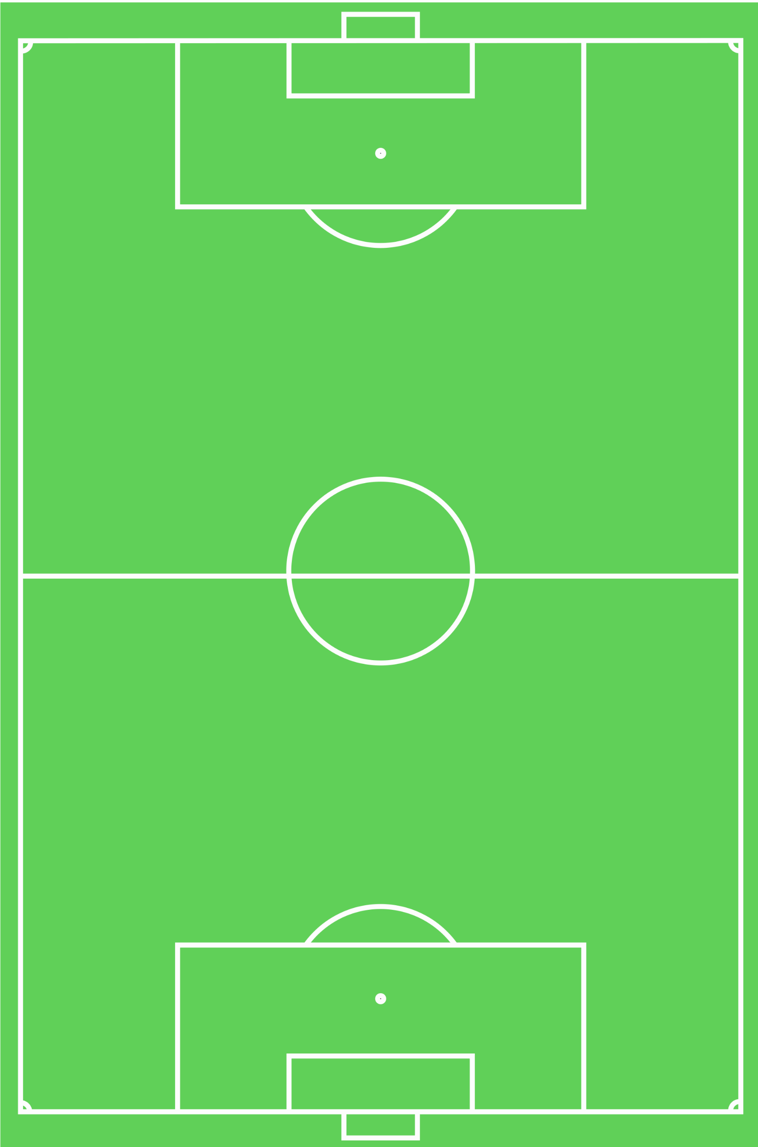
Recommendations
Teams should focus efforts on getting ball into the ‘box’, and shooting from that area
Teams should also focus on preventing the opposing team from entering and attempting shots from the 'box’
In many cases, outcomes probably can’t be predicted by match statistics alone
Best ML algorithm in this study achieved 56% accuracy
Hidden information not expressed in basic match statistics
A shot may be a 'good' scoring opportunity (open goal) or a 'poor' one (immediately blocked by a defender)

Slide 10
Future Work
Test ML algorithms on larger datasets
Additional leagues, longer time periods
Use neural networks to try to improve prediction accuracies

Slide 11
Thank you!

