Slide 1

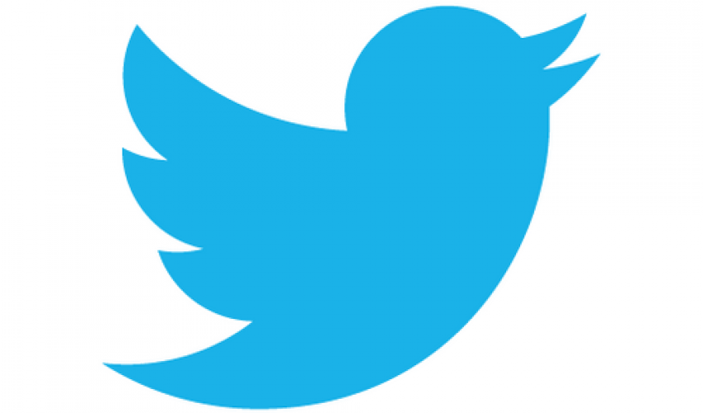
Leveraging Twitter Data in the Airline Industry: How to More Efficiently Identify Customer Sentiment
Doug Steen
3/27/2020

Slide 2
Background: Why use tweets?
Roughly 330 million active users worldwide
Allows users to quickly and concisely state opinion on a subject
Text increasingly used to learn about customers through Natural Language Processing (NLP)
NLP allows for numerical representations of text data
Critical for machine learning (ML)

Slide 3


Question:
Can NLP and machine learning (ML) be used to predict whether a tweet about an airline is positive, negative, or neutral?
How accurately?
How much data do we need?
Which NLP methods and ML algorithms work best?
Why do this?
Allows companies to efficiently classify statements from customers, so that:
Negative comments can be addressed by customer service teams
Positive comments can be noted and showcased
Questions can be quickly answered
and so on …

Slide 4


Data
Kaggle US Airline Twitter Sentiment Dataset
14.6k airline-related tweets labeled as Positive, Negative, Neutral (February 2015)
Twitter Developer API
41.5 k airline-related tweets (Mar – Feb 2020)
11 k American Airlines-related tweets (Jan – Feb 2020)

Slide 5
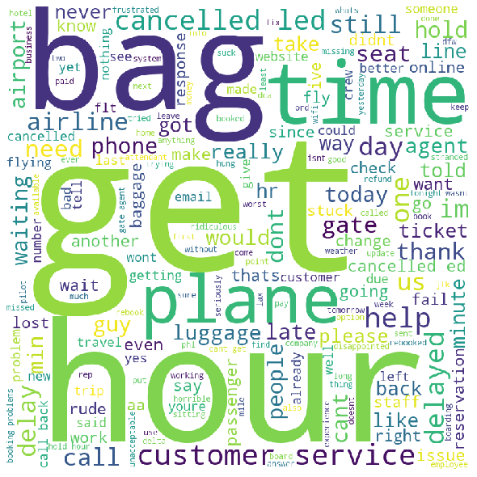
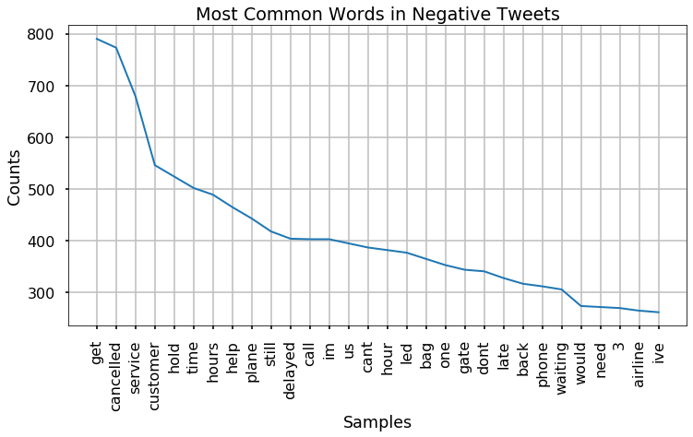

What are unhappy customers saying ?

Slide 6
Building a Tweet Classifier
Apply Vectorizer
Tweets
Train Classification Algorithm
(Try several vectorizers and classifiers)
Evaluate Classifier
Make predictions on previously unseen labeled tweets
Predict !
Classify unlabeled tweets from the ‘wild’ !

Slide 7
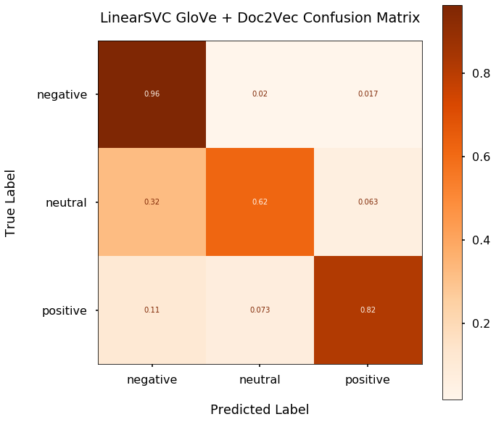
Top Classifier: 89% Accurate

Slide 8
Recommendations
Incorporate a tweet classifier into your customer service system
Identify positive, negative, neutral statements with ~90% accuracy
DS Teams: Use pre-trained word vectors to build classifiers
GloVe pre-trained on 2 Billion tweets
Difficult to improve upon or match ‘from scratch’
Use NLP for insight into what your company is doing well, and where you’re dropping the ball
Overall:
Positive: thanks, great, customer service, love, best, guys, crew
Negative: cancelled, customer service, hold, time, hours, help, delayed
Neutral: please, help, need, thanks, tomorrow, DM

Slide 9
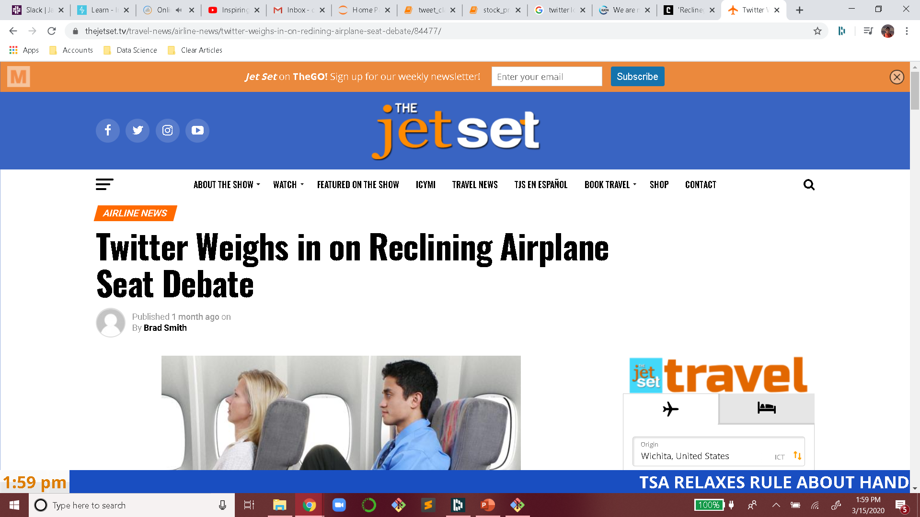
Future Work
What can still be improved? –> False ‘positives’
Sarcastic tweets
Negative tweets containing positive words
Using twitter sentiment to help predict:
Company’s future stock price
Customer retention
@SouthwestAir You need to be more accommodating to your loyal customers. Not happy now!
@VirginAmerica called your service line and was hung up on. This is awesome. #sarcasm

Slide 10
Thank you!

Slide 11
Building a Tweet Classifier
Apply Vectorizer
-Tfidf
-GloVe
Train Classifier
-Linear SVC
-Multinomial NB
-Random Forest
-Adaboost
-XGBoost
-Perceptron (Neural Net.)
Labeled Tweets
Unlabeled Tweets
-Doc2Vec
-GloVe + Doc2Vec
Predict !
Classify unlabeled tweets from the ‘wild’ !
Evaluate Classifiers
-Make predictions on previously unseen labeled tweets

