Slide 1

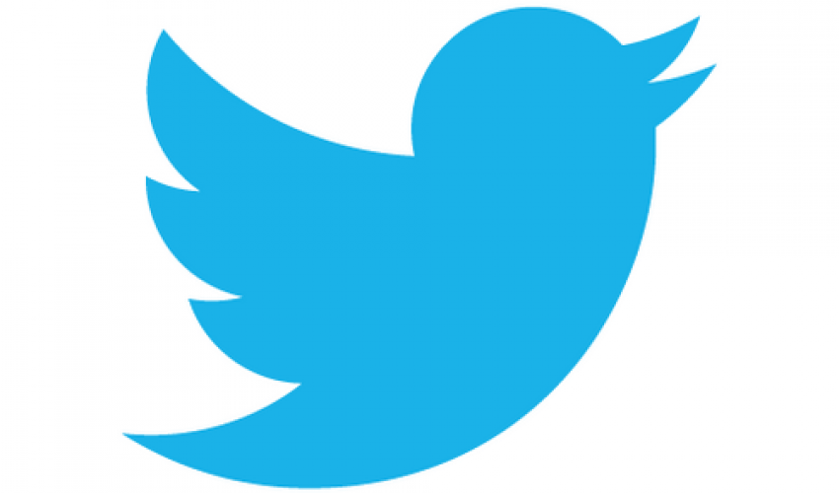
Leveraging Twitter Data in the Airline Industry: How to More Efficiently Identify Customer Sentiment
Doug Steen
3/16/2020

Slide 2
Background: Why use tweets?
Roughly 330 million active users worldwide
Allows users to quickly and concisely state opinion on a subject
Text increasingly used to learn about customers through Natural Language Processing (NLP)
NLP allows for numerical representations of text data
Critical for machine learning (ML)

Slide 3


Question:
Can NLP and machine learning (ML) be used to predict whether a tweet about an airline is positive, negative, or neutral?
How accurately?
How much data do we need?
Which NLP methods and ML algorithms work best?
Why do this?
Allows companies to efficiently classify statements from customers, so that:
Negative comments can be addressed by customer service teams
Positive comments can be noted and showcased
Questions can be quickly answered
and so on …

Slide 4


Data
Kaggle US Airline Twitter Sentiment Dataset
14.6k airline-related tweets labeled as Positive, Negative, Neutral (February 2015)
Twitter Developer API
41.5 k airline-related tweets (Mar – Feb 2020)
11 k American Airlines-related tweets (Jan – Feb 2020)

Slide 5
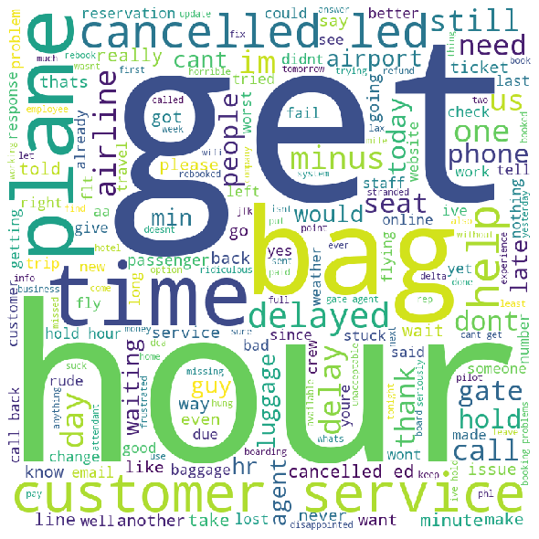
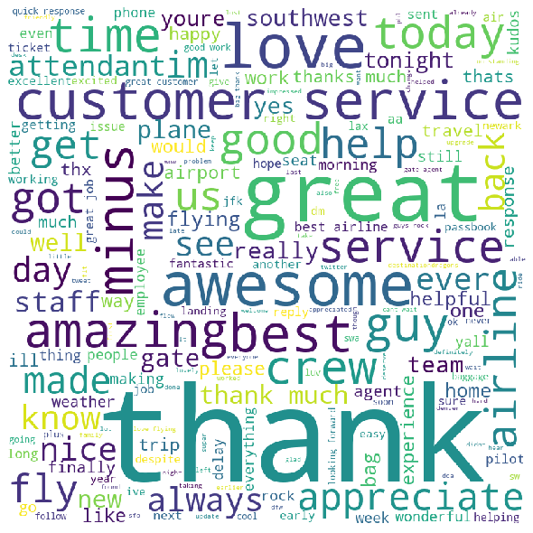


A Tale of Two Customers …

Slide 6
Building a Tweet Classifier
Apply Vectorizer
-Tfidf
-GloVe
Train Classifier
-Linear SVC
-Multinomial NB
-Random Forest
-Adaboost
-XGBoost
-Perceptron (Neural Net.)
Labeled Tweets
Unlabeled Tweets
-Doc2Vec
-GloVe + Doc2Vec
Predict !
Classify unlabeled tweets from the ‘wild’ !
Evaluate Classifiers
-Make predictions on previously unseen labeled tweets

Slide 7
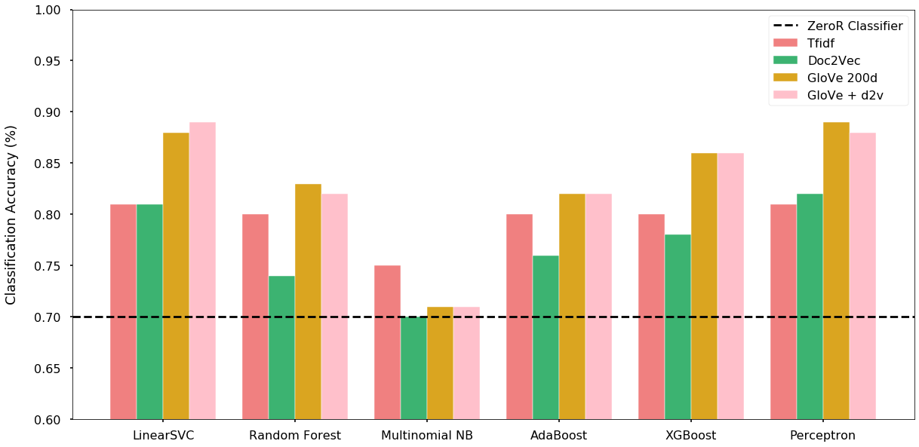
Classifier Performance

Slide 8
Recommendations
Incorporate a tweet classifier into your customer service system
Identify people saying positive, negative, neutral things with ~90% accuracy
DS Teams: use pre-trained word vectors to build classifiers
GloVe trained on 2 Billion tweets – difficult to improve upon
Beware! Some aspects of language are a problem for text classification…

Slide 9
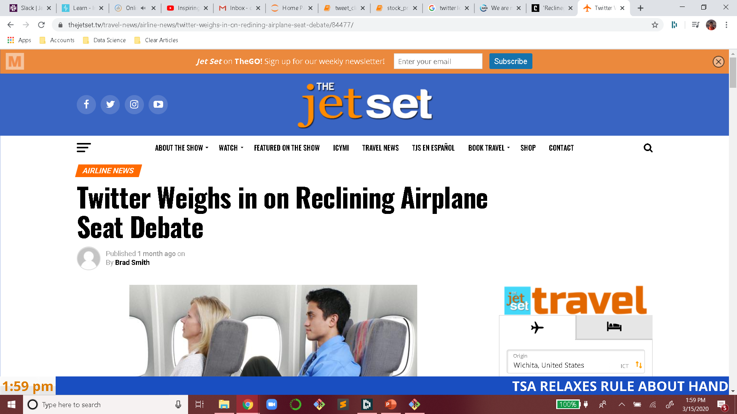
Future Work
What is ML still getting wrong ? … Sarcasm.
Using twitter sentiment to help predict:
Company’s future stock price
Customer retention
@VirginAmerica called your service line and was hung up on. This is awesome. #sarcasm
@AmericanAir thank you for the robotic and non helpful assistance.

Slide 10
Thank you!

