Slide 1

Hypothesis Testing Insights from the Northwind Database
Doug Steen
online-ds-ft-100719
12/13/2019

Slide 2
Purpose
Perform hypothesis testing using Northwind database to determine actionable steps management can take to increase sales

Slide 3

Hypothesis Testing: In a nutshell
Compare characteristics of two or more sample groups
Calculate the probability (p-value) that observed differences could have occurred purely by chance
If p-value is very small, we conclude difference is significant

Slide 4
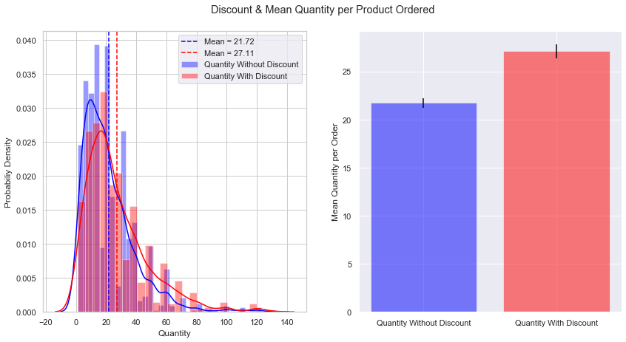
Discount & Quantity of Product per Order
Significant result! (p = 0.0000005) (At 5% discount or greater)

Slide 5
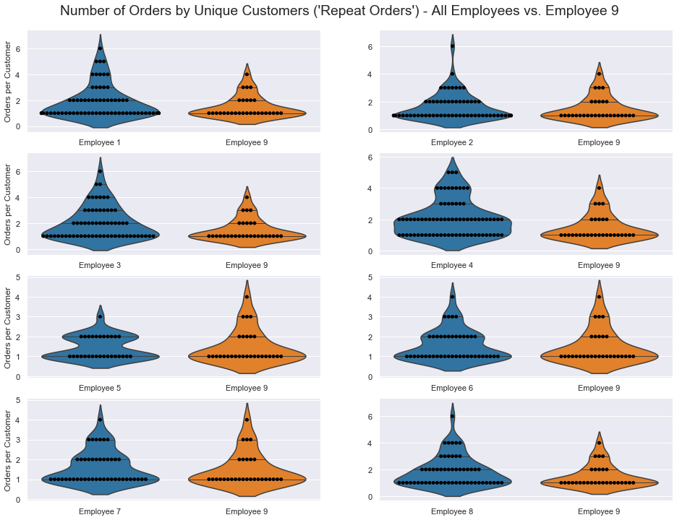
Repeat Order Customers by Employee
Significant result!
p = 0.034
Employee 9 underperforming others

Slide 6
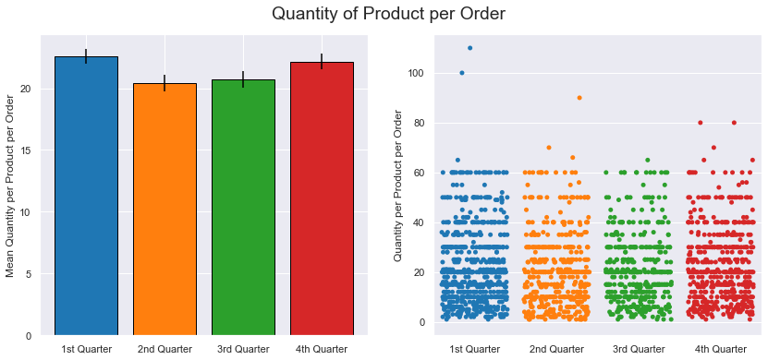
Time of Year & Quantity of Product per Order
Result not significant (p = 0.066, 1st & 2nd Quarter)

Slide 7
Recommendations
Apply discounts more frequently -> increase the quantity of products sold per order

Slide 8
Recommendations
Apply discounts more frequently -> increase the quantity of products sold per order
Target a discount amount of 5%
-> minimum needed to have a significant impact

Slide 9
Recommendations
Apply discounts more frequently -> increase the quantity of products sold per order
Target a discount amount of 5% -> minimum needed to have a significant impact
Customer relationship training for employees struggling to secure repeat orders

Slide 10
Future Work
Additional testing for certain employees’ performance before & after customer relationship training
Explore tests using additional data from previous or more recent years

Slide 11
Thank you!

