Slide 1

Forecasting the Tarrant County Housing Market: Insights for Your DFW Investment Strategy
Doug Steen
1/18/2020

Slide 2
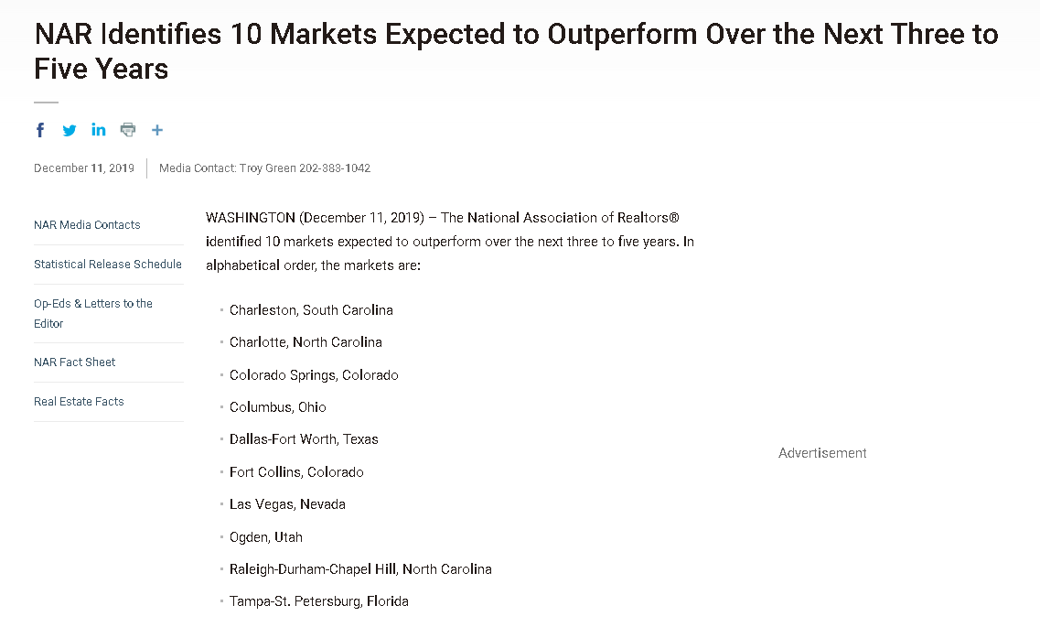
Dallas – Ft. Worth Investment Potential
Outlook for DFW Real Estate is Strong
DFW Metro =
Dallas & Tarrant counties
(National Association of Realtors, Dec. 2019)

Slide 3
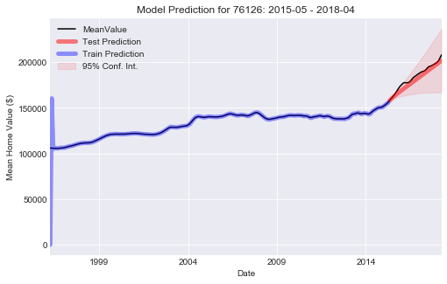
Time Series Modeling & Forecasting (In a Nutshell)
1) Fit a model using to historical ‘training’ data, capturing past patterns
Note: Unique model fit to each zip code in this study – not one model for all
2) Evaluate model quality by predicting known ‘test’ data
‘Test’ data excluded from Step 1
3) Use model to Forecast future values

Slide 4
CHOOSING THE RIGHT AREA FOR INVESTMENT
‘BEST’ ZIP CODES:
1) Predictable
2) Good Return on Investment (ROI) Forecast
3) Lower Uncertainty in ROI Forecast
‘WORST’ ZIP CODES:
1) Unpredictable
2) Poor ROI Forecast
3) Higher Uncertainty in ROI Forecast
ZIP RANK INDEX =
Predictability Rank +
ROI Forecast Rank +
ROI Forecast Uncertainty Rank

Slide 5
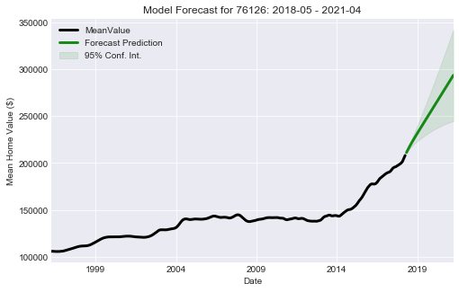
Example: ‘Good’ Zip Code – 76126 Zip Rank Index = 20.5
High Predictability
Good 3 Year Forecasted R.O.I.
Low Forecast Uncertainty

Slide 6
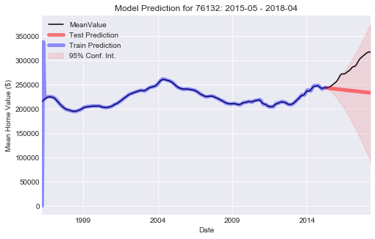
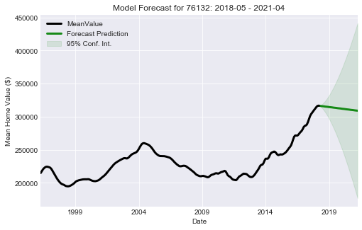
Example: ‘Unpredictable’ Zip Code - 76132 Zip Rank Index = 150
Low Predictability
Poor 3-Year Forecasted R.O.I.
High Forecast Uncertainty

Slide 7
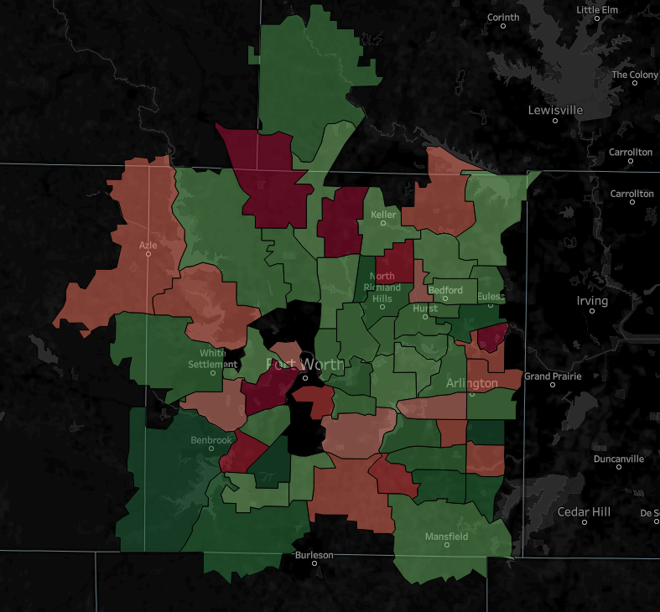
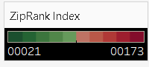

‘Best’ Zip Codes
76126 – Benbrook
76133 – SW Fort Worth
76014 – E Arlington
76001 – SW Arlington
76148 - Watauga
‘Worst’ Zip Codes
Keller
Azle
North Richland Hills
Bedford
Euless
Hurst
76132 – E Benbrook
76005 – NE Arlington
76052 – Haslet
76244 – W Keller
76017 – W Fort Worth
White Settlement
Fort Worth
Arlington
Benbrook
Mansfield
Burleson

Slide 8
‘Best’ Zip Codes - Overall
Zip Code | Zip Rank Index | Forecasted ROI (%) | Average Investment Cost per Home | Average Projected Home Value (3-Year Forecast)
76126 | 20.5 | 41.1 | $ 208,100 | $ 293,550
76133 | 22 | 38.9 | $ 164,900 | $ 229,070
76014 | 27.5 | 32.4 | $ 153,500 | $ 203,210
76001 | 37 | 22.2 | $ 217,200 | $ 265,390
76148 | 41.5 | 50.7 | $ 164,400 | $ 247,690

Slide 9

Recommendations for Housing Investment in Tarrant County
Strongly consider the zip codes with predictable behavior, good forecasted R.O.I., and low forecast uncertainty
Think twice about zip codes that are difficult to predict, have poor forecasted R.O.I., and high forecast uncertainty
Time series models just one piece of the puzzle
Often useful - rarely exactly correct
Forecasts may be inaccurate if systems experience rapid/dramatic change
Economic boom/recession
Natural disasters
Government policies, etc.

Slide 10
Recommendations by Category
Predictability Only
3 Year Forecasted ROI Only
Zip Code | Rank | Mean Absolute Percentage Error (MAPE) (%)
76001 | 1 | 1.1
76177 | 2 | 1.2
76247 | 3.5 | 1.9
76126 | 3.5 | 1.9
76040 | 5 | 2.0
Zip Code | Rank | Forecasted ROI (%)
76114 | 1 | 73.9
76148 | 2 | 50.7
76111 | 3 | 48.4
76164 | 4 | 43.7
76103 | 5 | 42.3
Uncertainty of 3 Year Forecasted ROI Only
Zip Code | Rank | ROI 95% Confidence Interval (%)
76014 | 1 | 11.6 – 53.1
76179 | 2 | -4.6 – 38.1
76001 | 3 | 0.6 – 43.8
76017 | 4 | -1.0 – 42.8
76133 | 5 | 16.8 – 61.0

Slide 11
Future Work
Use additional data to try to improve time series predictions
Population growth / decline
Per capita income changes
Economic growth / decline
Demographics
Assess 3-year forecasts made in this study when all data are available
… how well did these forecasts hold up ?

Slide 12
Thank you!

