Slide 1

Forecasting the Tarrant County Housing Market: Insights for Your DFW Investment Strategy
Doug Steen
1/18/2020

Slide 2
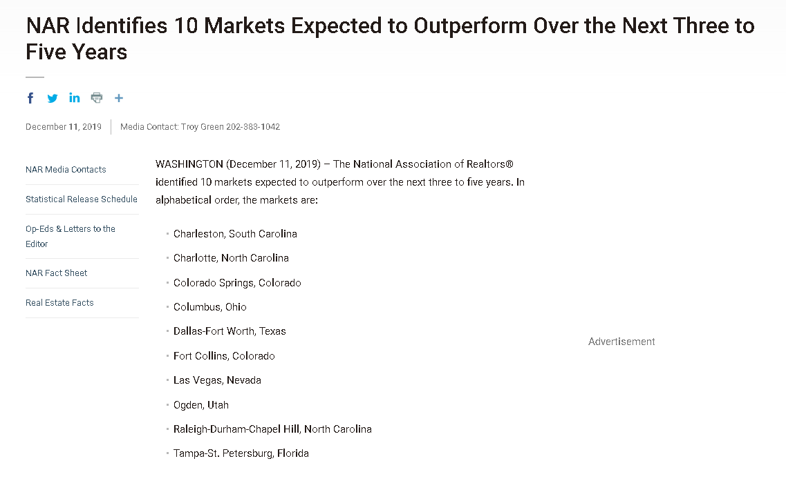
Dallas – Ft. Worth Investment Potential
Outlook for DFW Real Estate is Strong
DFW Metro =
Dallas & Tarrant counties
(National Association of Realtors, Dec. 2019)

Slide 3



Time Series Modeling & Forecasting (In a Nutshell)
1) Fit a model using to historical ‘training’ data, capturing past patterns
2) Evaluate model quality by predicting known ‘test’ data
‘Test’ data excluded from Step 1
3) Use model to Forecast future values

Slide 4
CHOOSING THE RIGHT AREA FOR INVESTMENT
‘BEST’ ZIP CODES:
1) Predictable
2) Good Return on Investment (ROI) Forecast
3) Lower Uncertainty in ROI Forecast
‘WORST’ ZIP CODES:
1) Unpredictable
2) Poor ROI Forecast
3) Higher Uncertainty in ROI Forecast
These three features weighted equally to create a ZIP RANK INDEX

Slide 5
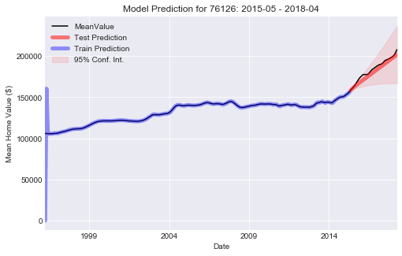
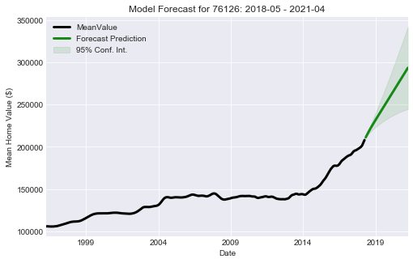
Example: ‘Good’ Zip Code – 76126 Zip Rank Index = 20.5
High Predictability
Good 3 Year Forecasted R.O.I.
Low Forecast Uncertainty

Slide 6
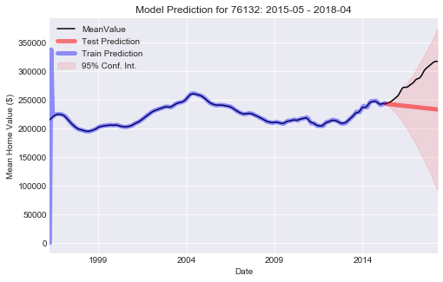
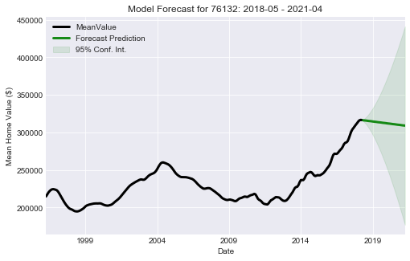
Example: ‘Not-So-Good’ Zip Code - 76132 Zip Rank Index = 150
Low Predictability
Poor 3-Year Forecasted R.O.I.
High Forecast Uncertainty

Slide 7
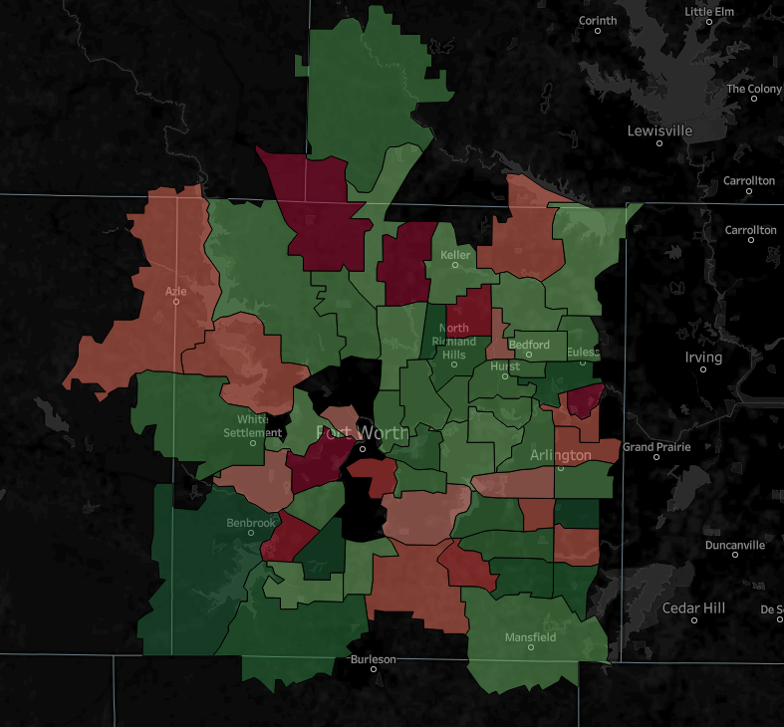
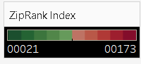

‘Best’ Zip Codes
76126 – Benbrook
76133 – SW Fort Worth
76014 – E Arlington
76001 – SW Arlington
76148 - Watauga
‘Worst’ Zip Codes
Keller
Azle
North Richland Hills
Bedford
Euless
Hurst
76132 – E Benbrook
76005 – NE Arlington
76052 – Haslet
76244 – W Keller
76017 – W Fort Worth
White Settlement
Fort Worth
Arlington
Benbrook
Mansfield
Burleson

Slide 8

Recommendations for Housing Investment in Tarrant County
Strongly consider the zip codes with predictable behavior, good forecasted R.O.I., and low forecast uncertainty
Think twice about zip codes that are difficult to predict, have poor forecasted R.O.I., and high forecast uncertainty
Time series models just one piece of the puzzle
Often useful - rarely exactly correct
Forecasts may be inaccurate if systems experience rapid/dramatic change
Economic boom/recession
Natural disasters
Government policies, etc.

Slide 9
Future Work
Use additional data to try to improve time series predictions
Population growth / decline
Per capita income changes
Economic growth / decline
Demographics
Assess 3-year forecasts made in this study when all data are available
… how well did these forecasts hold up ?

Slide 10
Thank you!

