Slide 1

Predicting King County House Prices Using Linear Regression
Doug Steen
10/30/2019

Slide 2
Project Approach
King County housing dataset includes home sale prices from May 2014 – May 2015
Includes other features:
Location - zip code, latitude and longitude
Size - ft² … above ground, basement, living area
Size of neighborhood homes
Number of floors, bedrooms, bathrooms
Condition, grade
Year built, year renovated
Setting - waterfront, view
Objective: Produce linear regression model to predict sale price using most critical features

Slide 3
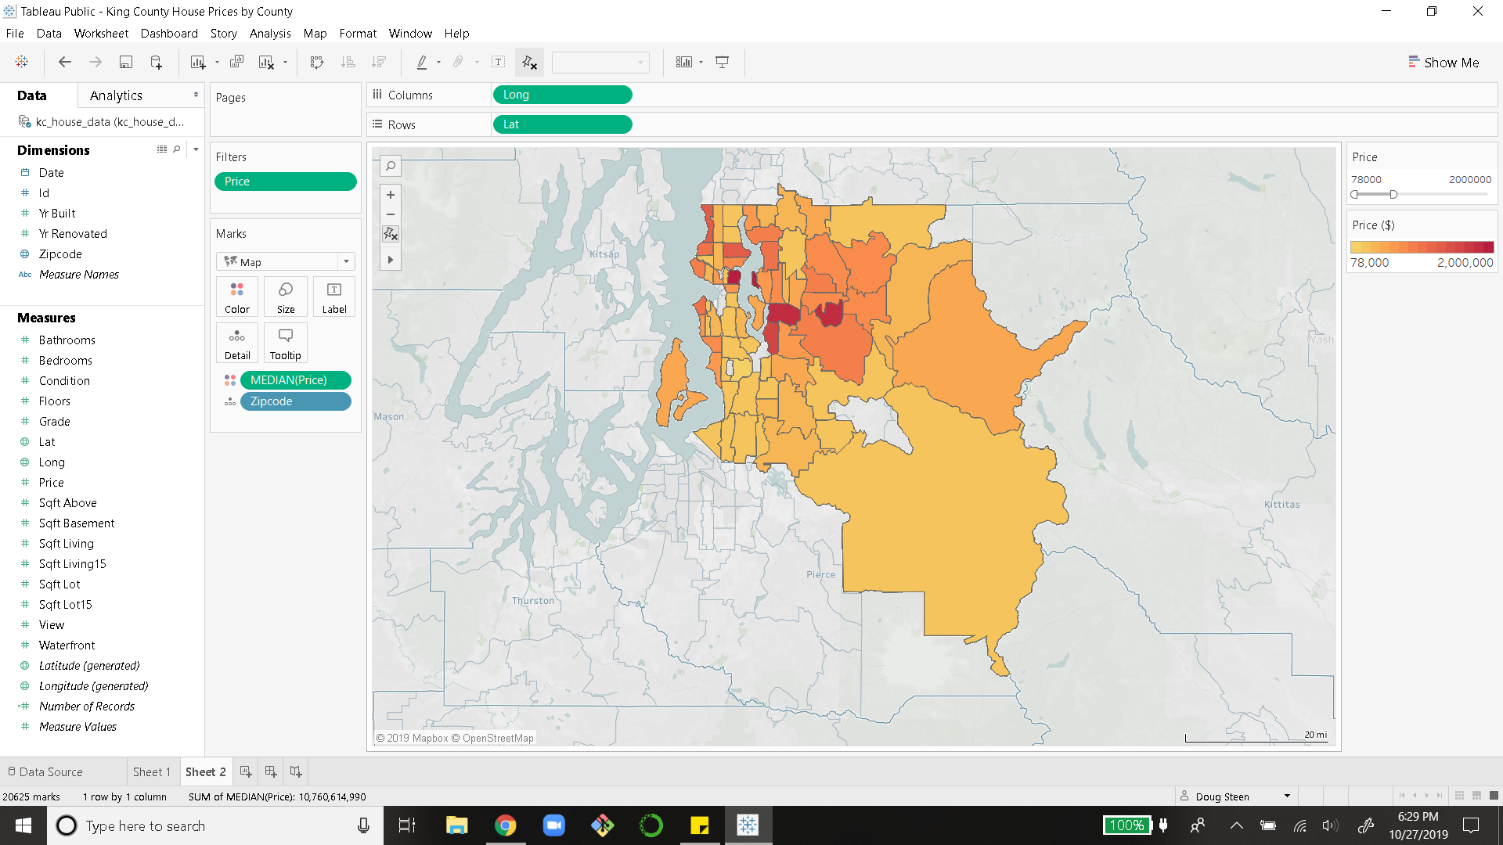
Results
Median Sale Price by Zip Code in King County
Five most important features for predicting sale price:
Zip code
Construction/Design Grade
Neighborhood Home Living Area
Distance from Seattle
Home Size (excluding basement)
Model explains 77% of the overall variability in King County house prices
Seattle

Slide 4
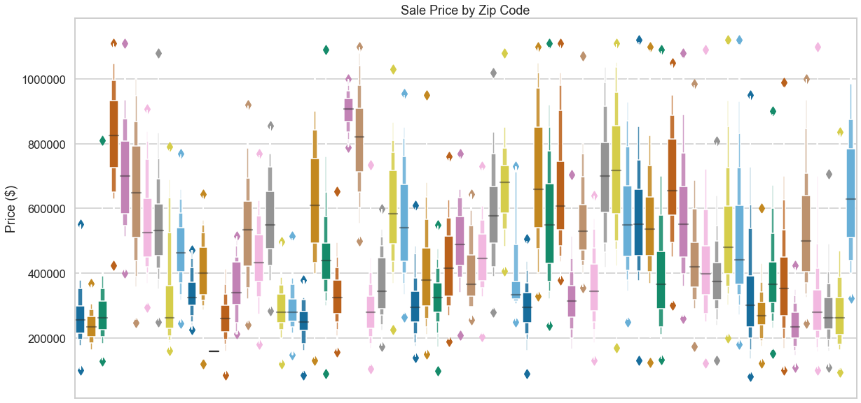

Slide 5
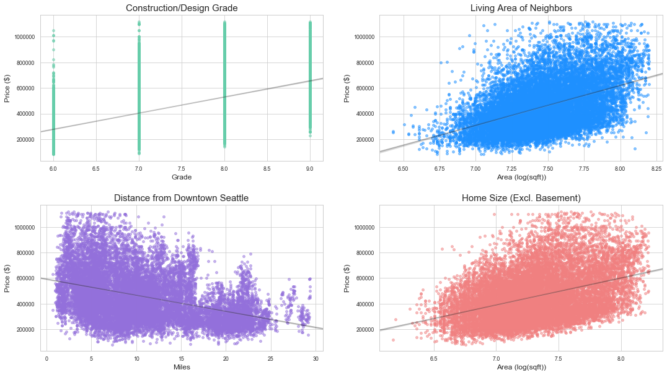

Slide 6



How to maximize profits when selling your home?
Consider an addition to increase the square footage of your home
Encourage your neighbors to do the same!
Stick to quality construction and design for home building and renovations
For current homeowners, location factors are largely out of your control
If you live in a desirable zip code or close to the city, know your worth!

Slide 7
Future Work
Explore more regional features driving house prices:
Are there unique temporal trends in certain areas?
Explore different methods for addressing outliers:
Predictors may change with different treatment of very cheap & very expensive properties

Slide 8
Thank you!

